Slide 1
Cereals

Slide 2
Minor Cereals
Barley, Hordeum vulgare, is an ancient cultivated cereal that was in use even before wheat.
Vavilov believed that barley originated in the arid lands of Southwestern Asia, Northern Africa and also in Southeastern Asia.
The genus Hordeum contains over 20 species, most of which are weeds in temperate regions.
Hordeum vulgare consists of many different strains.
Classification of the different species is difficult and opinions differ.
Nevertheless, there seems to be two well-defined groups, the 6-rowed forms and the 2-rowed forms.
In the former (H. vulgare & H. intermedium), all the spikelets are fertile.
In the latter (H. distichum & H. deficiens), the lateral spikelets are sterile, so that only two rows develop.
Barley has a high nutritive value although it is poor flour for bread due to the low gluten content.
Barley is also used in breakfast foods and food for small children.

Slide 3
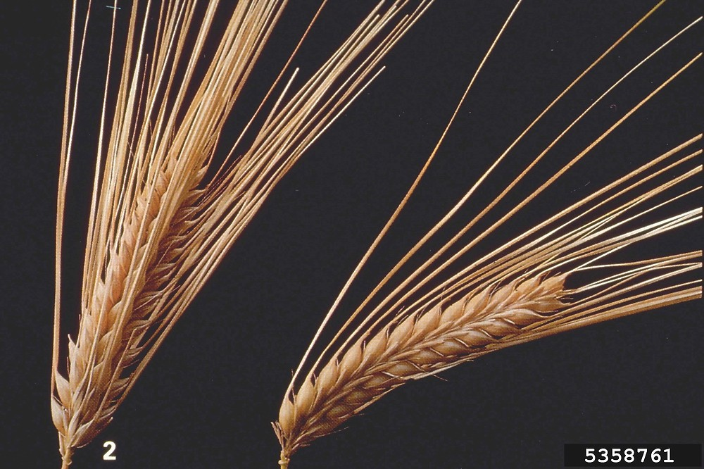
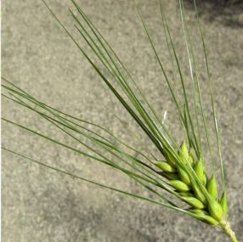
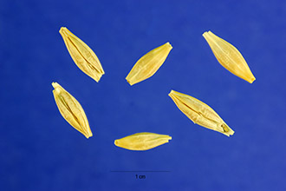
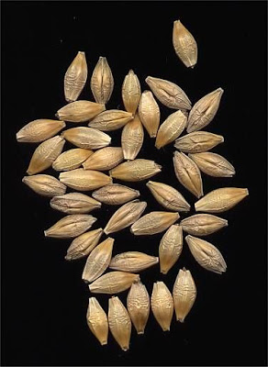
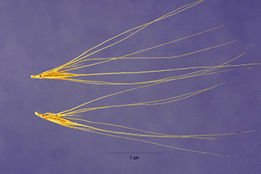
Hordeum vulgare
Hordeum intermedium
Hordeum distichum

Slide 4
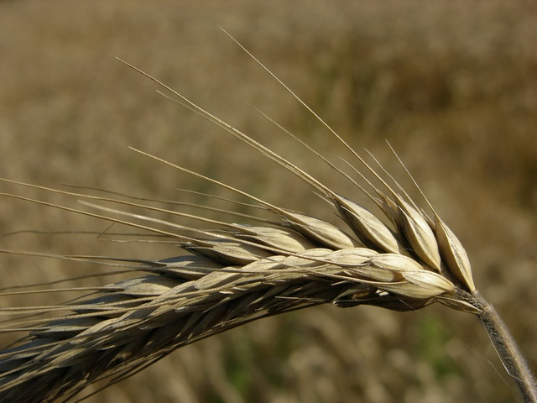
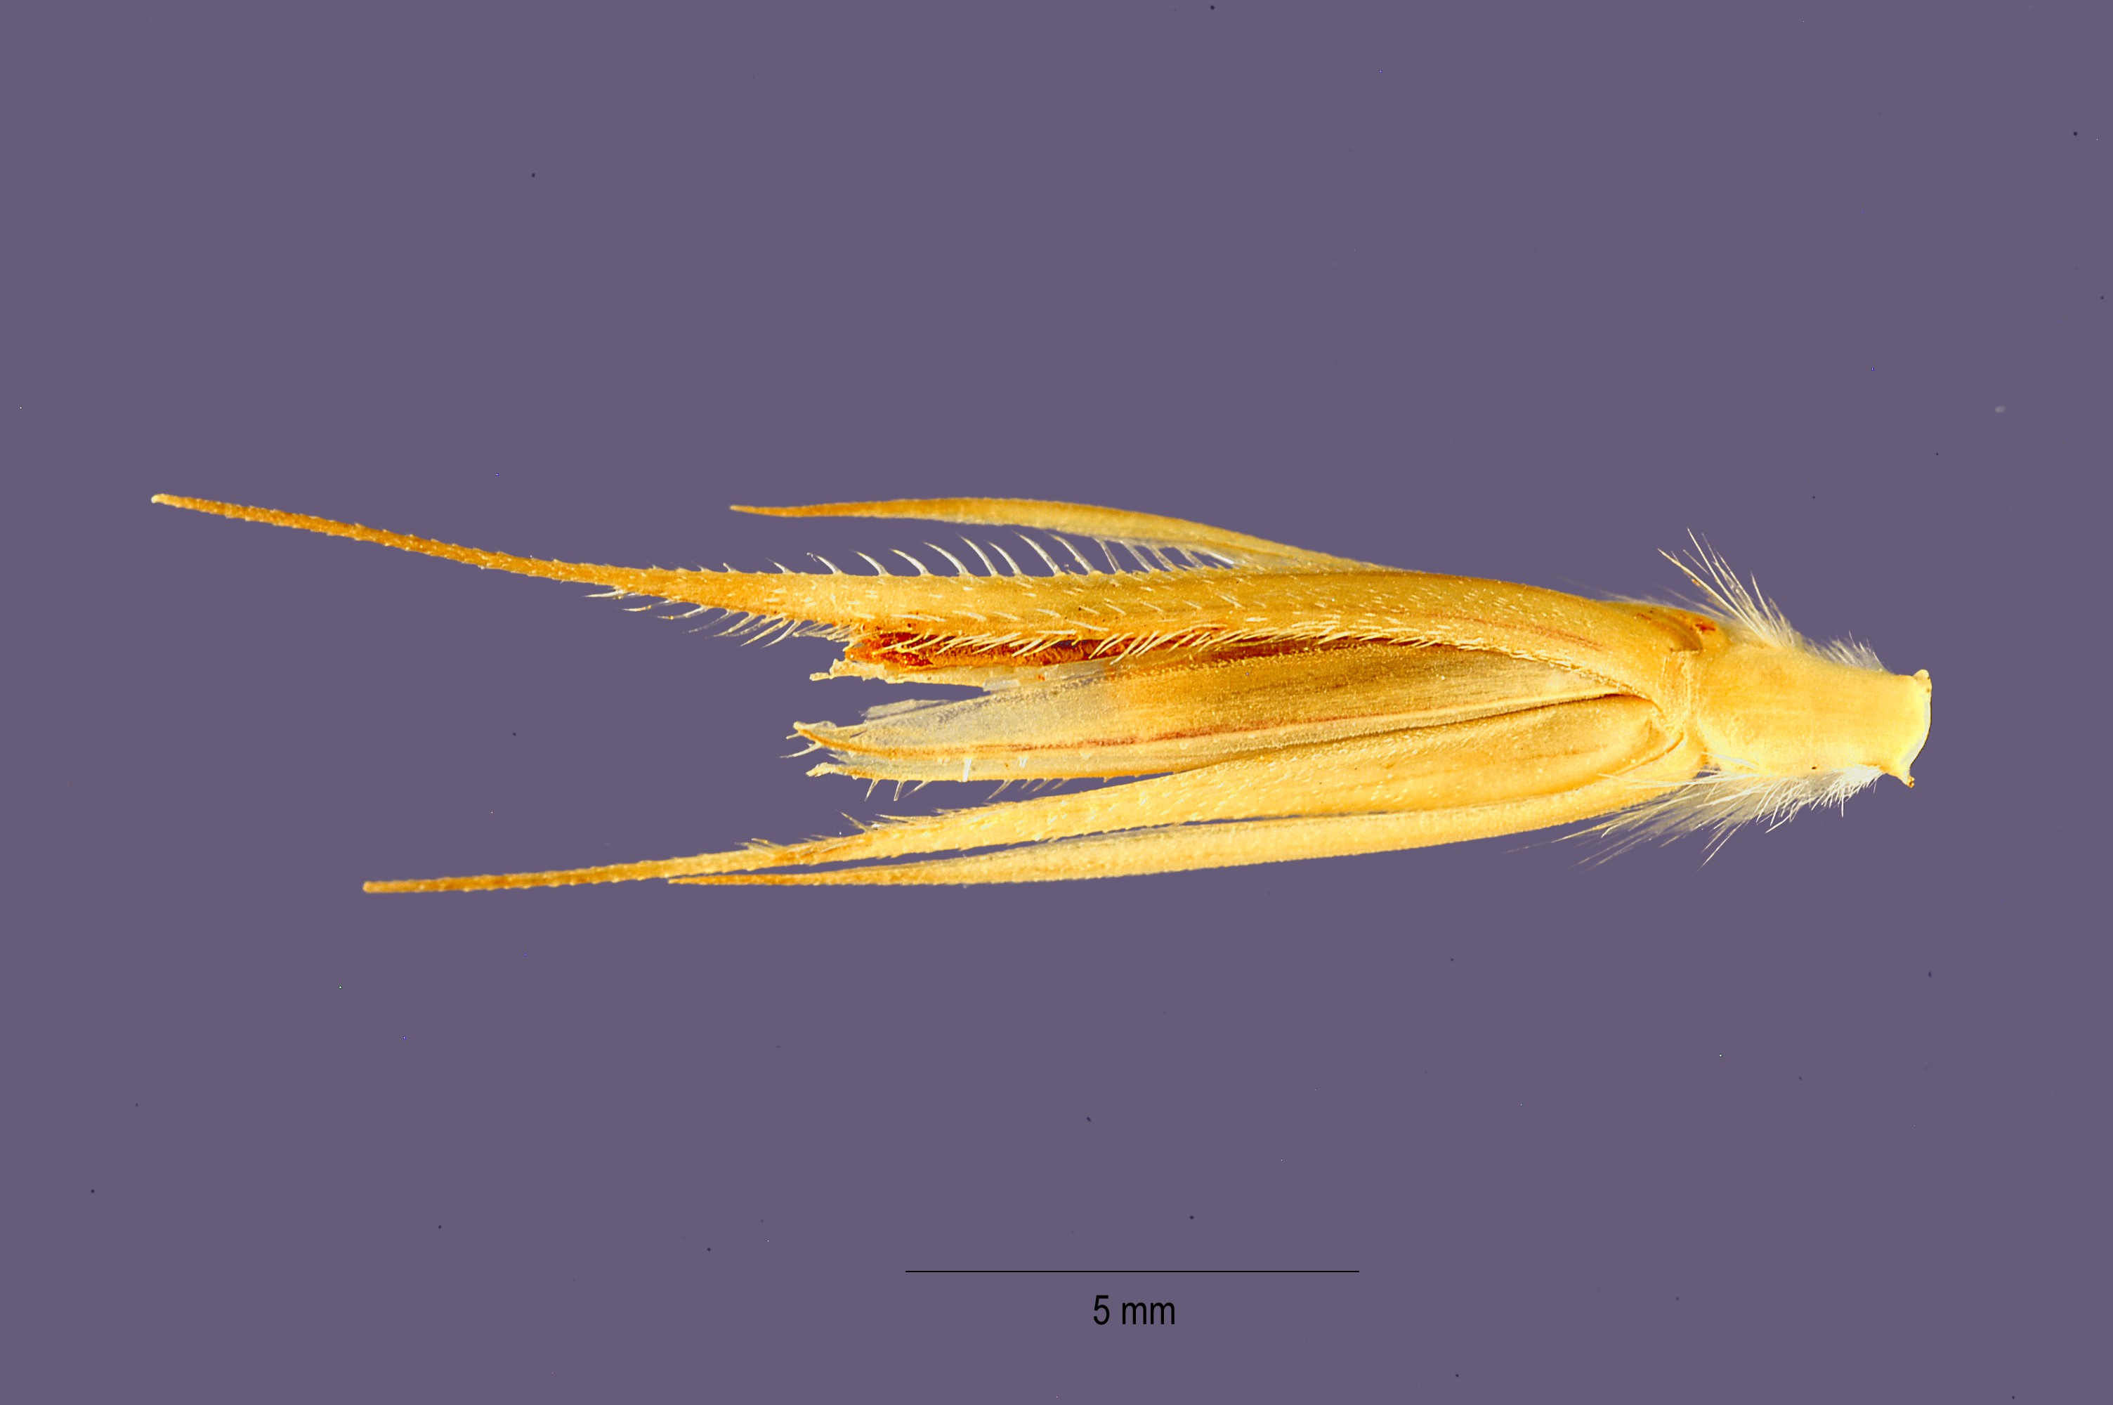
Rye, Secale cereale, is of more recent origin than the other cereals.
Nevertheless rye is most likely a native of the Caspian and Black Seas region of Central Eurasia.
Rye is primarily a plant of Europe where over 90 percent of the world’s cropis produced and consumed.
It is used there principally for brad because the grain contains gluten.
Oats (Avena sativa) is the main commercial species.
It probably had multiple origins, some emanating from Abyssinia others from the Mediterranean area and from China.
Other cultivated species are the side oat, A. orientalis, the red oat, A. byzantina, the naked oat, A. nuda, and the short oat, A. brevis.
, Secale cereale

Slide 5
Oats (Avena sativa) is the main commercial species.
It probably had multiple origins, some emanating from Abyssinia others from the Mediterranean area and from China.
Other cultivated species are the side oat, A. orientalis, the red oat, A. byzantina, the naked oat, A. nuda, and the short oat, A. brevis.
This is the most nutritious of all cereals for humans because of the high fat, protein and mineral content.
Oatmeal has muscle building qualities and because of its high energy content is especially well suited as a food in cold weather and by people who lead an active outdoor life.
It has been proven to lower cholesterol levels in the human body.
The protein material does not occur in the form of gluten and thus is not suited for making bread.
Its main use is in cakes, biscuits and breakfast food.

Slide 6
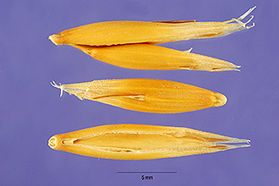
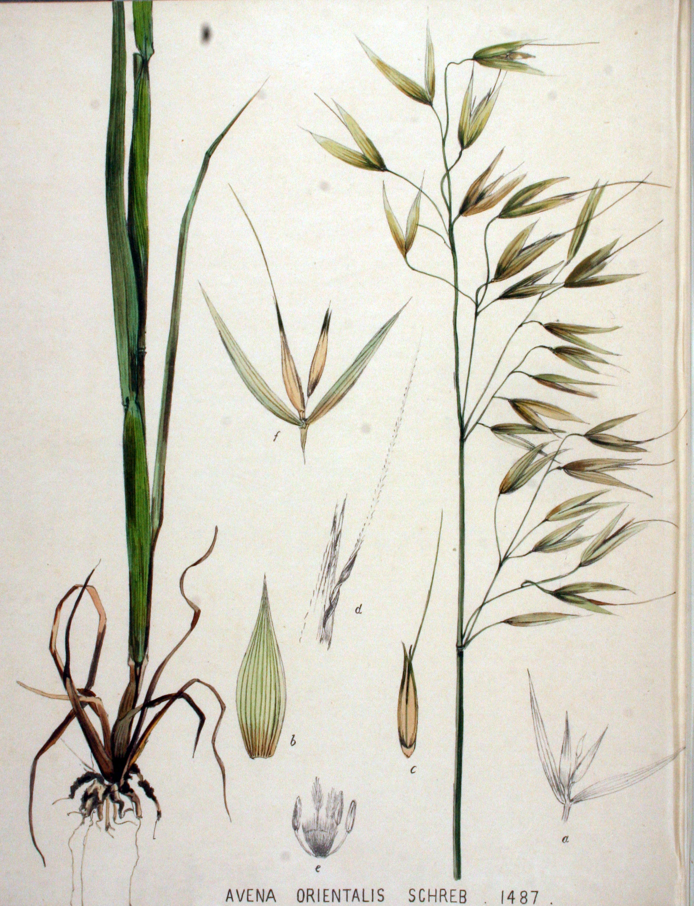
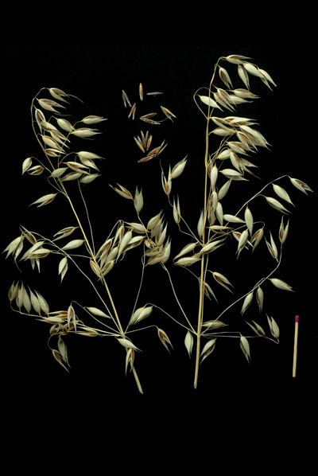
Avena sativa
Avena byzantina
Avena orientalis

Slide 7
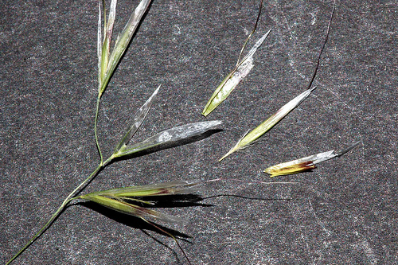
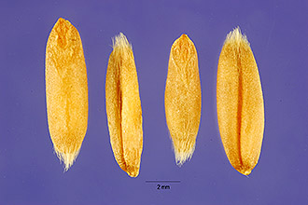
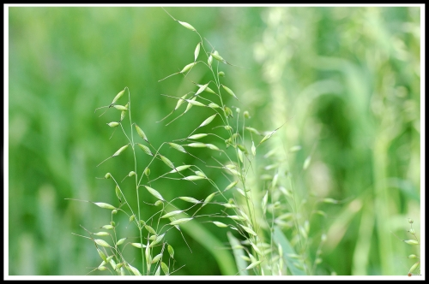
Avena nuda
Avena brevis

Slide 8
Small Grains
Sorghum was grown in Egypt before 2,200 B.C. and has continued as an important crop there ever since.
They are less nutritious than maize but they are a staple food in Africa and Asia.
Sorghums are also used for livestock feed and forage; in the manufacture of brushes, paper and syrup; and in Asia for many other purposes.
In North America the cultivated sorghums are usually referred to as Sorghum vulgare (Syn. S. bicolor).
This was derived from the perennial Johnson grass, Sorghum halepensis, and Old World species grown as a forage grass inn the warmer areas of both hemispheres.
Four types of sorghum are grown in North America. These include the grass sorghums, such as Sudan grass (var. sudanensis) and the Tunis grass (S. virgatum), used exclusively for hay and pasturage; the broom corns, used in the manufacture of brushes; the sweet or saccharine sorghums, used for forage and for syrup production; and the grain or nonsaccharine sorghums, which are cultivated for the grain and to some extent for forage.

Slide 9
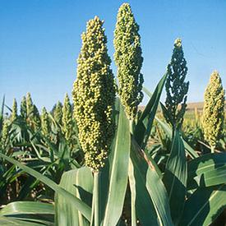
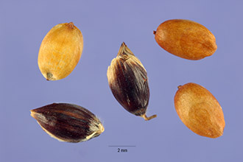
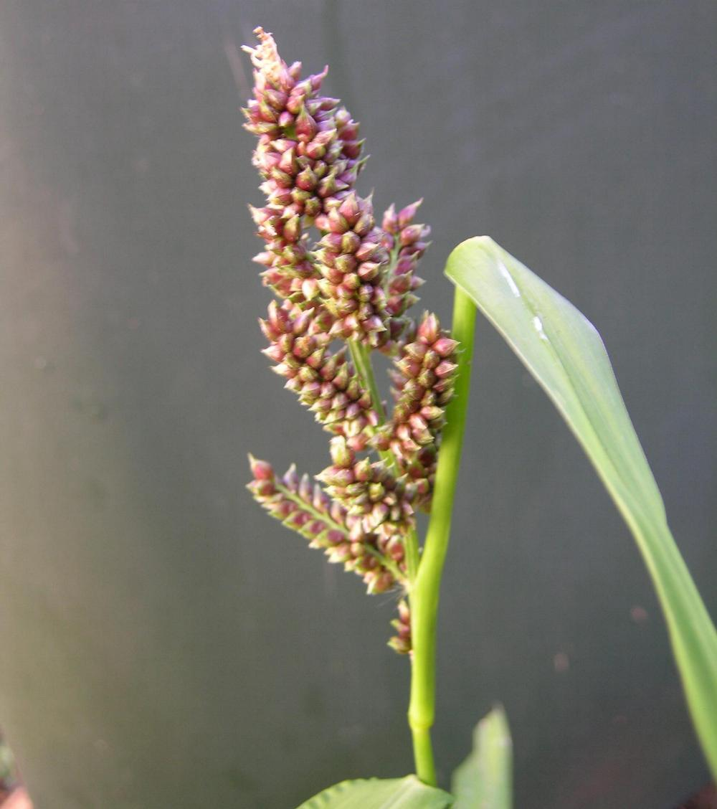
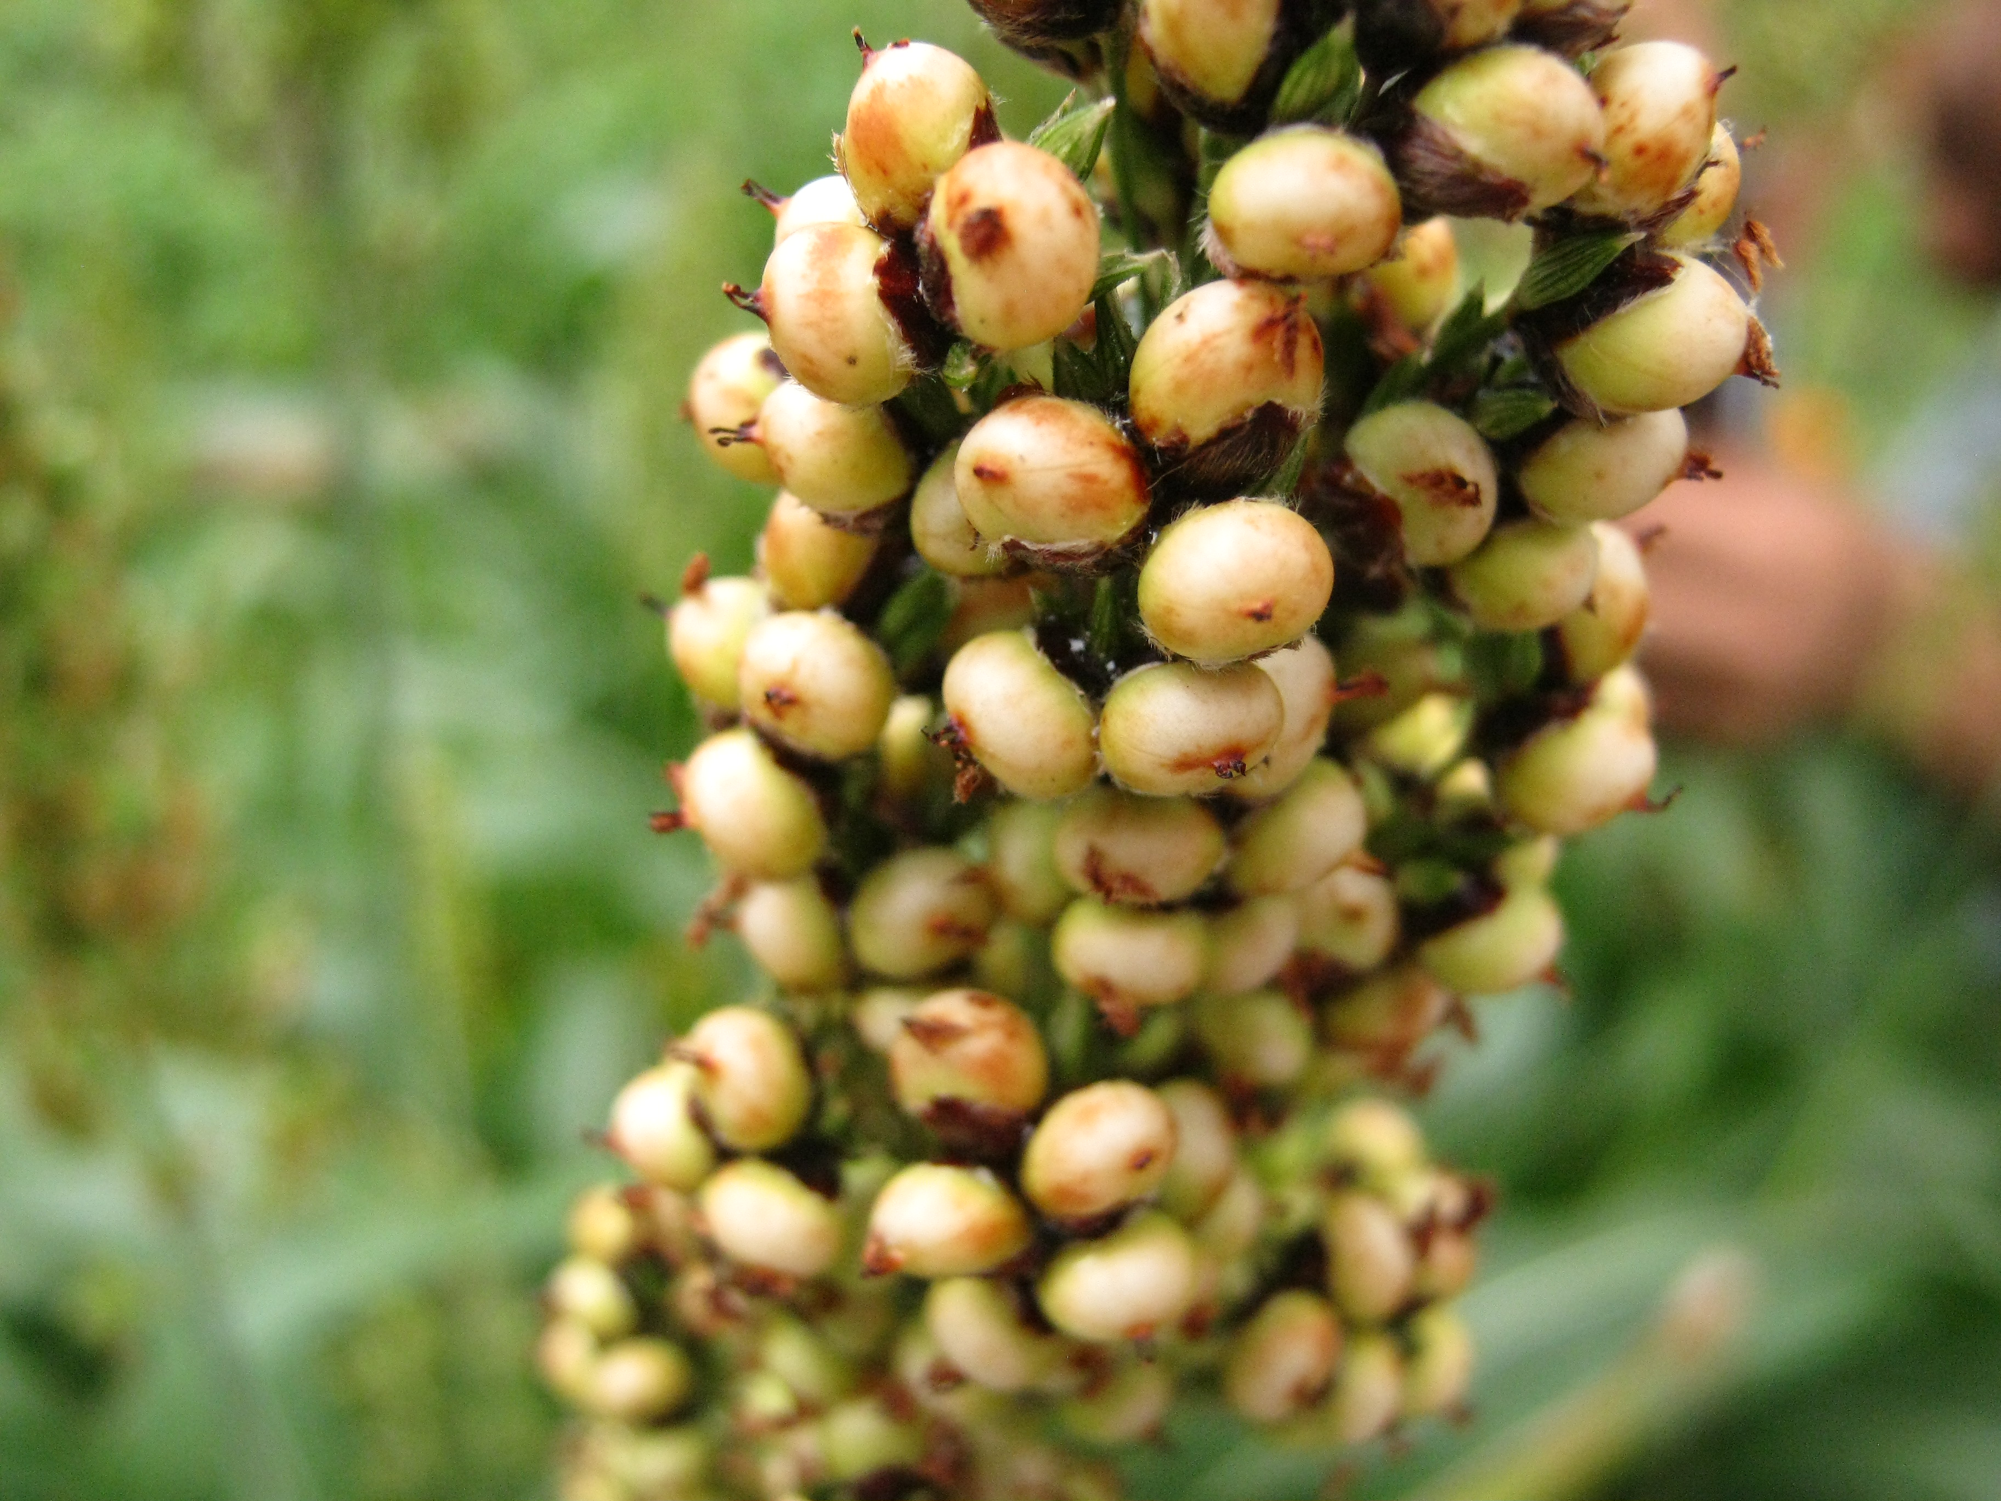
Sorghum vulgare

Slide 10
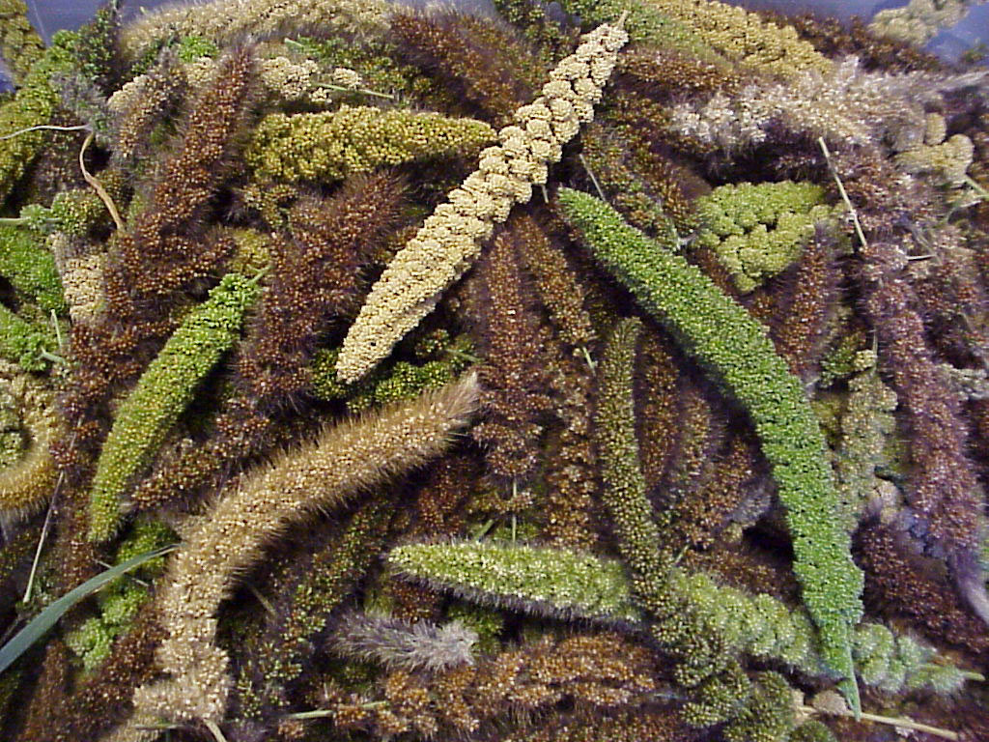
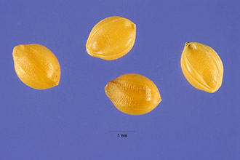
Millets is a term loosely applied to a large number of cultivated grasses that have very small seeds.
The millets are used for forage and as a food for both humans and livestock.
The importance of millet is not appreciated in North America or Europe, but almost one-third of the world’s population uses these grains as regular food.
Foxtail Millet: There are over 12 varieties of foxtail millets, Setaria italica, which commonly occur as weeds.
Their origin is not definitely known but there is some agreement that they have been derived from Setaria viridis, a common wild grass of the Old World.
To prepare foxtail millet as a food, the grains are boiled or parched.
It is important as a hay and forage crop.

Slide 11
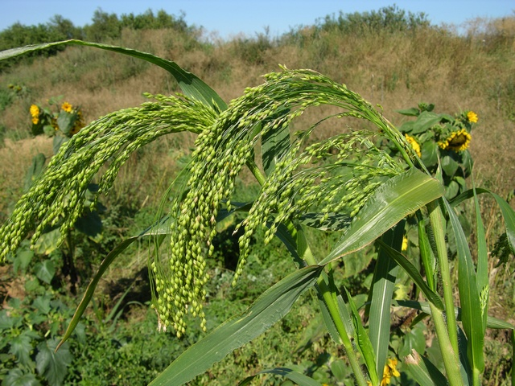
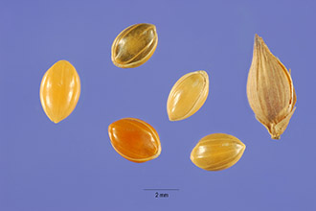
Proso Millet: Panicum miliaceum, is true millet, the milium of Roman times.
It has also been called Broomcorn Millet, Hog Millet, Russian Millet and Indian Millet.
Proso probably originated in the eastern Mediterranean region, and it has been under long cultivation in Europe especially.
It became popular in North America for use as a forage grain because it is very nutritious.

Slide 12
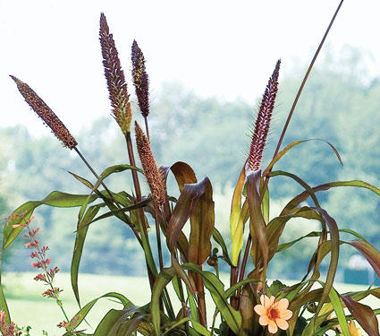
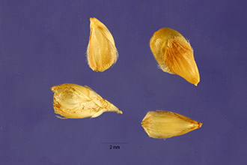
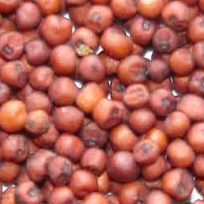
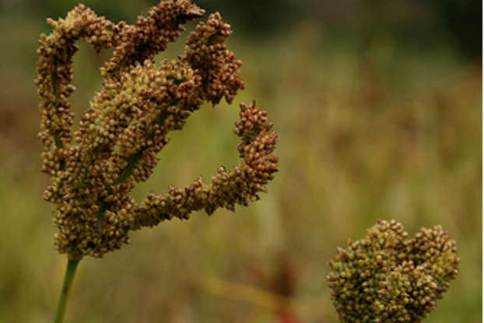
Pearl Millet, Pennisetum glaucum, is grown in Egypt, India and Africa as a wet-season crop.
Flour made from Pearl Millet is very nutritious and is used for bread or cake.
Ragi, Eleusine coracna, is a tall grass that is also known as Finger Millet, African Millet or Korakan.
Ragi flour is used for puddings and cakes and a fermented beverage is made from the grain.

Slide 13
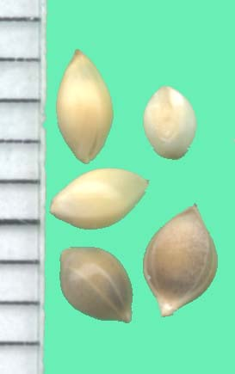
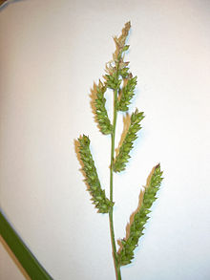
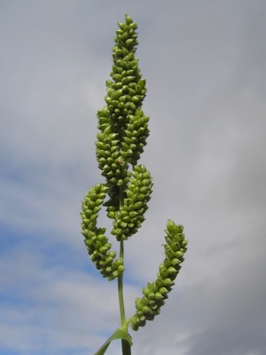
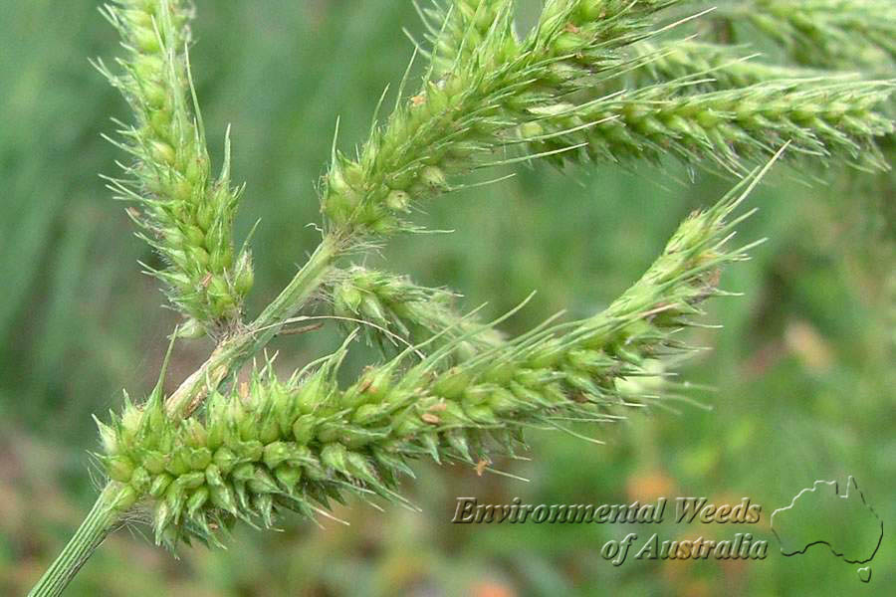
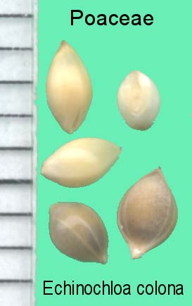
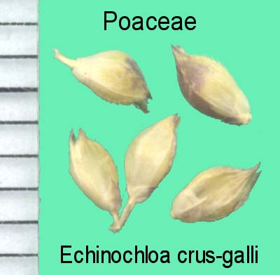
Other Millets
Other millets belong to the genus Echinochloa.
The Japanese or Sanwa Millet, E. frumentacea, is an erect awnless grass with turgid purplish seeds.
In Asia it serves as a food plant and is consumed as a porridge with rice.
A smaller species, the Shama Millet, E. colona, is also valuable as a forage and food crop, especially in the East Indies and India.
The common Barnyard Millet, E. crusgalli, which is a weed in North America, is cultivated in India and the Far East as a forage and food crop.
Echinochloa crusgalli
Echinochloa frumentacea
Echinochloa colona

Slide 14
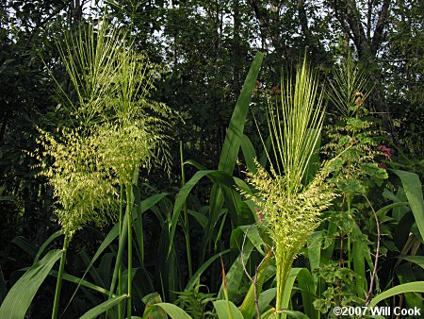
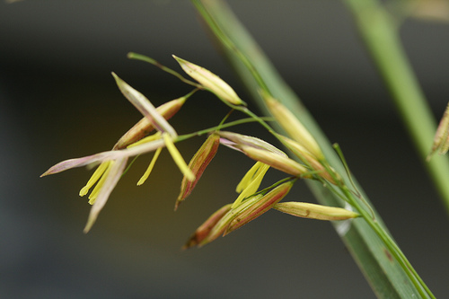
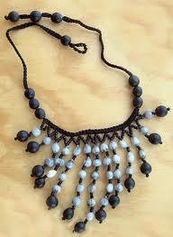
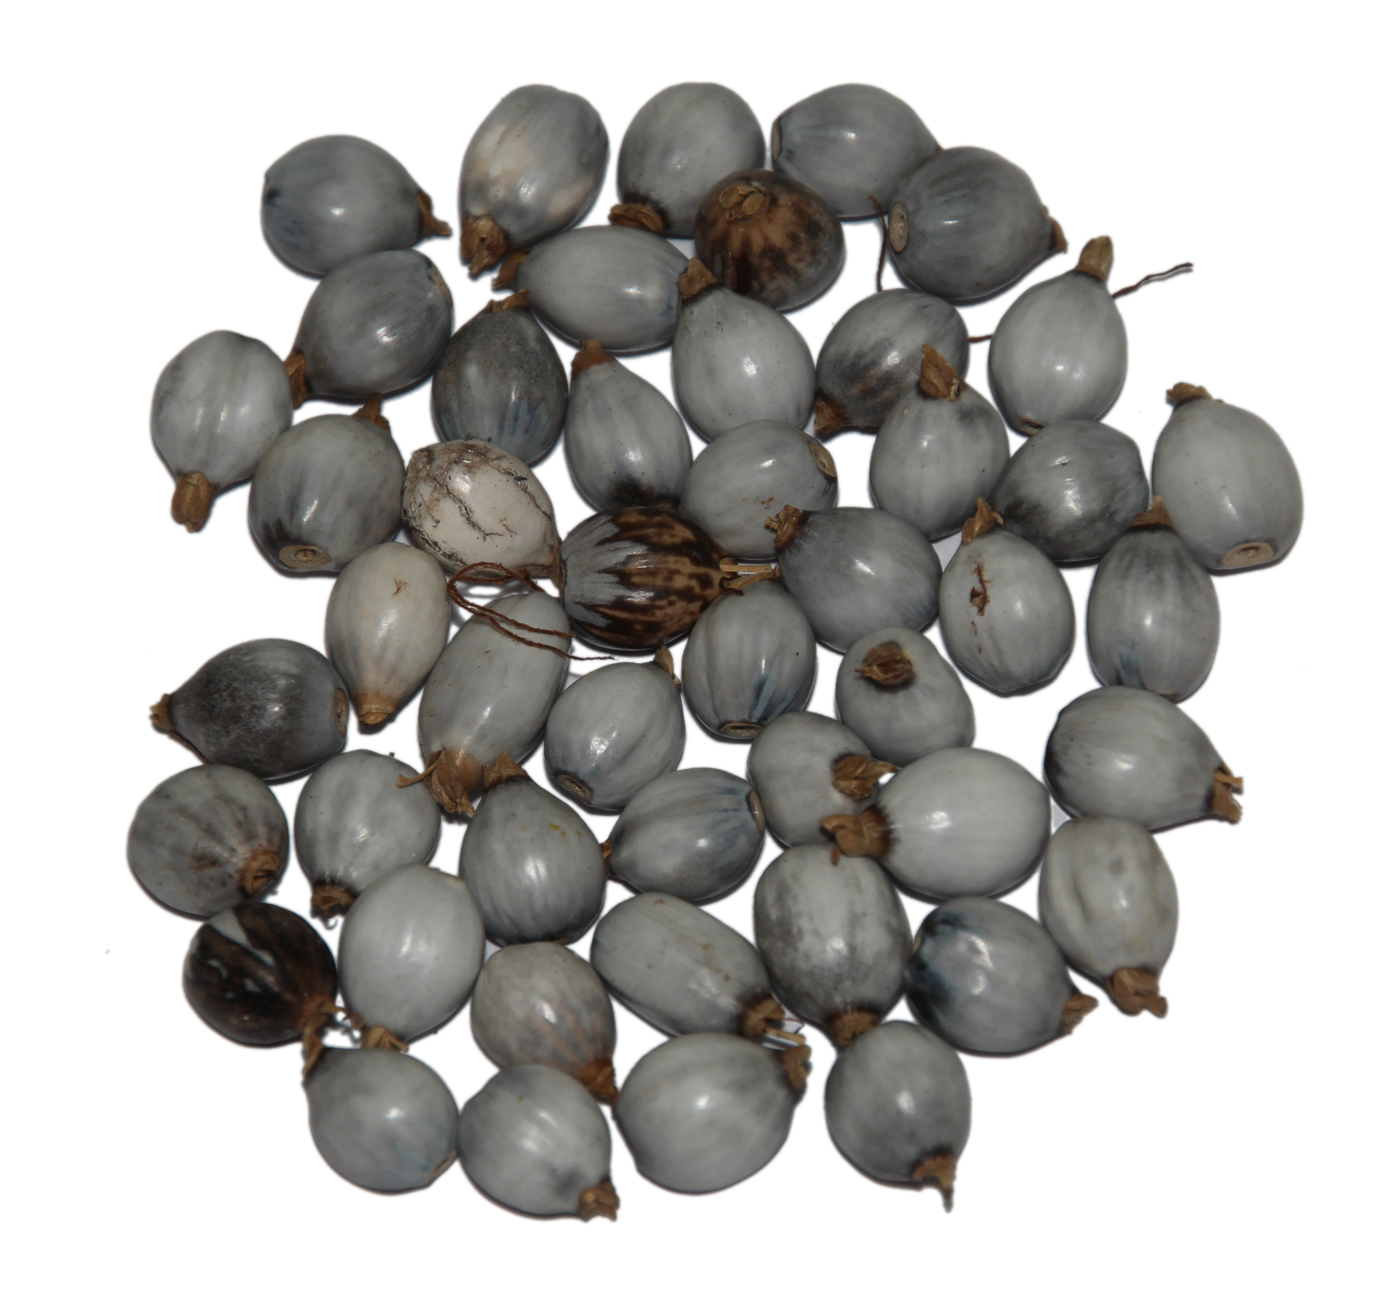
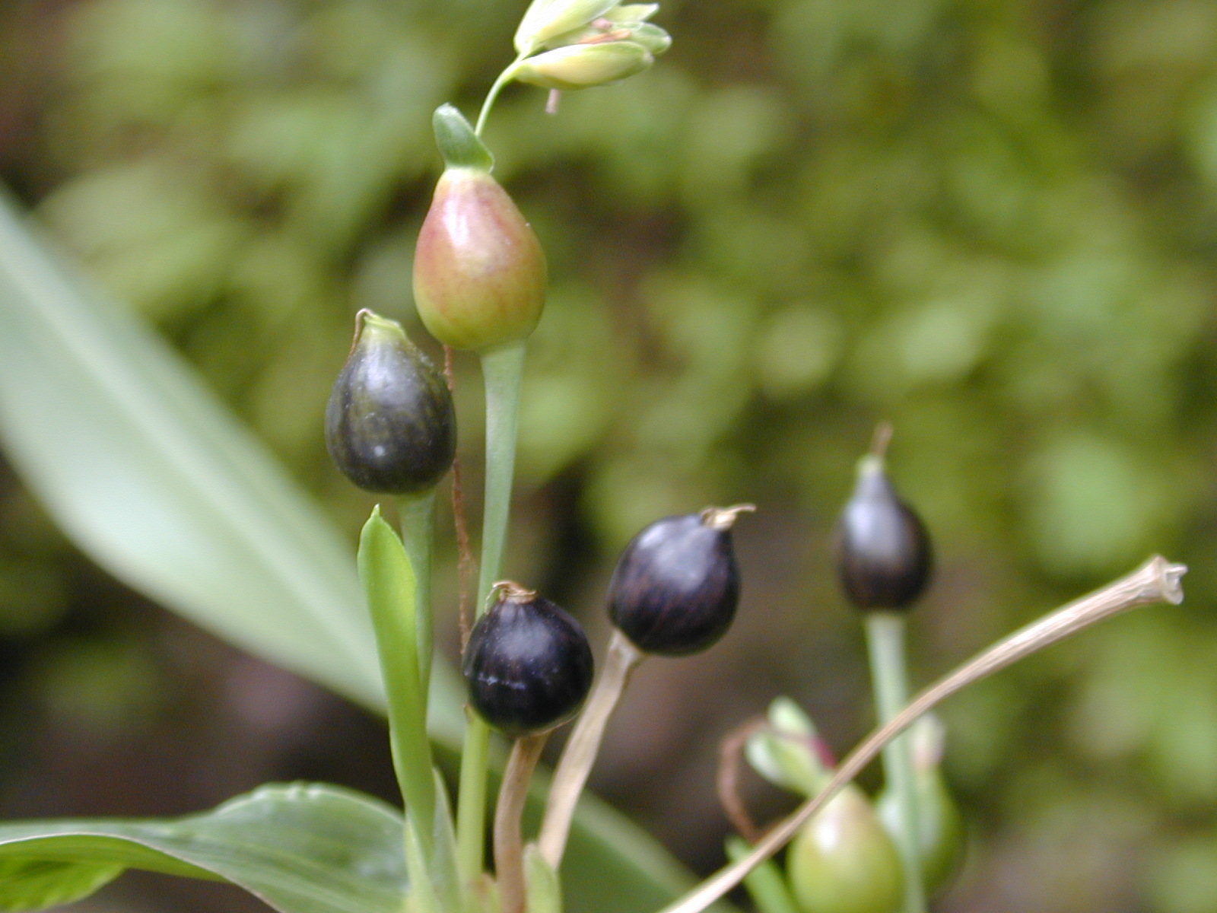
Misc Grains
Wild rice, Zizania aquatica var. angustifolia, is harvested from wild and cultivated plants in North America.
It has been an important food of the Amerindians in eastern North America.
Job’s Tears, Coix lachryma-jobi, native to Southeastern Asia.
It has been cultivated in most tropical countries.
Wild rice
Job’s Tears

Slide 15
Pseudo Cereals
There are many other plants that are used in a manner similar to the cereals and smaller grains as sources of human food. These are not grasses but have often been referred to as cereals.
Breadfruit, Artocarpus utilis, is actually a fruit with the flavor of bread when fried.
Buckwheat, Fagopyrum sagittatum, is native to Central Asia and still grows wild in Manchuria and Siberia.
The seed or groats are hulled and ground and the starchy flour is used for porridge, soups and to make pancakes.
Quinoa, Chenopodium quinoa, is a staple food of natives in South America.
It is native to Peru and was used in great quantities by the Incas.
Whole seeds are used in soups, or are ground into flour, which is made into bread or cakes.
The seeds are also used in making medicine, beer and as a poultry feed.

Slide 16
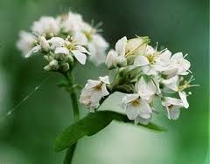
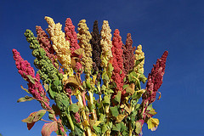
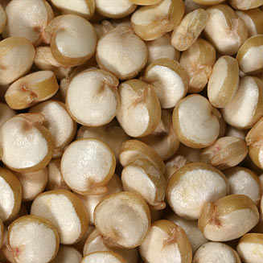
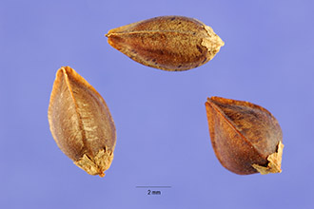
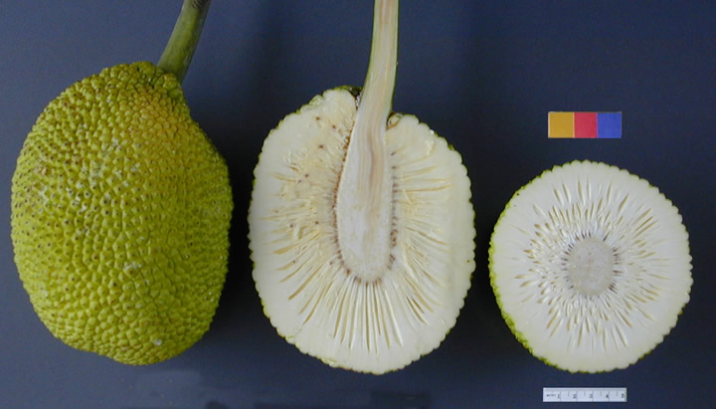
Artocarpus utilis
Fagopyrum sagittatum
Chenopodium quinoa

