Slide 1
Chapter Five Contingency & Situational Leadership
LEADERSHIP
Andrew J. DuBrin, 7th Edition

Slide 2
Learning Objectives
Describe how the situation influences the choice of leadership objectives.
Present an overview of the contingency theory of leadership effectiveness.
Explain the Path-Goal Theory of leadership effectiveness.
Explain Situational Leadership^{R} II (SLII).
Use the Normative Decision Model to determine the most appropriate decision-making style in a given situation.
Explain the basics of leadership during a crisis.
Explain how evidence-based leadership can contribute to contingency and situational leadership.

Slide 3
Situational Influences on Leadership Behavior
Situations can influence the leadership behavior or style a leader emphasizes.
This contingency approach to leadership implies leaders are most effective when they make their behavior contingent on situational forces, including group member characteristics and the internal and external environment surrounding the leadership situation.

Slide 4
Role of Situations in Leadership
Research has shown the following regarding the role of situations in leadership effectiveness:
Organizational leadership is affected by situational factors not always under control of the leader.
Situations shape how leaders behave.
Situations influence the consequences of how leaders behave.
Organizational structure and design influence which approach to leadership is likely to be most effective.

Slide 5
Leadership Situational Models
Fiedler’s Contingency Theory
House’s Path-Goal Theory
Hersey & Blanchard’s Situational Leadership^{R} (SL II)
Vroom & Jago’s Normative Decision Model
Leader-Member Exchange (LMX)

Slide 6
Fiedler’s Contingency Theory
The basic idea is simple:
Match the leader’s style with the situation most favorable for his/her success.
The theory was designed to enable leaders to diagnose both leadership style and organizational situations.
Leadership style may be relationship- or task-motivated.
Leadership style is relatively enduring and difficult to change.
Leaders are regarded as having a consistent style of task or relationship orientation.
Leaders should be matched to situations according to their style.

Slide 7
Least Preferred Coworker - LPC Scale
The LPC scale measures the degree to which a leader describes favorably or unfavorably an employee with whom he or she could work least well.
Not the coworker you LIKED least, but the one you had the most difficulty getting a job done with.
A relationship-motivated leader tends to describe their LPC in favorable terms.
A task-motivated leader tends to describe their LPC in unfavorable terms.

Slide 8
Measuring the Leadership Situation
Leadership situations are classified as High, Moderate, or Low control.
More controllable situations are viewed as more favorable for the leader.
Control is determined by three dimensions:
Leader-Member Relations
Task Structure
Position Power

Slide 9
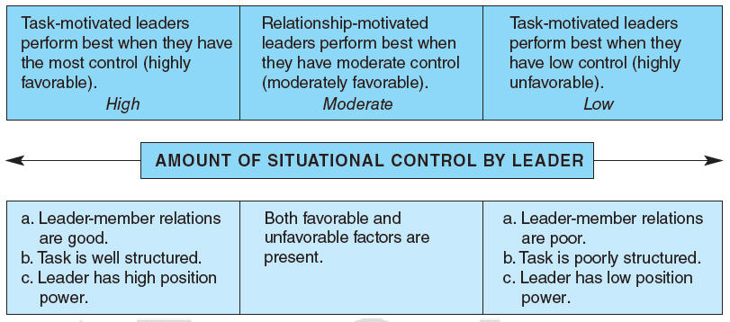
Summary of Findings From Fiedler’s Contingency Theory

Slide 10
Evaluating Fiedler’s Theory
Fiedler’s work did prompt others to conduct studies about the contingency nature of leadership.
Fiedler’s model/theory did alert leaders to the importance of sizing up the situation when working to gain control.
However, Fiedler’s Contingency Theory was found to be too complicated to have had much of an impact on the majority of leaders.

Slide 11
Path-Goal Theory
Developed by Robert House
Specifies what a leader must do to achieve high productivity and morale in a given situation.
In general, the theory says a leader who attempts to “clear the path” to a goal for a group member tends to find the group member’s job satisfaction and performance increase.
A leader should choose a leadership style that takes into account the group member characteristics and the task demands.
The theory is based on the Expectancy Theory of Motivation.

Slide 12
Path-Goal Theory

Slide 13
Using Path-Goal Theory to Match Leadership Style to Situations
DIRECTIVE
Tasks are unclear
SUPPORTIVE
Tasks are frustrating and stressful, plus group members are apprehensive
PARTICIPATIVE
Tasks are non-repetitive and group members are capable and motivated
ACHIEVEMENT-ORIENTED
Tasks are unique or entrepreneurial and group members are competent and committed

Slide 14
Evaluating Path-Goal Theory
The basic tenets of the theory are on target.
Any comprehensive theory of leadership must include the idea that a leader’s actions have a major impact on the motivation and satisfaction of group members.
The theory, however, has never attracted much interest from leaders or managers.

Slide 15
Situational Leadership^{R} (SL II)
Developed by Kenneth Blanchard and colleagues.
Primary focus is on the characteristics of group members – and – matching leadership style to those characteristics.
SLII is designed to increase the frequency and quality of conversations about performance and professional development between leaders and group members so that:
Competence is developed.
Commitment takes place.
Turnover among talented group members is reduced.
SLII is particularly applicable to front-line leaders, such as supervisors and team leaders.

Slide 16
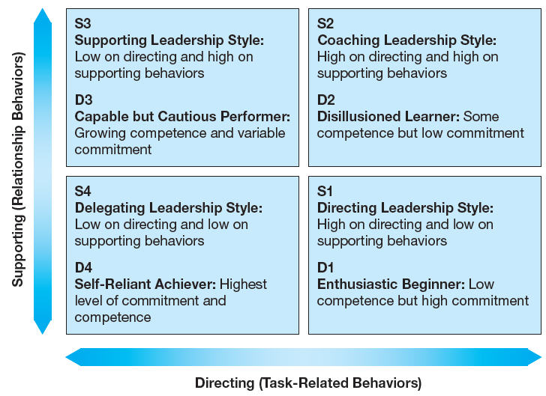
Basics of SLII
The basis for effective leadership is managing the relationship between a leader and a group member on a given task.

Slide 17
Basics of SLII
Effective leadership depends on two independent behaviors:
Supporting Behaviors
Listening
Giving Recognition
Communicating
Encouraging
Coaching
Directing Behaviors
Giving Explicit Directions
Controlling
Supervising
Ruling
Regulating

Slide 18
Evaluating SL II
Represents a consensus of thinking about leadership behavior in relation to group members.
No one style is best.
An effective leader uses all styles, depending on the situation and the individual group member.
Is challenging to apply SLII consistently because leaders must “stay tuned” and tasks shift rapidly.
However, the model has become a basis for leadership training as the model builds on other explanations of leadership that emphasize the role of task and relationship behaviors.

Slide 19
Normative Decision Model
See Figure 5-5 in Book on page 156
Leaders must choose a style that elicits the correct degree of group participation when making decisions.
Views leadership as a decision-making process where the leader examines the elements involved in the situation in order to determine the most effective decision-making style.
Model includes:
Five decision-making styles
Seven situational factors

Slide 20
Decision-Making Styles What differs is the degree of group member participation
Decide
Leader makes decision alone and announces it
Consult (Individually)
Leader works with each group member individually to gather their suggestions – and makes decision alone
Consult (Group)
Leader works with group members as a group in a meeting, gathers suggestions – and makes decision alone
Facilitate
Leader presents problem to group, facilitates discussion, gathers input, ensures they don’t favor their individual decision
Delegate
Leader permits group members to make the decision, works behind the scenes, does set limits but allows group members to work autonomously

Slide 21
Contingency/Situational Factors
Decision Significance to the success of a project or the organization
Importance of Commitment of the team to the decision
Leader Expertise and knowledge in relation to the problem
Likelihood of Commitment of the team to a decision if the leader makes the decision on his/her own
Group Support of the team in relation to the organization’s objectives at stake in the problem
Group Expertise of the team members in relation to the problem
Team Competence of the team members ability to work together in solving problems

Slide 22
Evaluating the Normative Decision Model
Has been shown to lead to increased decision-making effectiveness.
Leaders who consistently use the model are typically seen to be more effective leaders in that they have increased the effectiveness of their decision making.
Assessing the situational factors can be challenging – and – typically relies on intuition and distorted thinking.
Using the model requires much time.
Model does not deal with charismatic or transformational leadership.

Slide 23
Leader-Member Exchange (LMX)
Another perspective on the contingency approach.
Leaders who adapt their style to different individuals within the group, or have different quality relationships with individual group members, are essentially practicing contingency leadership.

Slide 24
LMX Conclusions
Leaders tend to give members of their in-group more favorable performance ratings than they give to out-group members, even when objective performance is the same.
Leaders do not always develop entirely different relationships with each group member, but may respond the same way to a few members of the group.
Larger groups tend to result in differences with respect to leader-member exchanges.
Managers are more likely to use servant leadership in groups with whom the leader has high-quality exchanges.
Leaders are more likely to use empowerment with group members with whom they have high-quality exchanges.

Slide 25
Leadership During a Crisis
Crisis leadership is the process of leading group members through a sudden and largely unanticipated, intensely negative, and emotionally draining circumstance.
Be decisive
Lead with compassion
Reestablish the usual work routine
Avoid a circle-the-wagons mentality
Display optimism
Prevent the crisis through disaster planning
Provide stable performance
Be a transformational leader

Slide 26
Evidence-Based Leadership
Before taking action, a leader asks “What does the research literature tell me is most likely to work in this situation?”
Leaders translate principles based on best evidence into organizational practices.
While evidence-based leadership and management is not yet widely practiced, taking the study of leadership and management seriously will move managers and organizations toward basing their practices and decisions on valid evidence.

Slide 27
Summary
Leaders are more effective when they make their behavior contingent upon situational factors.
Situations shape how leaders behave, and they also influence the consequences of leader behavior.
Fiedler’s Contingency Theory proposes the best style of leadership is determined by situational factors including leader-member relations, task structure, and position power.
The Path-Goal Theory of leadership effectiveness specifies the best leadership style based on the characteristics of the group members and the tasks.
The Situational Leadership (SLII) model explains how to match leadership style to the readiness of group members.

Slide 28
Summary - Continued
The Normative Decision Model explains leadership as a decision-making process.
The Leader-Member Exchange model indicates leaders who adapt their style to different individuals within the group, or who have different quality relationships with individual group members, are essentially practicing contingency leadership.
Leading through a crisis is a form of contingency leadership.
Leaders applying evidence and research to their behaviors and practices are using evidence-based leadership.

