Slide 1
6. Systems of Layout of Fruit Orchards
i. Square System
It is the most common and popular method of laying out fruit orchards on flat ground. In this method plants are set at right angles to each other with equal plant to plant and row to row distance.
Merits
It is good for permanent fruit trees like mango, citrus, guava, and apple.
It is simple and easy to lay out.
Intercropping can be done.
Two directional cultivation can be done.
Management practice are easy.
Demerits
Some unutilized space is left in center.

Slide 2
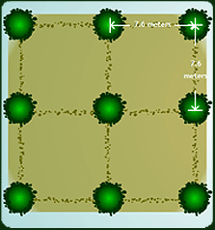

Slide 3
ii. Rectangular System
In this system plant-to-plant distance is kept half of the row-to-row distance. In this system plants are set at the corners of the rectangle.
Merits
No. of plants are more.
It is good for medium size trees.
Demerits
It is not good for long term plantation.
Because land is not fully used
And Crowding will occur on two sides.
Pruning requirement is more.
One way cultivation is possible.

Slide 4
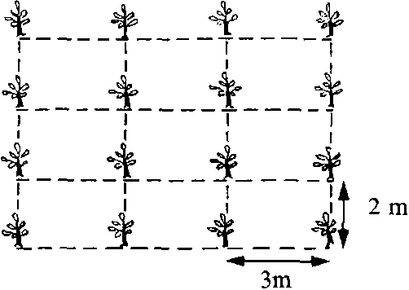

Slide 5
iii. Hexagonal System
This is the best system of layout because all plants are equidistant from each other and no unutilized space is left in the center. Six plants are planted at the corner of hexagon with seventh one in the center of hexagon.
Merits
15% more plants can be planted as compare to square system.
Cultivation can be done in three directions.
Demerits
It is difficult to layout.

Slide 6
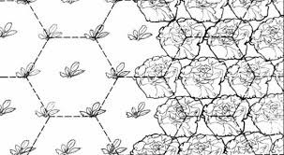

Slide 7
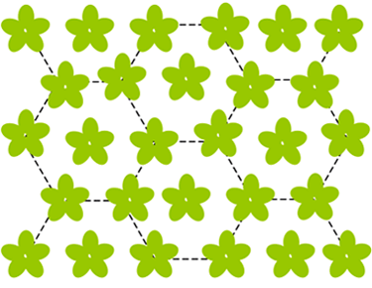

Slide 8
iv. Quincunx System
This system is modification of square system. First plants are planted according to square system and then one plant is planted in the center of each square. The additional plant is called filler. Filler must be quick bearing and low height. Guava is mostly used as filler.
Merits
No unutilized space is left.
70% more plants can be planted.
Early return from fillers.
Demerits
Fillers may adversely affect the growth of permanent plants.

Slide 9
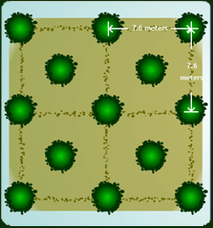

Slide 10
v. Triangular System
This system is modification of rectangular system. After laying out a rectangular system one tree is planted at the center of rectangle making a triangle.
Merits
50-60% more plants rectangular system.
Demerits
Crowding will occur at later stages of the orchard.

Slide 11
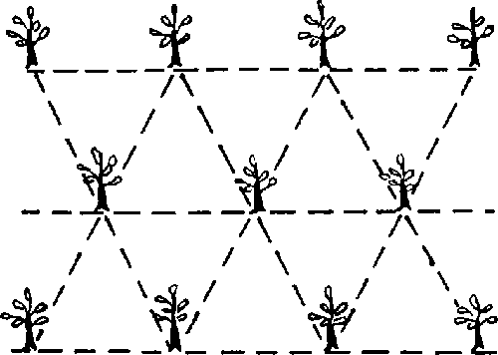

Slide 12
vi. Contour system
This system is used in hilly areas.
Plants are planted according to the contour of the land.
There is no specific row-to-row and plant-to-plant distance.

Slide 13
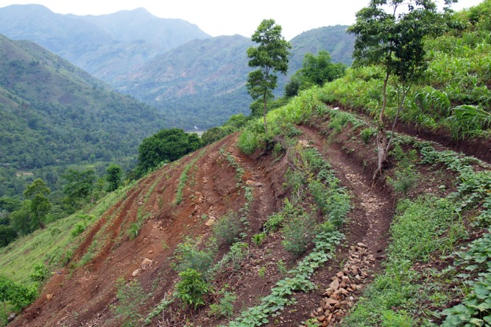

Slide 14
Digging and Refilling of Pits
After laying out orchards it is desirable to make pits for plants.
The main objective of digging pits is to provide a suitable environment for the development of the plant and its roots.
If there is problem of hardpan present in soil can be solve at this stage.
The size of pit depends upon the type of soil and species and variety of fruit. The size of the pit should be 1x1x1 m³.
This is the volume in which most of the roots development occurs during the early days of plant growth.

Slide 15
While digging pits, 1/3rd upper soil should be kept on one side and remaining 2/3rd soil should be scattered in the orchard.
The pits are left open for 2-3 weeks for exposure to sun and circulation of air.
It is harmful to keep the pits open for longer time because their surface gets hardened.
These pits are then refilled with an equal mixture of soil, silt and well rotten FYM.
The pits should be filled a little higher 10-15 cm than the surrounding soil.
This will allow for soil settling after the first irrigation.
The field is then irrigated heavily.
After the field dries, the pits are leveled once again. Plants are set in the centers of the pits and in straight rows on all sides.

Slide 16
5 Selection and Purchase of Plants
The selection of a species and the varieties of fruit plants to be raised is an important step in the establishment of a new orchard.
Selection of Scion variety
Scion is the upper portion of the plant, which has to give ultimate yield.
Selection of scion should be done by keeping following points in mind:
Climatic suitability
Resistance to insect/pest and diseases
Market demand
Requirement of pollinator

Slide 17
6 Care Of Plants at Arrival
The 1st thing should be done on arrival of nursery plants is to check them for variety, number of plants and grade.
The plants are then sprayed with lime and sulphur and stored in the shade for about 48 hours. They should be kept soaked with water and covered with straw during storage.
In case of deciduous plants, if the roots are dry should be soaked in water for several hours before planting.
Roots broken during lifting of the plants from the nursery soil must be cut off with a clean cut.
Pruning should be done by keeping in view the shape of the plant.

Slide 18
Setting of Fruit Plan
1. Time of Planting
Two principal planting seasons
Spring (Feb-March)
Autumn (Sept.-Oct.)
Evergreen fruit plants can be set in both seasons, but deciduous plants should be set in spring only.
Care should be taken to set evergreen plants well before the severe dry and cold season starts, and deciduous plants should be planted when the danger of frost and severe cold is over.

Slide 19
2. Actual Planting
Plants of evergreen fruits should be planted as soon as possible after they are dug from the nursery.
If deciduous plants are transplanted while they are dormant, delay does little effect.
The plants are set in the center of the pit keeping the rows straight.
The use of pegs and a planting board is also recommended to help in keeping the line of plants straight.

Slide 20
3. Post-planting care
After plants are set following cares should be taken.
Irrigate them sufficiently. (This will consolidate the soil and helps the roots to establish soil contact and a supply of water quickly). A basin should be made around the plant for this purpose.
Staking
Heading back of deciduous plants.
Protection from sun and frost by using sarkanda.

Slide 21
8. Wind breaks
These are the rows of plants around the orchard to protect the plants from strong winds.
Before planting an orchard, it is necessary to reserve some space for the trees, which are to serve as windbreaks.
It is better to establish windbreaks one or two years before the fruit trees are planted.
A channel of 1 m wide and 1.5 m deep is dug about 4-5 m from the windbreak trees. This is done to avoid competition.

Slide 22
Characteristics of windbreaks
Adaptable to the soil and climate
Strong mechanical frame
Rapid growth
Tall with dense foliage
Deep rooted
Prefer those plants which can give income (jaman, Mulberry, ber)

Slide 23
Plants used as windbreaks are
Jaman
Mulbery
Eucalyptus
Kikar
Simbal
Popular
Shisham
Desi mango
Ber
Bamboo
In temperate region different species of pine are used as windbreaks.

Slide 24
Advantages of Windbreaks
Reduce the damage by strong winds
Protect from sunburn and frost.
Minimize the wind erosion.
Reduce the water loss by transpiration as caused by dry winds.
Disadvantages of Windbreaks
Plants adjoining to windbreaks are more affected by insect/pest and diseases.
They compete with adjoining fruit trees for nutrition and light.
Delayed maturity of fruit of adjoining plants to windbreaks.
Less color and size development.

Slide 25
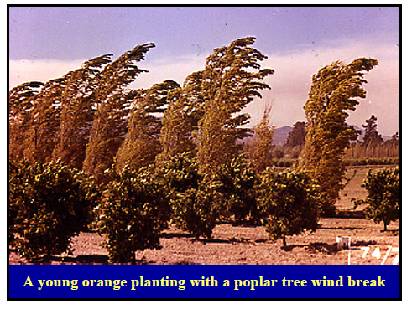

Slide 26
THANKS

