Slide 1
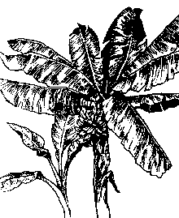
Botany

Slide 2
Botany
Common name: Banana
Musa cavendishii (Dwarf banana)
Musa sapientum (Tall banana)
Musa paradisiaca (Cooking)
Family: Musaceae
Origin: Edible bananas originated in the Indo-Malaysian region reaching to northern Australia.

Slide 4
132

Slide 5
Adaptation
Bananas can be grown in every humid tropical region and constitutes the 4th largest fruit crop of the world.
The plant needs 10 months of frost-free conditions to produce a flower stalk.
All but the hardiest varieties stop growing when the temperature drops below 53° F.
Growth of the plant begins to slow down at about 80° F and stop entirely when the temperature reaches 100° F.

Slide 6
Adaptation
High temperatures and bright sunlight will also scorch leaves and fruit, although bananas grow best in full sun.
Freezing temperatures will kill the foliage.

Slide 7
Growth Habit
Bananas are fast-growing herbaceous perennials arising from underground rhizomes.
The fleshy stalks or pseudostems formed by upright concentric layers of leaf sheaths constitute the functional trunks.

Slide 8
Growth Habit
The true stem begins as an underground corm which grows upwards, pushing its way out through the center of the stalk 10-15 months after planting, eventually producing the terminal inflorescence which will later bear the fruit.
Each stalk produces one huge flower cluster and then dies.

Slide 9
Fruits: The ovaries contained in the first (female) flowers grow rapidly, developing parthenocarpically (without pollination) into clusters of fruits, called hands.
All hands on an inflorescence are collectively called a bunch.
Each hand consists of 12-20 fruits called fingers.
The number of hands varies with the species and variety.
The fruit (technically a berry) turns from deep green to yellow or red, and may range from 2-1/2 to 12 inches in length and 3/4 to 2 inches in width.

Slide 10
Soil
Bananas will grow in most soils, but to thrive, they should be planted in a rich, well-drained soil.
The best possible location would be above an abandoned compost heap.
They prefer an acid soil with a pH between 5.5 and 6.5.
The banana is not tolerant of salty soils.

Slide 11
Irrigation:
The large leaves of bananas use a great deal of water.
Regular deep watering is an absolute necessity during warm weather.
Do not let plants dry out, but do not overwater.
Standing water, especially in cool weather, will cause root rot.

Slide 12
Fertilization:
Their rapid growth rate make bananas heavy feeders.
During warm weather, apply a balanced fertilizer once a month
A mature plant may require as much as 1-1/2 to 2 pounds of the NKP fertilizer each month.
In general NPK three fertilizers are important for good growth and yield

Slide 13
Fertilization:
250 kg N 26 kg P and 500kg K are removed by the growth cycle of banana to produce 72 tones of fruit /ha.
(N vegetative growth, P helps in fruit formation, K helps in increasing the yield and quality of Fruit)

Slide 14
Frost Protection
Bananas flourish best under uniformly warm conditions but can survive 28° F for short periods.
If the temperature does not fall below 22° F and the cold period is short, the underground rhizome will usually survive.
To keep the plants that are above ground producing, protection against low temperatures is very important.

Slide 15
Frost Protection
Wrap trunk or cover with blanket if the plants are small and low temperatures are predicted.

Slide 16
Pruning
Only one primary stem of each rhizome should be allowed to fruit.
All excess shoots should be removed as soon as they are noticed.
This helps channel all of the plant's energy into fruit production.
Once the main stalk is 6 - 8 months old, permit one sucker to develop as a replacement stalk for the following season.
When the fruit is harvested, cut the fruiting stalk back to 30 inches above the ground.

Slide 17
Pruning
Remove the stub several weeks later.
The stalk can be cut into small pieces and used as mulch

Slide 18
Propagation
Cultivated commercial varieties are seedless.
Vegetative propagation
The crops grown after the first year of plantation are called Ratoons.
One meter tall, narrow-leaved suckers known as sword suckers are preferred for propagation.
Broad leaved or water suckers should not used for propagation as they produced late and inferior quality fruit.

Slide 19
Propagation
New plantation should be done in FEBRUARY–MARCH or July-August
Planting distance 2-3 m

Slide 20
Varieties
Basrai
Mirpuri
Sonkel
Safri
Chini champa

Slide 22
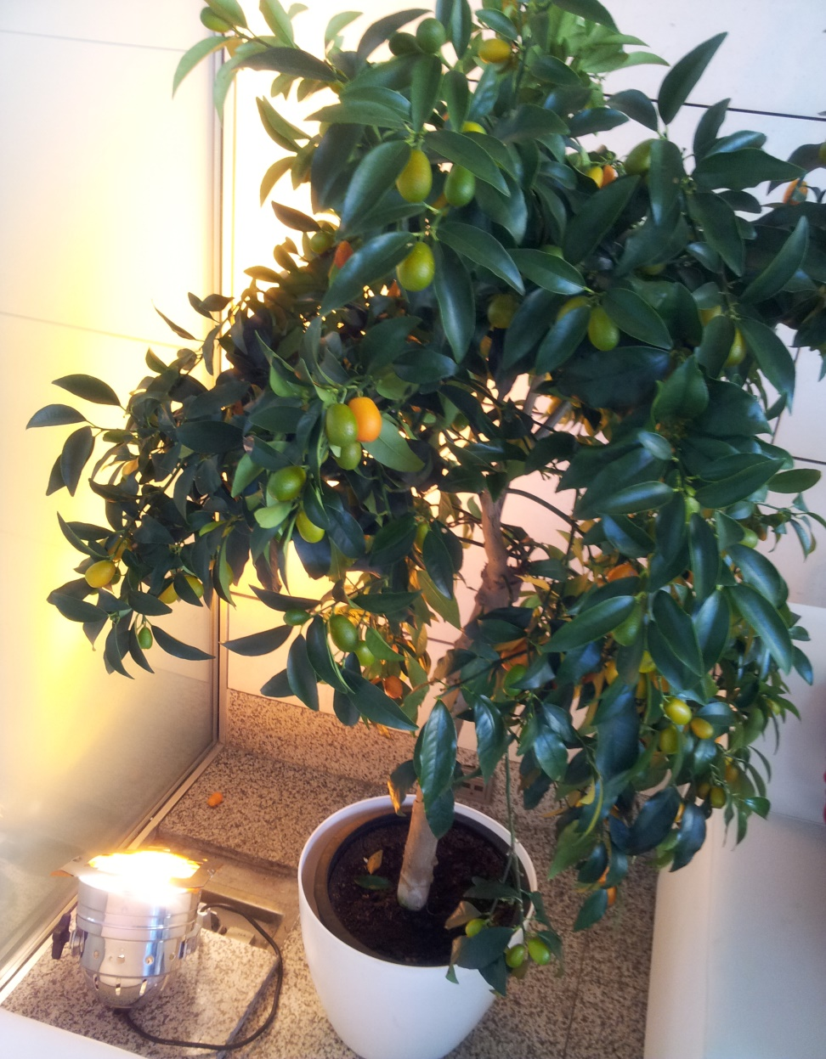

Slide 23
