Slide 1
Bacteriology and virology
Topic: discovery, history and general characteristics of bacteria

Slide 2
Contents of topic:
Discovery
History
General characteristics
Definition
Structure
Size
Shape
Arrangement
Habitat
Nutrition
Growth and reproduction

Slide 3
Discovery:
The discovery of bacteria depends on the invention of microscope.
After the invention of microscope, following scientists played their role in its discovery.
Antone Van Leeuwenhoek.
Leeuwenhoek was the first scientist who observed microbes in 1673.
He was called as the “father of microbiology”.
These microbes were bacteria and protozoa.
He used simple microscope to describe them.
He named these particles “ani molecules”

Slide 4
Continue…
Christian Gottfried Ehrenberg:
In 1938, a German naturalist gave the proper name to these particles as “bacteria”.
This term bacteria derived from the Latin word “Bacterium”.
Also from the Greek word “ bacterion”.
History
Bacteria have existed from very early in the history of life on Earth.
Bacteria fossils discovered in rocks date from at least the Devonian Period (419.2 million to 358.9 million years ago),
Some are the arguments that bacteria have been present since early Precambrian time, about 3.5 billion years ago.

Slide 5
General features of bacteria:
Definition:
Bacteria are referred to as microscopic, single-celled organisms which exist in their millions, in every environment, both inside and outside other organisms.
Bacteria belong to the prokaryotic domain.
Shapes: They have various shapes such as:
spherical (cocci), (bacilli), spiral (spirilla), comma (vibrio), corkscrew (spirochetes).
They can be found in soil, water, acidic hot springs, radioactive waste, and the deep biosphere of the earth’s crust.

Slide 6
Continue….
Bacteria can be found in both symbiotic and parasitic relationships with plants and animals.
The biology where we study about bacteria is called bacteriology, which is a branch of microbiology.
All bacterial species are not harmful some of them are beneficial
for example, they help in the synthesis of vitamin B12 and also play an important role in the fixation of nitrogen from the atmosphere.
In the animal body, the largest number of bacterial cells can be found in the gut and skin.

Slide 7
Structure of bacteria:
A typical structure of bacteria is as follows:
1.) A rigid cell wall.
2.) A cytoplasmic or plasma membrane (below the cell wall)
Components of the cell interior – Inside the cell envelope,
Bacterial flagellum
there is protoplasm consists of the cytoplasm and cytoplasmic inclusions such as
Ribosomes
Mesosomes
Granules
Vacuoles
the nuclear body.

Slide 8
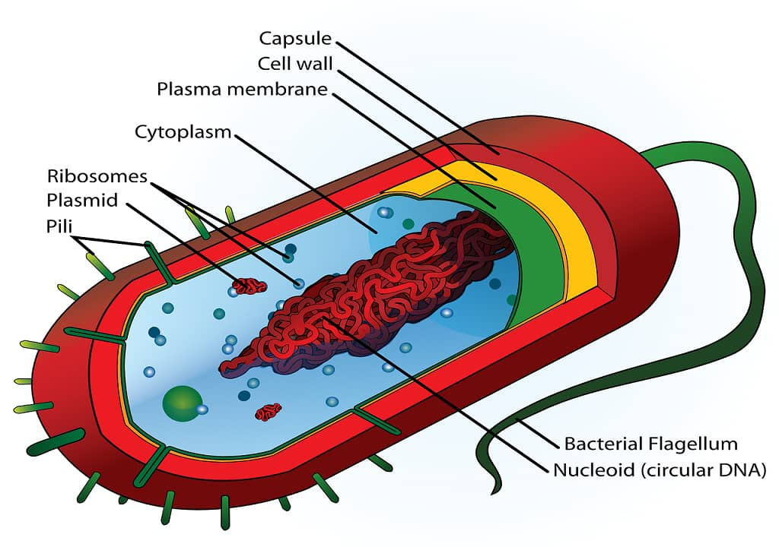
Diagram:

Slide 9
Size of bacteria:
The primary unit we used to measure the size of a bacterial cell is micron (micrometer).
Where 1 micrometer (um) is one-thousandth of a millimeter.
The average size of a bacteria is varied between 0.2 and 2.0 um.
The resolution limit of our eyes (Naked eye) is between 100 and 200 um, which is about the diameter of our hair.
Whereas, a bacterial cell’s size varies between 0.2 and 2.0 micrometers (diameter).
However, there are few bacteria that hold this to range between 1 and 10 micrometers.
The size range of the smallest bacteria is between 0.2 and 0.5um (200 to 500 nanometers)

Slide 10
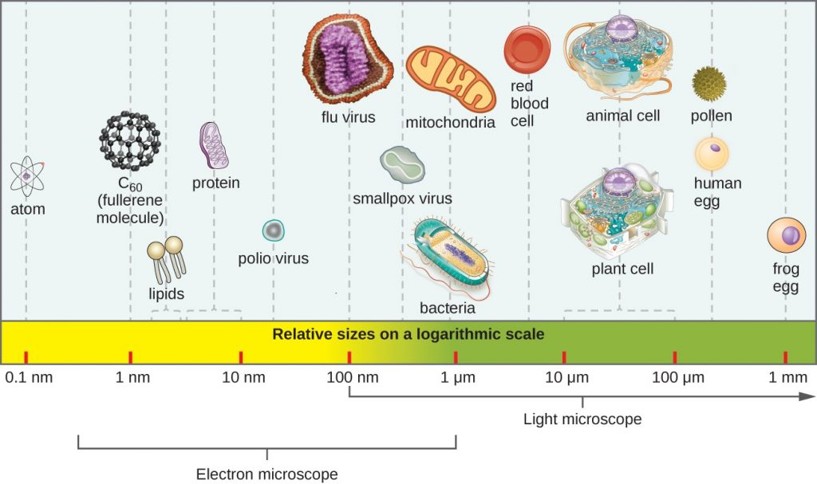
Size of bacteria:

Slide 11
Shapes of bacteria:
There are present different varieties of bacterial cells in different shapes.
This variation in shape of a bacterial cell is determined by the bacterial rigid cell wall and cytoskeleton.
Environmental factors are also responsible for the variations in shapes.
Naturally there are present three types of bacterial cell, which are classified based on their shapes;
Coccus: These types of bacterial cells appear as spherical or round in shape.
Bacillus: These types of bacterial cells appear as rod shapes.
Spiral: These types of bacterial cells appear as curved, spiral or curved in shape.

Slide 12
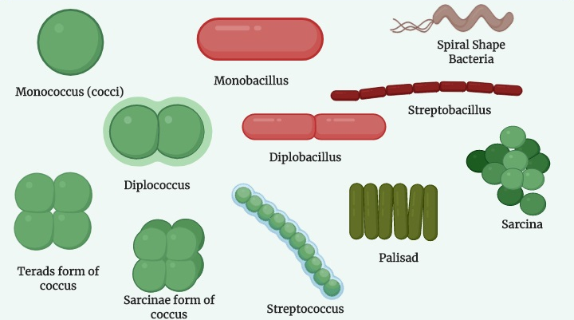
Shapes of bacteria

Slide 13
Arrangement of bacterial cell:
There are present mainly five types of bacterial cell arrangement such as;
Diplo: In this type cells remain in pairs after division.
Strepto: In this type cells remain in chains after division.
Tetrad: In this type cells remain in groups of four and divide in two planes.
Sarcinae: In this type cells remain in groups of eight and divide in three planes.
Staphylo: In this type cells remain in clusters and divide in multiple planes.

Slide 14
Habitat of bacteria:
They can be found in ocean depths, down to 32,800 feet or 10,000 meters deep.
Aerobic bacteria grow where oxygen is present such as soil, water, plants, animals, etc.
Anaerobic bacteria grow where oxygen is absent such as the gastrointestinal tract.
Facultative anaerobes, or facultative anaerobic bacteria, can thrive with or without oxygen, but most of them prefer environments where there is oxygen.
mesophilic bacteria live in moderate temperatures, around 37°C. These bacteria are responsible for human infections. They can be found in the human body.

Slide 15
Continue…
extremophilic bacteria can be found in extreme environments such as hot springs, deep in the ocean, etc. Some example of Extremophiles are;
Thermophiles: Can thrive up to 75 to 80°C.
Hyperthermophiles: Can thrive up to 113°C.
Halophiles: Live in a salty environment.
Acidophiles: Found in environments as acidic as pH 0.
Alkaliphiles: can be found in alkaline environments up to pH 10.5.
Psychrophiles: Can live in cold temperatures, for example, in glaciers

Slide 16
Nutrition of bacteria:
Bacteria get their nutrition in various ways such as; some bacteria get energy from light using photosynthesis known as phototroph
whereas a few bacterial cells get energy from chemical compounds by oxidizing them known as chemotrophic.
Phototrophic bacteria or phototrophs
get their energy from Sunlight, carbon from Organic compounds (photoheterotrophs) or carbon fixation (photoautotrophs).
Some examples of phototrophs are Cyanobacteria, Green sulfur bacteria, or Purple bacteria.

Slide 17
Continue…..
Lithotrophs
get their energy from Inorganic compounds, carbon from Organic compounds (lithoheterotrophs) or carbon fixation (lithoautotrophs)
Examples of Lithotrophs are Thermodesulfobacteria, Hydrogenophilaceae, or Nitrospirae.
Organotrophs get their energy from Organic compounds (chemoheterotrophs) or carbon fixation (chemoautotrophs)
Examples of Lithotrophs are Bacillus, Clostridium or Enterobacteriaceae.

Slide 18
Continue…
Growth and Reproduction of Bacteria
Bacteria can be reproduced by these following methods;
Binary fission
It is an asexual method, where the bacterial cell grows
then form a new cell wall between the center
divides into two identical daughter cell
Both of these two daughter cells contain the same genetic material.
Budding
A group of bacteria follow this method for reproduction.
In this method a bud or outer growth occurs at one end of the mother cell

Slide 19
Continue….
Then the size of buds constantly increases,
when the bud is about the same size as the parent cell,
it separates from the parent cell.
Then it grows and forms a fully formed bacterial cell.
Spores:
In certain conditions when bacterial cells lack nutrients
they form spores and remain in a dormant stage
When they found an optimum environment they reactivated and formed bacteria.
Spores can thrive in different environmental stress such as ultraviolet (UV) and gamma radiation, desiccation, starvation, chemical exposure, and extremes of temperature.

Slide 20
Reference:
guidancecorner.com/bacteria/
microbiologynote.com/what-is-bacteria
aramedicsworld.com/bacteriology-notes/structure-of-bacteria/medical-parame
www.britannica.com/science/bacteria/Evolution-of-bacteria

