Slide 1
http://www.rodneyohebsion.com/mulla-nasrudin.htm

Slide 3
Key elements of a comic strip include character, setting, and plot — all conveyed in a few frames through a combination of pictures, captions, and dialogue.
Or
A comic strip is a sequence of images with a small amount of text in each box. This text is normally inside balloons or written as captions.

Slide 4
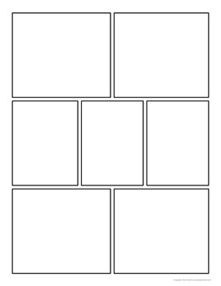
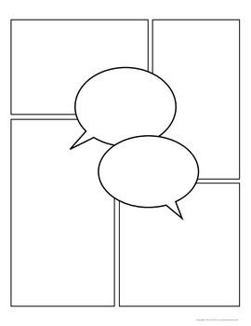
Comic Templates
Comic strip consists on different number of panels and frames. For text dialogue box or speech bubble are used.

Slide 5
A panel is an individual frame, or single drawing, in the multiple-panel sequence of a comic strip or comic book. A panel consists of a single drawing depicting a frozen moment. When multiple panels are present, they are often, though not always, separated by a short amount of space called a gutter.

Slide 6
Comic strips (or comic books) are a form of story-telling, which uses drawings or cartoon characters to tell a story. Most comic strips are created for humour, while some can be serious.
Most comic strips are created for humour, while some can be serious
Comic strips are most likely to be seen in newspapers or magazines.

Slide 7
the main genres of comic books are: alternative/esoteric, manga, science fiction, fantasy, action/adventure, horror, humor, romance, children's, and adult.

Slide 8
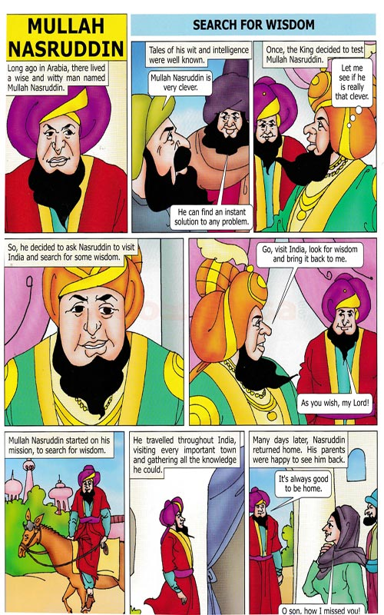
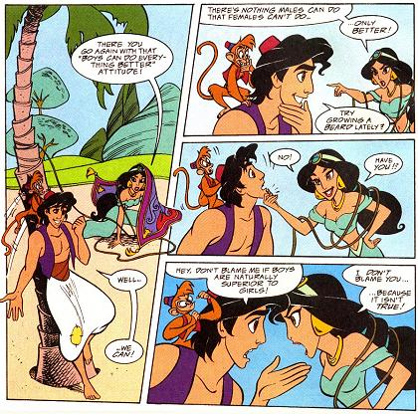
Examples

