Slide 2
Presentation Group # 02
Drinking Water Pollution

Slide 3
What is Pollution…????
Pollution is the introduction of contaminants (harmful or Poisonous) into the natural environment that cause adverse change.
Pollution can take the form of chemical substances or energy, such as noise, heat or light.

Slide 4
What is water Pollution…????
Water pollution is the contamination of water bodies (e.g. lakes, rivers, oceans, aquifers and groundwater).
This form of environmental degradation occurs when pollutants are directly or indirectly discharged into water bodies without adequate treatment to remove harmful compounds.

Slide 5
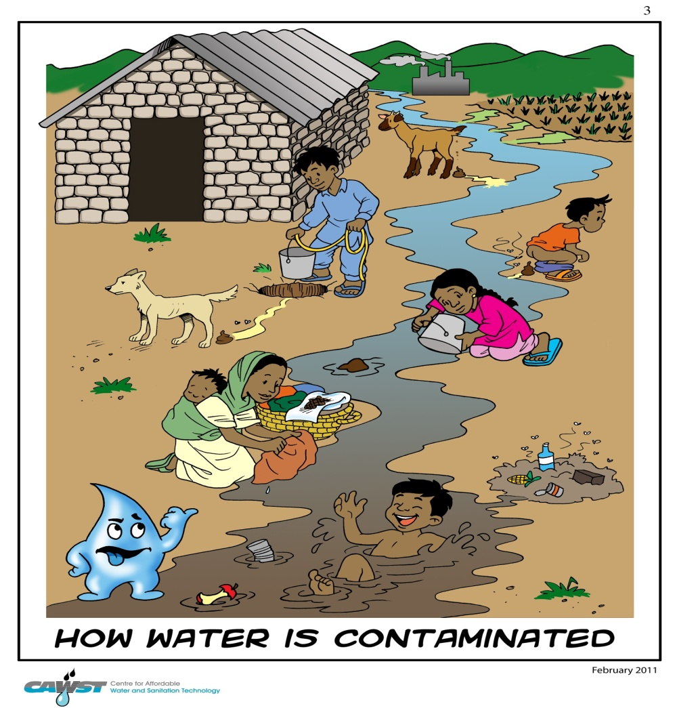

Slide 6
Sources of water pollution..!!!
There are many sources for water pollution but two general categories exist: direct and indirect contaminant sources. Direct sources include effluent outfalls from factories, refineries, waste treatment plants etc.. that emit fluids of varying quality directly into urban water supplies.
The two main sources of water pollution are;
Point Source water pollution
Non-point source water pollution

Slide 7
Comparison
Point Source pollution
Non-point Source pollution
It comes from a specific source, like a pipe.
It can be monitored and controlled by a permit system.
Example:
factories, industry, municipal treatment plants
Nonpoint Source (NPS) Pollution is pollution associated with storm water or runoff.
NPS pollution cannot be traced to a direct discharge point such as a wastewater treatment facility
Example:
oil & grease from cars, fertilizers, animal waste, grass clippings etc.

Slide 8
Kinds of Water Pollution
There are mainly three kinds of drinking water pollutants that contaminate the water.
Those are;
Inorganic Pollutants
Organic Pollutants
Biological Pollutants

Slide 9
Inorganic Pollutants
Produce no health effects until a threshold.
Example:
Pb in gasoline
Atmospheric testing of nuclear weapons is now banned
Example:
Radionuclides
Phosphates mostly a result of sewage outflow and phosphate detergents. Additional phosphate grows excess algae
Example:
Phosphorus, nitrogen (Great Lakes)

Slide 10
Organic Pollutants
There are mainly three classes of organic compounds which are;
Pesticides and Herbicides
Materials for common household and industrial use
Materials for industrial use

Slide 11
Pesticides
Pesticides:
Most present pesticides are 10-100 x more toxic than those used in 1050’s.
About 25% of pesticide use in houses, gardens, lawns, parks, swimming pools, and golf courses.
Each year about 250,000 people are admitted to hospitals and/or emergency rooms with pesticide poisoning
Example:
Chlorinated hydrocarbons
Organophosphates
Carbamates

Slide 12
Herbicides
Triazines: Interfere with photosynthesis.
Systemic—phenoxy compounds, N compounds: create excess growth hormones.
Soil sterilants: kill soil microorganisms

Slide 13
Biological Pollutants
Greater obvious problems than organic and inorganic contaminants in worldwide.
Major cause of deaths in world
Diarrhea kills 4-15 million children/year
Example:
Bacteria, Viruses & parasites

Slide 14
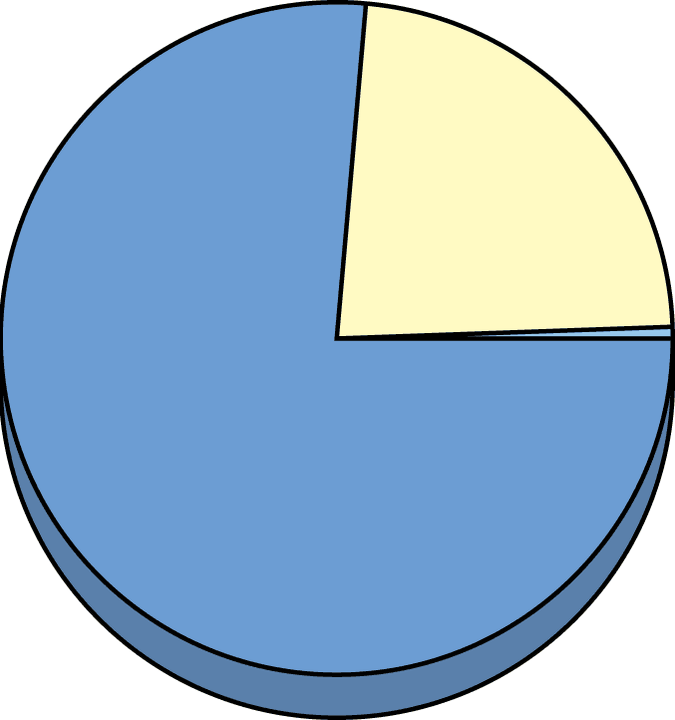
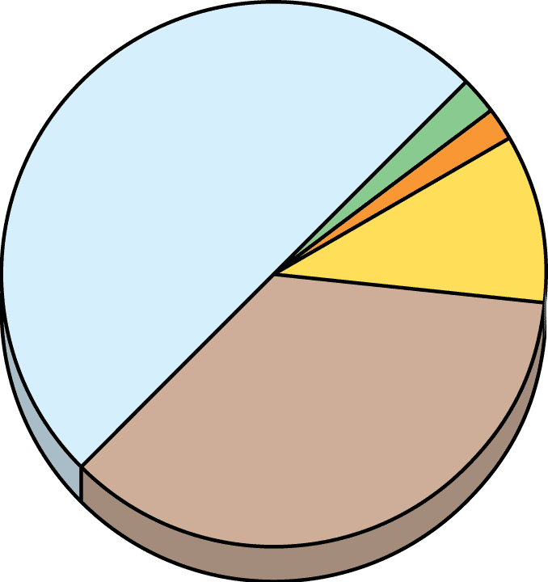
Supply of Water Resources
Freshwater
Readily accessible freshwater
Groundwater
0.592%
Biota
0.0001%
Lakes
0.0007%
Rivers
0.0001%
0.014%
Ice caps
and glaciers
0.592%
Soil
moisture
0.0005%
Atmospheric
water vapor
0.0001%

Slide 15
Use of Water Resources
Agriculture
Domestic
Power plants
Humans use about 54% of reliable runoff.
Agriculture
38%
Power
cooling
38%
Industry 11%
Public 10%

Slide 16
Water Resources
Over the last century
Human population has increased 3x
Global water withdrawal has increased 7x
Per capita water withdrawal has increased 4x
About one-sixth of the world’s people don’t have easy access to safe water
Most water resources are owned by governments and are managed as publicly owned resources

Slide 17
Human water Needs
In Asia a person needs about 1 gallon water/day for hydration.
In the US each person uses about 188 gallons/day
An additional 657 gallons/person/day are used for irrigation, industrial use.
Total per capita use is about 2000 gal/person/day
US has highest per capita water withdrawal, followed by Canada, Australia, Russia, Japan

Slide 18
Common Diseases Transmitted to Humans through Contaminated Drinking Water

Slide 19
Testing Water for Pollutants Level of dissolved Oxygen
Water Quality
DO (ppm) at 20°C
Good
8–9
Slightly polluted
6.7–8
Moderately polluted
4.5–6.7
Heavily polluted
4–4.5
Gravely polluted
Below 4

Slide 20
Problems with Using Groundwater for Drinking.
Water table lowering
Depletion
Subsidence
Saltwater intrusion
Chemical Contamination
i.e.,
The 20 most abundant compounds in groundwater at industrial waste disposal sites include TCE, benzene, vinyl chloride…all are carcinogens, and also affect liver, brain, and nervous system)
Reduced stream flows

Slide 21
Laws to Protect Drinking water..!!
1974: U.S. Safe Drinking Water Act
Sets maximum contaminant levels for any pollutants that affect human health
Health scientists: strengthen the law.
Water-polluting companies: weaken the law.
Federal Water and Pollution Control Act of 1956
Fish and Wildlife Coordination Act of 1958
National Environmental Policy Act of 1969

Slide 22
Laws to Protect Drinking water..!!
Water Quality Improvement Act of 1970 Control of oil pollution; work to eliminate acid mine drainage.
CLEAN WATER ACT OF 1972 Billions of $ to clean up nation’s waters; modern sewage treatment plants

Slide 23
Ways to Purify drinking water..!!
Purification of urban drinking water
Protection from terrorism
Purification of rural drinking water
Safe Drinking Water Act
Reservoirs and purification plants
Process sewer water to drinking water
Expose clear plastic containers to sunlight (UV)

Slide 24
Possible Solutions to improve water Quality
Prevent groundwater contamination
Greatly reduce nonpoint runoff
Reuse treated wastewater for irrigation
Find substitutes for toxic pollutants
Work with nature to treat sewage
Practice four R's of resource use (refuse, reduce, recycle, reuse)
Reduce resource waste
Reduce air pollution
Reduce poverty
Reduce birth rates

Slide 25
Suggestions
Fertilize garden & yard plants with manure or compost instead of commercial inorganic fertilizer.
Less use of pesticides especially near water bodies.
Don’t flush unwanted medicines down the toilet.
Prevent yard wastes from entering storm drains.
Don’t pour pesticides, paints, oil, solvents, antifreeze or other products containing harmful chemicals down the drain or onto the ground.
Protecting Watersheds Instead of Building Water Purification Plants.

