Slide 1
Applications of Bernoulli’s Equation

Slide 2
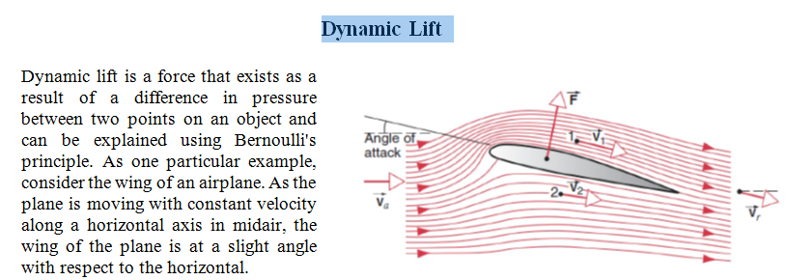

Slide 4
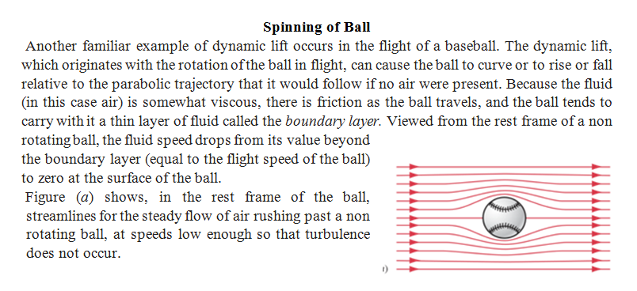

Slide 6
