Slide 1
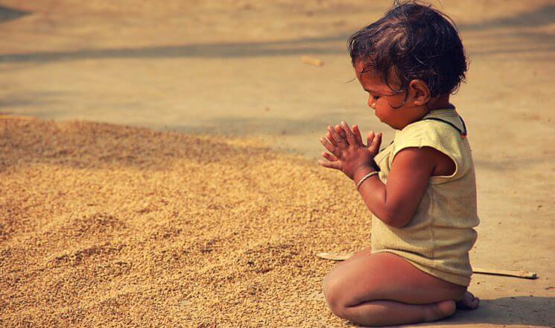
Gratitude and Happiness

Slide 2
How did English speakers get the phrase “thank you

Slide 3
Origin
Even though the language of “thank you” dates back hundreds of years ago, the concept of gratitude has always been a piece of human interaction. The fact that nearly every language today embodies the idea of thanking someone is incredible and goes to show how human communication can survive across different cultures and times.
According to Merriam-Webster, the first known use of “thanks” occurred before the 12th century, but it didn’t exactly translate to “gratitude” back then.
The word “thank” stems from the Latin word tongēre. The root tong- means “think.” Loosely translated, the expression might read “I will remember what you have done for me.” However, English is not the only language where “thank you” derives from Latin roots.

Slide 4
Origin
Merci derives from the Latin word mercēs, which translates to “wages, fee, or price.” However, the modern use of merci comes from the Old French meaning of the word mercit which means “reward, gift, kindness, grace, and pity
In Spanish, the word gracias means “thank you” and derives from the Latin phrase, gratias agere, which means “to express thanks.” In Italian, grazie is used to say “thank you” and it also derives from gratias agere.

Slide 5
What Actually Thank You Means !
Word used to tell someone that you are grateful because they have given you something or done something for you.
said to politely accept or refuse something that has been offered to you

Slide 6
Types Of Gratitude
Verbal gratitude: Saying thank you in some way.
Concrete gratitude: Reciprocating with something the child likes, such as offering the person some candy or a toy.
Connective gratitude: Reciprocating with something the wish-granter would like, such as friendship or help.

Slide 7
Gratitude across cultures
Despite these age-related similarities, there were still differences between countries. Overall, children in China and South Korea tended to favor connective gratitude, while kids in the United States leaned toward concrete gratitude. Children in Guatemala—where it’s common to say “Thanks be to God” in everyday speech—were particularly partial to verbal gratitude

Slide 8
How cultures shape our gratitude
Theoretically, these autonomous-related societies would be the ones that are most supportive of authentic gratitude, since people would want to strengthen their relationships but would do so freely rather than out of a sense of obligation. True gratitude, after all, is not the polite thank you uttered to avoid seeming rude but a genuine wish to pay back the undeserved blessings you receive.

Slide 9
Why don’t Asian and Asian American participants see the same benefit from this practice
Expressing appreciation for other people’s help may generate more mixed emotions for them, like indebtedness, guilt, and regret. In a recent study led by Liudmila Titova, for example, Indians who wrote about their gratitude did feel more positive emotions, but they also felt more guilt and sadness—feelings absent in Anglo Americans. The guilt they carried was mirrored in their writings, which more often talked about feeling in debt. For example, one person wrote, “[The] only thing which always pulls me down is that I could have given some gift as a token of gratitude.”

Slide 10
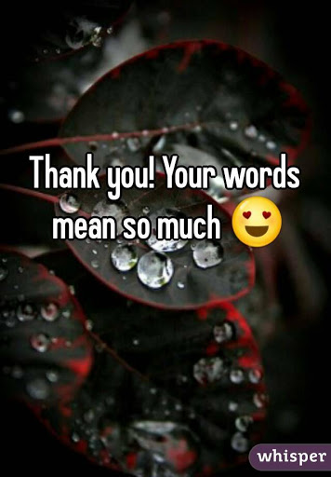
Social and psychological effect of saying Thank you

Slide 11
Social effect
Researchers studying gratitude have found that being thankful and expressing it to others is good for our health and happiness.
Not only does it feel good, it also helps us build trust and closer bonds with the people around us.

Slide 12
Feelings of gratitude and generosity are helpful in solidifying our relationships with people we care about, and benefit to the one giving as well as the one on the receiving end.

Slide 13
Moments of gratitude can act as “booster shots” for even healthy relationships, using the metaphor to argue that, just as vaccines provide a periodic boost toward one’s immune system functioning, appearing grateful towards one’s partner can act as a boost to maintaining a healthy relationship

Slide 14
Psychological effect
Awareness
Research has determined that people who are appreciated by a simple thank-you demonstrate a 50 per cent increase in their willingness to help.
Accountability
Many of us remind ourselves each day how busy we are and how little time we have. However, we’re never so busy that we can’t take a second to say thank you to someone who does something to help us.

Slide 15
Action
Obtaining the benefits of saying thank requires only intention and authenticity.
Monitor for missed opportunities Scan your day quickly and self-evaluate missed opportunities where you could have given a thank you but did not.
Observe
Notice how you feel when you say thank you sincerely and how the other person reacts.

Slide 16
Neurological Pathway of Experiencing and Expressing Gratitude

Slide 17
A handful of neuroimaging studies have shed light on brain areas that are likely involved in experiencing and expressing gratitude, which leads towards a person’s happiness. Brain areas that are activated while experiencing gratitude involves; 1- Activation of mesolimbic and basal forebrain 2- More activity in medial prefrontal cortex 3- Activity increases in anterior cingulate cortex 4- Activity increases in dorsomedial and ventromedial areas of brain 5- More gray matter in right temporal lobe

Slide 18
Brain areas that go for more work while expressing gratitude involves; 1- Increased response of ventromedial prefontal cortex 2- More activity in pareital and lateral prefrontal cortex 3- Increased activity in pregenual cingulate cortex 4- Increased neural hallmarks of altruistic brain 5- Practicing gratitude may increase brain activity related to predicting how our actions affect other people. Because; Experiencing and expressing gratitude is not just emotional, rather it’s a cognitive process.

Slide 19
Researches suggest that experiencing and expressing gratitude leads to one’s happiness and satisfaction. fMRI studies shows increased activity of amaygdala ( the emotion center of brain) during gratitude experience, expression and happiness.

Slide 20
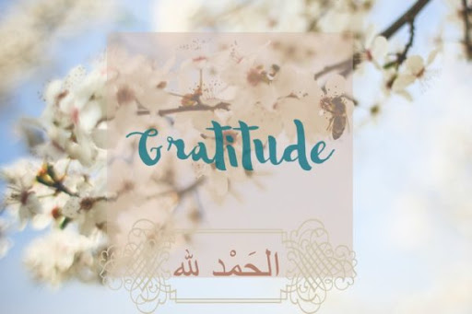

Slide 21
Islam on Gratitude and Happiness
Let us see what Islam says about gratitude and happiness. One of God’s commandments involves remembering Him and being grateful to Him. And one of the best ways to worship Him is to do so in the manner that he describes. God says:
… remember Me; I will remember you. And thank Me, and never be ungrateful. (Quran 2:152)

Slide 22
And He goes on to say:
… if you are grateful I will give you more of my blessings… (Quran 14:7)
If we look back at what we just read and understood we see that being grateful releases dopamine, dopamine sets up a loop, we find more things to be grateful for because it makes us feel good.
This is the perfection of God the Creator. He tells us how we can be happy and wires our brain in order for us to create the happiness by obeying Him.

Slide 23
Prophet Muhammad made it clear that expressing our gratitude to God not only involves thanking Him but also thanking others. He said that the one who does not thank the people does not thank God.[5]
He also said:
When someone does you a favor, then reciprocate and if you cannot find anything with which to return the favor then pray for him until you feel you have reciprocated enough.[6]

Slide 24
In a third narration Prophet Muhammad said that whoever says Jazakallhu khairun, (may God reward you with good) to the one who has done him a favor has done enough to thank him.[7]
Prophet Muhammad was able to take God’s commandments and weave them into the fabric of the society that he built.
The inbuilt gratitude in Islam paves a way to happiness and contentment in this life and the next.

Slide 26
Ways to show gratitude
1. Touch someone
Next time you are saying thank you to someone, reach out and lay your hand on their arm. Portray just how grateful you are.
2. Give
Give something small to those closest to you for no reason at all-just to show that they are on your mind.

Slide 27
3. Feel lucky
Feel lucky that you have a few dollars to spend on something like socks… take a brand new pair from that bulk bag you just got and hand them to someone homeless – new socks are priceless to them, but a dime a dozen to you.
4. Smile
Show your thanks to the world with an ear-to-ear smile and help spread that yummy feeling.

Slide 28
5. Give again
Spend your thanksgiving in a soup kitchen, feeling gratitude for the capacity to volunteer your time and the fact that you have a home with fridge stocked with food waiting for you. And that giant smile with you.
6. Act without reward
It look a while for me to see that this was his way of being grateful to something else, so he did not need to look back for a reward.
7. Write a note
A co-worker or a family member, or perhaps the guy who packs your groceries will all appreciate a handwritten note from you. In fact I bet they keep it somewhere for years to come.
8. Be present
Show gratitude by showing up and paying attention. Clear your mind and be in the room wit the people you are with, put your phone away and open your ears.

Slide 29
9. Grow
Be grateful for what you already have by trying to further it, grow it and then spread it. Taking anything for granted often results in complacency and will stunt your growth as a human being.
10. Have courage
Show your thanks for the health, wellness and presence of others around you by having the bravado to say it, live it and keep it that way.

Slide 30
Effect Of Gratitude On RelaTionsHips
A powerful insight from the domain of positive psychology concerns the practice of gratitude (thankfulness and appreciation for the good things in one’s life).
A large-scale study of over 31,000 people (broken down into three different samples) found that gratitude is associated with higher subjective well-being across the lifespan.
Another study of Vietnam war veterans with PTSD found that daily gratitude was associated with increased resilience to trauma.

Slide 31
In addition, practicing gratitude is linked to increases in relationship connection and satisfaction; research suggests that everyday gratitude may act as a kind of “booster-shot” for our romantic relationships
Gratitude can help relationships thrive by promoting a cycle of generosity. That is, one partner’s gratitude can prompt both partners to think and act in ways that convey gratitude to each other and promote commitment to their relationship. How does this cycle work?

Slide 32
Step One: Feel more grateful –> Want to hold onto your relationship
This part of the process is very simple: Moments of gratitude help people recognize the value in their partners—and a valuable partner is worth holding onto, of course. We found this to be true in a number of studies—i.e., when people feel more appreciative than usual of their partners, they also report more feelings of commitment.
And this benefit of gratitude has long-term consequences: The more grateful people were at the beginning of the study, the more committed they were nine months later. So it seems that feelings of gratitude are tied to the motivation to maintain one’s relationship.

Slide 33
Step Two: Feel more grateful –> Work to keep your relationship
Being motivated to stay in a relationship is only part of the story. We also need to act on that motivation. And gratitude is valuable here as well: Experiencing gratitude also seems to promote behaviors that help people hold onto their relationships.
In one study, we found that people reported being more thoughtful and responsive to their partners’ needs on days when they felt more grateful for them.

Slide 34
Step Three: Work to keep relationship –> Partner feels appreciated
This is where the good stuff happens. Recognizing you have a valuable partner and acting accordingly can help your partner feel more valued.

Slide 35
Step Four: Partner feels appreciated –> Partner more grateful
we complete the cycle: In our research we find that an appreciated partner is a grateful partner. On days when people report feeling more appreciated by their partners, they experience increases in their own feelings of gratitude for their partners. And this makes sense: What partner is more valuable than one who clearly values you?
And this is where the benefits of gratitude really take off. Going back to the initial steps in this cycle, we remember that a grateful partner is a partner who will think and act in ways that help him hold onto the relationship. So now, both partners are focused on maintaining the relationship. In this way, that first moment of gratitude can spark an ongoing cycle of gratitude and generosity

Slide 37
Cultural Differences Shape Your Gratitude
Why don’t we all express gratitude in the same way?
Cultural values, language, parenting practices, and education each play a role.
First understand gratitude types.
Verbal gratitude:
Saying thank you in some way.
Concrete gratitude:
Reciprocating with something the child likes, such as offering the person some candy or a toy.
Connective gratitude:
Reciprocating with something the wish-granter would like, such as friendship or help.

Slide 38
China and South Korea tended to favor connective gratitude.
United States leaned toward concrete gratitude.
Children in Guatemala where it’s common to say “Thanks be to God” in everyday speech (were particularly partial to verbal gratitude).
Americans were more likely than the Iranians to simply say thank you. Americans (and Italians, too) are inveterate thankers, expressing gratitude in many everyday situations when people from other cultures simply do not.
In Pakistan being a Muslim “The Quran mentions gratitude and thankfulness as one of the major attributes of the faithful”. Mostly Pakistani shows verbal gratitude.
In India, according to their religion they show gratitude with closes hands. That is sign of gratitude.

Slide 39
