Slide 1
Concepts of Ecology

Slide 5
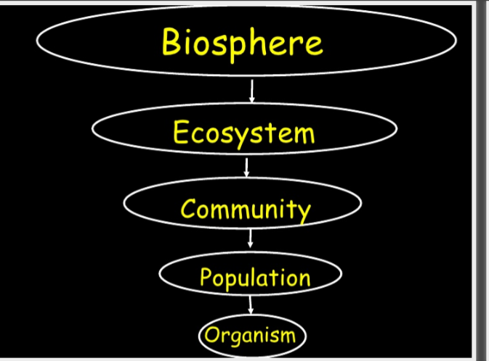

Slide 11
