Slide 1
Skull & Mandible
ANATOMY

Slide 2
The Skull
WHAT IS THE SKULL ?
The Skeleton of the head of a vertebrate forming a bony or Cartilaginous case that encloses and protects the brain and chief sense organs and supports the Jaws.
WHAT IS THE FUNCTION OF SKULL ?
The skull has various functions including protection of brain and special sense organs (Smell, Taste, Slight, Equilibrium, and hearing). It provide opening for the air and food and the jaws including the teeth for the mastication, support of the facial muscles by providing origin and insertion sites,

Slide 3
STRUCTURE
The skull is made of many small and flat bones, Mostly form immoveable joints. Most of which are paired. Cartilage or fibrous tissue separates the bones of the skull in the young animal and once growth has ceased, the sutures begin to ossify.
The Skull is a four sided pyramid having
i) Dorsal (Parietal, frontal, Nasal, and Premaxillary Region)
Ventral (Cranial, Choanal and Palatine Region)
Lateral (Cranial, Orbital , and Preorbital Region)
Caudal (Ocipital Region)

Slide 4
The Bones of the Cranium
Single Bones Occipital, Sphenoid, Ethmoid
Paired Bones Interparietal, Parietal, Frontal, Temporal
The Bones of the Face
Single Bones Vomer, Mandible, Hyoid
Pired Bones Maxilla, Premaxilla, Palatine, Pterygoid, Nasal, Lacrimal, Malar, Turbinates

Slide 5
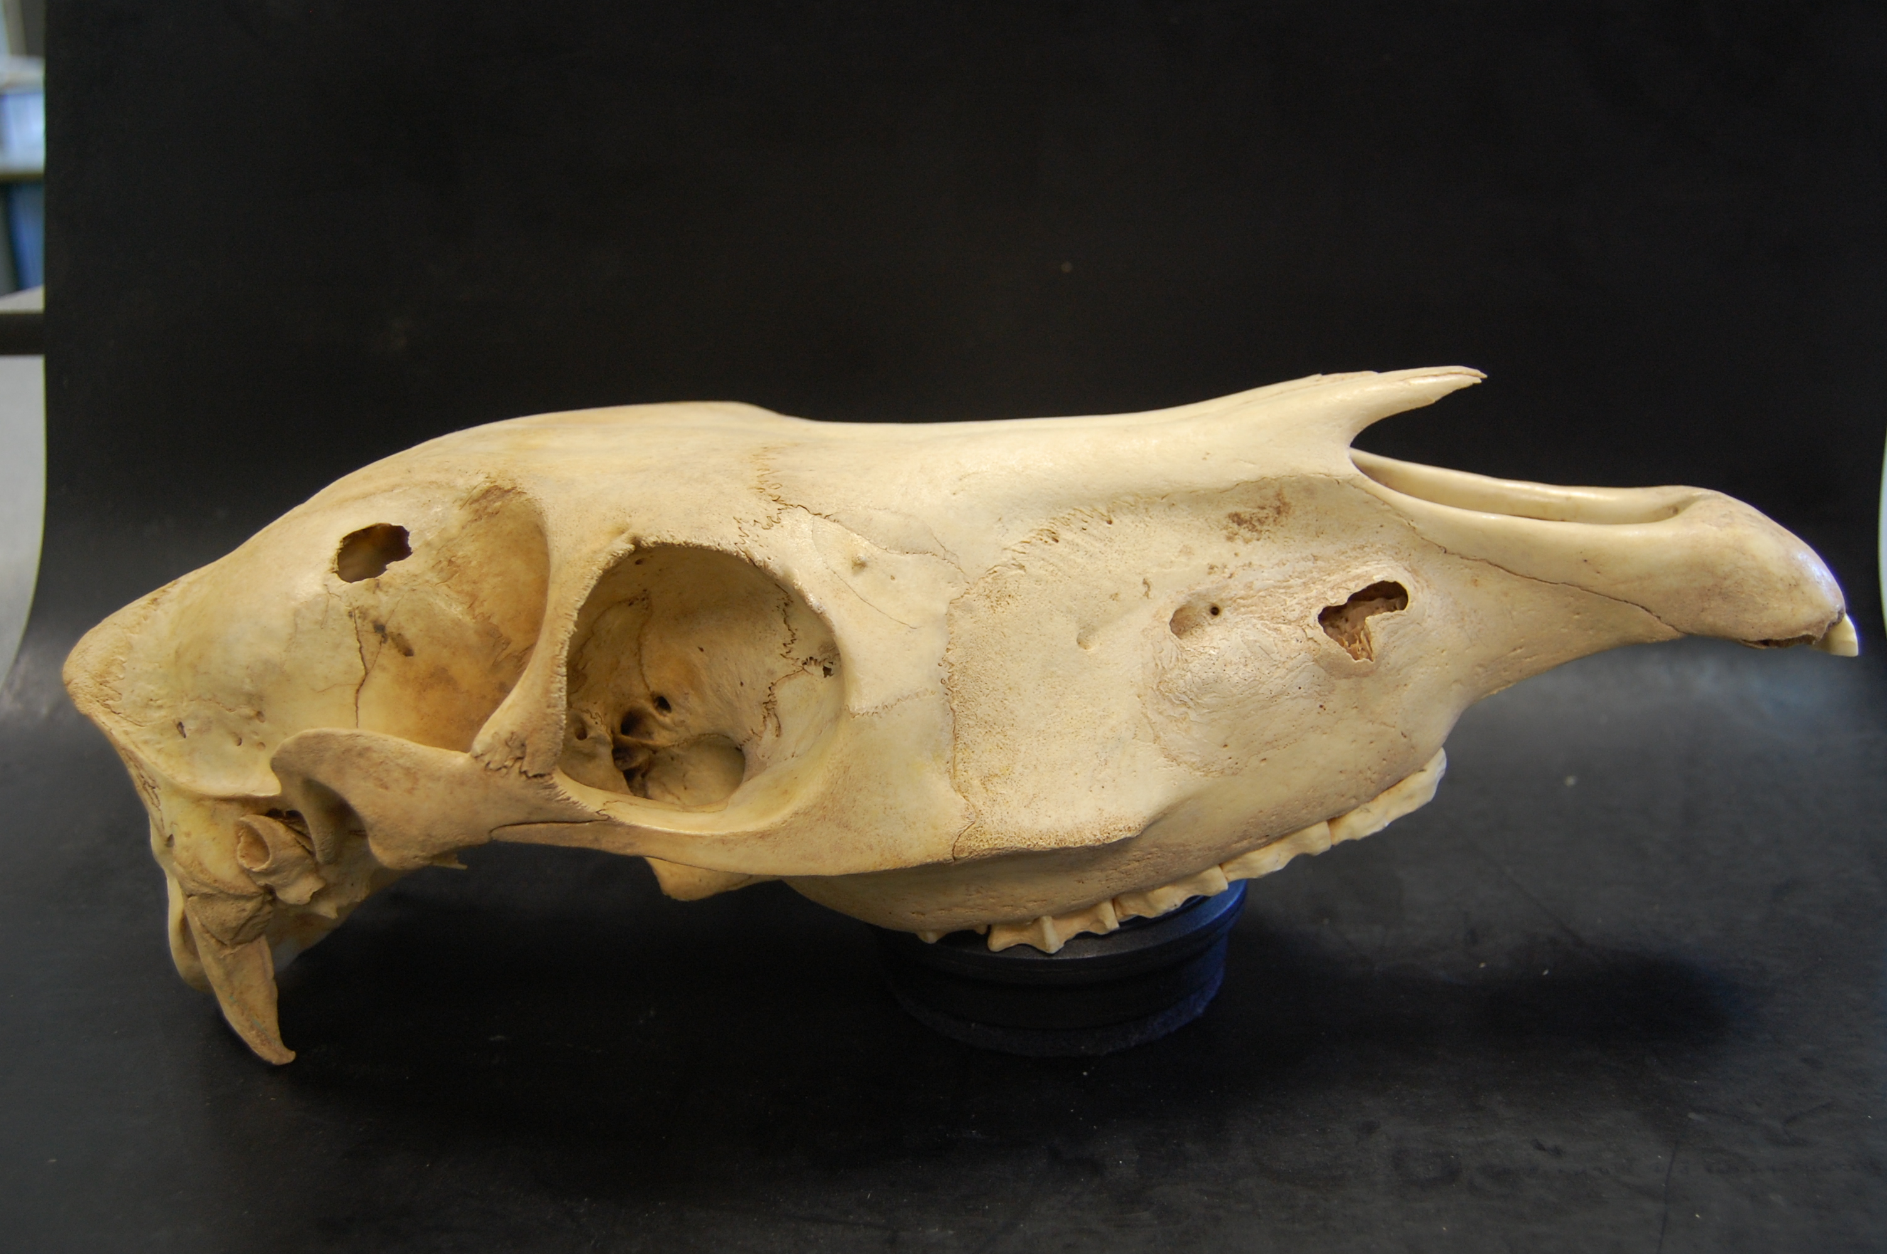
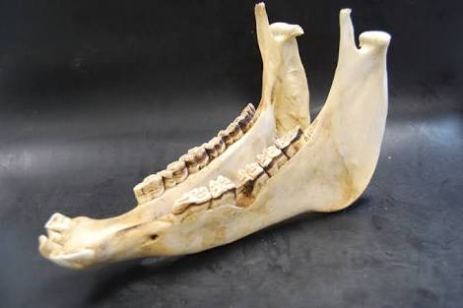
THE SKULL
THE MANDIBLE

Slide 6
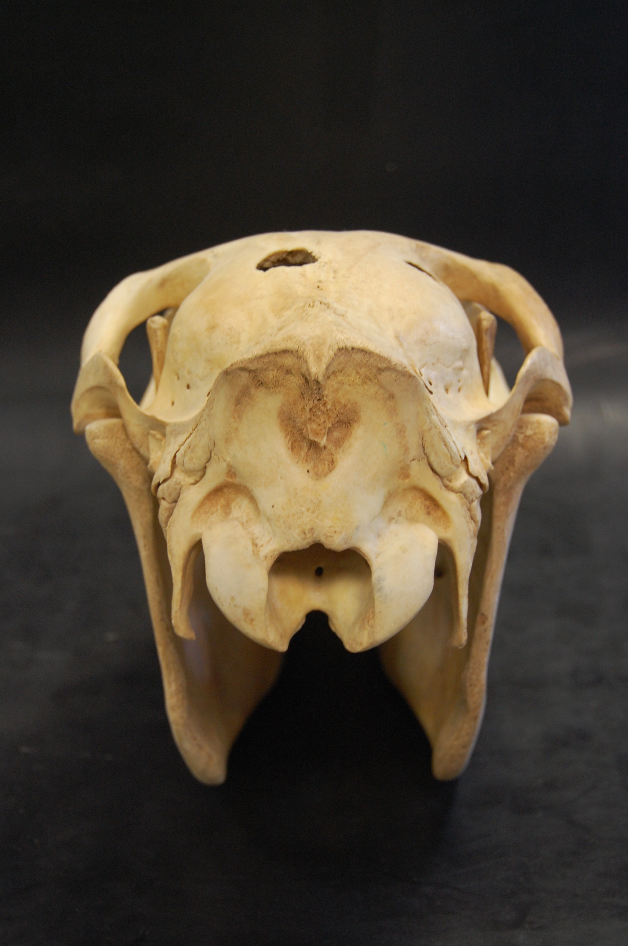
CAUDAL VIEW
DORSAL VIEW

Slide 7
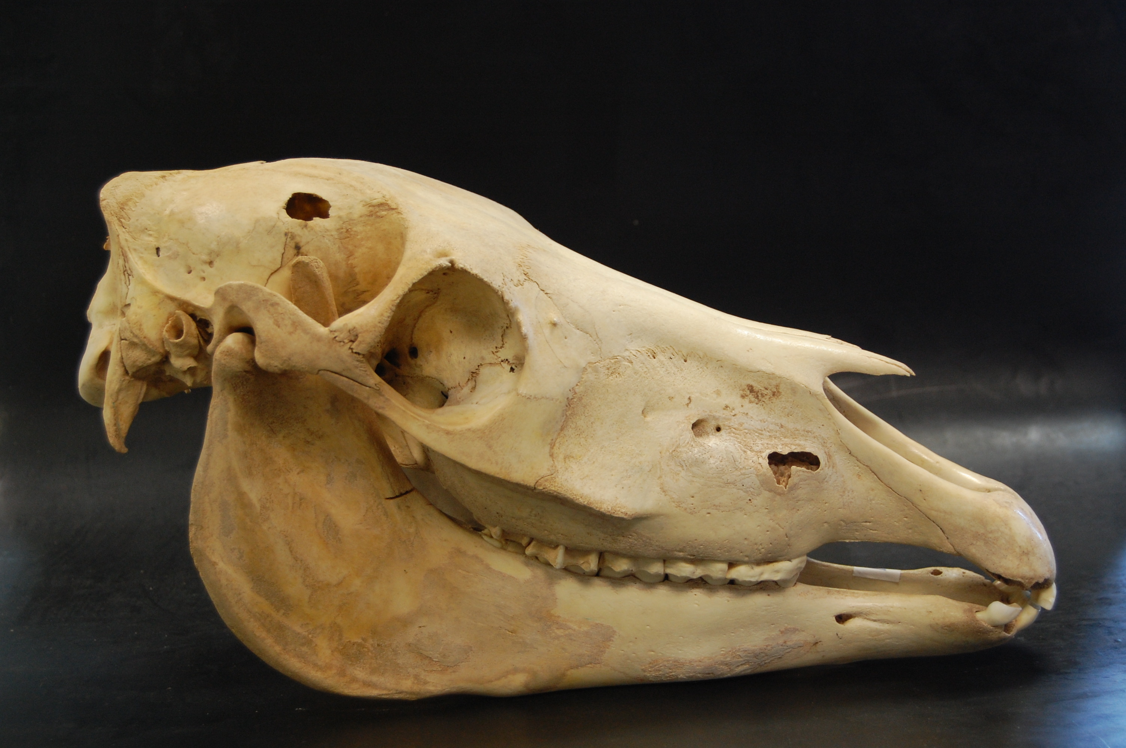
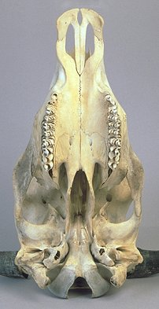
LATERAL VIEW OF SKULL
VENTRAL VIEW

Slide 8
Horse Skull

Slide 9
Bones of Cranium
The bones of the cranium (Ossa cranii) are the occipital, sphenoid, ethmoid, interparietal, parietal, frontal, and temporal. The first three are single, the others paired.
Occipital Bone
The occipital bone (Os occipitale) is situated at the posterior part of the eraoium, of which it forms the posterior wall and part of the ventral wall or base.

Slide 10
Occipital Bone

Slide 11
SPHENOID BONE
The sphenoid bone (Os sphenoidale) is situated in the base of the cranium, its central part lying in front of the basilar part of the occipital. It consists of the body, two pairs of wings, and two pterygoid processes.
The Orbital Wings (Alse orbitales) curve dorso-laterally from the sides of the body of
the presphenoid.
The Temporal Wings (Alse temporales) extend outward and somewhat upward from the body of the postsphenoid; they are smaller than the orbital wings and are irregularly quadrilateral in outline.

Slide 12
The Ethmoid Bone
The ethmoid bone (Os ethmoidale) lies in front of the body and orbital wings of the sphenoid. It projects forward between the orbital parts of the frontal bones and enters into the formation of the cranial, nasal, and paranasal cavities
The Interparietal Bone
This bone (Os interparietale) is centrally placed between the squamous part of the occipital and the parietal bones. It is usually described as a single bone.
The Parietal Bones
The two parietal bones (Ossa parietalia) form the greater part of the roof of the cranium. The external, parietal surface is convex, and is marked by a more or less prominent curved line, the external parietal crest; this is median in its posterior part, and is continuous with the crest of like name on the interparietal and occipital.
The Frontal Bones
The frontal bones (Ossa frontalia) are situated on the limits of the cranium and face, between the parietals behind and the nasal bones in front. Each is irregularly quadrilateral, and consists of naso-frontal, orbital, and temporal parts. The naso-frontal part (Pars naso-frontalis) forms the basis of the forehead.

Slide 13
The Ethmoid Bone Structure

Slide 14
The Interparietal Bone
The Parietal Bones
Right Parietal Bone of New-born Foal, Cerebral Surface.
1, Junction with opposite bone; 2, junction with interparietal; 3, junction with occipital; 4, junction with squamous temporal; 5, junction with frontal; 6, edge which concurs with temporal bone in formation of temporal canal.
Right Parietal Bone of New-born Foal; Dorso-lateral View.
1, Junction with opposite bone; 2, junction with interparietal; 3, junction with occipital; 4, junction with squamoua
temporal; .5, junction with frontal,

Slide 15
The Frontal Bones
.A Cerebral surface; B, B, vorbital part; C, temporal part; D, nasal surface; 1, surface of junction with opposite bone; 2, frontal sinus; 3, ridge to which cribriform plate of ethmoid bone is attached; 5, fissure into which orbital wing of .sphenoid bone fits; 6, sphenoidal notch; 7, supraorbital process; 8, junction with nasal bone; 9, junction with parietal bone; 10, junction with squamous temporal bone.
Left Frontal Bone of New-born Foal; Ventro-medial View.

Slide 16
The Temporal Bones
The temporal bone (Os temporale) forms the greater part of the lateral wall of the cranium. It is situated between the occipital behind, the parietal dorsally, the frontal in front, and the sphenoid ventrally. It consists in the horse of two distinct parts, squamous and petrous.
1. The squamous temporal bone (Squama temporalis) is a shell-like plate which has two surfaces and four borders.
1, Zygomatic process; 2, glenoid cavity; 3, condyle; 4, postglenoid process; 5, notch; 6, posterior process; 7, temporal crest; 8, junction with parietal; 9, junction with frontal; 10, junction with supraorbital process; 11, junction with zygomatic process of malar; 12, junction with sphenoid; 13, junction with petro-mastoid- 14, junction with oc
cipital.
F.C., Cerebral surface; 1, zygomatic process; 2, junction with parietal; 3, junction with temporal wing of sphenoid; 4, posterior process (overlaps petro-mastoid).

Slide 17
2. The petrous temporal bone (Os petrosum) is placed between the occipital behind and the parietal in front, and is largely overlapped by the squamous temporal. It has the form of a four-sided pyramid, the base of which is ventral.
1, External acoustic meatus; 2, mastoid process; 3, hyoid process; 4, muscular process; 5, petrosal crest; 6, groove which concurs in formation of temporal canal;
7, groove for posterior meningeal artery.
1, Mastoid process; 2, notch which concurs with
occipital bone in formation of mastoid foramen; 3, apex;4, opening of aquseductus vestibuli; 5, medial surface; 6, petrosal crest; 7, internal acoustic meatus; 8, muscular process; 9, bullaossea; 10, stylo-mastoid foramen;A.c, opening of aquseductus cochleae.

Slide 18
BONES OF THE FACE
The bones of the face (Ossa faciei) are the maxilla, premaxilla, palatine, pterygoid, nasal, lacrimal, malar, dorsal turbinate, ventral turbinate, vomer, mandible, and hyoid. The last three are single, the others paired.
The Maxillae
The maxillae are the principal bones of the upper jaw and carry the upper cheek teeth. They are situated on the lateral aspect of the face, and articulate Avith almost all of the facial bones and the frontal and temporal also
The Premaxilla
The premaxillae (Ossa incisiva) form the anterior part of the upper jaw and carry the incisor teeth. Each consists of a body, a nasal process, and a palatine
process.
The Palatine Bones
The palatine bones (Ossa palatina) are situated on either side of the choanse or posterior nares, and form the posterior margin of the hard palate.
The Pterygoid Bones
The pterygoid bones (Ossa pterygoidea) are narrow, thin, bent plates, situated on either side of the posterior nares. Each has two surfaces and two extremities. The medial surface is smooth, and forms part of the wall of the posterior nares. The lateral surface articulates with the palatine, vomer, and sphenoid, concurring with the last in the formation of the pterygoid canal
The Nasal Bones
The nasal bones (Ossa nasalia) are situated in front of the frontal bones and form the greater part of the roof of the nasal cavity. They have an elongated triangular outline, wide behind, pointed in front
The Lacrimal Bones
The lacrimal bones (Ossa lacrimalia) are situated at the anterior part of the orbit, and extend forward on the face to the posterior border of the maxilla.

Slide 19
The Malar Bones
The malar or zygomatic bones (Ossa zygomatica) are placed between the lacrimal above and the maxilla below and in front. Each is irregularly triangular in outline and presents three surfaces, three borders, and a process.
The Turbinate Bones
These (Ossa turbinata) are delicate, scroll-like bones, four in number, which are attached to the lateral walls of the nasal cavity.
The dorsal turbinate bone (Os turbinatum dorsale)^ is somewhat cylindrical in form, but is flattened from side to side and tapers at each end.
The ventral turbinate bone (Os turbinatum ventrale)^ is shorter and smaller than the upper one. It is attached to the ventral turbinate crest.
The Vomer
The vomer is a median bone, which assists in forming the ventral part of the septum nasi. It is composed of a thin lamina which is bent (except in its posterior part) so as to form a narrow groove (Sulcus vomeris) , in which the lower part of the perpendicular plate of the ethmoid bone and the septal cartilage are received.
The Mandible
The mandible (Mandibula),^ or lower jaw bone, is the largest bone of the face. The two halves of which it consists at birth unite during the second or third month, and it is usually described as a single bone. It carries the lower teeth, and articulates by its condyles with the squamous temporal on either side. It consists of a body and two rami.

Slide 20
UPPER JAW OF HORSE
1, 1, Choanse or posterior nares; 2, vomer; 3, horizontal part of palatine bone; 4, anterior palatine foramen; 5, palatine groove; 6, transverse palatine suture; 7, median palatine suture;
8, palatine process of maxilla; 9, palatine process of premaxilla; 10, foramen incisivum; 11, malar bone; 12, maxilla; 13, anterior end of facial crest; 14, interalveolar space; /. 1-3, incisor teeth; C, canine tooth; P.l, first premolar or "wolf" tooth. The
opening lateral to 9 is the palatine fissure.

Slide 21
The Hyoid Bone
The hyoid bone (Os hyoideum) is situated chiefly between the vertical parts of the rami of the mandible, but its upper part extends somewhat further back. It is attached to the petrous temporal bones by rods of cartilage, and supports the root of the tongue, the pharynx, and the larynx. It consists of a body, a lingual process, and three pairs of cornua.
a. Body; b, lingual process; c, thyroid cornu; c',
cartilage of c; d, small cornu; e, middle cornu; /.great cornu; /', muscular angle of great cornu; g, cartilage of great cornu.

Slide 22
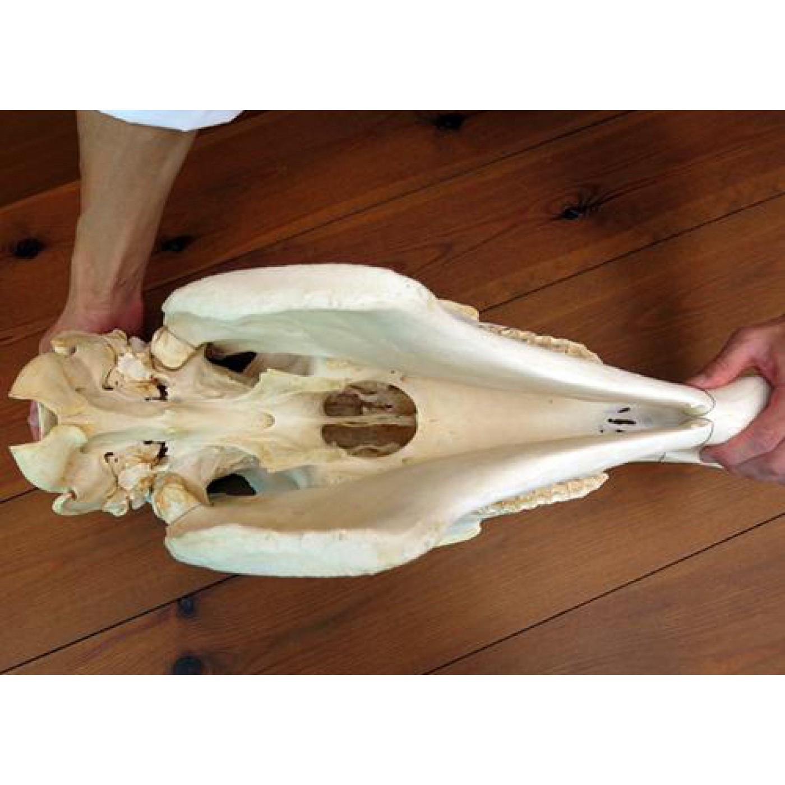
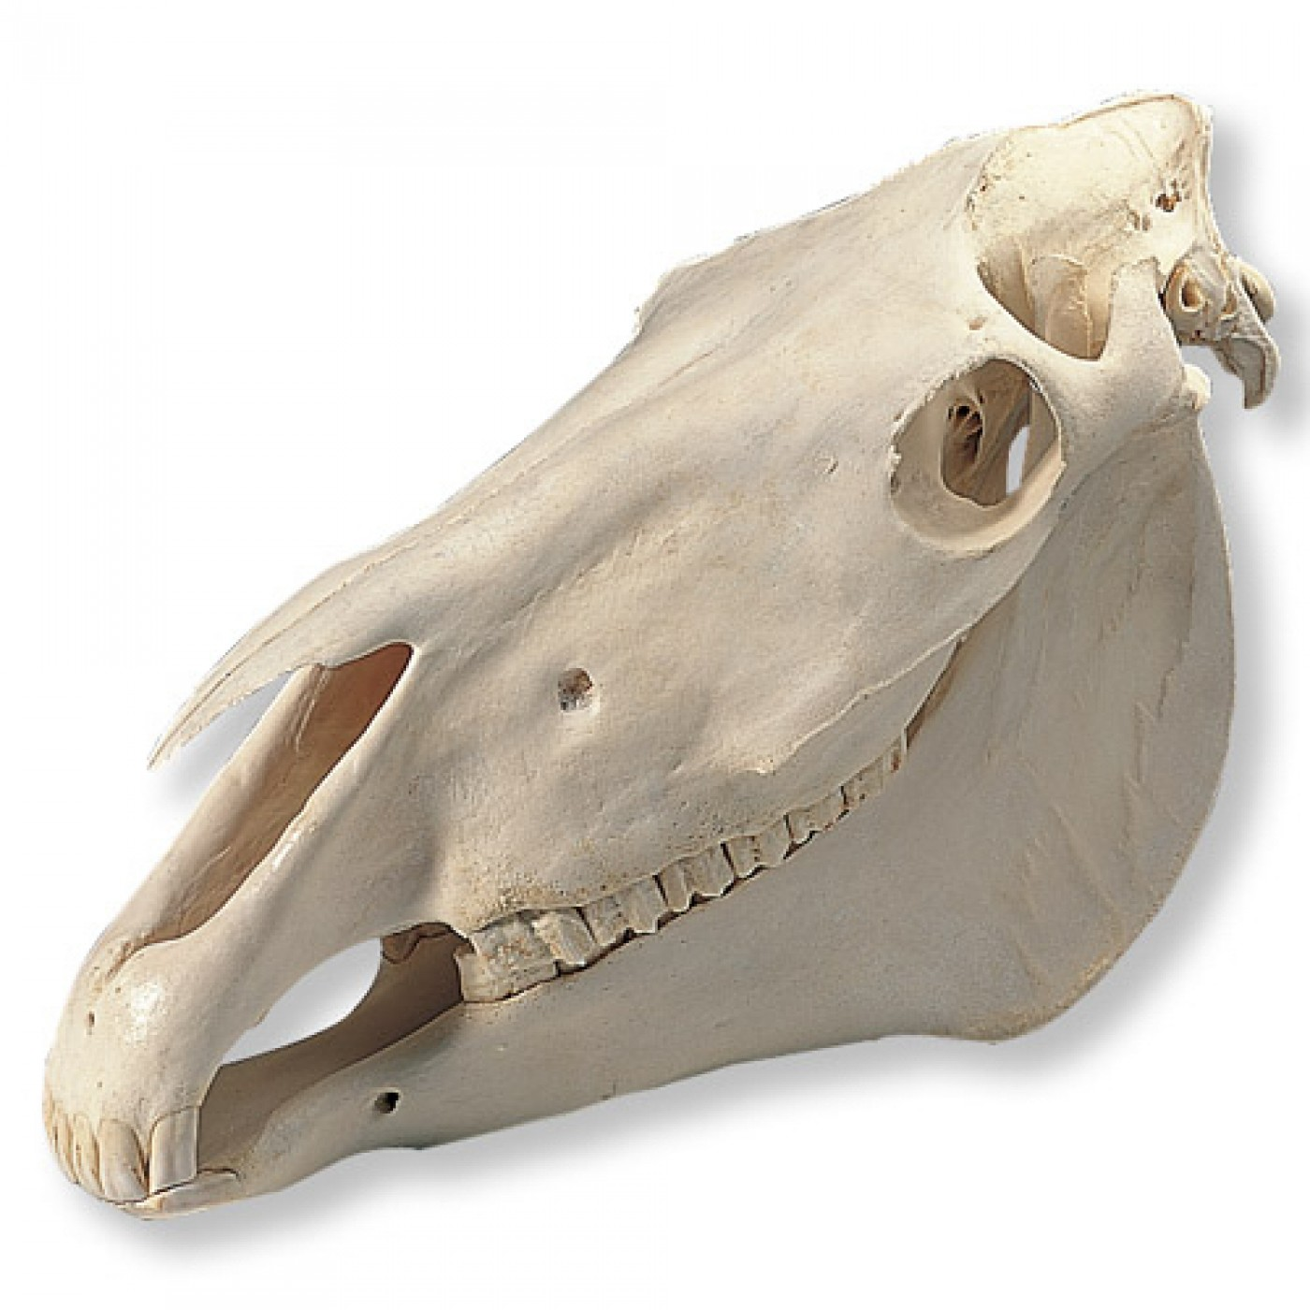
Ventral View
Lateral View

Slide 23
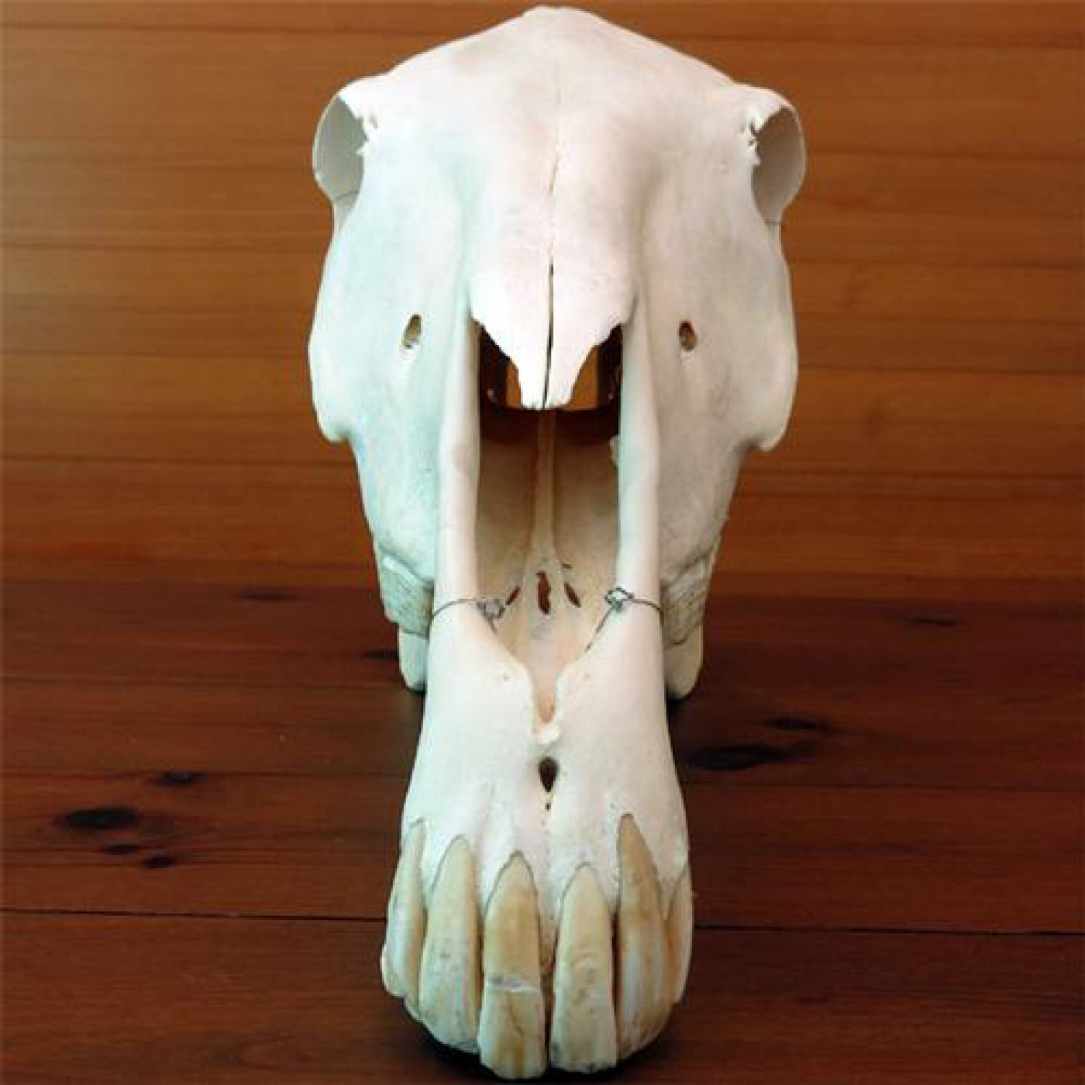
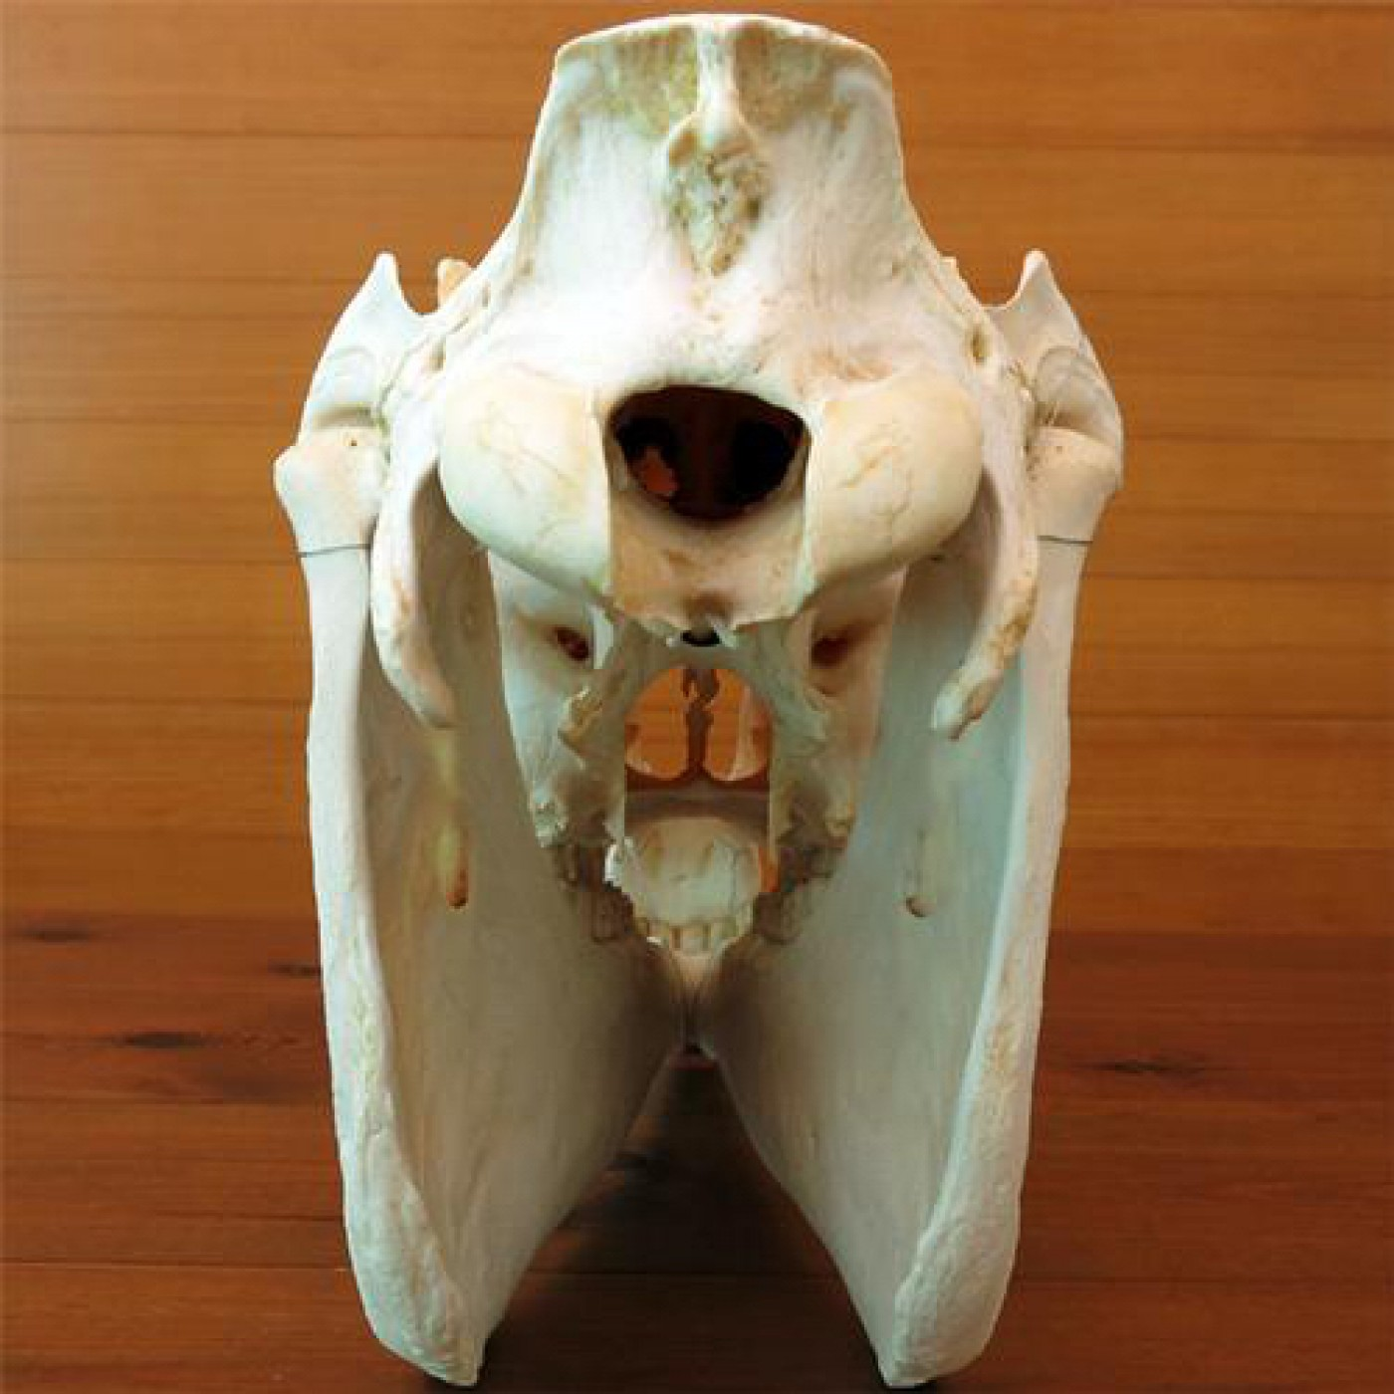
Dorsal View
Caudal View

Slide 24
Ox Skull

Slide 25
OCCIPITAL BONE
The occipital bone forms the lower part only of the posterior surface of the skull, and is separated from the highest part (the frontal eminence) by the parietal and interparietal bones.

Slide 26
Ethmoid Bone
The ethmoid bone has an extensive perpendicular plate.
Interparietals
The interparietals are primitively paired, but unite before birth. As already mentioned, fusion occurs before or shortly after birth with the parietals and supraoccipital. The bone has no intracranial projection.
Parietal Bones
The parietal bones do not enter into the formation of the roof of the cranium. They constitute the upper part of the posterior wall, bend sharply forward along the lateral wall, and enter into the formation of the temporal fossa. They constitute the upper part of the posterior wall, bend sharply forward along the lateral wall, and enter into the formation of the temporal fossa.

Slide 27
The horn core, supraorbital process, and greater part of zygomatic arch have been sawn off: A, Frontal bone; A', A", temporal and orbital parts of same; B, parietal bone; C, squamous temporal bone; D, D', orbital and facial parts of lacrimal bone; E, malar bone; F, maxilla; G, perpendicular part of palatine bone; 1, occipital condyle; 2, paramastoid process; 3, temporal crest; 4, temporal condyle; 5, postglenoid process; 6, external opening of temporal canal; 7, meatus acusticus externus; S, bulla ossea; 9, stylo-mastoid foramen; 10, muscular process of temporal bone; 11, tip of basilar tubercle; 12, foramen ovale; 13, foramen orbito-rotundum; 14, optic foramen; lo, ethmoidal foramen; 16, orbital opening of supraorbital canal; 17, pterygoid crest; 18, ridge of orbital wing of sphenoid; 19, pterygoid process of sphenoid; 20, hamulus of pterygoid bone; 21, lacrimal bulla; 22, fossa sacci lacrimalis; 23, root of supraorbital
process; 24, processus cornus (section) ; 25, frontal eminence.

Slide 28
Ventral &
Dorsal View
1, Foramen magnum; 2, occipital condyle; 3, paramastoid process; 4, condyloid foramen; 5, foramen lacerum; 6, basilar part of occipital bone; 7, 7', basilar tubercles; 8, bulla ossea; 9, foramen ovale (concealed by muscular process) ; 10, meatus acusticus externus; 11, zygomatic process of temporal bone, 12, condyle of same; 13, external opening of temporal canal ; 14, processus cornus; 15, muscular process of temporal bone; 16, pterygoid crest; 17, orbital opening of supraorbital canal; 18, choanae or posterior nares; 19, hamulus of pterj'goid bone; 20, crest formed by pterygoid processes of sphenoid and palatine bones; 21, horizontal part of palatine bone; 22, anterior palatine foramen; 23, lacrimal bulla; 24, maxillary tuberosity; 25, palatine process of maxilla; 26, zygomatic process of malar bone; 27. facial tuberosity: 28, body of premaxilla; 29, palatine process of same; 30, palatine fissure; 31, incisive fissure; 32, premolars; 33, molars.

Slide 29
Bones of Face
The bones of the face (Ossa faciei) are the maxilla, premaxilla, palatine, pterygoid, nasal, lacrimal, malar, dorsal turbinate, ventral turbinate, vomer, mandible, and hyoid. The last three are single, the others paired.
Maxilla
The maxilla is shorter but broader and relatively higher than in the horse.
Premaxilla
The body of the premaxilla is thin and flattened, and has no alveoli, since the canine and upper incisor teeth are absent
Pterygoid bone
The pterygoid bone is wider than in the horse, and forms the greater part of the lateral boundary of the posterior nares.
Nasal bone
The nasal bone is little more than half the length of that of the horse. It is straight in its length, but strongly curved from side to side.
Lacrimal bone
The lacrimal bone is very large. The extensive facial part is concave in its length, and bears no lacrimal tubercle.
Malar bone
The malar bone is relatively long. The facial surface is extensive; it bears a curved crest (Crista facialis) just below the orbital margin which is continued on the maxilla

Slide 30
Dorsal Turbinate Bone
The dorsal turbinate bone is less cribriform and fragile than in the horse, and is widest in its middle, small at either end. It is attached to the turbinate crest of the nasal bone, and curves downward, outward, and then upward to be applied outwardly to the frontal and lacrimal bones.
Ventral Turbinate Bone
The ventral turbinate bone is shorter but much broader than in the horse. It is attached to the maxilla by a basal lamella about an inch (ca. 2 to 3 cm.) wide, which slopes ventro-medially.
Vomer
The vomer forms a wider and deeper groove than in the horse. Its anterior end rests in a groove formed by the ends of the palatine processes of the premaxillae.
Hyoid Bone
The hyoid bone has a short tuberous lingual process. The middle cornua are almost as large as the small cornua. The great cornua are narrow, except at the ends. The upper end divides into two branches, which correspond to the two angles of that of the horse. The thyroid cornua do not fuse with the body except in old age.

Slide 32
Hyoid Bone
a, Body; b, lingual process; c, thyroid cornu and cartil age, c'; d, small cornu; e, middle cornu; f, great cornu; g muscular angle.

Slide 33
MANDIBLE
Lower Jaw Bone, Moveable, Largest flat bone of the face.
Coronoid process, Condyle Process and mandibular Notch and mental foramen on Lateral Surface
Pterygoid fossa, Mandibular foramen on medial surface
Alveolar border and alveoli for Teeth

Slide 34
MANDIBLE OF OX
32 Teeth in the Ox
3/3 Pre-molars Teeth
3/3 Molars Teeth
8 Incisors Teeth
And Incisors teeth are absent in upper Jaw
Canines are absent
Symphysis mandibulae is present
Ventral border is convex
Coronoid process is turned upward

Slide 36
MANDIBLE OF HORSE
No symphysis mandibulae
Ventral border is straight
Coronoid process is turned Caudally
40-42 Teeth in the Horse(Male)
36-40 Teeth in the Horse(Female)
6-7 Pre-Molars
3-4 in upper Jaw
3 in Lower Jaw
6 Molars
3 in Upper Jaw
3 in Lower Jaw
12 Incisors Teeth
6 In Lower Jaw
6 In Upper Jaw
4 Canines are Present in Males
And Canines are absent in Females

Slide 37
1, Body of mandible (median section); 2, 2', horizontal and vertical parts of ramus; 3, interalveolar border; 4, depression for attachment of genio-hyoideus muscle; o, mandibular foramen; 6, vascular impression; 7, angle; 8, condyle; 9, coronoid process; 10, mandibular notch; 11, incisor teeth; 12, canine tooth; 13, cheek teeth.

