Slide 2
PP 407 Seed and Postharvest Pathology
Objective
To study seed borne and postharvest diseases and their management

Slide 3
Postharvest Diseases of Vegetables

Slide 4
Postharvest Diseases of Tomatoes
Disease Causal organism
Rhizopus rot Rhizopus stolonifer
Gray mould Botrytis cinerea
Late blight Phytophthora infestans
Southern blight Sclerotium rolfsii

Slide 5
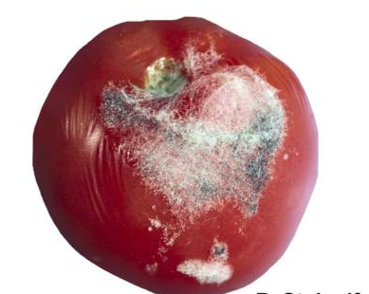
Symptoms of Rhizopus rot
Water soaked lesions.
Lesions surface covered with white cotton like fungal structures.
Dark sporulation is also evident.
Courtesy: Google Images

Slide 6
Symptoms of Gray mould
Watery lesion area
Grayish mycelium and spore clusters develop
Courtesy: Google Images

Slide 7
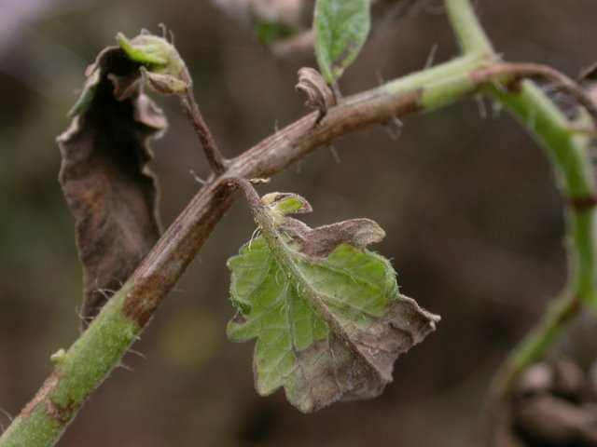
Symptoms of Late blight
Leaves, stem and fruit are affected.
Brown to purple black lesions develop.
Courtesy: Google Images

Slide 8
Symptoms of Southern blight
Plants are attacked below the soil surface.
The root system is destroyed.
Courtesy: Google Images

Slide 9
Postharvest Diseases of Brinjal
Disease Causal organism
Fruit rot Phomopsis vexans
Anthracnose Colletotrichum melongenae

Slide 10
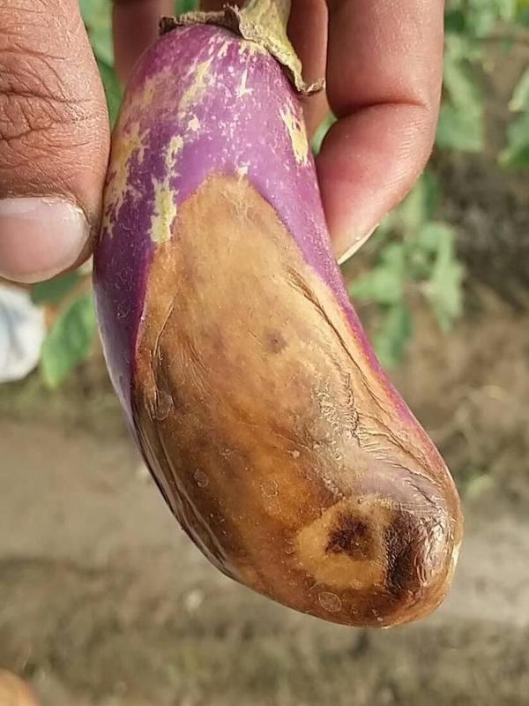
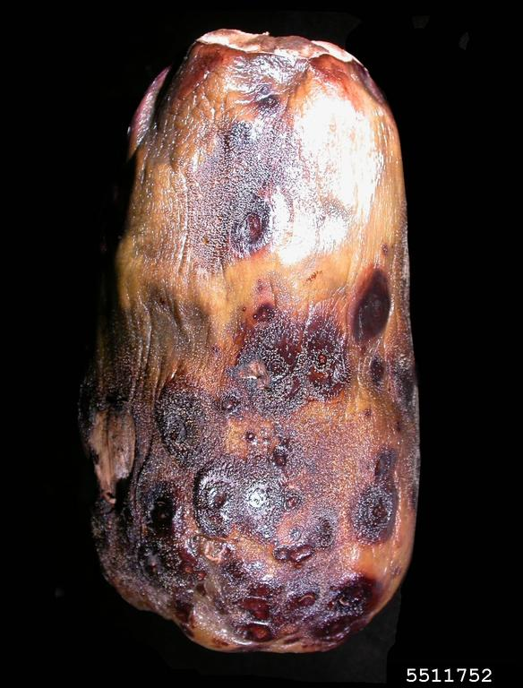
Symptoms of Fruit rot (Phomopsis vexans)
Symptoms of blight appear on young seedlings.
Fruit becomes gray and watery and show decay symptoms.
Courtesy: Google Images

Slide 11
Symptoms of Anthracnose
Sunken lesions develop on fruit.
Fruit dries, become black and drop.
Courtesy: Google Images

Slide 12
Postharvest Diseases of Okra
Disease Causal organism
Rhizoctonia rot Rhizoctonia solani

Slide 13
Symptoms of Rhizoctonia rot
Infected tissue become brown to black.
Mycelia are fluffy and form dark sclerotia.
Courtesy: Google Images

Slide 14
Postharvest Diseases of Chillies
Disease Causal organism
Bacterial soft rot Erwinia carotovora
Anthracnose Colletotrichum capsici

Slide 15
Symptoms of Bacterial Soft Rot
Lesions on fruit are light to dark colored.
Bacterial ooze develop in affected areas.
Courtesy: Google Images

Slide 16
Symptoms of Anthracnose
Small black, circular spots appear on fruit.
Courtesy: Google Images

Slide 17
Postharvest Diseases of Potato
Disease Causal organism
Dry rot Fusarium solani var. coeruleum
Scab Streptomyces scabies

Slide 18
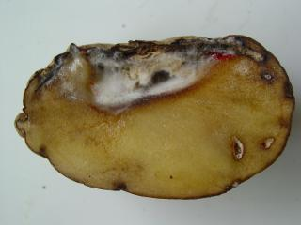
Symptoms of Dry rot
Dry dark areas are manifested on the peel.
Internal tissue become brown and sunken.
Courtesy: Google Images

Slide 19
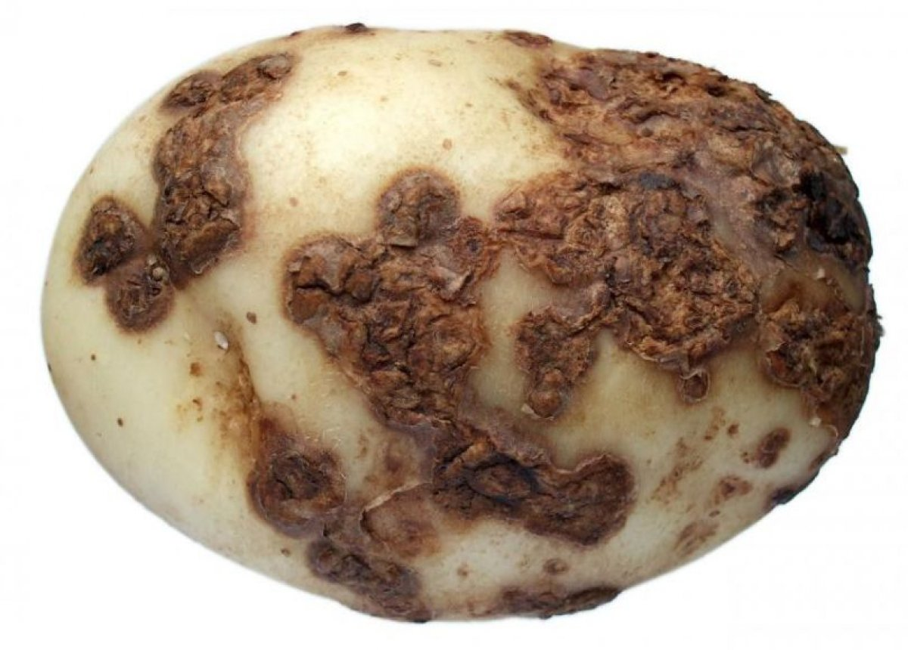
Symptoms of Scab
Corky lesions 1 to 3 mm deep develop which are darker that shallow lesions.
Courtesy: Google Images

Slide 20
Postharvest Diseases of Carrot
Disease Causal organism
Crown rot Rhizoctonia solani
Black rot Alternaria radicina

Slide 21
Symptoms of Crown rot
Damping off of carrot seedlings develop.
Dark brown sunken lesions or cankers develop on carrots.
Courtesy: Google Images

Slide 22
Symptoms of Black rot
Pre-emergence and post emergence damping off.
Dry black sunken lesions which cause decay of entire root.
Courtesy: Google Images

Slide 23
Postharvest Diseases of Cucurbits
Disease Causal organism
Fruit rot Pythium aphanidermatum
Belly rot Rhizoctonai solani

Slide 24
Symptoms of Fruit rot
Dark green water soaked lesions are formed on fruit.
Wooly mycelial mat develop on affected fruit.
Internal tissue become soft and watery.
Courtesy: Google Images

Slide 25
Symptoms of Belly rot
Fruit touching soil develop dark brown water soaked decay.
Yellowish brown discoloration of fruit surface.
Courtesy: Google Images

Slide 26
Postharvest Diseases of Onion
Disease Causal organism
Neck rot Botrytis allii
Blue mould rot Penicillium spp.
Black mould Aspergillus niger

Slide 27
Symptoms of Neck rot
Softening of scales occurs.
Grayish sporulating mycelial mat develop on scales’ surface.
Courtesy: Google Images

Slide 28
Symptoms of Blue mould rot
Blue green mould develops on bulbs.
Bulbs show symptoms of watery rot.
Courtesy: Google Images

Slide 29
Symptoms of Black mould
Masses of black spores develop on exterior and between scales of bulbs.
Courtesy: Google Images

Slide 30
Postharvest Diseases of Garlic
Disease Causal organism
Basal rot Fusarium oxysporum
Neck rot Botrytis allii

Slide 31
Symptoms of Basal rot
Bulb size is reduced.
Bulb decay occurs.
Courtesy: Google Images

Slide 32
Symptoms of Neck rot
Affected scale tissue become soft.
Dense layer of gray mould becomes visible on the neck.
Courtesy: Google Images

Slide 33
*Sources
1. Recommended books.
2. Latest research articles downloaded from
Google.
3. Google images.
*Solely for academic purpose and guidance of students.

