Slide 1
WATER, pH AND BUFFERS
Dr. SIDRA TUL MUNTAHA

Slide 4
It possesses a regular crystalline structure based on the molecular structure of water, which consists of a single oxygen atom covalently bonded to two hydrogen atoms: H-O-H.

Slide 10
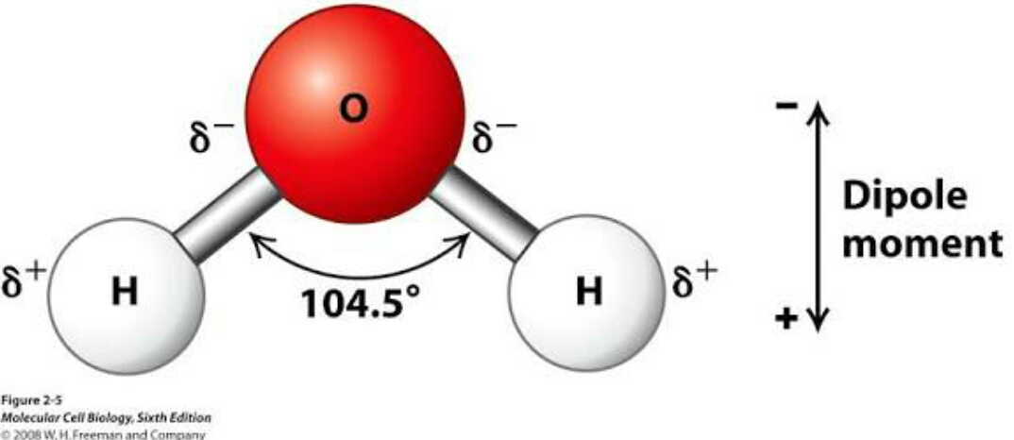
Ionization of water

Slide 11
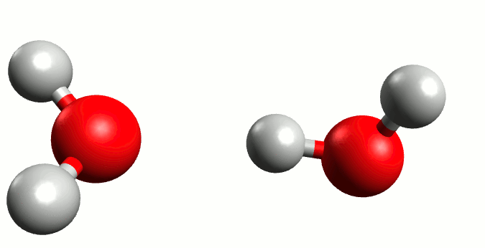

Slide 14
The self-ionization of water (also autoionization of water, and autodissociation of water) is an ionization reaction in pure water or an aqueous solution, in which a water molecule, H2O, deprotonates (loses the nucleus of one of its hydrogen atoms) to become a hydroxide ion, OH−.
The hydrogen nucleus, H+, immediately protonates another water molecule to form hydronium, H3O+.

Slide 15
It is an example of autoprotolysis, and exemplifies the amphoteric nature of water.

Slide 17
Although neutral water has a tendency to ionize
H2O <-> H+ + OH-
The free proton is associated with a water molecule to form the hydronium ion H3O+
High ionic mobility due to proton jumping

Slide 18
Equilibrium expression
Described by:
K = [H+][OH-]
[H2O]
Where K is the dissociation constant
Considering [H2O] constant yields
Kw = [H+][OH-]

Slide 19
Kw = [H+][OH-]
Where Kw is the ionization constant of water
For pure water ionization constant is
${10}^{−14}$ M at 25ºC
For pure water
[H+] = [OH-] = (Kw)1/2 = ${10}^{−7}$ M

Slide 22
For pure water (neutral)
[H+] = [OH-] = (Kw)1/2 =10ˉ⁷M
Acidic if [H+] > 10ˉ⁷ M
Basic if [H+] < 10ˉ⁷ M

Slide 36
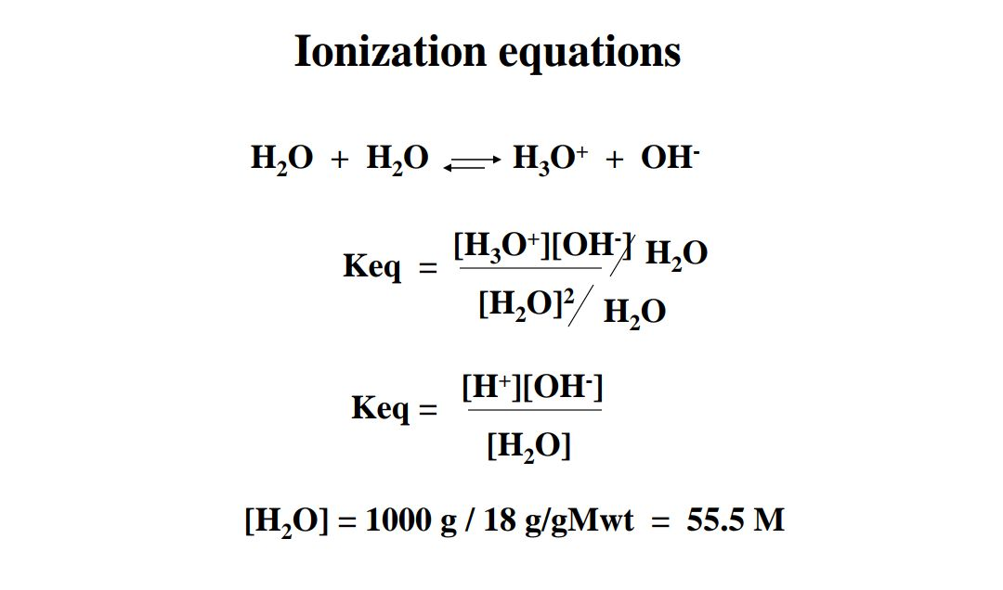

Slide 40
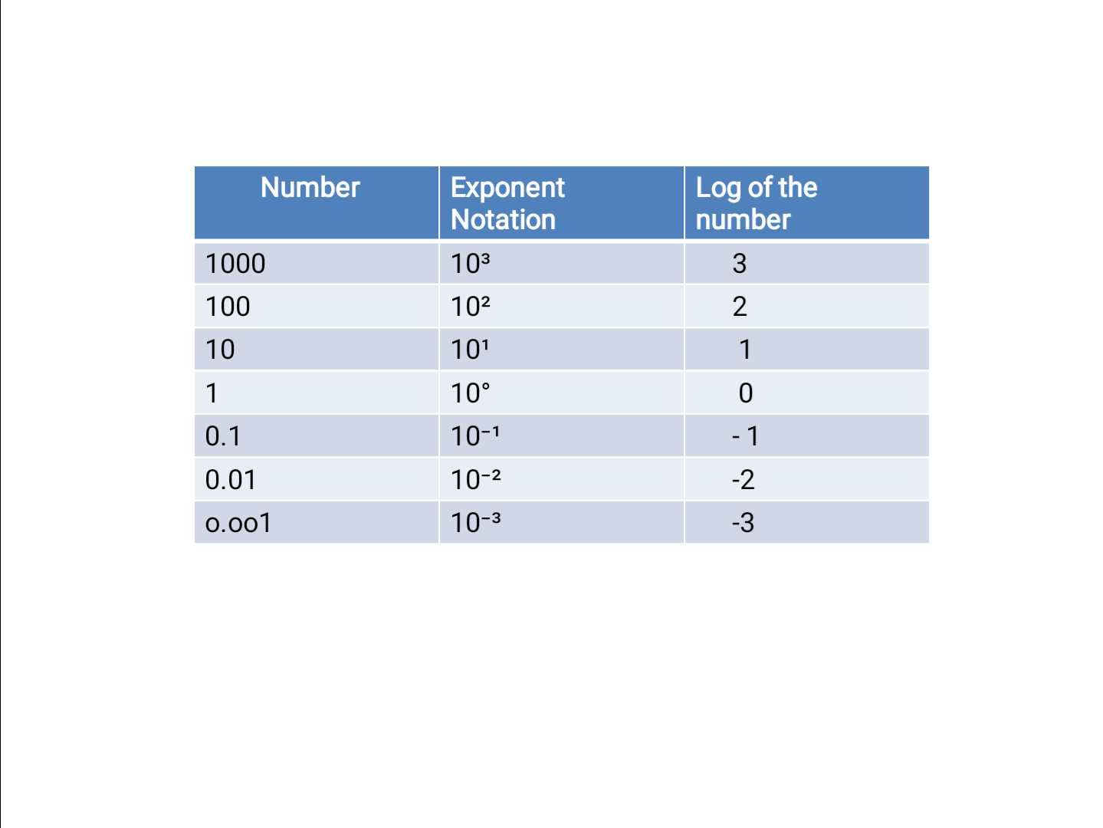

Slide 49
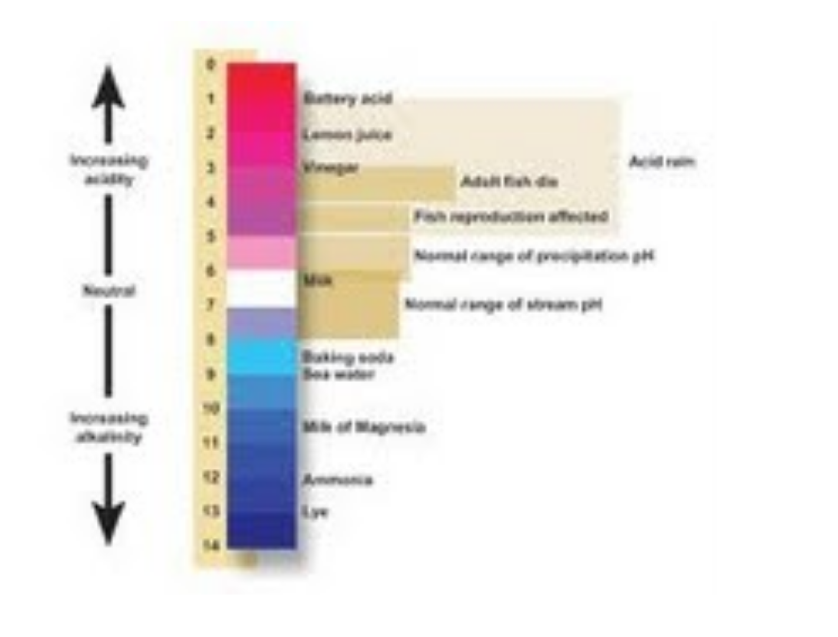

Slide 52
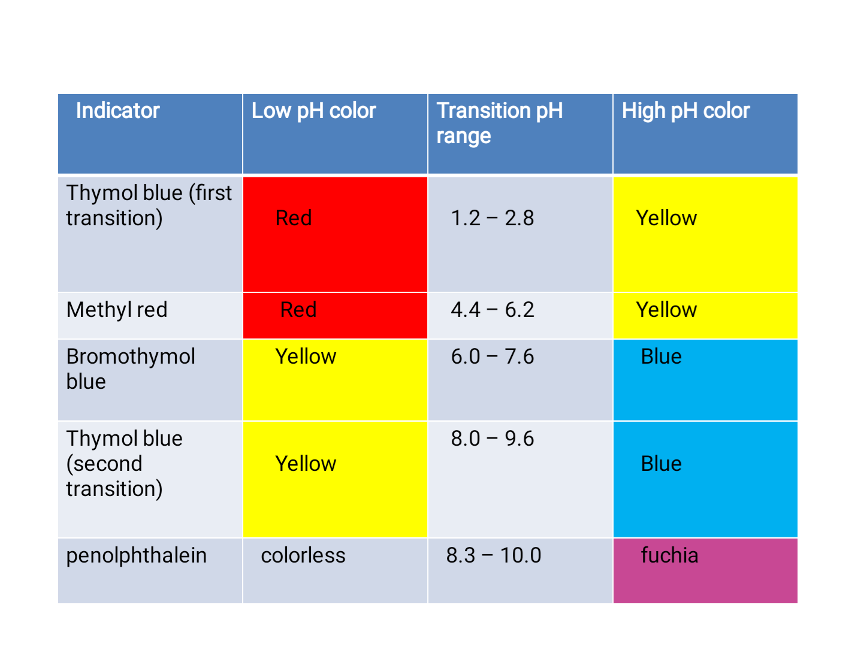

Slide 57
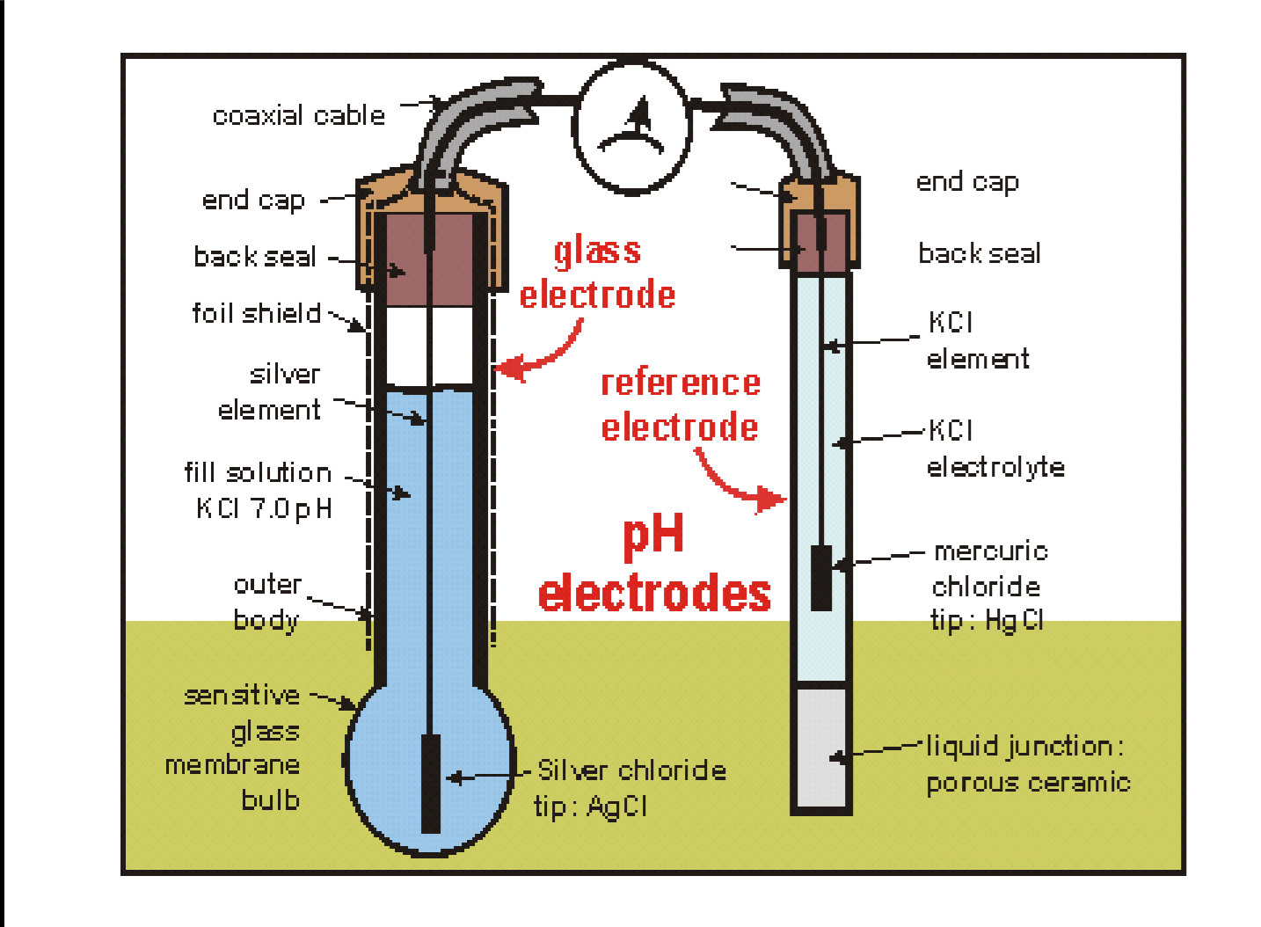

Slide 66
The isoelectric pH
The isoelectric point (pI, pH(I), IEP):
is the pH at which a particular molecule carries no net electrical charge
The standard nomenclature to represent the isoelectric point is pH(I)

Slide 67
The net charge on the molecule is affected by pH of its surrounding environment and can become more positively or negatively charged due to the gain or loss, respectively, of protons (H+).

Slide 68
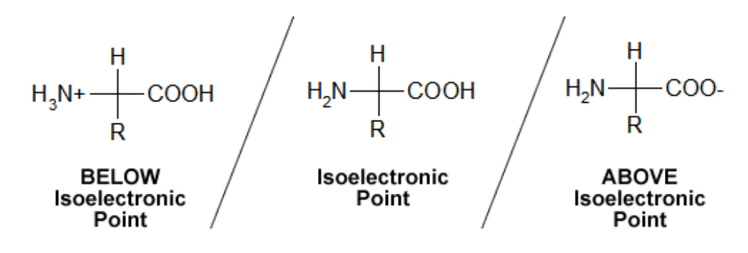

Slide 69
The pI value can affect the solubility of a molecule at a given pH. Such molecules have minimum solubility in water or salt solutions at the pH that corresponds to their pI and often precipitate out of solution

Slide 70
. Biological amphoteric molecules such as proteins contain both acidic and basic functional groups. Amino acids that make up proteins may be positive, negative, neutral, or polar in nature, and together give a protein its overall charge.

Slide 71
At a pH below their pI, proteins carry a net positive charge; above their pI they carry a net negative charge. Proteins can, thus, be separated by net charge in a polyacrylamide gel using either preparative gel electrophoresis, which uses a constant pH to separate proteins or isoelectric focusing, which uses a pH gradient to separate proteins

Slide 73
For an amino acid with only one amine and one carboxyl group, the pI can be calculated from the mean of the pKas of this molecule

