Slide 1
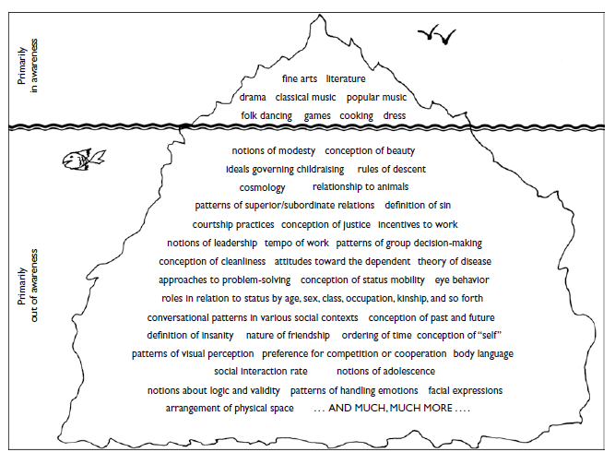
Cultural Communication Basics

Slide 2
“We all are the same: We are all different.” Similarity Within Dissimilarity & Vice Versa Cultural Paradox
Universal Culture ( safety, security, respect, well-being and creativity etc.)
vs
Communal Culture ( A patterned way of living by a group of interacting individuals who share similar sets of traditions, beliefs, values and norms.
Normative Culture (Collective view to the existing set of norms)
vs
Subjective Culture (The degree of importance attached by the individuals to cultural values, traditions and beliefs)

Slide 3
Cultural Components
Beliefs (Refer to the concepts that answer to questions of origin of life, death, life hereafter, time, space etc. Deep-seated)
Values (Refer to the Set of priorities that guide good and bad behaviours, fair and unfair actions. Explanatory logic for behaviour. Deep-seated)
Traditions( Refer to myths, legends, ceremonies and rituals.)
Norms (Collective expectations for appropriateness, inferable and observable)
Symbols (Verbal/non-verbal Sign that has Subjective and objective meaning)
Rules (Prescriptions for behaviour in a culture)
Taboos (Something in culture people do not normally even mention.

Slide 4
Formative Features
Enculturation: Culture is learned both consciously and unconsciously through communication.
Transferability: Culture is transmitted from generation to generation via communication.
Symbolic portability: Culture is stored through communicative symbols.
Dynamic Nature: Culture is always open to change.
Ethnocentrism: Culture pampers its followers with a sense of superiority.

Slide 5
Cultural Issue
Similar Others
vs
Dissimilar Others

Slide 6
Functions of Culture
Identity Meaning: Who we are?
Group Inclusion: Comfort zone of affiliation.
Inter-group boundary regulations: Formation of evaluative attitudes.
Ecological Adaptation: Compatibility between the self, community and environment.
Cultural Communication: Culture is communication, communication is Culture.

Slide 7
Frameworks for understanding Culture
Universal Values:
1.self-direction (independent thought and action); 2.stimulation (activity, variety); 3.hedonism (pleasure); 4.achievement (success, prestige); 5.power (social status); 6.security (safety, stability); 7.conformity (restraint of action); 8.tradition (passed-on behaviors); 9.spirituality(personal meaning in life); 10.benevolence (positive interaction with and influence on others);and 11.universalism (understanding and appreciating all people).
Intercultural Comm. Lary A. Samovar P: 75

Slide 8
Frameworks for understanding Culture
Terminal Values:
Desired outcomes of action for individuals. These include things such as a comfortable life, salvation, true friendship, freedom, pleasure, mature love, and self-respect.
Instrumental Values:
“modes of conduct” that people in a culture hold to be important for reaching societal goals—the “means” to the end. They include things such as being polite, cheerful, honest, or courageous.
Values do not operate in isolation, but work together with other values in “value systems.”
Intercultural Comm. Lary A. Samovar P: 76

Slide 9
“Where does meaning lie?” in a Culture
High- and low-context cultures
High context cultures:
Meaning tends to be implicit, inside the communicators, is in the situation and the background, roles, and status relationships of the speakers. Meaning will be hidden in nuances of word meaning and nonverbal behavior as well.
Low context cultures:
Meaning embedded in actual words, communication is based upon “explicit code,”. People tend to seek more information from the speaker himself.

Slide 10
Understanding Cultures
“etic” vs “emic” Approach
etic Approach: (Scientific)
A set of terms or a theory that researchers develop from outside of any one cultural system in order to compare different cultures
emic Approach: (Humanistic)
Opposed to the idea of cultural dimensions it favors understanding each culture
in its own terms (Gudykunst & Nishida, 1989).

Slide 11
Communication ?
‘communication’ as a system of signs and practices of a group or community of people to share ideas, feelings and thoughts.
‘communication’ is process of management of messages with a view to attain maximum understandability.

Slide 12
Inter-cultural Approach
Intercultural research involves examining behaviour when members of two or more cultures interact (e.g. examining self-disclosure when Japanese and Iranians communicate with each/one another).
Japanee & Iranians & Pakistani

Slide 13
Cross-culture Approach
Cross-cultural research involves comparing behaviour in two or more cultures (e.g. comparing self-disclosure in Japan, the USA and Iran when individuals interact with members of their own culture)…
Pakistani & Pakistani & Pakistani VS Japanee & Japanee & Japanee
Understanding cross-cultural differences in behaviour is a prerequisite for understanding intercultural behaviour.

Slide 14
Language and Culture
language was the soul of a nation and that we could discover national characteristics by means of language analysis (von Humboldt 1997).
A language is like a window to the world of another culture (Saint-Jacques, 2006).

Slide 15
Language and CCC
Assumptions:
1. linguistic and communicative competence in individuals, like other forms of human knowledge, is fragmentary and defective – if it exists at all.
2. The imperfection of linguistic and communicative behaviour and language based relations between groups and societies can be clarified and bettered and resolved by intervention.

Slide 16
Language and CCC Cont……
Assumptions:
applied linguists are in a better position to mediate and demonstrate their findings for solutions.
4. Being socially accountable an A. linguist has to be critical and reflexive in his suggestions and recommendations.

Slide 17
Issues in Cross-Cultural Context
Misunderstandings and the impact of cultural factors on the making of meaning.
Conflict and the impact of cultural factors on relationship management and development.
Gatekeeping and discrimination.
The impact of unequal power relations on communication.

Slide 18
Issues in Cross-Cultural Context Cont……..
Business and management success In intercultural contexts.
Media impact in a globalized world.
Identity perception and communication.
Intercultural competence and assessment.
Intercultural adjustment and training.

Slide 19
Significance of Learning CCC
Intercultural communication provides remediation of the cultural filter that information processors impose on the content.
Cultural understanding avoids the pitfalls of early development communication research.
The study of culture helps us understand ourselves.
Intercultural Comm. Lary A. Samovar P: 42-46

Slide 20
Significance of Learning CCC Cont…….
Assessing and developing intercultural competence
Prejudice in the media is a manifestation of the beliefs of those who are in charge.
Communication rules are seldom explicit; they must be uncovered.
Establishing an intercultural relationship requires attention to the subtle aspects of culture.

Slide 21
Significance of Learning CCC Cont….
Although knowledge of a culture provides the cognitive tools for understanding, only acting in a culture can provide the tools for appropriate emotional and motor responses.
The study of communication and culture can prevent war.

