Slide 1
Implementing the Project Plan
By: Saba Ashraf
Noon Business School, University of Sargodha

Slide 2
A Quick Walk-Through
Once you have successfully passed the Planning Phase it is time for real action – Execution!
The Project Execution Phase of the project management lifecycle is all about deliverables & outputs.
The Project Management Body of Knowledge (PMBOK) states –
"The Executing Process Group consists of those processes performed to complete the work defined in the project management plan to satisfy the project specifications.“
The Execution and Control phase is where the project team build and produce the deliverables required. It begins after the approval of project plans and the allocation of the resources necessary for executing the tasks. During this phase, the project team build the physical project deliverables.

Slide 3
Major Activities of Execution Phase
Activity | Description | Deliverables
Conduct Execution Kick-off Meeting | Conduct a kick-off meeting with all the participants of this phase, to inform the team of the scope and expectation of this phase.
Perform Project Communications Management | Communicate project status to stakeholders. | Status Report, Meeting Agenda, Meeting Minutes
Manage Project Procurement | Document the items procured and keep records for any procurement documents. | Procurement Log
Track and Manage Project Risks and Issues | Track and manage the project issues and risks identified | Risk Register (Updated), Issues Log

Slide 4
Major Activities of Execution Phase
Activity | Description | Deliverables
Quality Assurance | Facilitate improvement of quality measures
Conduct Project Change Management | Execute change management process for each of the change requests initiated. | Change Control Request, Change Request Log
Accept Project | Perform acceptance testing with user and to obtain a formal acceptance sign-off, signifying that the project has met the objectives and requirements. | User Acceptance Report

Slide 6
Perform Project Communications Management
An important activity of this phase is to keep all appropriate parties informed of the project's progress, by sending them a status report.
This involves collecting information about project status, consolidating and formulating the information, producing status reports and sending them to the appropriate stakeholders, following the Communications Plan developed in the Planning phase.
A status report is an important means of regular communication of the progress and status of a project. A typical status report consists of two parts: Project status and deliverable status.
Project status oversees the progress of the whole project. It consists of the parts below:
Project status summary, which highlights anything specific which should be brought to attention. It should be at high level so it should not get too much into the details of the project.
Weekly accomplishment, which provides a highlight of work performed and milestones and/or deliverables met during the past week

Slide 7
Upcoming activities, which provide an overview of the work to be performed/completed in next week and any upcoming milestones or deliverables required to be satisfied.
Open issues, list the unsolved issues along with their status.
Open risks, list the risks which have occurred, or are on the verge of occurring.
The second part of the status report focuses on reporting the status of individual deliverable, which involves:
Forecasted time of completion. Although there's a planned time of completion for each deliverable, it's quite likely that the final product will be delivered earlier or later than the planned time, due to different un-predictable factors. The forecasted time of completion is an estimation made and updated based on the latest situations.
Status, which is a description of the status of completion of the deliverable.

Slide 8
Manage Procurement Plan
This activity involves management the procurement of goods and services in supporting the project tasks. It consists of three main parts.
Choose a vendor: Choose a vendor according to the method and criteria documented in the Project Procurement Plan. It is important to ensure that the process of selection is fair and the quality of goods and service are acceptable.
Execute the procurement: Purchase the goods and services. Take necessary measures to ensure that the agreed amount of goods or services are delivered on time and meet the level of quality agreed upon.
Log the procurement: log each of the procurement activities. For each transaction, provide information about the transaction and store the related and supporting documents in the Project Management Repository. (e.g. signed contracts, purchase orders, statements of work)

Slide 9
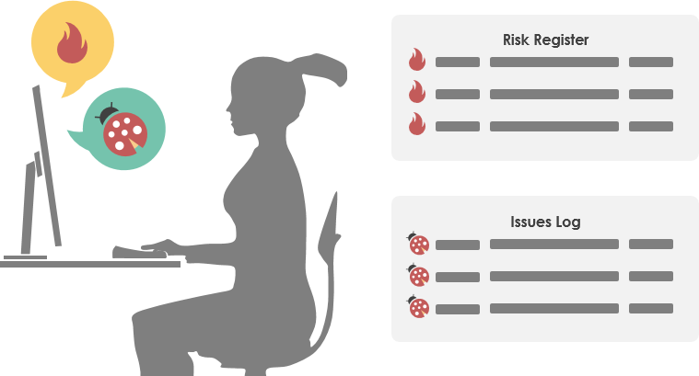
Track and Manage Project Risks and Issues
Managing risks appropriately ensures that your project will stay on track and on budget.
In the Planning phase, a Risk Management Plan was developed. This phase focuses on executing the resolution and mitigation strategies planned, monitoring the project for the occurrences of risks, and to keep updating the Risk Register by including any newly identified risks.
Besides, organize, maintain and track the issues arise during project execution. Ensure that each issue is resolved without much impact to the project's performance.

Slide 10
Risk Management:
The Risk Register is a log of all identified risks. It shows the probability and impact of the risks to the project, mitigation strategy, and when the risk is estimated to occur. The document was developed in the Planning phase, and keep updated throughout the Execution and Control phase with the risks identified during the execution of project activities. It consists of the elements below:
Affected Work Packages, which are the work packages that will be affected if the risk occurs.
Probability: The chance that a risk will occur, on a scale from 0 to 10.
Impact: The impact of the risk on the project, again, scale from 0 to 10.
Risk Score: A number that determines the severity of risk, obtained by multiplying the value of probability and impact.
Risk Management Approach/Mitigation Actions: The action to take to resolve or mitigate the risks.
Early Warning Signs/Trigger: Something which indicates that a risk is about to occur or has already occurred

Slide 11
Issue Management:
An issue log is used to track, document, and report issues that are identified during project execution. It consists of the elements below:
Affected Work Package(s), which are work packages affected by the issue, or the source of issue.
Urgency: The urgency of getting the issue resolved.
Resolution: The action taken to address and resolve the issue.
Status: The status of issue. Typical status include New, Open, In Progress, Fixed, Resolved and Won't Fix.
Reported Date: The date the issue was reported.
Close Date: The date the issue was closed.

Slide 12
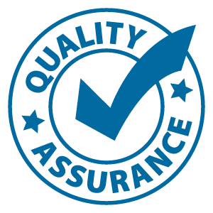
Quality Assurance
In the Project Management Body of Knowledge (PMBOK), Quality Assurance is part of the Executing process group and is performed throughout the duration of the project.
Quality Assurance is the process of auditing the quality requirements and the results from quality control measurements to ensure that appropriate quality standards and operational definitions are used.
The key benefit of this process is that it facilitates the improvement of quality processes

Slide 13
Conduct Project Change Management
A change request arises when someone wants a change to the agreed-upon project baseline or deliverables for a project. It can pertain to project, product, documents, requirements, or any other control items identified and documented under the Change and Configuration Management Plan.
Upon completion, the request is submitted to the Change Control Board or other similar body for review and approval.
The change request log maintains a list of all change requests submitted with summaries to the dispositions and justifications. Here are the elements of a Change Request Log.
Title of Request, which is A brief summary of change request.
Date of Initiation: The date when the change was initiated.
Initiator: The person who initiated the change request.
Disposition: Whether the change is approved, rejected or deferred.
Justification: The Change Control Board provides a justification for the change request disposition.
Changes Summary: The changes and the actions to take as a result of an approved change. Typical changes include additional project effort, cost, schedule, and resources.

Slide 14
Accept Project
The final activity of this phase is to have the user accept the project.
When the deliverables are developed, the user will evaluate whether the deliverables satisfy the requirements.

