Slide 1
Introduction to Computer
Chapter # 3

Slide 2
Electronic-mail
E-mail (short for electronic mail) is the transmission of messages and files via a computer network. Today, e-mail is a primary communications method for both personal and business use.
An e-mail program allows you to create, send, receive, forward, store, print, and delete e-mail messages.
Just as you address a letter when using the postal system, you address an e-mail message with the e-mail address of your intended recipient. Likewise, when someone sends you a message, he or she must have your e-mail address.
An e-mail address is a combination of a user name and a domain name that identifies a user so that he or she can receive Internet e-mail. A user name is a unique combination of characters, such as letters of the alphabet and/or numbers, that identifies a specific user.

Slide 3
Continue..
In an Internet e-mail address, an @ (pronounced at) symbol separates the user name from the domain name. Your service provider supplies the domain name.
Most e-mail programs allow you to create an address book, or contacts folder, which contains a list of names and e-mail addresses.
Cc/bcc

Slide 4
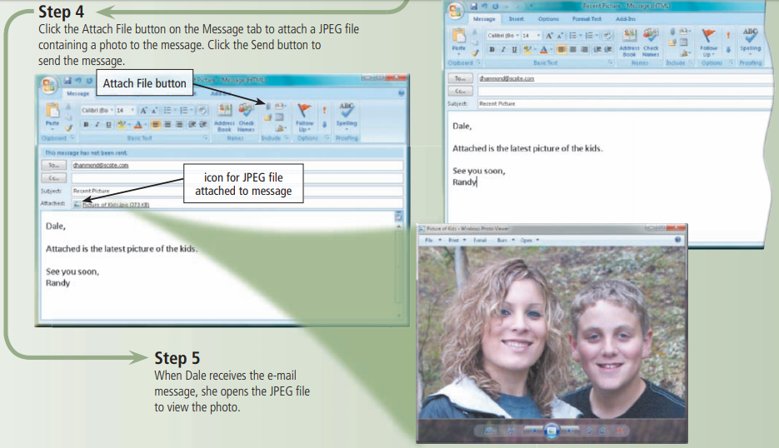

Slide 6
Mailing Lists
A mailing list, also called an e-mail list or distribution list, is a group of e-mail names and addresses given a single name.
When a message is sent to a mailing list, every person on the list receives a copy of the message in his or her mail box.
– Subscribing: adds your e-mail name and address.
– Unsubscribing: removes your name.

Slide 7
Instant messaging (IM)
Instant messaging (IM) is a real-time Internet communications service that notifies you when one or more people are online and then allows you to exchange messages or files or join a private chat room with them.
Real time means that you and the people with whom you are conversing are online at the same time.
Some IM services support voice and video conversations. For IM to work, both parties must be online at the same time. Also, the receiver of a message must be willing to accept messages.
To use IM, you may have to install instant messenger software on the computer or device, such as a smart phone, you plan to use.
Some operating systems, such as Windows, include an instant messenger. Few IM programs follow IM standards. To ensure successful communications, all individuals on the contact list need to use the same or a compatible instant messenger.

Slide 9
Chat Rooms
A chat is a real-time typed conversation that takes place on a computer.
A chat room is a location on an Internet server that permits users to chat with each other. Anyone in the chat room can participate in the conversation, which usually is specific to a particular topic.
As you type on your keyboard, a line of characters and symbols is displayed on the computer screen. Others connected to the same chat room server also see what you type.
Some chat rooms support voice chats and video chats, in which people hear or see each other as they chat.
To start a chat session, you connect to a chat server through a program called a chat client. Today’s browsers usually include a chat client. If yours does not, you can download a chat client from the Web.

Slide 11
Newsgroup & Message Board
A NEWSGROUP is an online area in which users have written discussions about a particular subject.
To participate in a discussion, a user sends a message to the newsgroup, and other users in the newsgroup read and reply to the message.
Some newsgroups require you to enter a user name and password to participate in the discussion. For example, a newsgroup for students taking a college course may require a user name and password to access the newsgroup. This ensures that only students in the course participate in the discussion.
To participate in a newsgroup, typically you use a program called a newsreader.
A popular Web-based type of discussion group that does not require a newsreader is a MESSAGE BOARD. Many Web sites use message boards instead of newsgroups because they are easier to use.

Slide 15
Notes:
BI Business Intelligence

