Slide 1
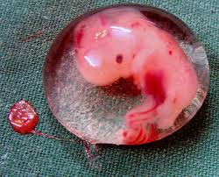
Ectopic Pregnancy

Slide 2
An ectopic pregnancy is a complication of pregnancy in which the pregnancy implants outside the uterine cavity. Usually ectopic pregnancies are not only viable but are also very dangerous for the mother as it used to be followed by a massive internal bleeding.

Slide 3
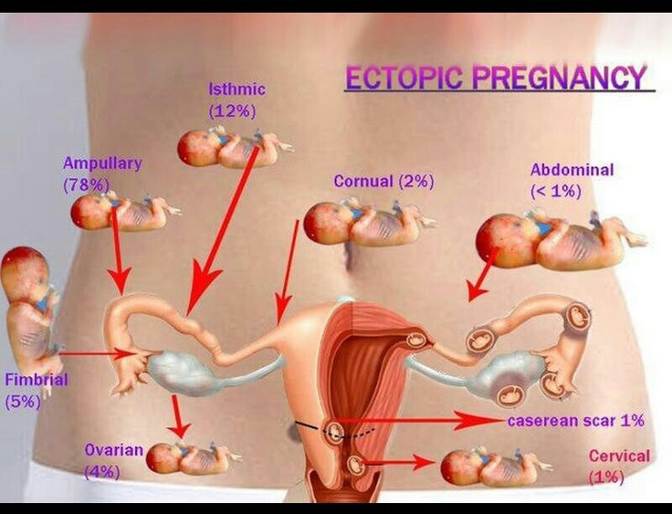

Slide 5
ETIOLOGY
Any factor that causes delayed transport of the fertilised ovum through the tube.
Fallopian tube favours implantation in the tubal mucosa itself thus giving rise to a tubal ectopic pregnancy.
These factors may be Congenital or Acquired.

Slide 6
CONGENITAL
Tubal Hypoplasia
Tortuosity
Congenital diverticuli
Accessory ostia
Partial stenosis
Elongation
Intamural polyp
Entrap the ovum on its way.

Slide 7
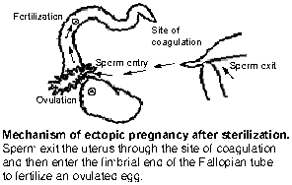
ACQUIRED CAUSES
INCREASING AGE
PID(6 TO 10 TIMES )
TUBAL LIGATION
CONTRACEPTION FAILURE
PREVIOUS ECTOPIC PREGNANCY
TUBAL RECONSTRUCTIVE SURGERY
INFERTILITY

Slide 8
PREVIOUS ABORTIONS
TUBAL ENDOMETRIOSIS.
CIGARETTE SMOKING
DES EXPOSURE
FIBROIDS
TRANS PERITONEAL MIGRATION OF OVUM.

Slide 9
ACUTE ECTOPIC PREGNANCY

Slide 11
7
CHRONIC ECTOPIC PREGNANCY
Patient would have recovered from previous attack of acute pain.
Pt may present with amenorrhoea, dull aching lower abdominal pain, vaginal bleeding, dysuria, frequency of micturation or retention of urine and rectal tenesmus.

Slide 12
INVESTIGATION ➢ BLOOD INVESTIGATION. ➢ β HCG. SPECIAL INVESTIGATIONS ➢ ULTRASOUND. ➢ LAPAROSCOPY ➢ LAPAROTOMY ➢ DILATATION & CURETTAGE ➢ CULDOCENTESIS ➢ MAGNETIC RESONANCE ➢ IMAGING

Slide 13
β HCG:
URINE PREGNANCY TEST –ELISA IS SENSITIVE TO 10-50miu/ml. & ARE POSITIVE IN 95%OF ECTOPIC PREGNANCY.
QUANTITATIVE BETA HCG VALUE THAT IN CONJUNCTION WITH TRANSVAGINAL ULTRASOUND CAN USUALLY MAKE THE DIAGNOSIS.
WHEN HCG LEVEL < 2000 IU/L DOUBLING TIME HELP TO PREDICT VIABLE VS NONVIABLE PREGNANCY.

Slide 15
MANAGEMENT:
MEDICAL MANAGEMENT:
The administration of methotrexate intramuscularly may be a suitable treatment for ectopic pregnancy in certain circumstances.
Methotrexate is an antimetabolite which inhibits folate reductase .
Administering a single 75mg IM injection of methotrexate is a suitable treatment for ectopic pregnancy in cases where beta hcg is<3000IU/ml.

Slide 16
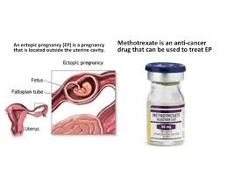
THE REGIMEN INVOLVES ADMINISTRATION OF METHOTREXATE AS 1mg/kg on days 0,2,4,and 6 followed by 4 doses of leucovorin as 0.1mg/kg on days 1,3,5,7 because of higher incidence of adverse effect and increased need for motivation and compliance ,the multiple dosage has fallien out of favour in us.
SUITABLE CRITERIA:
NORMAL RENAL AND LIVER FUNCTION
SERUM HCG LESS THAN 3000IU/ML.
MINIMAL OR MILD SYMPTOMS ONLY
NO EVIDENCE OF HAEMOPERITONEUM
ECTOPIC MASS LESS THAN 5CM DIAMETER.
NO EVIDENCE OF FETAL ACTIVITY.

Slide 17
SURGERY:
Laparotomy.
Laparoscopy.
INDICATION:
Pt not suitable for medical management.
Medical therapy has failed.
Pt has a heterotopic pregnancy with a viable intrauterine pregnancy.
Pt is hemodynamically unstable and needs immediate treatment.
CONTRAINDICATED
PT medically treatable.
PT having other medical conditions that would make the risks associated surgery unacceptable,.

Slide 18
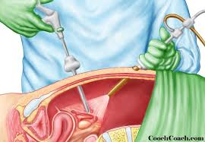
LAPAROSCOPY:
INDICATION:
MORE APPROPRIATE IN STABLE
SITUATION.
SHORTER OPERATING TIME.
LESS BLOOD LOSS.
SHORTER STAY IN HOSPITAL
LESS NEED FOR ANALGESIA.

Slide 19
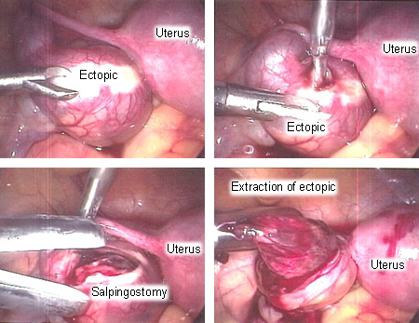

Slide 20
MILKING OR FIMBRIAL EXPRESSION:
THIS IS IDEAL IN DISTAL AMPULLARY OR INFUNDIBULAR PREGNANCY.
IT HAS GOT INCREASED RISK OF PERSISTENT ECTOPIC PREGNANCY.

Slide 21
Follow up after conservative surgery
With weekly Serum β HCG titre till it is negative.
If titre increases methotrexate can be given.

Slide 22
SUMMARY - KEY POINTS
Incidence of ectopic pregnancy is rising while maternal mortality from it is falling.
Ectopic pregnancy can be diagnosed early (before it ruptures) with recent advances in Immunoassay to detect S-hCG , high resolution USG, and dignostic Laparoscopy.
There has been shift in the M/m from ablative surgery to conservative fertility preserving therapy
Laparotomy should be done when in doubt
The choice today is Laparoscopic treatment of unruptured ectopic pregnancy.
Careful monitoring and proper counselling of patients is mandatory.

Slide 23
Thank you

