Slide 2
NEOPLASIA
By
Dr. Tahira Tabassum
Associate Professor,
Department of Pathology,SMC
Consultant Histopathologist UMC&RC, Sargodha

Slide 3
NEOPLASIA
New growth

Slide 4
NEOPLASM
An abnormal mass of tissue, the growth of which exceeds & is uncoordinated with that of normal tissues & persists in the same excessive manner after the cassation of the stimuli which evoked the change

Slide 5
ONCOLOGY
Study of tumors/Neoplasms

Slide 6
TYPES OF NEOPLASMS
BENIGN: Remain localized, can not spread to other sites, amenable to local surgical removal & pt. survives
MALIGNANT: Invade & destroy adjacent structures, spread to distant sites, pt. dies

Slide 7
NOMENCLATURE OF TUMORS
BENIGN
Mesenchymal | Epithelial
SUFFIX “ Oma” | On the basis of app
On the basis of cell of origin

Slide 8
NOMENCLATURE OF MALIGNANT TUMORS
MESENCHYMAL | EPITHELIAL
SARCOMAS | CARCINOMAS
ON THE BASIS OF APP.
ON THE BASIS OF CELLS OF ORIGIN

Slide 10
CANCER
Malignant tumors are collectively referred to as cancers, derived from the Latin word for crab, because they adhere to any part that they seize on in an obstinate manner, similar to a crab

Slide 11
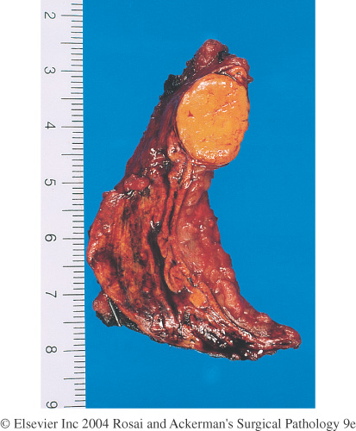

Slide 12
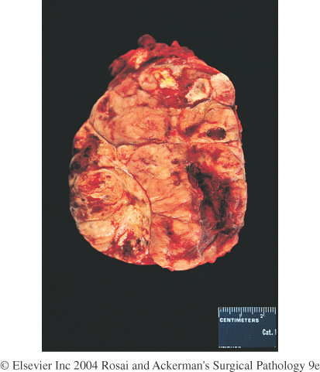

Slide 13
Leiomyoma of the uterus. This benign, well-differentiated tumor contains interlacing bundles of neoplastic smooth muscle cells that are virtually identical in appearance to normal smooth muscle cells in the myometrium.

Slide 14
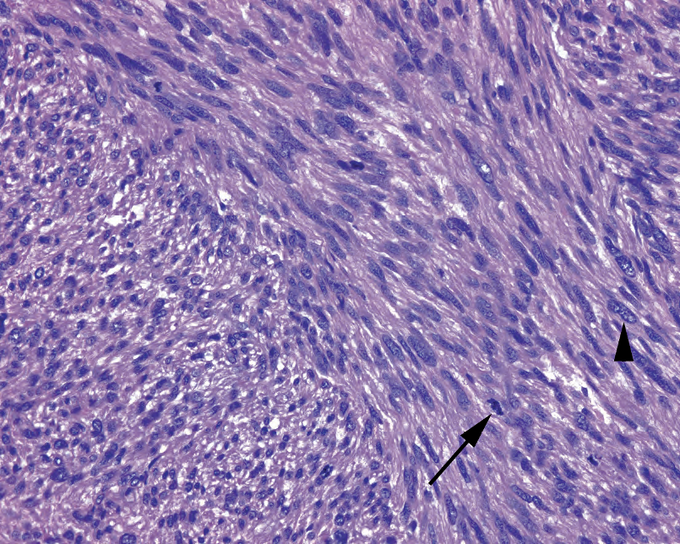
Leiomyosarcoma.

Slide 15
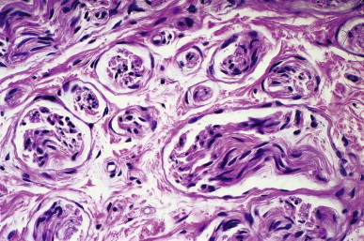
Traumatic Neuroma The haphazardly distributed nerve trunks are surrounded by fibrous tissue.

Slide 16
Benign tumor:Adenoma) of the thyroid. Note the normal-looking (well-differentiated), colloid-filled thyroid follicles.

Slide 17
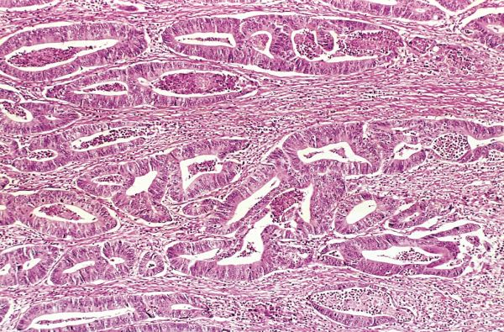
Adenocarcinoma of colon. Note that the cancerous glands are irregular in shape and size and do not resemble the normal colonic glands. This tumor is considered differentiated because gland formation can be seen.

Slide 19
NOMENCLATURE OF SPECIAL TUMORS
MIXED TUMORS: More than one type of cells derived from same germ layer
TERATOMAS
HAMARTOMAS: Disorganized overgrowth of mature cells indigenous to that part
CHORISTOMA: Presence of well developed & normally organized tissue of one organ in another

Slide 20
EXCEPTIONS
Melanoma
Lymphoma
Hepatoma
Mesothelioma

Slide 21
Neoplasms are of monoclonal origin. Infrequently, divergent differentiation of a single neoplastic clone along two lineages creates what are called mixed tumors.

Slide 22
MONOCLONALITY
The entire population of neoplastic cells within an individual tumor arises from a single cell that has incurred genetic change, and hence tumors are said to be monoclonal.

Slide 24
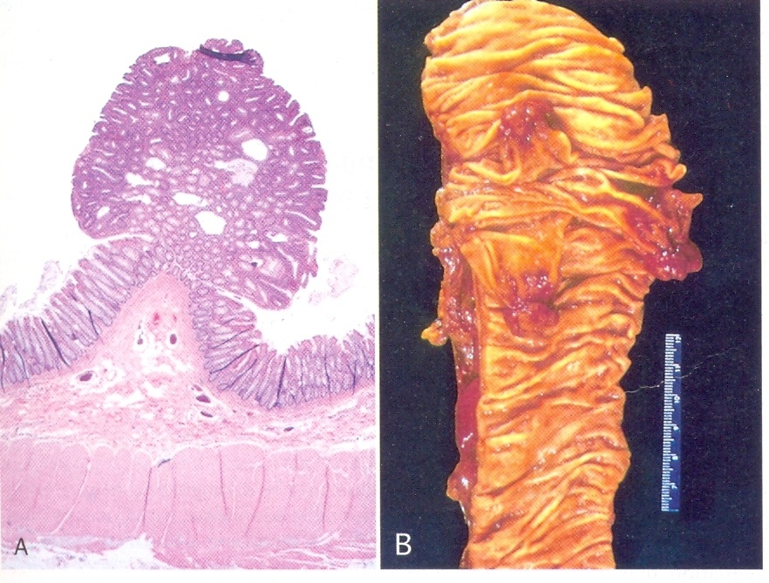

Slide 27
Components Of Benign And Malignant Tumors
Parenchyma
Stroma

Slide 29
Components Of All Benign And Malignant Tumors
(1) parenchyma Clonal neoplastic cells constitute parenchyma
(2) Stroma made up of connective tissue, blood vessels, and variable numbers of macrophages and lymphocytes.
Neoplastic cells largely determine a tumor's behavior, their growth is dependent on stroma. Adequate stromal blood supply is requisite for the tumor cells to live and divide, and the stromal connective tissue provides structural framework essential for the growing cells..

Slide 31
CONSTRASTING FEATURES OF BENIGN & MALIGNANT TUMORS

Slide 32
Contrasting Features Of Benign & Malignat Tumors
I. Clinical & Gross Features
1. Boundries
2. Surrounding Tissue
3. Size
4. Secondary Changes

Slide 33
II. Microscopic Features
Pattern or Resemblence
Basal Polarity
Pleomorphism
Hyperchromatism
N/C Ratio
Anisonucleosis
Prominent Nucleoli
Mitoses
Tumor Giant Cells
Function

Slide 34
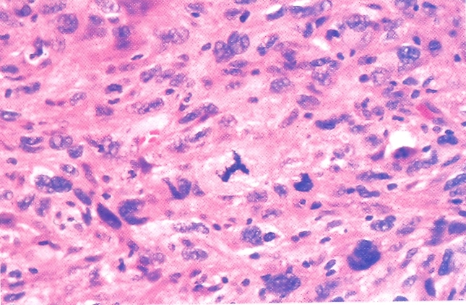

Slide 35
Gross/Clinical Features
Microscopic Features
Growth Rate
Local Invasion
Metastasis
Prognosis

Slide 36
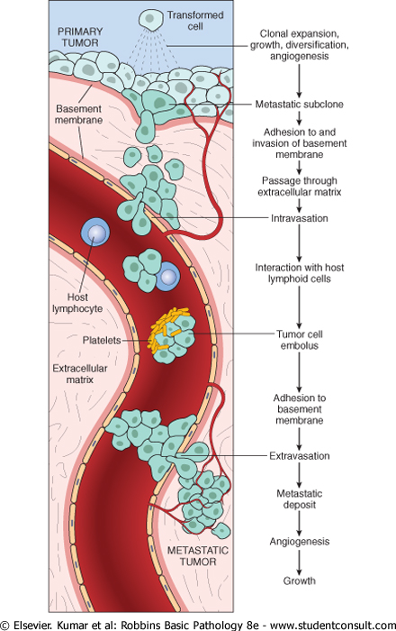
clonal growth
metastatic subclone
intravasation
tumor cell embolus
extravasation

Slide 38
CHARACTERISTICS OF BENIGN & MALIGNANT TUMORS
Differentiation & anaplasia
Rate of growth
Encapsulation & local invasion
Metastasis

Slide 39
Differentiation and Ananplasia
Differentiation refers to extent to which neopalstic cells resemble normal cells both morphologically and functionally, lack of differentiation is called anaplasia.
Some tumors are well differentiated and extreme variant is called poorly differentiated while in between of above two is called moderately differentiated tumors.

Slide 40
Lack of differentiation (anaplasia) is characterized by…
Pleomorphism
Both cells and the nuclei display pleomorphism (variation and size and shape)
Hyperchromasia
Nuclei contain abundance of DNA showing dark staining (hyperchromatic)
High N/C ratio
1:1 changes to 1:4 or 1:6.
Mitoses.
Bizarre mitotic figures may be tripolar, quadripolar instead of bipolar.

Slide 41
Loss of polarity.
Orientations of anaplastic cells is markedly disturbed (lose normal polarity). Sheets and masses of tumor cells.
Tumor giant cells
Dysplasia disorderly but non-neoplastic proliferation. Loss of uniformity of individual cells as well as loss in their architectural orientation.
Carcinoma in situ: Pre-invasive stage
Dysplastic changes are marked & involve entire thickness of epith.but do not invade the basal layer

Slide 45
Anaplastic tumor of the skeletal muscle (rhabdomyosarcoma). Note the marked cellular and nuclear pleomorphism, hyperchromatic nuclei, and tumor giant cells.

Slide 46
RATE OF GROWTH
Determined by three main factors…
Doubling time of tumor cells
Fraction of tumor cells which are present in replicative pool
Rate at which cells are shed
Minimum tumor size detectable is usually seen after 30 doublings of neopalstic cells (1 gm in weight) and maximum size of 1 kg is seen after 10 doublings of the previous detectable mass

Slide 47
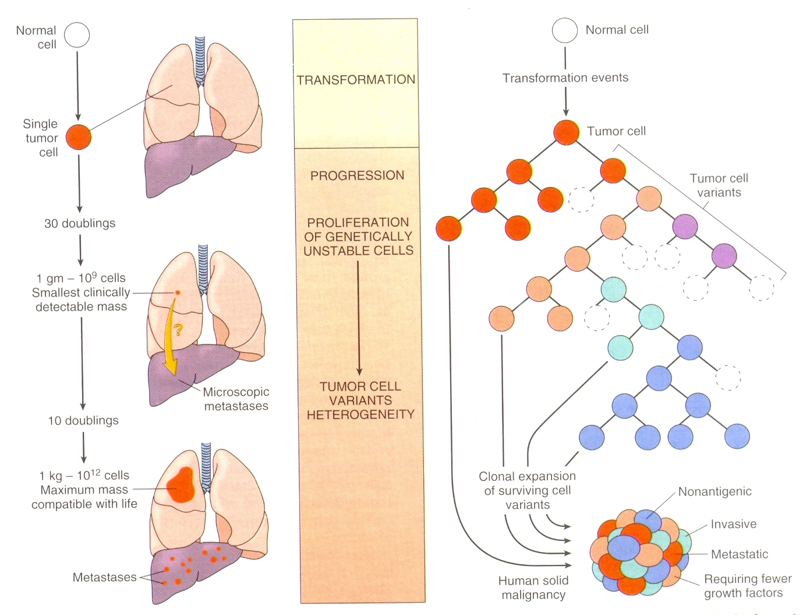
Rate of Growth

Slide 48
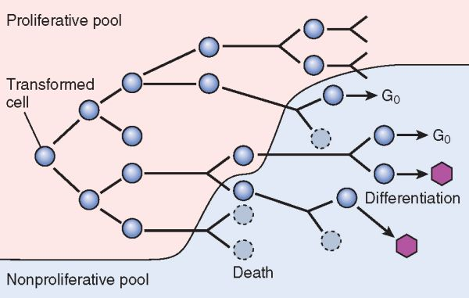

Slide 49
Growth rate of tumors corelates with their level of differentiation thus most malignant tumors grow more rapidly than benign lesions
The growth fraction of tumor cells has a profound effect on their susceptibility to cancer chemotherapy.

Slide 50
LOCAL INVASION
Benign Tumors grow as expensile masses that remain localized and do not invade or metastasize
A well defined cleavage plane exists around most benign tumors but Hemangioma is an exception
Malignant tumors grow by progressive infiltration, invasion & destruction of surrounding tissue, a well defined cleavage plane is lacking so are invasive

Slide 51
Next to the development of metastasis, invasiveness is the most reliable feature that differentiates malignant from benign tumors

Slide 52
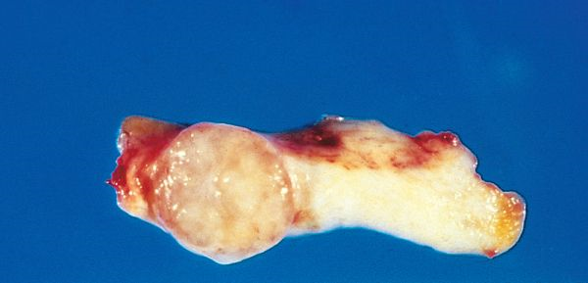

Slide 53
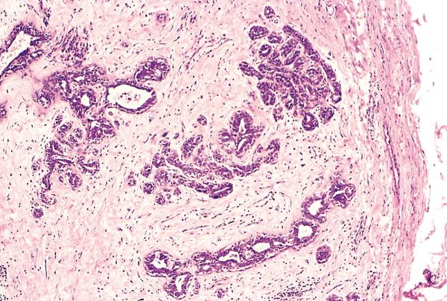

Slide 54
Cut section of an invasive ductal carcinoma of the breast.

Slide 55
METASTASIS
Development of secondary implant discontinuous with primary tumor
Several mechanisms: Tumor cells first must become discohesive & detach from primary site then attach elsewhere

Slide 56
Metastasis
Discohesive
Detach
Attach

Slide 57
Tumor cells tend to have many more laminin receptors than do normal cells, allowing them to attach more readily to basement membranes at distant sites Exceptions: BCC, Primary CNS tumors

Slide 59
clonal growth
metastatic subclone
intravasation
tumor cell embolus
extravasation

Slide 61
PATHWAYS OF SPREAD
Seeding of body cavities
Lymphatic spread
Hematogenous spread

Slide 62
SEEDING OF BODY CAVITIES
Malignant neoplasm penetrate into natural cavity (pleural, pericardial, peritoneal, subarachnoid and joint space)
This mode of transmission is characteristic of cancers of ovary
Neoplasms of CNS e.g; medulloblastoma or ependymoma penetrate cerebral ventricles, carried by CSF to reimplant on meningeal surfaces within brain or in spinal cord.

Slide 63
LYMPHATIC SPREAD
Pattern of lymph node involvement follows the natural route of lymphatic drainage e.g. CA breast in upper outer quadrants involve the axillary lymph nodes while medial breast lesions involve the lymph nodes around IMA.
A sentinel lymph node is defined as, first node in a regional lymphatic basin that receives lymph flow from primary tumor.

Slide 64
HEMATOGENOUS SPREAD.
Blood born metastasis involves mainly veins than arteries.
Liver and lungs are frequently involved.
Portal area drainage flows to LIVER and all caval blood flows to LUNG.
RCC invades renal veins in snake like fashion into right side of heart through inferior vena cava.

Slide 67
EPIDEMIOLOGY OF NEOPLASMS
Study of relationship of various factors determining the incidence & distribution of disease

Slide 68
EPIDEMIOLOGY
Cancer
incidence.

Slide 70
GEOGRAPHIC AND ENVIRONMENTAL FACTORS
I. Age:
More common after 55.
Cancer is main cause of death in females from 40 to 79 and among male 60 to 79.
Age < 15 is not spared and 10% of all death fall in this group e.g., common neoplasm of infancy are
Neuroblastoma
Wilms Tumor,
Retinoblastoma,
Acute leukemias,
Rhabdomyosarcomas.

Slide 71
OCCUPATIONAL CANCERS
Arsenic & related comp-------CA lung,Skin
Asbestose -----------------------Mesothelioma
GIT,Lung
Benzene --------------------------Leukemia, HL
Beryllium--------------------------Lung
Cadmium-------------------------Prostate
Ghromium------------------------Lung
Nickle comp----------------------Nose, Lung
Radiation--------------------------Lung
Vinyl Chloride--------------------Angiosarcoma, Liver

Slide 72
II GENETIC PREDISPOSITION
RB ---------------------- Retinoblastoma
P53 ---------------------- Li-Fraumeni syndrome
P16/INK4A ------------- Melanoma
APC ---------------------- Familial ad. polyposis coli
NF1, NF2 --------------- Neurofibromatosis 1 & 2
BRCA1,BRCA2 ------- Breast & ovarian tumors

Slide 73
III. NONHEREDITARY PREDISPOSING CONDITIONS
1. Ch. Inflammation
In the setting of unresolved ch inf. Immune response may become maladoptive, promoting tumorigenesis
Ch inf may increase pool of tissue stem cells which becomes subject to effect of mutagens
2. Precancerous conditions
Ch atrophic gastritis, U.C, leukoplakia

Slide 74
A 32 yrs old woman has experienced dull pelvic pain for the past 2 months. Physical exam. Shows a Rt. adenexal mass. An abd. USG shows a 7.5 cm cystic ovarian mass. Mass is excised. Surface of mass is smooth & it is non adherent to surrounding pelvic structures. On gross exam. Mass is cystic & filled with hair. Microscopically, sq. epith, tall columnar glandular epith, cartilage & fibrous C.T are present. Which of the following is most likely diagnosis?

Slide 75
(a) Adenocarcinoma
(b) Fibroadenoma
(c) Glioma
(d) Hamartoma
(e) Mesothelioma
(f) Teratoma

Slide 76
A 60 yrs old man comes to his physician b/c he has noted a mass in his neck that has increased rapidly in size over past 2 months. On physical exam, a firm, non tender, 10 cm mass in Lt. lateral posterior neck that appears to be fused to cervical L.N is palpated. Biopsy performed & on microscopic exam, it shows abnormal lymphoid cells with many mitotic figures & many apoptotic nuclei. Pt treated with cell-cycle acting chemotherapeutic agents. Masses shrink over next month. Based on history & treatment, tumor cells have which of the following features:

Slide 77
(a) Limited capacity to metastasize
(b) Polyclonality
(c) Poor vascularity
(d) High growth fraction
(e) Strong expression of tumor-antigens

Slide 78
A 58 yr old woman has experienced feeling of fullness in neck for the past 3 months & she has noted a 3 Kg wt. loss. On physical exam, there is a firm, fixed mass in a 3×3 cm area. C.T scan shows solid mass in Rt. Lobe of thyroid gland. Biopsy performed & microscopic appearance is shown in figure. Which of the following terms best describes this neoplasms:

Slide 80
(a) adenoma
(b) Well diff. adenocarcinoma
(c) Squamous cell carcinoma
(d) Leiomyoma
(e) Anaplastic carcinoma

Slide 81
Which one of the following numbered sequences best illustrate the postulated sequence of events that precedes the formation of an infiltrating SCC of cervix
1. carcinoma in situ
2. Invasive ca
3. Mild dysplasia
4. Mod. Dysplasia
5. severe dysplasia
6. Sq. metaplasia

Slide 85
CARCINOGENIC AGENTS
CHEMICAL CARCINOGENS
Direct Acting
Indirect Acting
RADIATION CARCINOGENS
MICROBIAL CARCINOGENS

Slide 86
CHEMICAL CARCINOGENS
1. DIRECT ACTING AGENTS
Require no metabolic conversion
Weak carcinogens, imp b/c chemotherapeutic agents e.g; Alkylating agents---Evoke 2nd cancer, usually leukemia

Slide 87
2. INDIRECT ACTING AGENTS
Requires metabolic conversion-Procarcinogen
Polycyclic hydrocarbons e.g; Benzo(a)pyrine formed at high temp. from tobacco---leads to Ca lung
Aromatic amines & azo dyes--β naphthalamine – Bladder ca
Aflatoxin B1---------HCC
Preservative- Nitrite…cause nitrosylation of amines in food---Carcinogenic

Slide 88
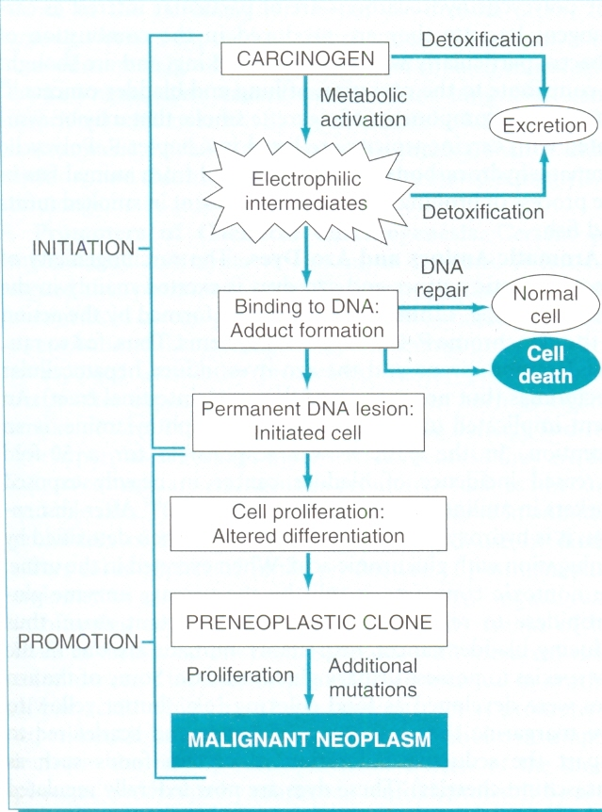

Slide 89
STEPS INVOLVED IN CHEMICAL CARCINOGENESIS
Initiation results from exposure of cells to a sufficient dose of carcinogenic agent (initiator) an initiated cell is altered, making it potentially capable of giving rise to a tumor. Initiation alone, however, is not sufficient for tumor formation.
Initiation causes permanent DNA damage (mutations). It is therefore rapid and irreversible and has memory.
Promoters can induce tumors in initiated cell but they are nontumorigenic by themselves.

Slide 90
MOLECULAR TARGETS OF CHEMICAL CARCINOGENS
Ames test, is used to check the ability of chemicals to induce mutations in microorganisms (70% to 90%).
DNA is a primary target for chemical carcinogens and result is DNA damage which may be repaired by several enzymes if damage is beyond the repairing capacity of individual damage may initiate the tumorogenic effect by causing mutations in RAS and p53 (finger prints)

Slide 93
RADIATION CARCINOGENESIS
Radiation is an established carcinogen
10 fold inc. in Ca Lung in miners of radioactive elements
Atomic bomb survivors—AML, CML, thyroid, breast, colon & lung Ca.
Therapeutic irradiation of H&N- papillary Thyroid CA

Slide 94
Ionizing radiation causes
Chromosomal breakage
Translocations
Point mutations
Radiation causes formation of pyrimidine dimers within DNA, leading to mutations
SCC, BCC, Melanomas

Slide 95
VIRAL & MICROBIAL ONCOGENESIS
Oncogenic RNA Viruses
HTLV1- Only Retrovirus- T cell leukemia
In immunodeficient like HIV HTLV1 has tropism for CD4 T cells
HTLV-1 encodes viral TAX protein which turns on genes for cytokines & receptors in T cells- it stimulates T-cell proliferation- initially polyclonal- these T-cells are at inc. risk of secondary mutations leading to outgrowth of monoclonal leukemia

Slide 96
ONCOGENIC DNA VIRUSES
HPV, EBV, KSHV-HHV8, HBV, HCV.
70-80% HCC-multifactorial but dominant effect is immunologically mediated ch.inf.→ ep. Injury- stimulation of hepatocyte proliferation-ROS-DNA damage
H.pylori – immune mediated ch. Inf.-Gastric cell proliferation-ROS-DNA damage

Slide 99
Hepatitis B and C Viruses
Epidemiologic Studies suggest close association b/w HBV infection and liver cancer
70 to 85% of HCC are due to HBV or HCV
Oncogenic effects of HBV & HCV are immunologically mediated ch inflammation causing hepatocyte injury, proliferation-ROS-DNA damage

Slide 100
CLINICAL ASPECTS OF NEOPLASIA
Tumors may cause problems because of:
Location & impingement on adjacent st.
Functional activity such as hormone synthesis or development of paraneoplastic syndromes
Bleeding & infections when tumor ulcerates through adjacent surfaces
Symptoms that result from rupture or infarction
Cachesia or wasting

Slide 101
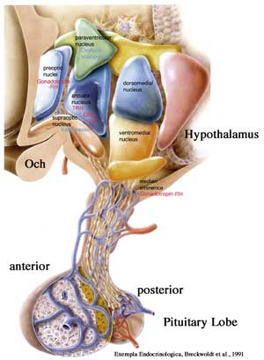
Effects Of Tumor On Host
Location is crucial in both benign & malignant tumors
A small pituitary adenoma (1cm)
A small leiomyoma (0.5cm) in wall of Renal A
A small Ca within CBD-Fatal billiary tract obstruction

Slide 102
Hormone Production
Seen in neoplasms arising in endocrine glands
Adenomas & Ca arising in β cells of pancreatic islets of langerhans – Fatal hyperinsulinism
Some Adenomas & Ca of adrenal cortex elaborate corticosteroids e.g; aldosterone
A tumor may ulcerate through surface.
Tumors that protrude into gut may be caught in peristaltic pull causing intussusception-obs & infarction

Slide 103
CANCER CACHESIA
Progressive loss of body fat and lean body mass, accompanied by profound weakness, anorexia & anemia, caused by release of cytokines by tumor or host
Not caused by nutritional demands of tumor
TNF produced by macrophages in response to tumor cells or by tumor cells themselves
TNF suppresses appetite, inhibits lipoprotein lipase→ inhibiting release of FFA

Slide 104
PARANEOPLASTIC SYNDROMES
Systemic symptoms that can not be explained by tumor spread or by hormones appropriate to the tissue, are caused by ectopic production & secretion of bioactive substances such as ACTH, PTHrP, TGF-α

Slide 105
Paraneoplastic Syndrome
Cushing syndrome ----ACTH
Hypercalcemia----------PTHrP, TGF-α, TNF,IL-1
Hypoglycemia-----------Insulin or related
Carcinoid syndroma---Serotonin, Bradykinin
Polycythemia------------Erythropoitin
SIADH---------------------ADH, ANP
Myasthenia---------------Immunological
Venous thrombosis-----Mucins activate clotting
Nephrotic Syndrome---Tumor antigens, immune complexes

Slide 106
GRADING AND STAGING OF CANCER
Grading: Degree of differentiation-grade I-IV
Staging: Extent of spread of cancer, based on size of primary tumor,spread to regional LN & presence or absence of metastasis
Two methods-TNM & AJC
T1-T4, N0-N3, M0-M1
AJC: Stage 0 to IV
Staging is of greater clinical value than grading

Slide 107
CARCINOGENESIS: THE MOLECULAR BASIS OF CANCER
Nonlethal genetic damage
4 classes of normal regulatory genes are principal targets of genetic damage
Proto-oncogenes
Tumor suppressor
Apoptosis
Involved in DNA repair

Slide 108
Protooncogenes
Tumor suppressor
Genes of Apoptosis
DNA repair Genes

Slide 109
PROTO
ONCOGENES
ONCOGENES

Slide 110
Protooncogenes and oncogenes
.
Protooncogenes
Oncogenes
Proteins
oncoprotein
Growth Factors
(Hormones etc.)
No need of Growth Factors
Normal Growth
Malignant Growth
Oncoprotein → similar functions as their normal counterparts (proto-oncogenes) but make cells self-sufficient to grow

Slide 111
ONCOGENES
Encode
Transcription Factors
Growth regulating proteins
Proteins involved in cell survival
Cell-Cell interactions
Cell-Matrix interactions
Oncogenes are Domanant b/c mutation of a single allele can lead to cellular transformations

Slide 112
Tumor Suppressor genes
Guardians
(p53)
Governors
(RB)

Slide 113
Tumor Suppressor Genes
Prevent uncontrolled growth
Usually both alleles must be damaged but occasionally a single allele can promote transformation- Haploinsufficiency
Two types-Governors(RB) &Guardians(TP53)
Governors remove brakes on cell proliferation
Guardians sense genomic damage

Slide 114
GENES INVOLVED IN APOPTOSIS AND DNA REPAIR MAY ACT LIKE:
proto-oncogenes (Loss of one copy is sufficient)
or tumor suppressor genes (Loss of both copies)

Slide 115
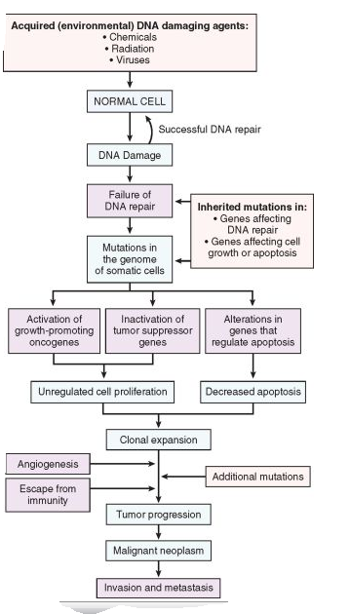

Slide 116
GENETIC LESIONS IN CANCER
May be subtle e.g;
Point mutations
Insertions
Deletions
Or may be large enough to produce:
Karyotypic changes

Slide 117
KARYOTYPIC CHANGES IN TUMORS
Balanced Translocations
Overexpression of protooncogenes-Burkitt lymphoma- t 8;14
Creat fusion genes- Philadelphia ch in CML
Deletions
Deletions involving 13q14-the site of RB gene are asso. with Retinoblastoma and deletion of 17p is asso with p53
Gene Amplifications
Produce several 100 copies of protooncogenes
NMYC in Neuroblastoma & ERBB2(HER2/NEU)in Breast cancer

Slide 118
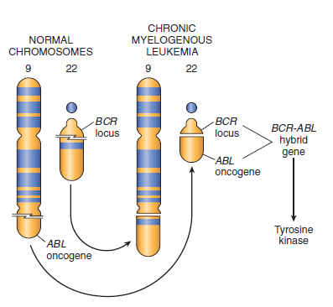
The chromosomal translocation and associated oncogene in chronic myelogenous leukemia.

Slide 119
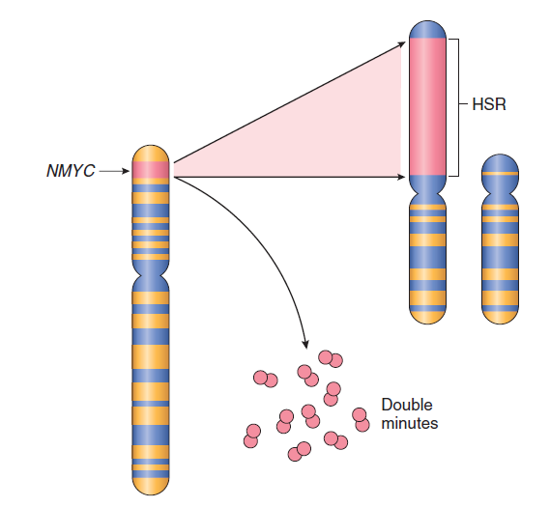
Amplification of the NMYC gene in Neuroblastoma NMYC gene, present on chromosome 2p

Slide 120
MicroRNAs & Cancer
Are noncoding, single stranded RNAs, 22 nucleotides in length, function as –ve regulator of genes
Participate in neoplastic transformation either by increasing expression of oncogenes or reducing the expression of tumor suppressor genes
If miRNA inhibits translation of an oncogene, a reduction in quantity or function of that miRNA will lead to overexpression of oncogene product.
Conversely if target of miRNA is a TSGene then overactivity of miRNA can reduce TS protein
miRNA profiling of human tumors

Slide 121
Epigenetic Modifications & Cancer
Reversible heritable changes in gene expression that occur without mutation but by methylation of promoter
In normal cells,major portion of genome is not expressed
These regions of genome are silenced by DNA methylation & histone modifications
But cancer cells are characterized by a global DNA hypomethylation & selective promoter localized hypermethylation

Slide 122
Carcinogenesis: A multiple-step process
Results from accumulation of multiple genetic alterations that collectively give rise to transformed phenotype

Slide 124
Hallmarks of cancer
Insensitivity to growth inhibitory signals
Evasion of apoptosis
Selfsufficiency in growth signals
Sustained angiogenesis
Invasion & Metastasis
Limitless replicative potential

Slide 125
Hallmarks of Cancer
Self-sufficiency in growth signals
Insensitivity to growth inhibitory signals
Evasion of apoptosis
Limitless replicative potential
Sustained angiogenesis
Invasion and metastasis

Slide 126
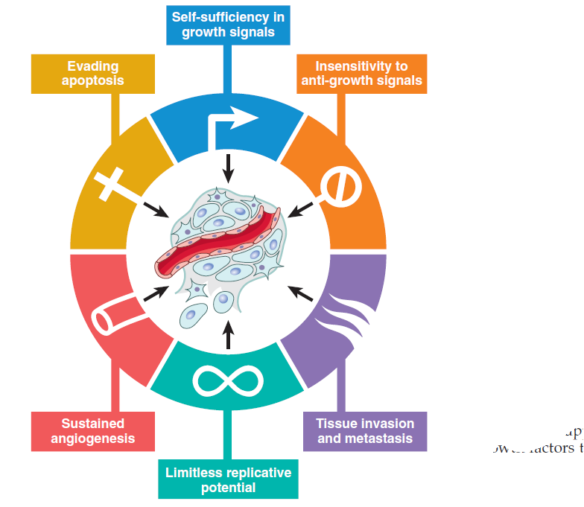

Slide 127
Growth Factors
All normal cells require stimulation by growth factors to undergo proliferation
Most GF are made by one cell type, act on neighbouring cell
Normally cells that produce GF,do not express cognate receptors-this prevents formation of +ve feedback loops within the same cell

Slide 128
Self-sufficiency in growth signals
Binding of GF to its specific receptor
Limited activation of GFR-activates signal trnnsducing proteins RAS,ABL
Transmission of transduced signals to nucleus
Activation of nuclear regulatory factors CDK,CDKI
Entry of cell in cell cycle-cell division

Slide 129
Growth Factors
Cancer cells acquire growth self sufficinncy by acquring ability to synthesize the GF to which they are responsive
Glioblastomas secrete PDGF and express PDGF receptors
Many Sarcomas secrete TGFα

Slide 130
GF Receptors and Non-Receptor Tyrosine Kinases
Mutation of GFrecp→continous mitogenic signal
More common is GFrecp overexpression→ EGFrecp family:
ERBB1: Overexp in 80% of SCC of lungs
ERBB2/HER2/NEU: Br CA, AdenoCA of lung ovary and salivary gland

Slide 131
Downstream signal transducing proteins
Cancer cells acquire growth autonomy by mutations in genes encoding components of signalling pathways downstream of GFrecp to nucleus
Two important members are:
RAS most commonly mutated proto- oncogene
ABL 2nd most common proto-oncogenes

Slide 132
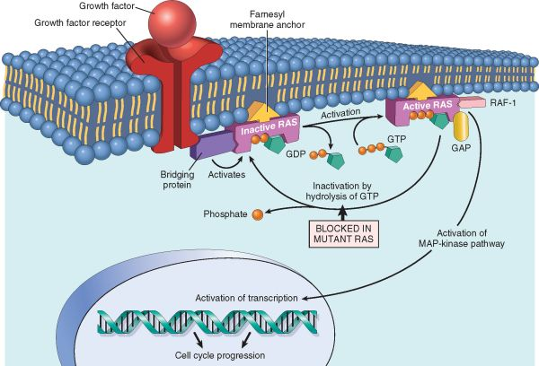
RAS Proteins

Slide 133
ABL
Has tyrosine kinase activity
In CML – BCR ABL (t9:22)

Slide 135
Nuclear Transcription factors
Mutations affecting genes that regulate DNA transcription
MYC,MYB,JUN,FOS and REL oncogenes
MYC protein can either actvate or repress transcription of other genes
Activated by MYC include growth promoting proteins including CDKs→drive cell into cell cycle
Repressed by MYC include CDKIs
Thus, dysregulation of MYC promotes tumorigenesis by increasing expression of genes that promote progression through the cell cycle and repressing genes that slow or prevent progression through the cell cycle.

Slide 136
Cyclins and CDKs
Cyclic nature of production and degradation
Cell cycle: G0→G1presynthetic→S(DNA synthesis)→G2(premitotic)→M(mioitic) phases
Check points: Emergence from G0 intoG1 and G1 to S phase
G1 to S is regulated by Cyclins and assoc enzymes CDKs. CDKs bind to Cyclins and orchester cell cycle phases
More than 15 cyclins:D,E,A and B
CDK-Cyclin activity regulated by CDKIs which enforce checkpoints
CDKIs families: p21(CDKN1A), P27(CDKN1B, p57(CDKN1C)→inhibit CDKs

Slide 137
II. INSENSITIVITY TO GROWTH INHIBITORY SIGNALS
RB Gene: Governor of cell cycle,13q14
RB-1st tumor suppressor gene, a prototypical representative
Involved in Retinoblastoma:Familial & sporadic
Two Hit Hypothesis:Both normal alleles of RB locus must be inactivated
Familial cases:Children inherit 1 defective copy of RB gene in germ line,other copy is normal which is lost as a result of somatic mutation,so AD
Sporadic cases:Both normal RB alleles are lost by somatic mutation

Slide 139
P53 Gene: Guardian of Genome
One of the most commonly mutated gene
It does neoplastic transformation by 3 mechanisms:
Activation of temporary cell cycle arrest (Quiescence)
Induction of permanent cell cycle arrest (Senescence)
Triggering of progammed cell death (Apoptosis)

Slide 140
III. EVASION OF APOPTOSIS
Apoptotic pathway,divided into upstream regulators and downstream effectors
Regulators divided into two
i. One interpreting E/C signals
Ii. Other interpreting I/C signals
Stimulation of either results in activation of normally inactive proteases: Caspase 8 & 9
So cell is disassembled-phagocytosis

Slide 141
EXTRINSIC (DEATH RECEPTOR) PATHWAY
Initiated when a TNF receptor such as CD95(Fas) is bound to CD95L
→Trimerization of receptor & its cytoplasmic death domains which attract I/C adaptor protein FADD
→ This recruits Caspase 8
→activation of downstream Caspases such as Caspase 3
→ this cleaves DNA & other substances
→ Cell Death

Slide 142
INTRINSIC (MITOCHONDRIAL) PATHWAY
Initiated by stress, injury
Its activation leads to permeabilization of mitochondrial outer memb→ Release of cytochrome c→ this initiates apoptosis
Integriyt of mitochondrial memb is regulated by pro-apoptotic(BAX & BAK) and anti-apoptotic(BCL2 & BCL-XL) proteins
A 3rd set called BH3-only proteins include BAD,BID & PUMA regulate balance b/w pro & anti-apoptotic members

Slide 143
IV. LIMITLESS REPLICATIVE POTENTIAL
Each normal dividing cell can count their cell division.
After each cell division there is shortening of some specialized structure, called telomere.
Once the telomeres are shortened beyond cretin point it leads to activation of p53 dependent cell cycle check points, causing proliferative arrest or apoptosis.
Telomerase activity and maintenance of telomere are essential for maintenance of replicative potential in cancer cell.

Slide 145
Cancer cells exhibit Evasion of Apoptosis
Best established is the role of BCL2 in protecting tumor cells from apoptosis
BCL2 is over-expressed in Lymphomas (Follicular), Protects lymphocytes from apoptosis

Slide 146
V. SUSTAINED ANGIOGENESIS
Solid tumors can not enlarge beyond 1-2mm in diameter unless they are vascularized

Slide 150
VI. INVASION AND METASTASIS

Slide 151
clonal growth
metastatic subclone
intravasation
tumor cell embolus
extravasation

Slide 152
Other hall marks
Genomic instability as an enabler of malignancy-HNPCC,Xeroderma,BRCA
Evasion of immune system - Reprogramming of energy metabolism
Tumor ptomoting inflammation as an enabler of malignancy – H-pylori

Slide 153
Lab Diagnosis of cancer
Morphologic methods
Histopathology
Cytopathology (FNAc) and cytology
Immunohistochemistry(Tumor markers)
Molecular Diagnosis
Molecular profiliong of tumors
Whole genome sequencing
Notes:
GENOME; Ablend of gene and chromosome. It is complete set of genetic material in a cell or organism

Slide 154
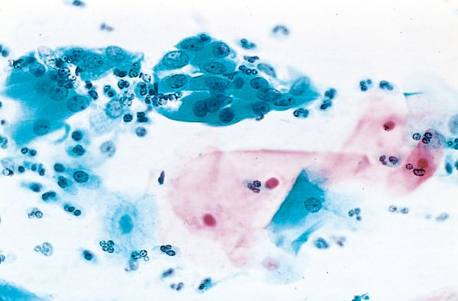

Slide 155
TUMOR MARKERS
Tumor associated enzymes or hormones
Not for definitive diagnosis but for
Screening
Response to therapy
Detecting recurrence
PSA
Cytokeratins (CK)
vimentins
CEA
EMA

Slide 156
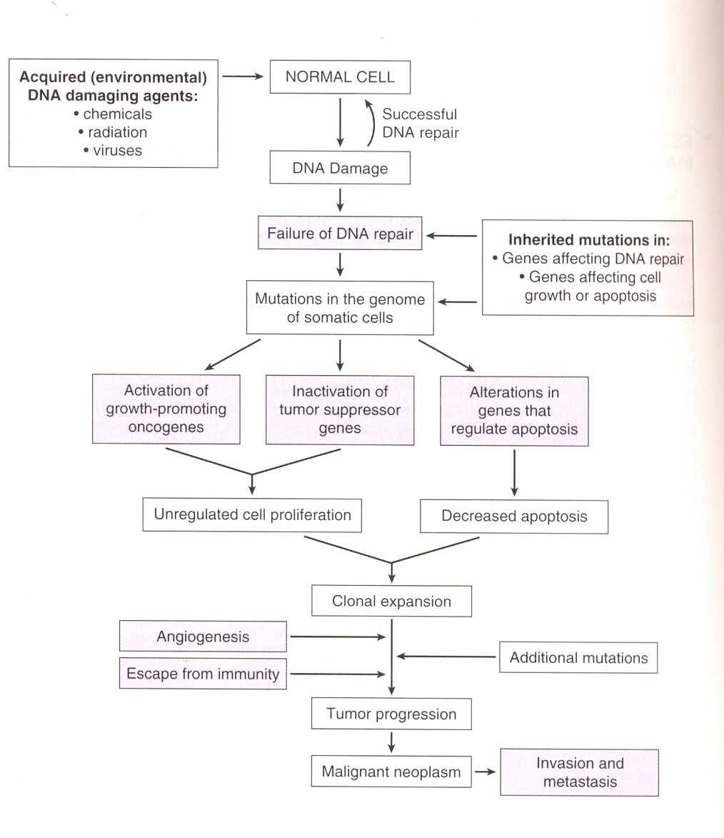

Slide 158
THANK YOU

