Slide 1
MARKET SEGMENTATION
ADVERTISING-II

Slide 2
Market Segmentation
Markets are Heterogeneous; Segmentation divides them into Homogeneous Sub-Units The market for a product is nothing but the aggregate of the consumer of that product Markets break up the heterogeneous market for product into several sub units, or sub markets, each relatively more homogeneous within itself, compared to market into a number of sub markets/ distinct sub units of buyer , each with relatively more homogeneous characteristics, is known as market segmentation.

Slide 3
Market Segmentation

Slide 4
Market Segmentation
Market Segmentation consists of taking the total heterogeneous market for a product & dividing into several sub-market of segments, each of which tends to be homogenous in full significant aspects

Slide 5
Bases for Segmentation
A market/ consumer population for a product can be segmented using several relevant bases. The major ones include:
• Geographic
• Demographics
• Psychographic
• Buying Behavior

Slide 6
Bases for Segmentation

Slide 7
Bases for Segmentation

Slide 8
Market Segmentation

Slide 9
Market Segmentation

Slide 10
Demographics Segmentation

Slide 11
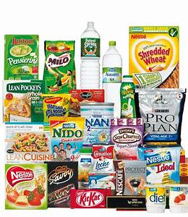
Demographics segmentation
“Divide the market into groups based on variables such as age ,gender, family size, income,occupation,education,religion, race, generation and nationality”

Slide 12
Geographic Segmentation

Slide 13
Geographic Segmentation
Divide a market into different geographical units such as nations, states,regions,countries,cities or neighborhoods”

Slide 14
Psychographic Segmentation

Slide 15
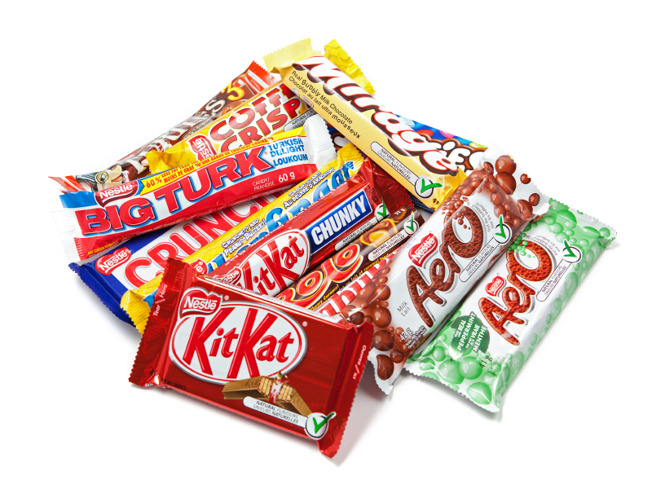
Psychographic Segmentation
Divides buyer into different groups based on social class , lifestyle, or personality characteristics

Slide 16
Behavioral segmentation

Slide 17
Behavioral segmentation
Divides buyer into groups based on their knowledge, attitude, or response to product”

Slide 18
Effective Market Segmentation
Measurability
Accessibility
Substantiality
Differentiability
Actionalbility

Slide 19
Market Targeting
Market targeting refers to picking a specific group or small set of groups to which a business will advertise.
It is based on the idea that, because it's not really possible to make or do something that will please everyone, a business has to specialize.
Companies select an advertising group to strengthen their brands, as well as to get an idea of potential sales for production or financing purposes. They can use three main approaches for this: universal, selective or concentrated. It is common for an organization to reevaluate its target groups and related campaigns over time because markets are always somewhat flexible

Slide 20
Marketing Mix
Marketing Mix is a combination of marketing tools that a company uses to satisfy their target customers and achieving organizational goals. McCarthy classified all these marketing tools under four broad categories:
Product
Price ,
Place ,
Promotion
These four elements are the basic components of a marketing plan and are collectively called 4 P’s of marketing.

Slide 21
Marketing Mix

Slide 22
Marketing Mix
The product is what the company offers to the market and the consumer. The product can be either a tangible good or a service. The product is the 1st category you should consider when work on marketing mix.
It is a fundamental element of the marketing mix; it is responsible for the final profit from the sale of the product. The price is based on the perceived value of the product by the consumer, the cost of the product, the competitors’ prices, and the desired rate of return.
Place of sale designates the company’s product distribution model.
In the context of marketing mix, the notion is understood as all advertising communications or promotions that allow to attract the consumer’s attention.

