Slide 1
COMPLICATIONS OF CARDIAC SURGERY
DR ALLAH NAWAZ
MBBS(K.E),FCPS(PAK)
Consultant general & laparoscopic surgeon
Assistant Professor surgery
TSU DHQ Hospital (UOS)

Slide 2
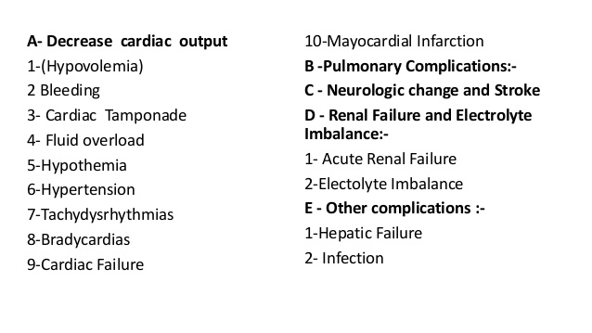

Slide 12
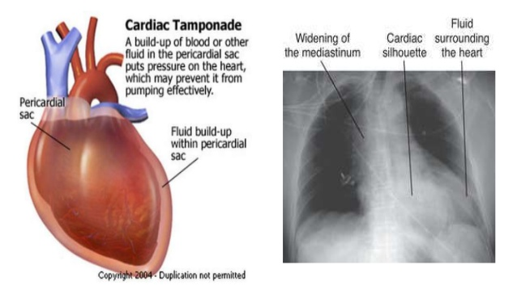

Slide 23
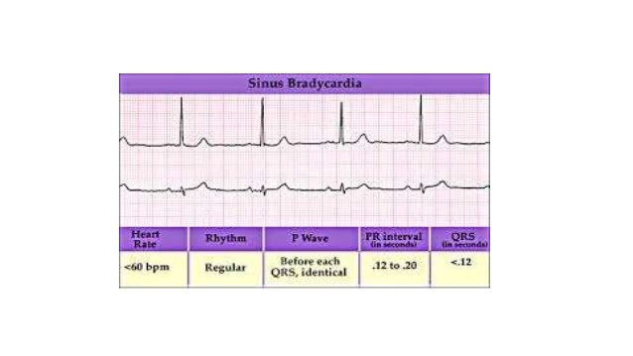

Slide 26
