Slide 2
ECOLOGICAL CONCEPTS OF ECOSYSTEM

Slide 3
ecology
All living organism, whether plant or animal or human being is surrounded by the environment, on which it derive its needs for its survival.
Each living component interacts with non –living components for their basic requirements form different ecosystem.

Slide 4
Ecology
Definition
Ecology is the study of interactions among
organism or group of organisms with their
environment. The environment consists of both biotic
components (living organisms) and abiotic components
(non – living organisms).
or
Ecology is the study of ecosystems.

Slide 5
Ecosystem
Ecosystem is the basic functional unit of ecology.
The term ecosystem is coined form a Greek word meaning study of home.
Definition
A group of organisms interacting among themselves and with environment is known as ecosystem. Thus an ecosystem is a community of different species interacting with one another and with their non living environment and one another and with their
non- living environment exchanging energy and matter.
Example
Animals cannot synthesis their food directly
but depend on the plants either directly or indirectly.

Slide 6
Types of ecosystem
Natural ecosystem
Artificial/man engineered
Terrestial ------Aquatic
Marine ------Fresh water

Slide 7
TYPES OF ECOSYSTEM
Natural ecosystem
Natural ecosystems operate themselves under natural conditions.
Based on habitat types, it can be further classified into .
1. Terrestrial ecosystem
This ecosystem is related to land.
Example
Grassland ecosystem, forest ecosystem, desert ecosystem, etc.,
2. Aquatic ecosystem
This ecosystem is related to water. It is further sub
classified into two types based on salt content.
Fresh water ecosystem
Running water ecosystems.
Examples
Rivers, Streams

Slide 8
(b) Standing water ecosystems
Examples
Pond, lake
Marine ecosystem
Example :
Seas and sea shores
Man – made (or) Artificial ecosystems
Artificial ecosystem is operated (or) maintained by man himself.
Example
Croplands, gardens

Slide 9
STRUCTURE (or) COMPONENTS OF AN ECOSYSTEM
The term structure refers to the various components.
So the structure of an ecosystem explains the relationship
between the abiotic (non –living) and the biotic (living) components.
An ecosystem has two major components
Biotic (living) components
Abiotic (non living) components
Biotic components
The living organisms (or) living members in an ecosystem collectively form its community
called biotic components (or) biotic community.
Examples
Plants (producers), animals (consumers), and microorganisms (decomposers).

Slide 10
Producer (plants)
Consumer (Animals)
Decomposers (Micro-organisms)
I. Procedures (Autotrophs)
Procedures synthesize their food themselves
through photosynthesis
Example :
All green plants, trees.
Photosynthesis
The green pigments called chlorophyll, present in
the leaves of plants,
converts CO₂ and H₂O in the presence of sunlight into
carbohydrates.
6CO₂ + 12H₂O ----------------------> C₆H₁₂O₆ + 6O₂+6H₂O
This process is called photosynthesis

Slide 11
2. Consumers (heterotrophs)
Examples
Plant eating species
Insects, rabbit, goat, deer, cow, etc.,
Classification of consumers
Consumers are further classified as
(i) Primary consumers (Herbivores) (Plant eaters)
Primary consumers are also called herbivores,
they directly depend on the plants for their food. So they are called plant eaters.
Examples :
Insects, rat, goat, deer, cow, horse, etc.,

Slide 12
(ii)-Secondary consumers (primary carnivores) (meat eater)
Secondary consumers are primary carnivores, they feed on primary consumers.
They directly depend on the herbivores for their food.
Example
Frog, cat, snakes, foxes, etc.,
(iii)-Tertiary consumers (Secondary carnivores) (Meateaters)
Teritiary consumers are secondary carnivores, they feed on secondary consumers.
They depend on the primary carnivores for their food.
Examples
Tigers, lions, etc.,

Slide 13
3. Decomposers
Examples
Microorganisms like bacteria and fungi.
Decomposers attack the dead bodies of producers and consumers and decompose them into simpler compounds. During the decomposition inorganic nutrients are released.
The inorganic nutrients together with other organic substances are then utilized by the procedures for the synthesis of their own food.

Slide 14
2. Abiotic (non-living) components
The non-living components (physical and chemical)
of ecosystem collectively form a community called abiotic components (or) abiotic community.
Examples
Climate, soil, water l air, energy, nutrients, etc.,
Physical components
They include the energy, climate, raw materials and
living space that the biological community needs. They are useful for the growth and maintenance of its member.
Example
Air, water, soil, sunlight, etc.,

Slide 15
2. Chemical Components
They are the sources of essential nutrients
Examples
Organic substances : Protein, lipids, carbohydrates, etc., (ii) Inorganic substances:
All micro (Al, Co, Zu, Cu) and macro elements (C,H, O, P, N, P, K) and few other elements.

Slide 16
Types of Functions
Functions of an ecosystem are of three types.
1. Primary function
The primary function of all ecosystem is
manufacture of starch (photosynthesis).
2. Secondary function
The secondary function of all ecosystem is distribution energy in the form of food to all consumers.

Slide 17
(iii)Tertiary Function
All living systems diet at a particular stage. These dead systems are decomposed to initiate third function of ecosystems namely “cycling”.
The functioning of an ecosystems may be understood
studying the following terms.
Food chains
Food webs
Food pyramids

Slide 18
FOOD CHAINS
Definition
“There sequence of eating and being eaten in an ecosystem is known as food chain”
(or)
“Transfer of food energy from the plants through a series of organisms is known as food chain”
When the organisms die, they are all decomposed by microorganism (bacteria and fungi) into nutrients that can again be used by the plants. At each and every transfer, nearly 80-90% of the potential
energy gets lost as heat.
A food chain always starts with plant life and ends with animal.
Herbivores
Animal that eat only plants are called herbivores.
Carnivores
Animals that eat other animals are called carnivores.

Slide 19
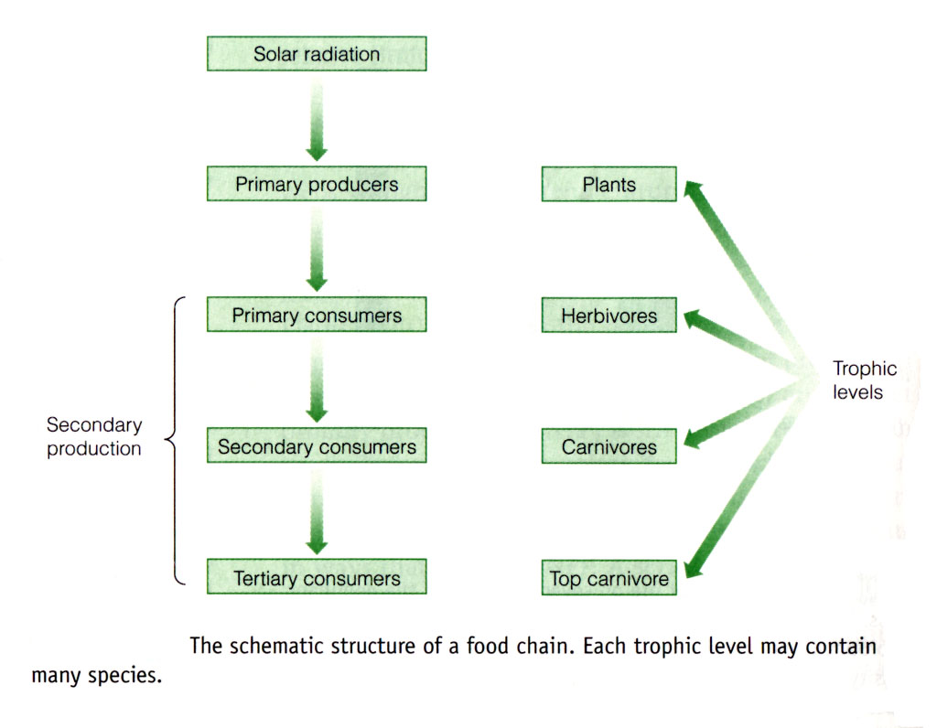
Trophic level: All the organisms that are the same number of food-chain steps from the primary source of energy
Modified from: General Ecology, by David T. Krome

Slide 20
Tropic Levels (T1,T2, T3, T4, T5) (or) Feeding levels
The various steps through which food energy passes in an ecosystem is called as tropic levels.
The tropic levels are arranged in the following way as
The green plants or producers represent first tropic level T1,
The herbiovores or primary consumers represent second tropic level T2.
The carnivores or secondary consumers represent third tropic level T3.
The tertiary consumers are fourth tropic level T4.
Finally decomposers represent last tropic level T5

Slide 21
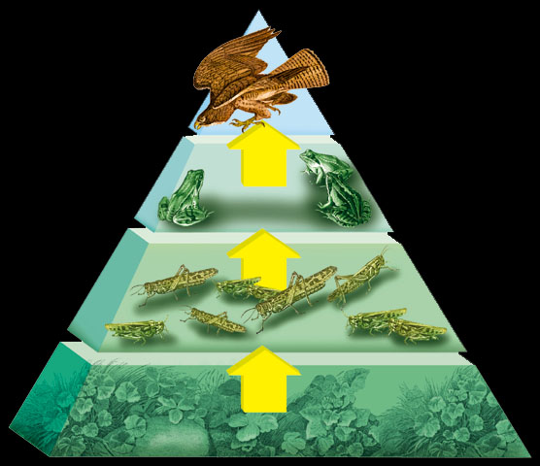
Trophic Levels Found on an Energy Pyramid
The greatest amount of energy is found at the base of the pyramid.
The least amount of energy is found at top of the pyramid.
Source: corpuschristiisd.org/user_files/91702/Ecosystem.ppt

Slide 22
Types of food chain
Food chains are classified into two main types
Grazing food chain
Detritus food chain
1. Grazing food chain
Found in Grassland ecosystems and pond ecosystems.
Grazing food chain starts with green plants (primary procedures) and goes to decomposer.
2. Detritus food chain
Found in Grassland ecosystems and forest ecosystems.
Detritus food chain starts with dead organic matter (plants and animals) and goes to decomposer food chain through herbivores and carnivores.
.

Slide 23
FOOD WEB
Definition
The interlocking pattern of various food chains in an ecosystem is known as food web.
In a food web many food chains are interconnected, where different types of organisms are connected at different trophic levels, so that there is a number of opportunities of eating and being eaten
at each trophic level.+
Example
Grass may be eaten by insects, rats, deers, etc., these may be eaten by carnivores (snake, tiger).
Thus there is a interlocking of various food chains called food webs.

Slide 24
Difference between food chains and food web
In a linear food chains if one species gets affected (or) becomes extinct, then the species in the subsequent tropic levels are also affected.
But, in a food web, if one species gets affected, it doest not affect other tropic levels so .
There are number of options available at each tropic level.
Significance of food chains and food webs
Food chains and food webs play a very important role in the ecosystem. Energy flow and nutrient cycling takes place through them.
2. They maintain and regulate the population size of different tropic levels, and thus help in maintaining ecological balance.
3. they have the property of biomagnification. The non – biodegradable materials keep on passing from one tropic level to another. At each successive tropic level, the concentration keep on increasing.
This process is known as biomagnification.

Slide 25
ECLOGICAL PYRAMIDS
Definition
“Graphical representation of structure and function of tropic level of an ecosystem, starting with producers at the bottom and each successive tropic levels forming the apex is known as an ecological pyramids.”
In food chain starting from the producers to the consumers, there is a regular decrease in the properties (ie., energy, biomass and number of the organisms). Since some energy is lost as heat in each tropic levels, it becomes progressively smaller near the top.

Slide 26
Types of Ecological, pyramids
Ecological pyramids are of three types.
1. Pyramid of numbers.
2. Pyramid of energy. L
3. Pyramid of biomass.
I. Pyramids of numbers
It represents the number of individual organisms present ach tropic levels.
2. Pyramids of energy
It represents the amount of energy present in each tropic levels. The rate of energy flow and the productivity at each successive tropic level.
At every successive tropic level, there is a heavy of energy (about 90%) in the form of heat. Thus at each next higher tropic level only 10% of the energy is transferred Hence, there is a sharp decrease in energy at each and every successive tropic level as we move from producers to top levels.

Slide 27
3-Pyramids of Biomass
It represents the total amount of biomass (dry mass of organic material in an organism) present in each tropic levels.

Slide 28
For Your Attention

