Slide 1
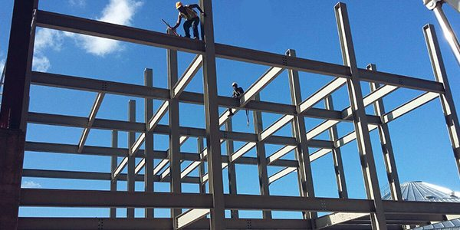
COLLEGE OF ENGINEERING AND TECHNOLOGY UNIVERSITY OF SARGODHA Theory Of Structures (CT-226) (B.S TECHNOLOGY)
07-May-2020
ONLINE LECTURE-8
Moment Dsitribution Method
Engr. Aqeel Ahmed
Lecturer, CET, UOS, Sargodha

Slide 4
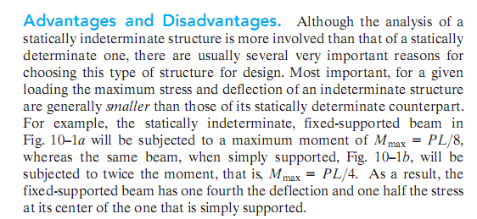

Slide 5
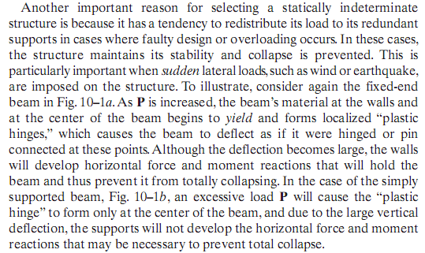

Slide 6
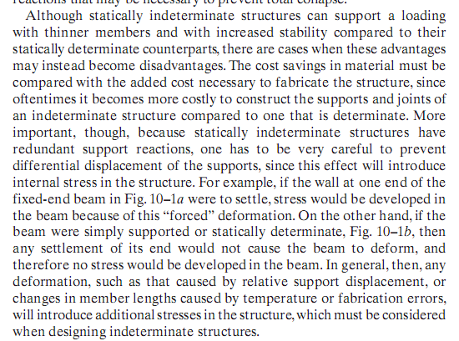

Slide 7
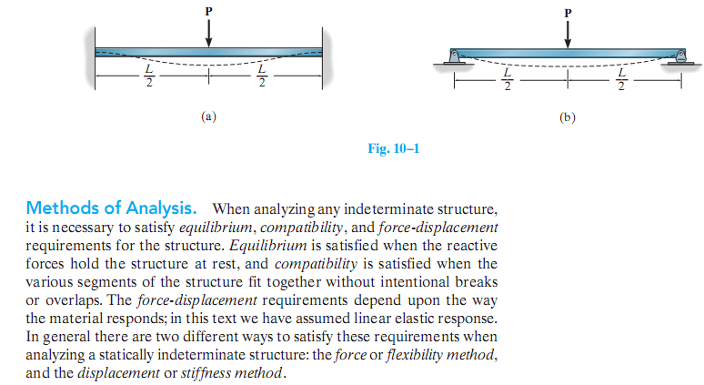

Slide 10
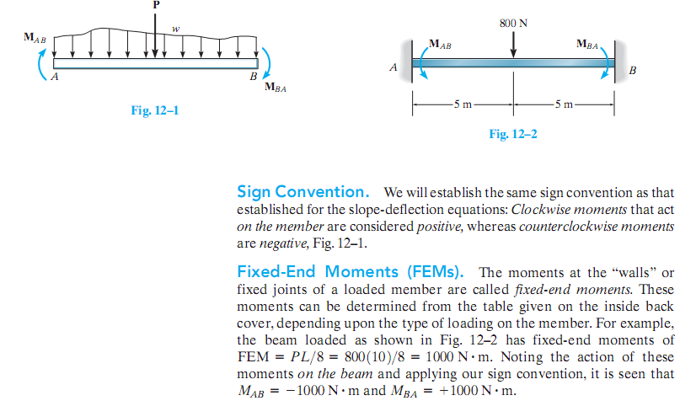

Slide 11
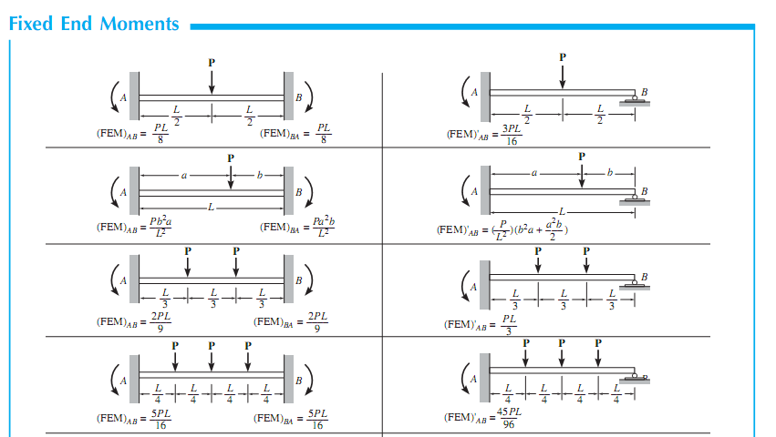

Slide 12
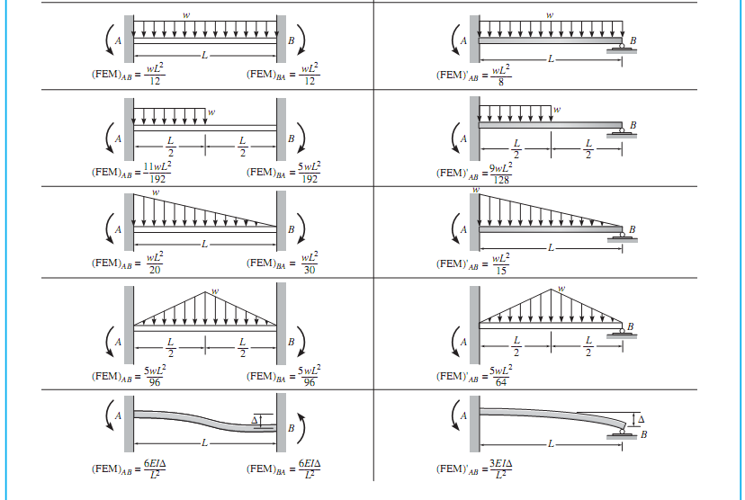

Slide 13
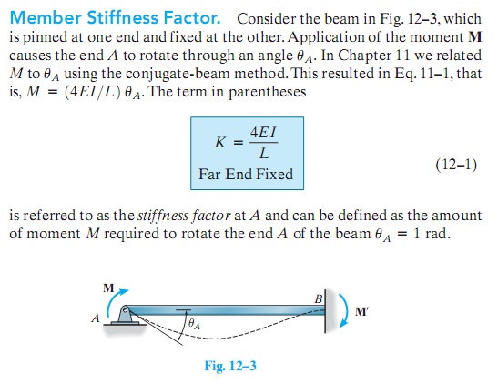

Slide 15
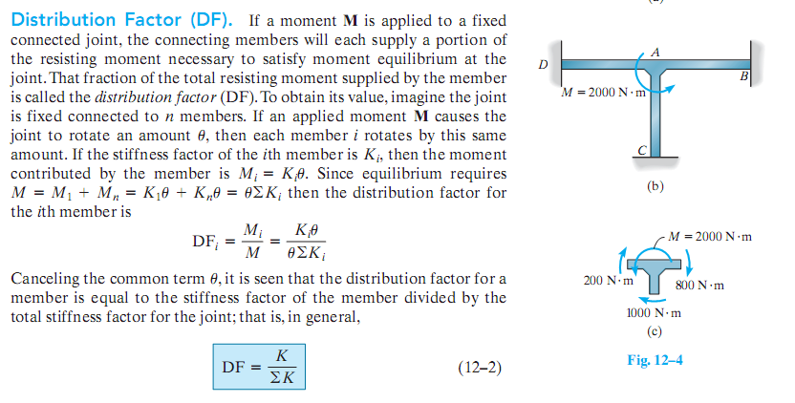

Slide 16
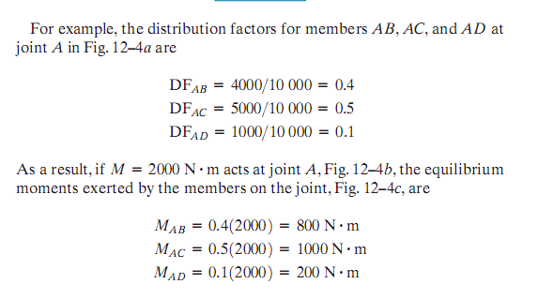

Slide 18
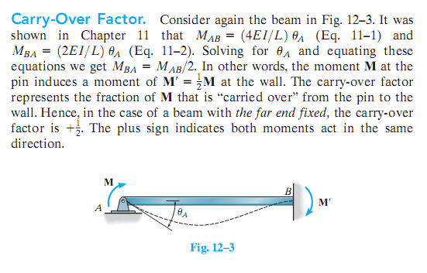

Slide 21
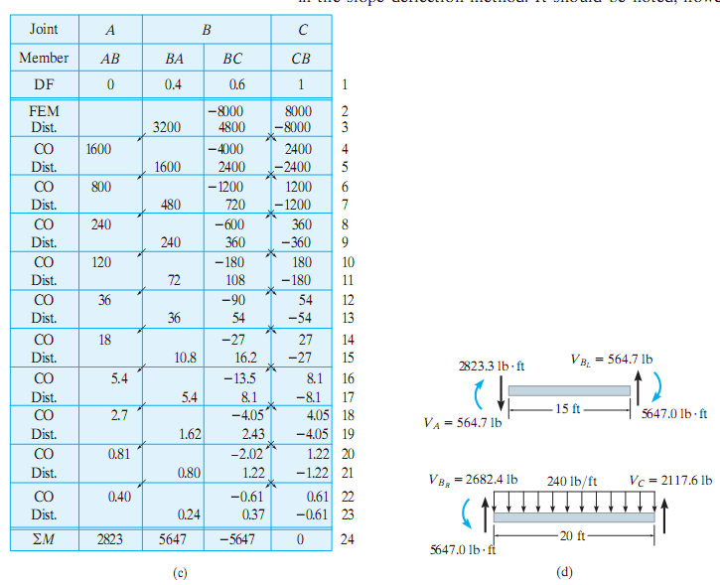

Slide 22
