Slide 1
Ankle Foot Orthoses
DR.AYESHA BHATTI
PP.DPT, BSPT

Slide 2
Ankle foot orthosis
An ankle-foot orthosis (AFO) is an orthosis or brace that encumbers the ankle and foot. AFOs are externally applied and intended to control position and motion of the ankle, compensate for weakness, or correct deformities.
AFOs can be used to support weak limbs, or to position a limb with contracted muscles into a more normal position. They are also used to immobilize the ankle and lower leg in the presence of arthritis or fracture, and to correct foot drop; an AFO is also known as a foot-drop brace.
Ankle-foot orthoses are the most commonly used orthoses, making up about 26% of all orthoses provided in the United States.
According to a review of Medicare payment data from 2001 to 2006, the base cost of an AFO was about $500 to $700.
An AFO is generally constructed of lightweight polypropylene-based plastic in the shape of an "L", with the upright portion behind the calf and the lower portion running under the foot. They are attached to the calf with a strap, and are made to fit inside accommodative shoes. The unbroken "L" shape of some designs provides rigidity, while other designs (with a jointed ankle) provide different types of control.
OBTAINING A GOOD FIT WITH AN AFO INVOLVES ONE OF TWO APPROACHES:
prefabricated AFO matched in size to the end user
custom manufacture of an individualized AFO from a positive model, obtained from a negative cast or the use of computer-aided imaging, design, and milling. The plastic used to create a durable AFO must be heated to 400°F., making direct molding of the material on the end user impossible.

Slide 3
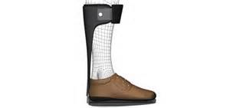
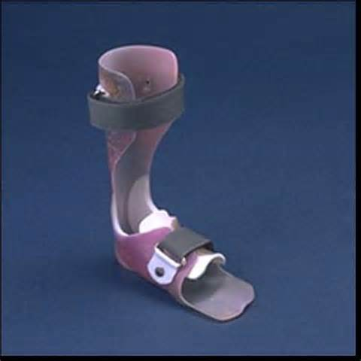
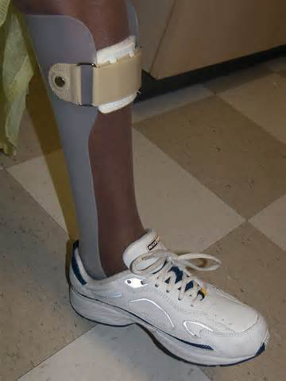

Slide 4
uses /advantages of Ankle orthosis
Ankle orthotics may potentially be useful after an acute ankle injury (acute ankle sprain (ligament injury) or fracture), for rehabilitation, to prevent ankle re-injury, and for chronically unstable ankles. Whether a specific ankle orthotic is effective depends on the particular indication for its use.
There are 4 potential uses for ankle supports: (i) treatment of acute injury (i.e., beginning within 3 days following injury); (ii) rehabilitation (for the first few weeks following injury until full function is obtained); (iii) prophylaxis and (iv) treatment of chronic instability. The length of time that ankle supports need to be used following injury varies depending largely on the type and severity of the injury

Slide 5
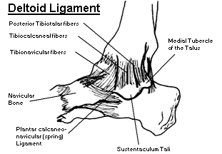
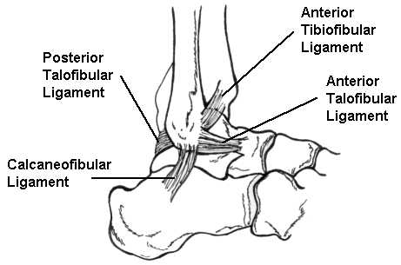

Slide 6
Uses/advantages of Ankle orthosis
1: Treatment after acute injury: The ankle begins to swell after injury, and swelling continues to increase for about 3 days following injury. Significant swelling persists for about 2 weeks following injury.
2: Rehabilitation: Ankle supports have been used for the first few weeks following injury to prevent re-injury during early return to activity.
After the pain has subsided and the patient can walk without a limp, use of the ankle support is only appropriate during high-risk activities (i.e., especially racquetball, football, and basketball). Leaving the ankle support on all the time only serves to restrict functional range of motion and encourage psychological dependence.
3: Prophylaxis: (used primarily in patients with a history of ankle injury);

Slide 7
Uses/advantages of Ankle orthosis
4: Chronic instability :Ankle supports are used to stabilize the ankle in patients with chronic instability. In most instances, they are to be used only during high-risk sports and activities. It is unusual for ankle supports to be prescribed for use during normal daily activities.
Many types of ankle supports exist as an alternative to ankle taping. In addition, shoes for some sports (particularly basketball) are available with high tops and built in straps for additional ankle protection.
Recent studies have shown that use of ankle supports during early rehabilitation of acute grade I or grade II ankle sprains (partial ligament rupture) produced results as good as cast immobilization, with more rapid return to activity.

Slide 8
Types of ankle-foot orthosis

Slide 9
1: Taping
A number of studies have supported the use of tape in helping stabilize the ankle and reducing sprains in persons with previous sprains.
The goal of taping is to prevent the ankle ligaments from being stressed to the point of injury. Taping should limit ankle inversion and eversion but allow functional dorsiflexion and plantarflexion. There is evidence that ankle taping also helps prevent injury by stimulating proprioceptive (position-sense) nerve fibers, causing the peroneus brevis muscle to be activated just before heel strike.
For treatment of acute injury (beginning within about 3 days following injury), taping may be used to provide support and to help reduce edema (swelling). Felt or foam pads may be applied under the tape to help reduce edema.
Taping may be used for rehabilitation (i.e., to prevent re-injury during early return to activity). About 3 days after the injury, swelling subsides, and tape is re-applied to decrease the risk of re-injury.
Using tape to prevent injury, however, is a time-consuming procedure, so it is recommended for early stages of rehabilitation only. Tape may be applied for the first few weeks after return to activity for rehabilitation of ankle injuries.

Slide 10
1: Taping
Taping may be used prophylactically in persons with or without a prior ankle sprain, although it is not recommended for routine use for this indication.
Although taping probably reduces the rate of ankle injuries, it loses support rapidly with movement and sweating. This is not as much as a factor in acute sprains, because in which tape is not stressed so much. For use prophylactically, however, it is not a time- and cost-effective option compared to the alternatives described below.
Taping has also been recommended as a possible treatment for chronic instability, although it is not recommended for routine use in this situation. With movement and sweating, tape rapidly loses support. Also, if used permanently, tape becomes expensive. This approach is probably not as cost- and time-effective as other options described below.

Slide 11
1: Taping
One-inch wide standard tape is used for the foot, and 1½-inch tape for the ankle. Areas sensitive to blistering must be protected with lubricated gauze sponges. Special adherent spray may be applied under the tape. If tape is to be re-applied often, an under-wrap is used to prevent chronic skin irritation.
Tape should only be wrapped by a person well-trained in its application, such as a trainer, physician, nurse, or physician assistant. Improperly applied tape may cause further injury.
Elastic tape has also been studied, and although it provides more compression than non-elastic tape, it loses its restriction of range of motion even more than standard tape.
Tape and wrapping does not meet the durability requirement for covered durable medical equipment, in that it is not reusable and is not “made to withstand prolonged use.” Although Aetna will cover taping or wrapping provided by a healthcare provider in their office, take-home tape and wrapping are not covered.

Slide 12
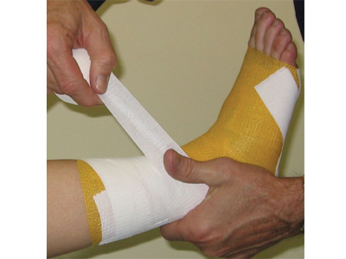
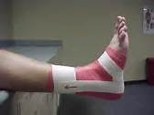

Slide 13
2: Elastic wrapping and sleeves
Wrapping with elastic bandages is useful in the early stages (about the first 3 days) of ankle sprain/soft tissue injury to provide compression that reduces swelling. It is used as an adjunct to ice and elevation.
It needs to be changed often to monitor the skin. Wrapping has not been proven to be useful for other indications: prevention of re-injury, prophylactic use, and use for chronic ankle instability. This is because wrapping provides little or no support during activity.
Elastic ankle sleeves that are pulled over the foot like open-ended socks offer no value as supports. They may, however, enhance proprioception.

Slide 14
2: Elastic wrapping and sleeves
They may also provide even compression to reduce ankle edema. Thus, they have been shown to be useful only in treating an acute ankle sprain (i.e., within about 3 days after injury). Like elastic wrapping, elastic ankle sleeves have not been proven to be useful for rehabilitation, prophylaxis, or use in chronically unstable ankles.
Certain manufacturers, e.g., Stromgen, combine the comfort of even compression by using Spandex, elastic, and Velcro strap combinations to restrict eversion, and inversion. They have been used primarily for prophylaxis.

Slide 15
3: Bracing
Like taping, bracing can be used in an acute injury, during rehabilitation to prevent re-injury, prophylactically, and in chronically unstable ankles. Braces come in 3 main types:
casts, lace-up wraps, and plastic orthoses. Casts can be either semi-rigid or rigid; lace-up braces and plastic orthoses are considered semi-rigid.
Braces have been shown to have several advantages over taping. They can be used by persons who do not have access to a person skilled in taping techniques. In some cases, they can be more cost-effective than taping.
But some braces may migrate during vigorous movement because of the lack of adhesion to skin. This movement may cause the brace to fail to provide support. But tape adhesion or straps to reduce migration may help.
During wear-and-tear, Velcro fasteners tend to fail and release, straps or buckles break, and elastic stretches out. Off-the-shelf braces may not fit persons who are too tall, are obese, or deformed. Custom-made braces are available, but are generally more expensive.

Slide 16
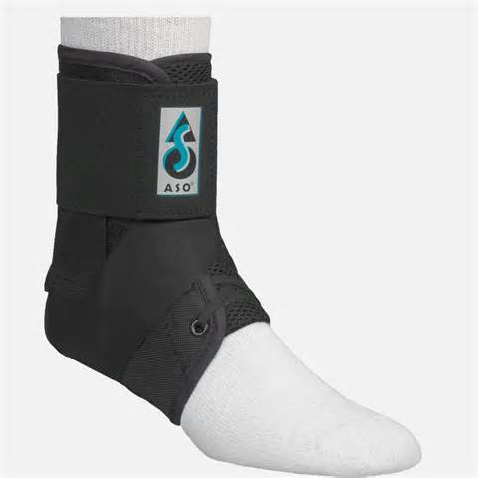
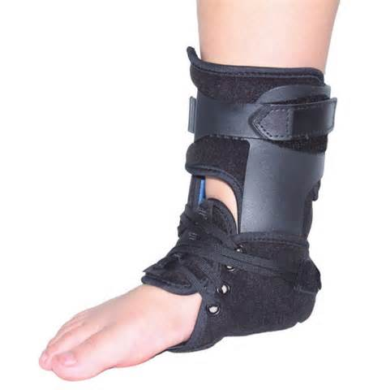

Slide 17
4: Air-stirrups:
The air-stirrup is a pre-fabricated semi-rigid orthosis. The largest-selling brand is the Aircast air-stirrup ankle brace (Aircast), which is composed of a rigid outer plastic shell that fits up both sides of the leg and is connected under the heel. It is lined with inner air bags and is attached to the leg with Velcro. As with lace-up ankle supports, some clinicians combine use of the air-stirrup with taping. The air-stirrup is an off-the-shelf device that does not require custom fitting. It can be worn under regular shoes.
The air-stirrup decreases inversion and eversion, and protects the already injured ligament and soft tissues from re-injury, thereby decreasing rehabilitation time. The pressure in the air-stirrup increases when weight-bearing, which is thought to provide intermittent compression during walking that aids in the milking out of edematous fluid. The air-stirrup can also be readjusted to allow total contact fitting while swelling is fluctuating.
The air-stirrup can be used after acute ankle sprains and in the early stages of rehabilitation to prevent recurrent sprain. It can also be used after rigid casting and for treatment of some fractures. There is currently insufficient evidence for their use for prophylaxis or in chronic instability, although some newer variations of the splint have been designed for this purpose.

Slide 18
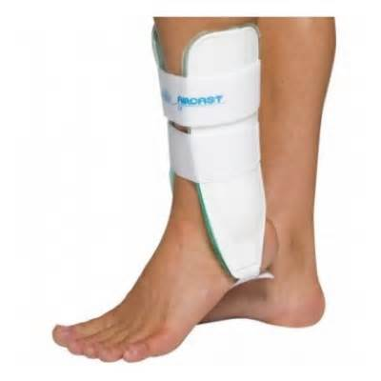
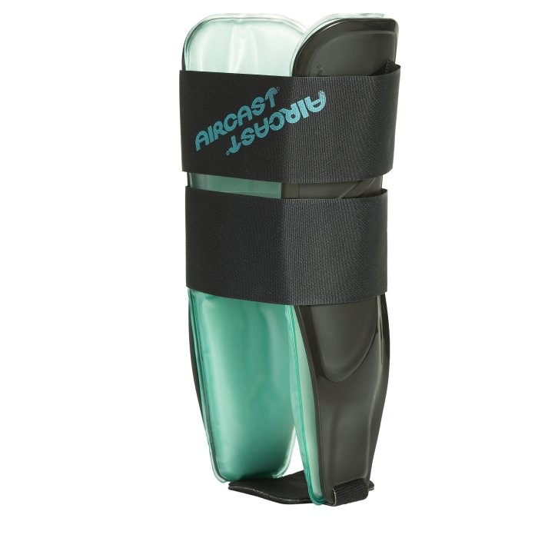

Slide 19
5: Orthoplast Stirrup:
The orthoplast stirrup is a strip of thermoplastic material custom-fitted to run under the heel and up both sides of the leg. The ankle bones (malleoli) and other bony prominences are covered with foam padding, and the stirrup is fitted with an elastic bandage.
Orthoplast is a low-temperature thermoplastic that becomes pliable when submerged in hot water. It is applied directly to the patient and molded evenly around the ankle. The fabrication is simple enough to be carried out in the office or clinic.
The orthoplast stirrup has been successfully used to treat ankle sprains, but because it is relatively hard, it does not adapt to reduction in swelling. It has not been shown to decrease inversion range of motion more than tape, and is most commonly used in the acute or early rehabilitative stages. Orthoplast deteriorates with long-term use, limiting its usefulness in prophylaxis and for chronic ankle sprains.

Slide 20
6: stabilizing shoes
Several shoe designs have been used for prevention and treatment of ankle sprains.
Acute injury, rehabilitation, and chronic instability: The use of ankle-stabilizing shoes, such as the Kunzli line of shoes (Swiss Balance, Santa Monica, CA), to treat ankle sprain and to prevent re-injury have not been studied adequately to date.
Prophylaxis: High-topped shoes have been shown to increase ankle stiffness in sports. However, the advantage of high-topped shoes over low-topped shoes in prophylaxis has been shown to be relatively small. The prophylactic benefits of various shoe types in sports have not been adequately investigated.

Slide 21
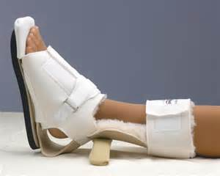
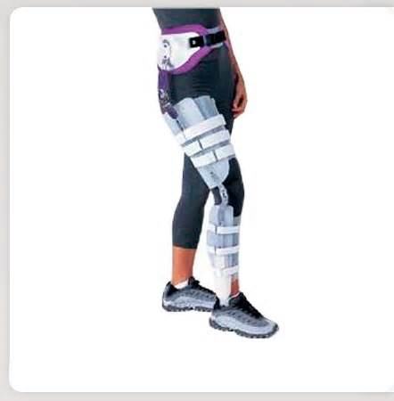
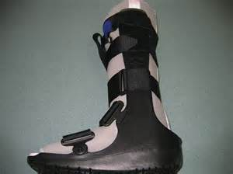

Slide 22
7: Ankle contraction splint:
According to Medicare Durable Medical Equipment Carrier Guidelines, an ankle contracture splint is a pre-fabricated AFO that has all of the following characteristics:
Applies a dorsiflexion force to the ankle , and
Designed to accommodate an ankle with a plantar flexion contracture up to 45°, and Has a soft interface, and Used by a patient who is non-ambulatory.
Ankle flexion contracture is a condition in which there is shortening of the muscles and/or tendons that plantarflex the ankle with the resulting inability to bring the ankle to 0 degrees by passive range of motion. (0 degrees ankle position is when the foot is perpendicular to the lower leg.)

Slide 23
8:Foot drop splint:
A foot drop splint/recumbent positioning device is a pre-fabricated AFO, which has all of the following characteristics:
Designed to maintain the foot at a fixed position of 0° (i.e., perpendicular to the lower leg), and Has a soft interface, and Not designed to accommodate an ankle with a plantar flexion contracture, and
Used by a patient who is non-ambulatory.
Foot drop is a condition in which there is weakness and/or lack of use of the muscles that dorsiflex the ankle but there is the ability to bring the ankle to 0 degrees by passive range of motion.
Foot and ankle orthoses for rheumatoid

Slide 24
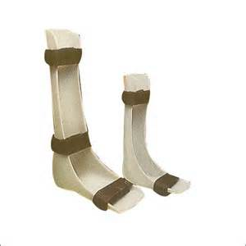
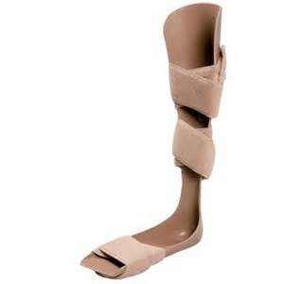
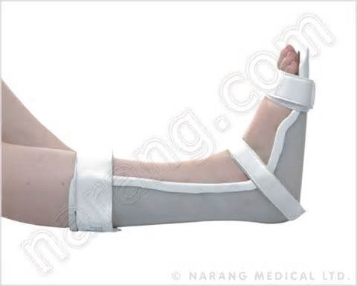
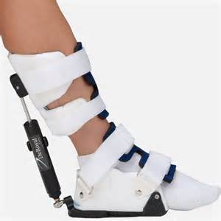

Slide 25
Ankle Control
Most AFO., are prescribed to control ankle motion by limiting plantar flexion and/or dorsi-flexion or by assisting motion.
The patient with dorsiflexor weakness or paralysis risks dragging the toe during swing phase.
Dorsiflexion assistance can be provided by a posterior leaf spring that arises from plastic insert. (31-14). The upright is bent backward slightly during early stance, when the patient progresses into swing phase the plastic recoils to fit the foot. Thin ,narrow plastic permits relatively greater motion.
Motion assistance can also be achieved with a steel dorsiflexion spring assist (klenzak joint 31-1) incorporated into each stirrup. The coil spring is compressed in stance and rebounds during swing.
The tightness of coil can be adjusted but orthosis is noticeably Bulkier than the posterior leaf spring model. Both types of spring assist will slightly into planterflexion at heel contact, affording the wearer protection against inadvertent knee flexion.

Slide 26
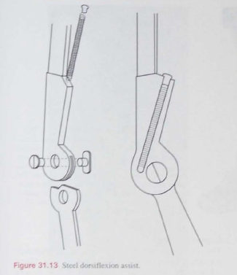
Toe off: AFO, ankle dorsiflexion assistance(31-14)

Slide 27
Ankle control
The alternate approach to prevent toe drag is planter flexion resistance, which prevent the foot from planter flexion so that patient with drop foot will not catch the toe and stumble during swing phase.

Slide 28
Ankle control
The solid ankle orthosis may be divided transversely at ankle, with the two sections hinged, creating the hinged solid ankle foot orthosis(lFig. 31.16). It provides slight sagital motion. Fostering achievement of the foot-flat position in early stance and enabling some patients with hemiplegia to walk with increased stride length and cadence.”
Children with spastic-diplegia preferred the hinged AFO, rather than the solid AFO, although gait velocity, cadence and stride length were unaffected.
An alternative to the plastic solid ankle AFO is metal joint that resists both plantar ﬂexian and dorsi ﬂexion known as limited motion joint. One type of limited motion joint is a pair of Bichannel adjustment ankle joint (BiCAALs) (Fig. 3l.l9) which consist of pair joint, each of which has an anterior and a posterior spring.

Slide 29
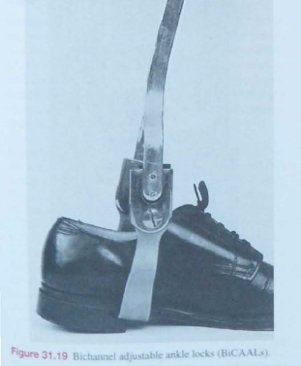
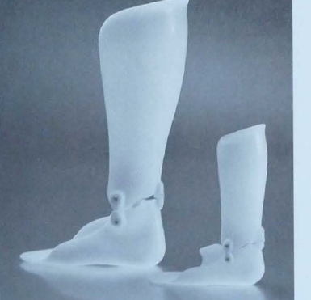
31-16 plastic hinged AFO

Slide 30
Foot control
Medial lateral motion can be controlled with solid ankle AFO.
The rigidity of the orhosis can be increased by using thicker or stiffer plastic, corrugating the plastic forming the edges with a rolled contour. or embedding carbon ﬁber reinforecemnt.
A solid ankle AFO (see Fig 3l.l8) or A hinged solid ankle AFO (see Fig. 3 I. I6) also controls frontal and transverse plane foot motion

Slide 31
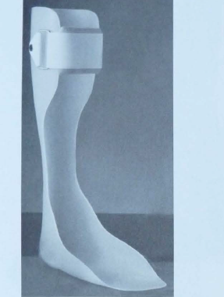
31-18. plastic solid AFO. A plastic solid hinged AFO(31-16)

Slide 32
Knee-ankle-foot orthosis (KAFOs)
A knee-ankle-foot orthosis (KAFO) is an orthosis that encumbers the knee, ankle and foot.
Motion at all three of these lower limb areas is affected by a KAFO and can include stopping motion, limiting motion, or assisting motion in any or all of the 3 planes of motion in a human joint: saggital, coronal, and axial.
Mechanical hinges, as well as electrically controlled hinges have been used. Various materials for fabrication of a KAFO include but are not limited to metals, plastics, fabrics, and leather.
Conditions that might benefit from the use of a KAFO include paralysis, joint laxity or arthritis, fracture, and others.
Although not as widely used as knee orthoses, KAFOs can make a real difference in the life of a paralyzed person, helping them to walk therapeutically or, in the case of polio patients on a community level.

Slide 33
CONTINUE…….
These devices are expensive and require maintenance. Some research is being done to enhance the design.
The term KAFO is an acronym that stands for Knee-Ankle-Foot Orthosis and describes the part of the body that this device encompasses.
This device extends from the thigh to the foot and is generally used to control instabilities in the lower limb by maintaining alignment and controlling motion.
Instabilities can be either due to skeletal problems: broken bones, arthritic joints, bowleg, knock-knee, knee hyperextension or muscular weakness and paralysis. With this in mind, the indications for the use of a KAFO are many and varied and any one particular design is specific to the needs of the person it is made for.

Slide 34
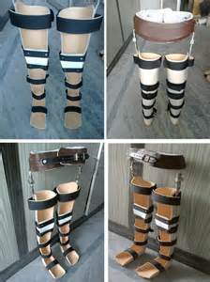
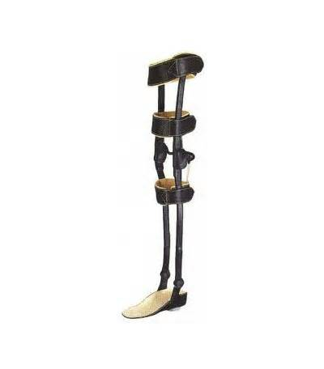

Slide 35
There are two very general categories of KAFOs/ knee control
Metal designs (See Figure 1) and plastic and metal designs (See Figures 2 and 3).
The metal design consists of a metal structure shaped to the limb and upholstered with leather at the points where the device makes contact with a person’s body.
The plastic and metal design is the one most frequently encountered today and is usually a plastic device custom molded to the person’s body with metal components in key structural areas only.
The reason for the increased use of the plastic and metal design is that it is lighter in weight and is considered to be more cosmetic.
Some KAFOs may have drop locks at the knee joint (See Figure 4).
A drop lock allows the knee to be kept in extension or straight while walking (See Figure 5), and the joints can be unlocked for sitting (See Figure 6).
Drop locks would be used for someone with severe knee instability.

Slide 36
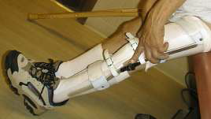
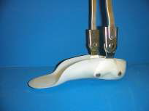
2,3,4,

Slide 37
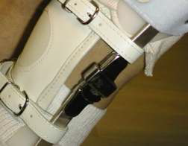
5.6

Slide 38
Application:
Since there are many different reasons to use a KAFO, there are many different designs. Each design has its own special features and its own specific way to be put on properly.
The orthotist providing the device will instruct the patient on the proper way to put the KAFO on at the fitting to make best use of the design features of the device.
The following instructions are for putting on a basic plastic KAFO with metal uprights:
1. While sitting, position the thigh and the leg inside the KAFO (Figure 4).
2. Position the heel completely back into the plastic of the KAFO (Figure 5).
3. Secure the Velcro strap across the instep (See Figure 6).
4. Continue fastening the Velcro straps up the leg and the thigh (Figure 7).
The foot can then be inserted into the shoe. If necessary, the insole of the shoe can be removed to allow for more room for the foot portion of the KAFO.

Slide 39
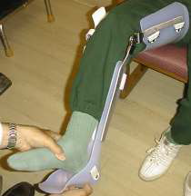
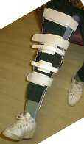
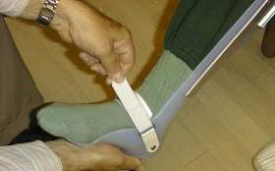

Slide 40
Wearing Schedule:
On the first day you receive the brace, begin by wearing for only 1 hour. After 1 hour, remove the brace and check your skin for red marks. Some small, light red marks may be noticed on the skin that should go away in 20 to 30 minutes after removing the brace.
Slight redness is common over the instep and under the ball of the foot. If the red marks do not go away in 20 to 30 minutes or if you notice any scratching, bruising, or blistering, do not put the brace back on.
Call immediately to schedule an appointment with your orthotist.
If the skin is ok, wait at least 1 hour and then put the brace back on for 1 hour at a time for the rest of the first day, checking the skin after each hour.
On the second day, put the brace on for 2 hours. After 2 hours, remove the brace and check the skin.
If the skin is ok, put the brace back on for 2 hours at a time for the rest of the day, checking the skin after every 2 hours. If your skin is ok, gradually increase wearing time by 1 hour each day, checking the skin after each wearing time.

Slide 41
Knee orthosis (KO)
A knee orthosis (KO) or knee brace is a brace that extends above and below the knee joint and is generally worn to support or align the knee.
In the case of diseases causing neurological or muscular impairment of muscles surrounding the knee, a KO can prevent flexion or extension instability of the knee.
In the case of conditions affecting the ligaments or cartilage of the knee, a KO can provide stabilization to the knee by replacing the function of these injured or damaged parts.
For instance, knee braces can be used to relieve pressure from the part of the knee joint affected by diseases such as arthritis or osteoarthritis by realigning the knee joint into valgus or varus. In this way a KO may help reduce osteoarthritis pain.
However, a knee brace is not meant to treat an injury or disease on its own, but is used as a component of treatment along with drugs, physical therapy and possibly surgery. When used properly, a knee brace may help an individual to stay active by enhancing the position and movement of the knee or reducing pain.

Slide 42
Cleaning and Maintenance:
The best way to clean a KAFO is to spray the inside with rubbing alcohol and wipe dry to remove body oils and residue. It can also be cleaned by wiping it out with a damp towel and anti-bacterial soap or anti-bacterial moist towelettes.
Do not immerse the KAFO in water, as this will harm the instep strap and metal fasteners.
Keep the KAFO away from excessive heat to prevent damage to the plastic.
Tips and Problem Solving:
• KAFOs should always be worn with socks and shoes and also some type of fabric
comfort and wick perspiration.
• The best type of shoe to use is a basic gym shoe with the laces or Velcro extending well down the front of the shoe. This provides adjustability and allows the shoe to accommodate the added dimension of the device in the shoe without having an excessively large shoe on the opposite foot.
• If you notice red marks, bruises, or blisters on your skin, discontinue wearing the brace and call your orthotist to schedule an appointment

Slide 43
THANKS

