Slide 1
Child Centred Activities in Mathematics BS Education-V Teaching Mathematics (EDU-511)
Department of Education University of Sargodha

Slide 3
Educational Trip Hira Khalil (Roll No: BEUF18M018) Teaching of Mathematics (EDU – 511) BS Education (Semester 5)
Department Of Education
University of Sargodha,40100 Sargodha, Pakistan
October 2020.

Slide 4
Educational Trip (Field Trip)

Slide 5
Introduction
It is the method of an education tour and is organized for a group to have first hand information through direct observation about place, objects.

Slide 6
Definition
It is defined as an educational producer by which the students obtain first hand information by observing laces, objects ,phenomena or activities and process in their natural setting to further learning.
OR
Educational field trip are defined as visits to an outside area of the normal classroom and made by a teacher and students for purposes of firsthand observation.

Slide 7
Purpose
To provide real life situation for the first hand information.
To supplement classroom instruction to secure definite information for specific lessons.
To serve as a preview of a lesson and for gathering instructional material.
To serve as a mean to develop positive attitudes values and special skills.

Slide 8
Continue…
To verify previous information, class discussion and conclusion of individual experiments.
To serve as a means of arousing specific interest in materials, objects, places or processes.
To create teaching situation for cultivating, observation, keenness and discovery.

Slide 9
Need and Importance
To help bridge the gap between and hands on experience.
Development of social skills of the learner.
Plenty of opportunities to incorporate the field trip experience back into classroom activity after returning to school.
The kids can instill the lessons garnered on the educational field trip through:
. Presentation
. Slide shows
. Answering questions

Slide 10
Organization And Procedure of Educational Field Trip
Pre-planning Actual conduct of the Trips
Evaluation

Slide 11
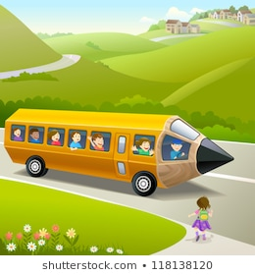
Pre-planning
It is done by teachers and students.
Decide on the trip
Know the resources.
Arrange transport time, data.
Dealing with the organization, obtain permission, data and time visit and know the resources, inform the objectives
Obtain administrative sanction of schools and colleges.

Slide 12
Continue…
Prepare the students with theoretical base teacher plans with the students.
Formulate the objectives
List down specific information to be obtained
Formulate question to be asked to be asked to the guide and prepare guide sheet
If a large group, divide and allot specific jobs
Brief them, equipment or accessories needed date and time of transport actual locations ,set up, conduct and behavior during the trips, safety to be observed.

Slide 13
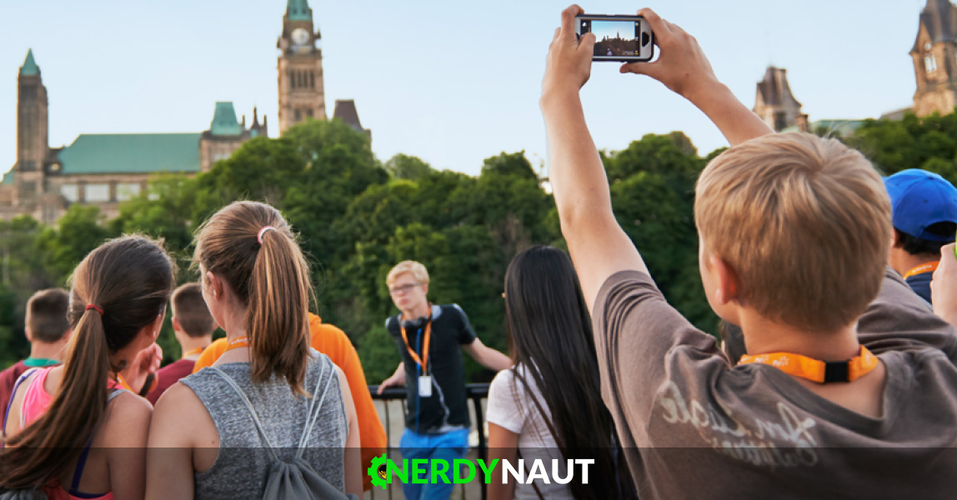
Actual Conduct of The Trip
Follow the scheduled.
Strictly follow safety precautions.
Observe and collect information needed.
Collect source/study materials if provided.
Teachers supervisor and call attention to the pertinent points.
Observe formalities extend courtesies.
Point to remember :trip should follow in an orderly manner.
Do not cause disturbance to the organization .

Slide 14
Evaluation phase
Should be done as early as possible
Students write a report with the observation on effectiveness of the trip and difficulties faced
Teacher evaluates the reports by the students
Teacher prepares an evaluation and along with specific observation from the students maintains a record which can be referred later
Conduct discussion with the students

Slide 15
Organization And Procedure for Educational Field Trip Visit
Knowledge: The teacher has to survey the area to know whether the field visit planned will contribute to the attainment of desired objectives
Rapport: The teacher should establish and maintain cordial relations with those in charge of the situations to be visited
Objectives: It should be stated carefully and completely. The learning activities have to be selected and it should contribute for the attainment of objective
Time and Transportation: Necessary arrangements have to be made with the administrative personnel of the place to be visited regarding the time, place of meeting and the length of visit.

Slide 16
Continue…
Preparations of the students: Students should be given an opportunity to list cooperatively the objectives for which the trip is planned. Direction to be given, on the procedure to be followed in the observation and the special points to note.
Supervision: Trip should be supervised carefully. The teacher can assist the students by calling attention to pertinent point. Follow up and evaluation: An hour should be allotted for an open discussion.It can be done by means of students reports.

Slide 17
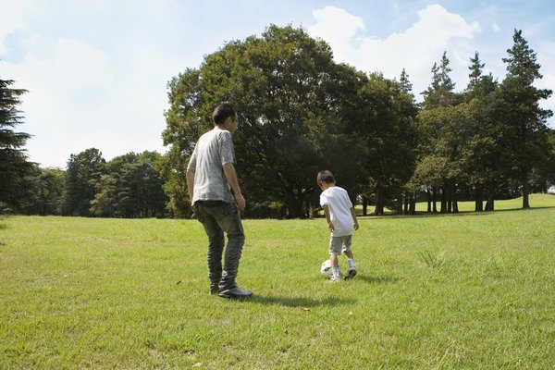
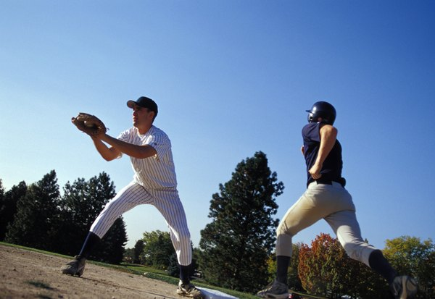
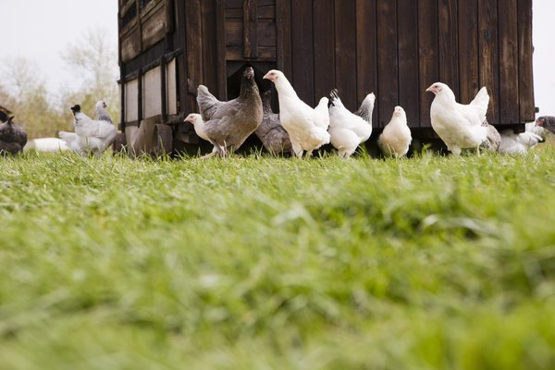
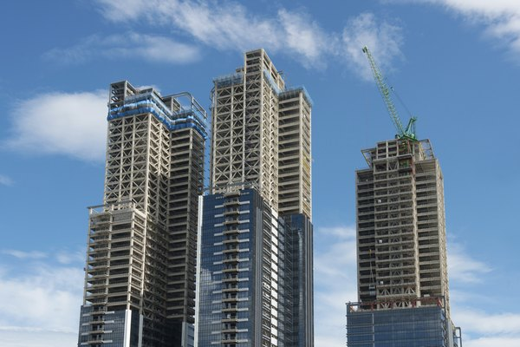
Ideas for a Math Field Trips….
Building
Sporting Event
Factory
Farm
park

Slide 18
Values of the Educational Field Trip
It provides opportunity in learning attitudes and positive values i.e. cooperation , discipline.
They correlate and blend school life with the outside world, providing direct touch with persons and with community situations.
It provide opportunity in learning and acquiring skills i.e. observations, communications, critical thinking and social skills.

Slide 19
Advantages
Acquisition of lasting concepts and change in attitudes are rooted on concrete and rich experience.
Real – world experience.
Increase in quality of education.
Improvement of the social relations.
Provide new cultural context.

Slide 20
Disadvantages
It is costly.
It involves logistics.
It is extravagant with time.
Contains an element of uncertainty.
Lack of support from school administrations.
Poor student behavior and attitudes.
Shortage of resources and choice of venue.
Medical risk.

Slide 21
MCQS
Students obtain ………… through Educational Field Trip .
a. First hand information
b. Information
c. Knowledge
d. Skill
Pre- planing is done by ……
a. Teacher
b. Students
c. Both A and B
d. None of them

Slide 22
Continue…
Teacher …….. the reports by the students.
a. Pre-plan.
b. Approve.
c. Conduct
d. Evaluates
Educational field trip provides.
a. Opportunity.
b. Learning attitudes.
c. Positive values.
d. All of them.

Slide 23
Continue…
The kids can instill the lessons garnered on the educational Trip through.
a. Presentation
b. Answering questions
c. Both A and B
d. None of them

Slide 24
Key for MCQS
First hand information
Both A and B
Evaluates
All of them
Both A and B

Slide 25
References…
https://www.slideshare.net/mobile/deven18/field-trip-50457228
(5 years ago)
https://www.slideshare.net/mobile/saru3008/field-trips-and-excursions
(6 years ago)
https://sciencing.com/ideas-for-a-math-field-trip-12742923.html
https://www.slideshare.net/mobile/angelinekanodia/field-trip-151310425
(1 year ago)

