Slide 1
Introduction of proteins.
Protein are a mass : a homogeneous substance, something that our diet should contain in a certain proportion . The protein isn’t just a single substance. Instead, there are lots and lots of different proteins in an organism, or even in a single cell. They come in every size, shape, and type we can imagine, and each one has a unique and specific job. . Some are structural parts, giving cells shape or helping them move. Others act as signals, drifting between cells like messages in a bottle. Still others are metabolic enzymes, putting together or snapping apart biomolecules needed by the cell. Proteins are among the most abundant organic molecules in living systems and are way more diverse in structure and function than other classes of macromolecules. A single cell can contain thousands of proteins, each with a unique function. Although their structures, like their functions, vary greatly, all proteins are made up of one or more chains of amino acids.

Slide 2
Types and functions of proteins.
Proteins can play a wide array of roles in a cell or organism. Here, are a few examples of common protein types that are important in the biology of many organisms .
Enzymes act as catalysts in biochemical reactions, meaning that they speed the reactions up. Each enzyme recognizes one or more substrates, the molecules that serve as starting material for the reaction it catalyzes. Different enzymes participate in different types of reactions and may break down, link up, or rearrange their substrates.
One example of an enzyme found in our body is salivary amylase, which breaks amylose (a kind of starch) down into smaller sugars.

Slide 3
Hormones.
Hormones are long-distance chemical signals released by endocrine cells (like the cells of our pituitary gland). They control specific physiological processes, such as growth, development, metabolism, and reproduction. While some hormones are steroid-based , others are proteins. These protein-based hormones are commonly called peptide hormones.
For example, insulin is an important peptide hormone that helps regulate blood glucose levels. When blood glucose rises, specialized cells in the pancreas release insulin. The insulin binds to cells in the liver and other parts of the body, causing them to take up the glucose. This process helps return blood sugar to its normal, resting level.

Slide 4
Amino acids.
Amino acids are the monomers that make up proteins. Specifically, a protein is made up of one or more linear chains of amino acids, each of which is called a polypeptide. There are 20 types of amino acids commonly found in proteins.

Slide 5
How are amino acids linked together in chains?
The amino acids of a polypeptide are attached to their neighbors by covalent bonds known as a peptide bonds. Each bond forms in a dehydration synthesis (condensation) reaction. During protein synthesis, the carboxyl group of the amino acid at the end of the growing polypeptide chain chain reacts with the amino group of an incoming amino acid, releasing a molecule of water. The resulting bond between amino acids is a peptide bond

Slide 6
Peptide bond.
Each protein in our cells consists of one or more polypeptide chains. Each of these polypeptide chains is made up of amino acids, linked together in a specific order. A polypeptide is kind of like a long word that is "spelled out" in amino acid letters4^4. The chemical properties and order of the amino acids are key in determining the structure and function of the polypeptide, and the protein it's part of.

Slide 7
Protein structure
The structure of protein sets the foundation for its interaction with other molecules in the body and, therefore, determines its function. Primary protein structure
Proteins are made up of a long chain of amino acids. Even with a limited number of amino acid monomers – there are only 20 amino acids commonly seen in the human body – they can be arranged in a vast number of ways to alter the three-dimensional structure and function of the protein. The simple sequencing of the protein is known as its primary structure

Slide 8
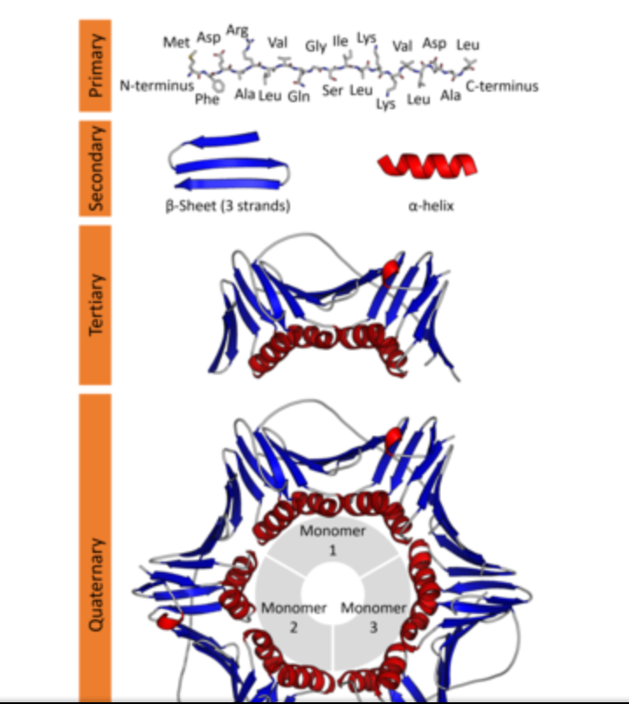
Protein structure.

Slide 9
Secondary protein structure.
The secondary protein structure depends on the local interactions between parts of a protein chain, which can affect the folding and three-dimensional shape of the protein. There are two main things that can alter the secondary structure:
α-helix: N-H groups in the backbone form a hydrogen bond with the C=O group of the amino acid 4 residues earlier in the helix.
β-pleated sheet: N-H groups in the backbone of one strand form hydrogen bonds with C=O groups in the backbone of a fully extended strand next to it.
There can also be a several functional groups such as alcohols, carboxamines, carboxylic acids, thioesters, thiols, and other basic groups linked to each protein. These functional groups also affect the folding of the proteins and, hence, its function in the body

Slide 10
Tertiary structure.
The tertiary structure of proteins refers to the overall three-dimensional shape, after the secondary interactions. These include the influence of polar, nonpolar, acidic, and basic R groups that exist on the protein

Slide 11
Quaternary structure of protein.
The quaternary protein structure refers to the orientation and arrangement of subunits in proteins with multi-subunits. This is only relevant for proteins with multiple polypeptide chains.
Proteins fold up into specific shapes according to the sequence of amino acids in the polymer, and the protein function is directly related to the resulting 3D structure.
Proteins may also interact with each other or other macromolecules in the body to create complex assemblies. In these assemblies, proteins can develop functions that were not possible in the standalone protein, such as carrying out DNA replication and the transmission of cell signals.

Slide 12
Protein function.
Proteins play an important role in many crucial biological processes and functions. They are very versatile and have many different functions in the body, as listed below:
Act as catalysts/enzymes
Transport other molecules
Store other molecules
Provide mechanical support
Provide immune protection\as antibodies
Generate movement/structural protein
Transmit nerve impulses/signal proteins
Control cell growth and differentiation
Oxygen transport.

Slide 13
Oxygen transport
Each of us has tens of thousands of proteins, which serve a variety of functions, and each protein has a unique three-dimensional structure that specifies its function. For example, hemoglobin is a protein found in red blood cells, which plays a key role in oxygen transport; it has 4 subunits of two distinct types (2 alpha and 2 beta subunits).

Slide 14
Proteins as enzymes.
Some proteins function as enzymes, i.e., proteins that catalyze specific biochemical reactions. Enzymes facilitate biochemical reactions and speed them up enormously, making them as much as a million times faster. There are thousands of enzymes, and each type facilitates a specific biochemical reaction. In other words, a given enzyme only acts on specific reactant molecules (substrates) to produce a specific end product or products. The diagram below illustrates enzymatic cleavage of the disaccharide lactose (the substrate) into the monosaccharides galactose and glucose.

Slide 15
Proteins as enzymes.

Slide 16
Lysozyme-a defensive enzyme.
Lysozyme is an important defensive enzyme found in tears, saliva, and mucus. Lysozyme's function is to break down the polysaccharides (sugar polymers) that are components of bacterial cell walls. Initially, lysozyme is synthesized as a single long polypeptide chain, but it folds in a characteristic way to form a globular protein with a characteristic pocket. A bacterial polysaccharide binds to lysozyme because it fits precisely into the pocket in the same way that a key fits into a lock. Once this specific binding has occurred, lysozyme destroys the bacterial polysaccharide by cleaving it into pieces

Slide 17
Antibodies are proteins.
Antibodies are defensive proteins that have binding sites whose three-dimensional structure allows them to identify and bind to very specific foreign molecules. By binding to foreign proteins they can help neutralize them and tag them, facilitating their engulfment and removal by defensive cells. IgG antibodies have a quaternary structure with four subunits, two "light chains" and two "heavy chains." The chains are bound to one another through disulfide bridges. After birth, each B-lymphocyte can manufacture antibodies for only one specific foreign shape. The portion of an antigen that is specifically recognized by an antibody is referred to an "epitope." In essence, the epitope is a particular portion of an antigen that has a distinctive molecular shape that fits into the protein binding site on an antibody.

Slide 18
Structural and contractile proteins
There are also structural proteins, which are frequently long and fibrous, such as silk, keratin in hair, and collagen in tendons and ligaments. There are contractile proteins, such as actin and myosin, that provide movement in muscles and movement within single cells.

Slide 19
Signal proteins.
There are signal proteins, such as the hormone insulin, which consists of two polypeptide chains linked together with disulfide (two sulfur) bridges.
The insulin receptor (a recognition protein) is embedded in the cell membranes of muscle, fat cells and certain types of other cells. Its function is to facilitate their uptake of glucose from the blood stream through special glucose transport proteins that are normally present inside the cell in an inactive form. For example, in muscle cells, the glucose transporter is called "GLUT4". When the insulin molecule binds to the alpha subunits of the receptor, it triggers a chain reaction within the cytosol (the interior of the cell) that activates GLUT4 and causes it to be translocated and inserted into the cell membrane.

Slide 20
Transport across the cell membrane.
With the exception of simple diffusion, proteins are also essential for moving polarized or charged molecules and large molecules across cell membranes.
Simple Diffusion
Small molecules like oxygen and carbon dioxide can diffuse across the lipid bilayer of the cell membrane. The direction of movement depends on the concentration gradient. Substances with higher concentration inside the cell (e.g., CO₂) will diffuse out of the cell toward the side with lower concentration. Substances in higher concentration outside the cell (e.g., O₂) will diffuse to the inside of the cell, i.e., down the concentration gradient.

Slide 21
Facilitated and active transport.
Polar molecules and charged ions cannot cross the lipid bilayer; their transit relies on special transport channels created by proteins embedded in the cell membrane. Facilitated transport is passive in that it does not require expenditure of cellular energy, and as with simple diffusion, movement of the molecules is down a concentration gradient from high concentration to low concentration. There are specific proteins for each substance transported by this mechanism, and transit can be regulated by the cell. Molecules like glucose and amino acids are transported this way. They will bind to their carrier/transpport protein, and binding triggers a change in the shape of the carrier which moves the molecule across the membrane. Once the molecule is released, the carrier returns to its original shape (conformation).
Active Transport
Active transport also relies on transmembrane transport proteins, but this process is able to transport substances against a conentration gradient, meaning that even if the concentration of, say potassium ions, is higher inside the cell than outside, more potassium can be transported into the cell. This is because cellular energy (ATP) is expended.
Proteins, then, play an integral role in the function of a cell. Many are embedded in the cell's membranes or span the entire lipid bilayer where they play an important role in recognition, signaling, and transport.

