Slide 3
FOOD SAFETY AND QUALITY MANAGEMENT
DHND
YEAR-V
Session: 2015-2020
Dr. Shahid Mahmood Rana
Associate Professor
INSTITUTE OF FOOD SCIENCE AND NUTRITION (IFSN)
UNIVERSITY OF SARGODHA, SARGODHA-PAKISTAN

Slide 4
FSQM L # 57. FOOD INSPECTOR AND PUBLIC ANALYST: QUALIFICATIONS, DUTIES, POWERS Courtesy: Dr. Hafiz Rizwan Sharif (AP-UoL, Gujrat)

Slide 13
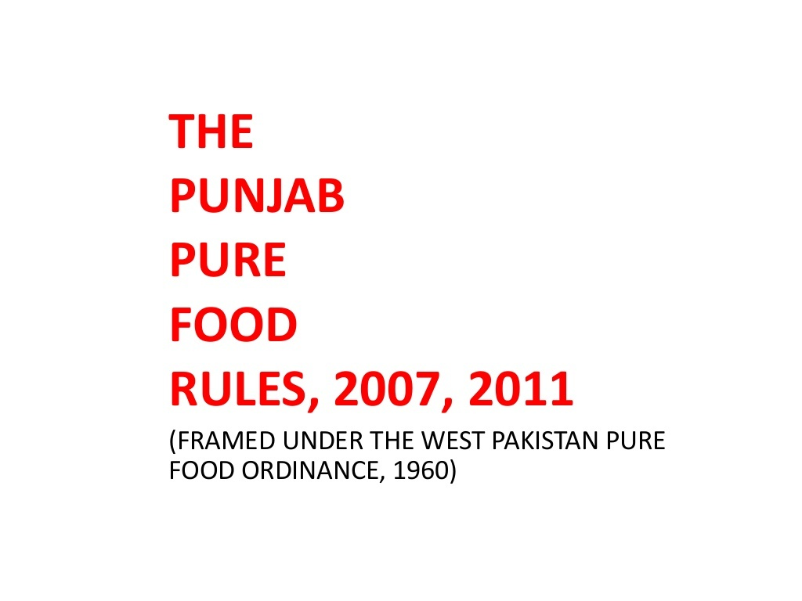

Slide 16
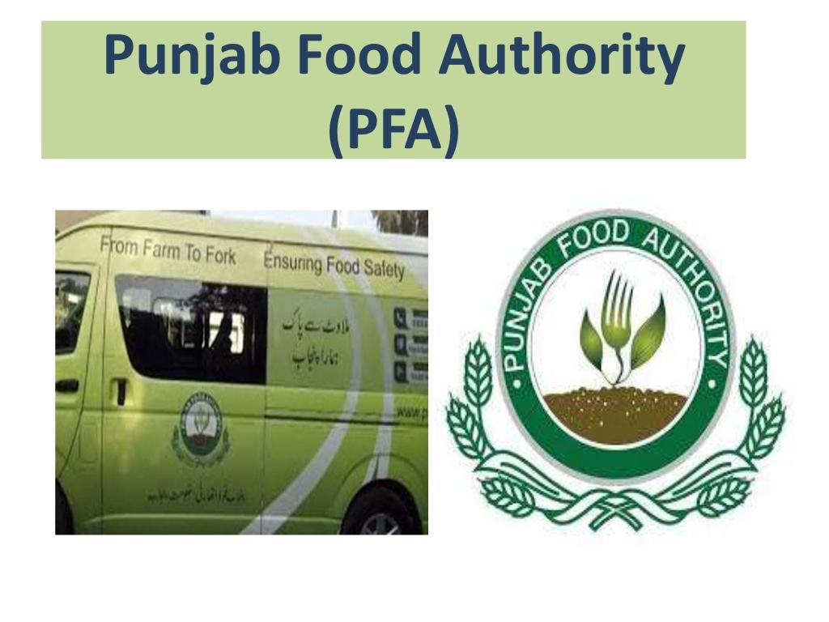

Slide 17
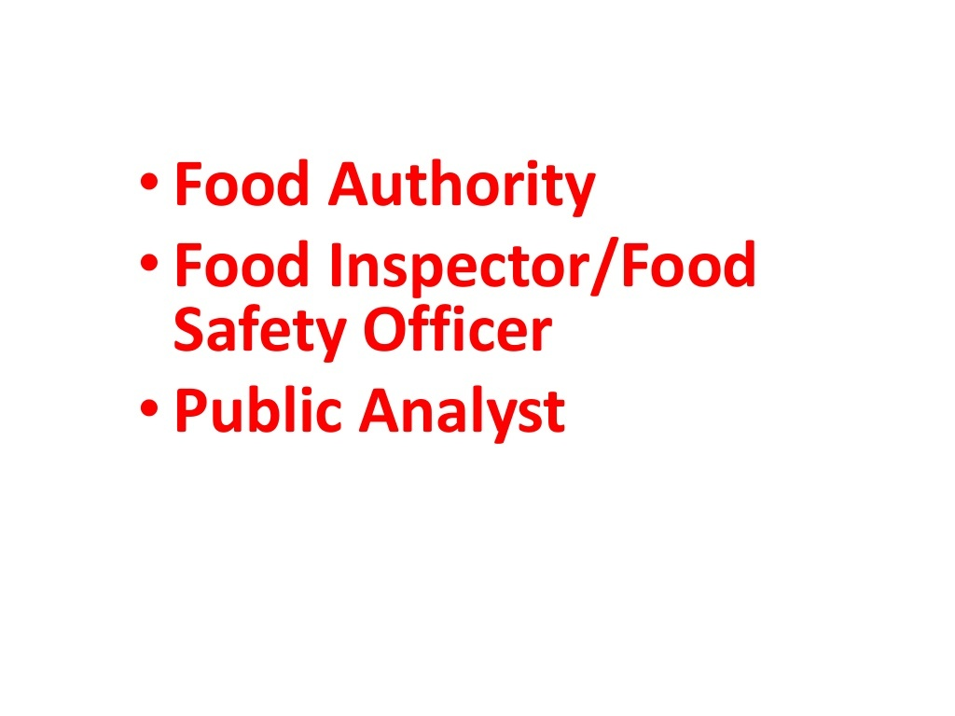

Slide 24
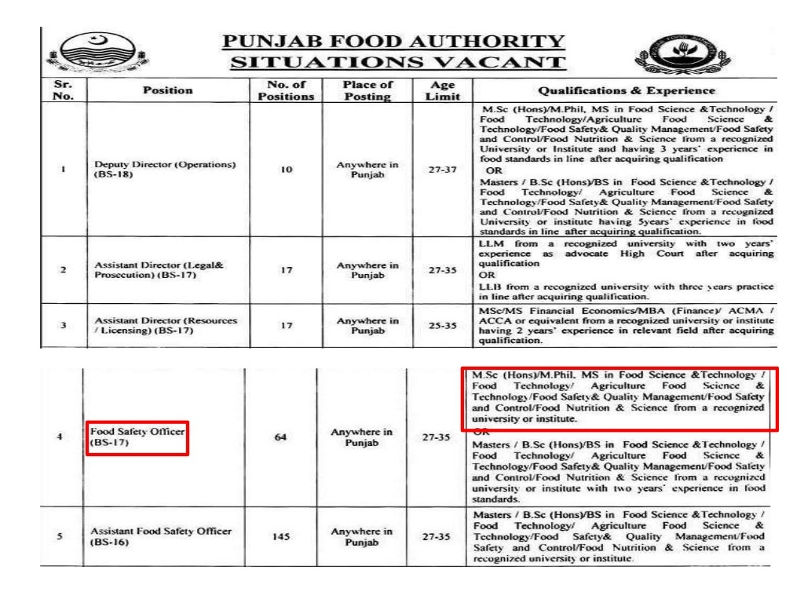

Slide 29
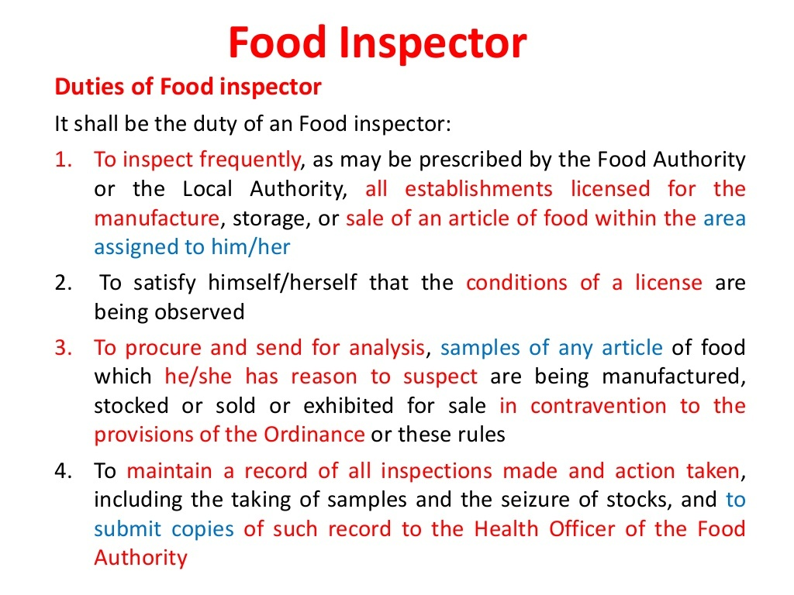

Slide 35
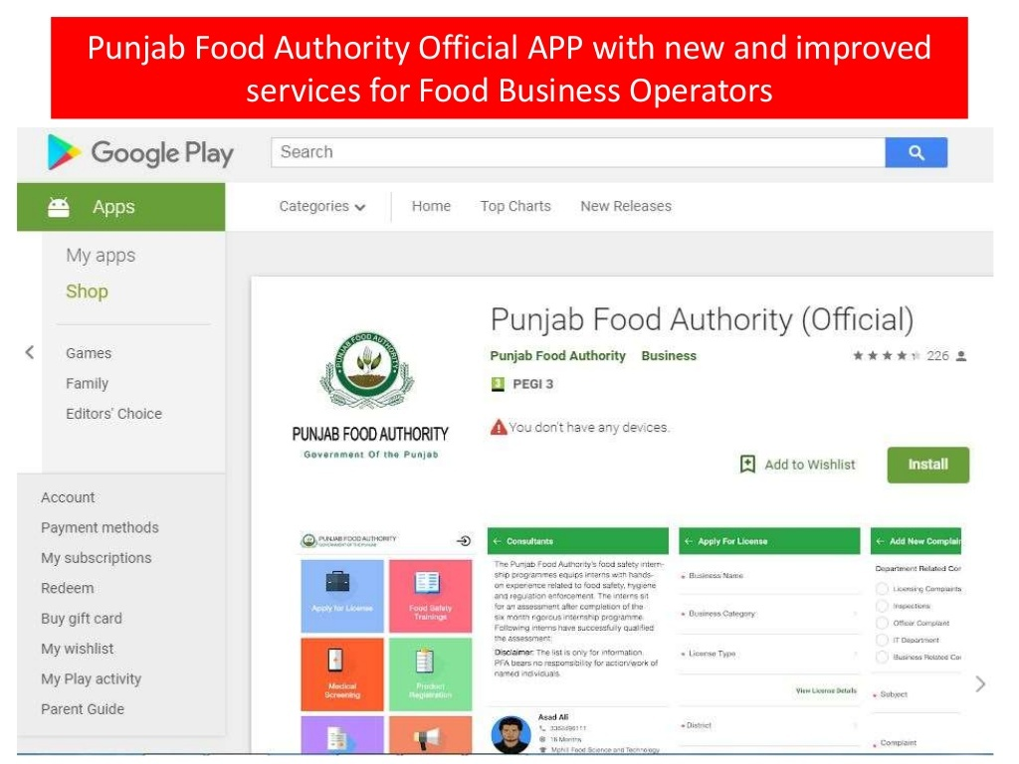

Slide 36
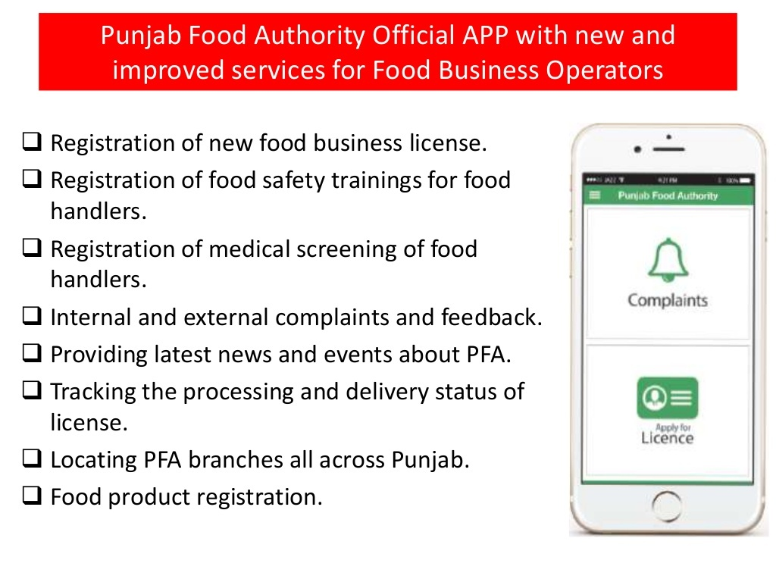

Slide 37
