Slide 1
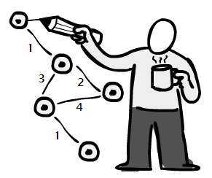
Critical Path Method
By: Saba Ashraf
Noon Business School, University of Sargodha

Slide 2
Outline
What is critical path method?
What will you be able to determine with CPM?
Terminologies used in CPM
Steps to create critical path scheduling
Critical path algorithm
Earliest start time, earliest finish time
Late start time, late finish time
Finding the critical path
Concept of slack
Significance of slack
Charting the final schedule
Resource planning

Slide 3
Outline
Prerequisites of resource planning
Techniques for resource planning
Loading up and levelling out
The reallocation question
Resource histogram

Slide 4
What is Critical Path Method?
“The Critical Path Method is the sequence of scheduled activities that determines the duration of the project.”
It a powerful but basically simple technique for analyzing, planning, and scheduling large, complex projects.
It is a great tool for complex and large projects like construction of building, scheduling ship construction and repairs, manufacture and assembly of larger generators, missile countdown procedures etc.
The critical chain concept illustrates that you can improve project control and scheduling through identifying critical links in the project’s chain.

Slide 5
What will you be able to determine with CPM?
In essence, the tool provides a means of determining;
Which jobs or activities, of the many that comprise a project, are “critical” in their effect on total project time.
How best to schedule all jobs in the project in order to meet a target date at minimum cost.

Slide 6
Definition of Terms used in CPM.
Earliest Start Date. This is simply the earliest date that a task can be started in your project. You cannot determine this without first knowing if any tasks are dependent on this one task, or figuring out other constraint that might impact the start of this task.
Earliest Finish Date. This being the earliest date your task can be completed.
Latest Start Date. This is the very last minute in which you can start a task before it threatens to upset your project schedule.
Latest Finish Date. By having a clear picture of this timeframe, you can better schedule the project to meet its deadline.

Slide 7
Definition of Terms used in CPM.
Float. also known as slack, is a term that describes how long you can delay a task before it impacts the planned schedule and threatens the project’s deadline.
Crash Duration is a term that describes the shortest amount of time that a task can be scheduled. You can get there by moving around resources, adding more towards the end of the task, to decrease the time needed to complete the task.

Slide 8
Steps to Create Critical Path Scheduling
First of all, each job necessary for the completion of a project is listed with a unique identifying symbol (such as a letter or number).
The time required to complete the job, and its immediate prerequisite jobs.
Each job is drawn on the graph as a circle, with its identifying symbol and time appearing within the circle.
Sequence relationships are indicated by arrows connecting each circle (job) with its immediate successors, with the arrows pointing to the latter.
The graph then depicts a number of different “arrow paths” from Start to Finish.

Slide 9
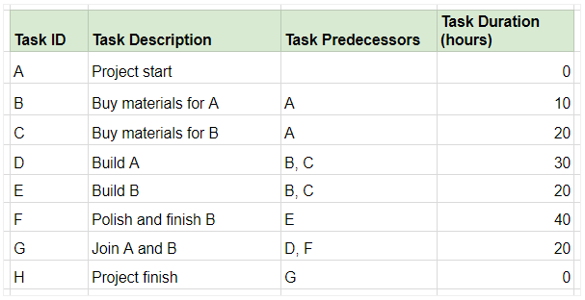
Critical Path Algorithm
Suppose you have a list of tasks as shown below. Column C and D list the tasks that must be accomplished for the activity to begin, and the duration of the activity, respectively.

Slide 10
Organize all tasks into a flowchart and note their durations next to the task ID. The arrows indicate the sequence of activities. We'll mark the Earliest Start (ES) time to the left of the activity, and the Earliest Finish (EF) time to the right.:

Slide 11
How to calculate earliest start and finish time?
B | ES 0 | EF 10
10 | LS 10 | LF 20
C | ES 0 | EF 20
20 | LS 0 | LF 20
D | ES 20 | EF 50
30 | LS 50 | LF 80
E | ES 20 | EF 40
20 | LS 20 | LF 40
F | ES 40 | EF 80
40 | LS 40 | LF 80
G | ES 80 | EF 100
20 | LS 80 | LF 100
H | ES 100 | EF 100
0 | LS 100 | LF 100
ES= EF of predecessor activity
EF= ES+ Task duration
LS= LF – task duration
LF=LS of successor activity

Slide 12
Now mark the Earliest Start (ES) time of each activity. This is given by the largest number to the right of the activity's immediate predecessor (i.e. its Earliest Finish time, or EF).
If the activity has two predecessors, the one with the later EF time would give you the ES of the activity.

Slide 13
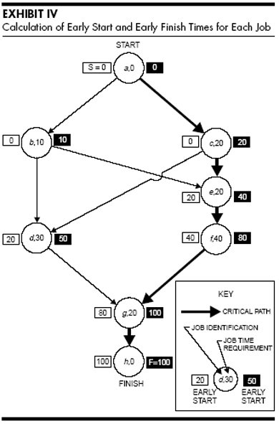

Slide 14
Calculation of late start and late finish time

Slide 15
Finding the Critical Path
There will be at least one path going from Start to Finish that includes critical jobs only, i.e., the critical path.

Slide 16
Concept of Slack
The difference between a job’s early start and its late start (or between early finish and late finish) is called total slack (TS).
Total slack represents the maximum amount of time a job may be delayed beyond its early start without necessarily delaying the project completion time.
We earlier defined critical jobs as those on the longest path through the project. That is, critical jobs directly affect the total project time. We can now relate the critical path to the concept of slack.
If the target date (T) equals the early finish date for the whole project (F), then all critical jobs will have zero total slack.
Free slack (FS) is the amount a job can be delayed without delaying the early start of any other job.

Slide 17
Significance of Slack
When a job has zero total slack, its scheduled start time is automatically fixed (that is, ES = LS); and to delay the calculated start time is to delay the whole project.
Jobs with positive total slack, however, allow the scheduler some discretion in setting their start times. This flexibility can usefully be applied to smoothing work schedules.
Free slack can be used effectively at the operating level. For example, if a job has free slack, the foreman may be given some flexibility in deciding when to start the job. Even if he delays the start by an amount equal to (or less than) the free slack, the delay will not affect the start times or slack of succeeding jobs (which is not true of jobs that have no free slack).

Slide 18
Options for Adjusting the Schedule
Reduce the scope of the project or keep the current scope and add people. Remember, it will affect your budget.
Split the work package into two or more work packages. You can also adjust the basic finish-to-start precedence relationship by adding lead and lag time.
Outsource the work
Negotiate for additional time in the schedule.
Find more productive people.

Slide 19
Charting the final schedule
When the final schedule is in place and approved, distribute it to all team members.
Post it in a common area so the team members can measure progress.
This helps to maintain a healthy competitive attitude.

Slide 20
Resource Planning

Slide 21
What is Resource Planning
According to PMBOK®, it’s “determining what resources (people, equipment, materials, etc.) and what quantities of each should be used to perform project activities.”
Resource plans may change and should be adjusted regularly to reflect changes in the scope, employees’ availability, etc. so that your schedule is always up-to-date.

Slide 22
Prerequisites of Resource Planning
Work breakdown structure (WBS), which is a deliverable-oriented structure of your project scope.
Estimated duration of the project and tasks, so you can schedule resources for the project.
Employees with skills corresponding with the tasks they will be assigned to.
Historical data to make the plan more reliable

Slide 23
Techniques for Resource
Expert Judgement: Comes from your professional experience, valuable insights that may come from your senior colleagues or consultants hired by your organization. As it may sound obvious, it’s really important for your project’s success.
Alternatives identification. As projects may change during their lifetime, you need to take different scenarios into consideration. This way, you can come up with solutions to use as changes occur. Two methods you may use are:
Pattern thinking – this method involves pattern recognition, which is useful while refining or improving, based on past experiences.
Lateral thinking – this approach requires creative thinking and solving problems with ideas that may not be obvious at first.
Bottom-up estimating: In this approach your team estimates tasks based on their knowledge and experience, resulting in a more detailed schedule

Slide 24
Loading up and Levelling out
The amount of work each team member or piece of equipment is assigned is called resource loading.
To compensate for overloaded workers, redistribute scheduled work from people with too much responsibility to those not full booked. This s termed as resource levelling.

Slide 25
The Reallocation Question
Before you reallocate or level resources, you need to answer these questions first.
How many hours each day a person or machine is available?
Is an assigned piece of equipment allocated to multiple projects for multiple project manager?
Have you factored in time lost to anticipated interruption?
Are you using people with specialized set of skills appropriately?
Are you scheduling people without appropriate skill set?
Have you planned for the time required to acquire additional people?

Slide 26
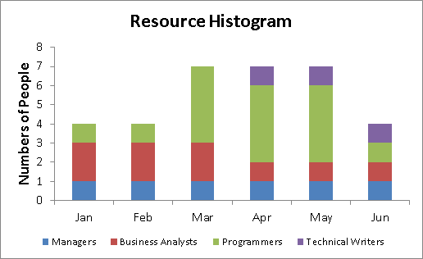
Resource Histogram
A visual tool that allows you to chart resource task allocation for each period through the project.

