Slide 1
Change & Stress Management
Change- making things different

Slide 2
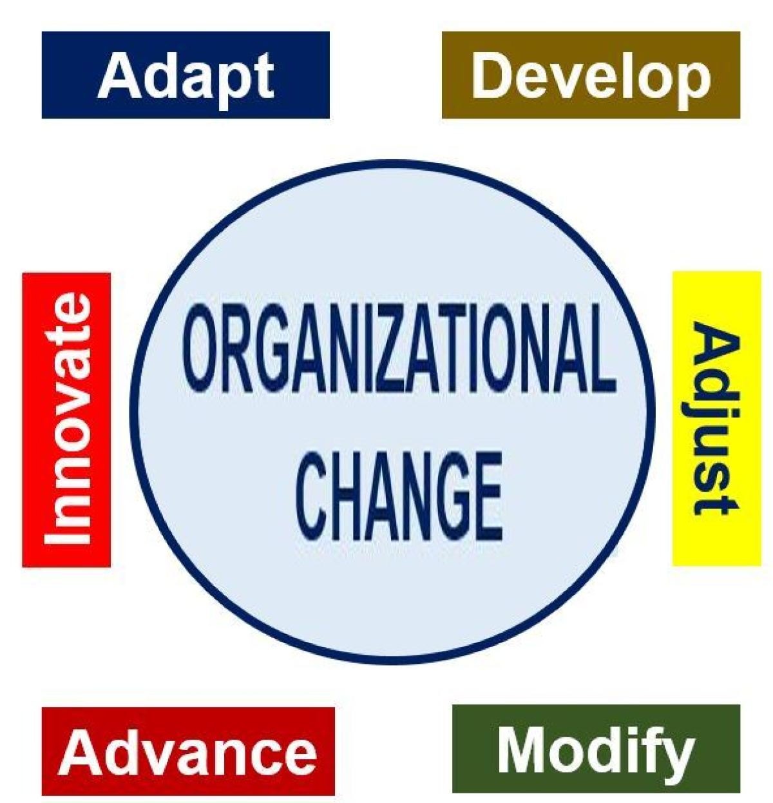
What is change?
Organizational change is about the process of changing an organization's strategies, processes, procedures, technologies, and culture, as well as the effect of such changes on the organization.

Slide 3
Forces for Change (mandatory)
Nature of the workforce- diversity, aging, new entrants with inadequate skills.
Technology-faster, cheaper, and online
Economic shocks- rise and fall of stocks, interest rates.
Competition- global, mergers and e-commerce growth.
Social trends- chatting, retirement and big box retailer (hyperstar, macro and metro).
World Politics- Iraq, terrorism, and china markets

Slide 4
Planned change
Planned change- change activities that are intentional and goal oriented.
Change Agents- Person who act as catalysts and assume the responsibility for managing change activities.

Slide 5
Change Resistance
As it is said that the change is only permanent in the world. But there are some barriers that resist the change. The sources of change can be divided into two groups:
Individual Sources
Organizational Sources

Slide 6
Individual Sources of Change Resistance
Habit- programed responses when confronted or amended create resistance.
Security- threats to feeling and safety.
Economic Factors-may create joblessness, pay tied to productivity
Fear of Unknown-what will happen after change.
Selective Information Processing- only that information is processed that support them.

Slide 7
Organizational Sources of Change Resistance
Structural Inertia- already system in force becomes resistant (stability concerns).
Limited Focus of Change- change is not on the whole with letter and spirit but in part.
Group Inertia- individual want to change but group becomes hurdle.
Threat to Expertise- new trends may create problem for expertise.
Threat to established Power relationships- that subordinate will dominate situation.
Threat to established resource allocation-other group will control the resources.

Slide 8
How to overcome change Resistance?
Following are way to overcome change resistance:
Education and Communication
Participation
Building Support and Commitment
Implementing Change Fairly
Manipulation and Cooption
Selecting People who Accept change
Coercion

Slide 9
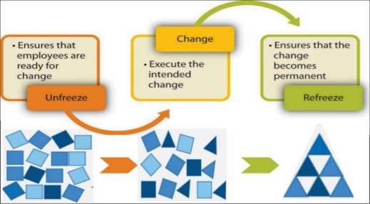
Approaches to Managing Organizational Change
Lewin’s Three Steps:
Unfreeze
Change
Refreeze
Notes:
Unfreezing- Changing to overcome the pressures of both individual resistance and group conformity.
Movement- A change process that transforms the organization from the status quo to desired end state/
Refreezing- Stabilizing a change intervention by balancing driving and restraining force.

Slide 10
Other ways of managing change
Action Research- A change process based on systematic collection of data, and then selection of a change action based on what the analyzed data indicate.
Organization Development (OD)- A collection of planned change interventions, built on humanistic-democratic values, that seeks to improve organizational effectiveness and employee well-being. OD efforts---
Respect for People
Trust and support
Power equalization
Confrontation
participation

Slide 11
6 INTERVENTIONS TO CHANGE
Sensitivity Training- Training groups that seek to change behavior through unstructured group interaction.
Survey Feedback- The use of questionnaires to identify discrepancies among member perception; discussion follows, and remedies are suggested.
Process Consultation- A meeting in which a consultant assists a client in understanding process events with which he or she must deal and identifying processes that need improvement.

Slide 12
6 intervention (continue)
4. Team Building- High interaction among team members to increase trust and openness.
5. Intergroup Development- OD efforts to change the attitudes, stereotypes, and perceptions that groups have of each other.
6. Appreciative Inquiry- An approach that seeks to identify the unique qualities and special strengths of an organization, which can then be built on to improve performance.

Slide 13
Creating a Culture for Change
As said that change is only permanent, then it is mandatory to create adaptability in the members of the organization. There are approaches for adaptability of change:
Stimulating an Innovative Culture.
Creating a Learning Organization.

Slide 14
Creating Learning Organization
Definition- An organization that has developed the continuous capacity to adapt and change.
Single-loop Learning- A process of correcting errors using past routines and present policies.
Double-loop Learning- A process of correcting errors by modifying the organization’s objectives, policies, and standard routines.

Slide 15
5 Characteristics of Learning Organizations
Shared Vision- values everyone agree upon
Discarding old ways of thinking and standard routines to solve problems.
Thinking all processes, activities, functions, and interactions with environment as part of a system of interrelationships.
Openly communicate without fear of criticism or punishment.
Sublimating self-interests and watching organizational interests and goals.

Slide 16
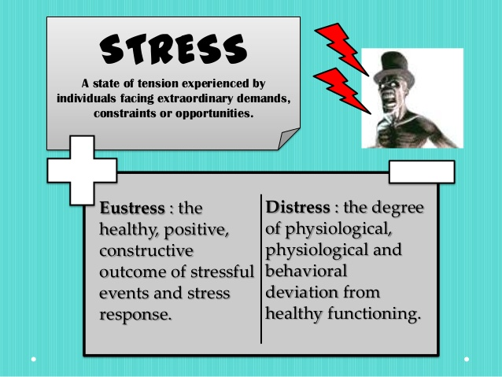
Stress and its Management
Definition of stress
Notes:
More demands with less resources in shape of “big job with small workforce and in short span of time”.

Slide 17
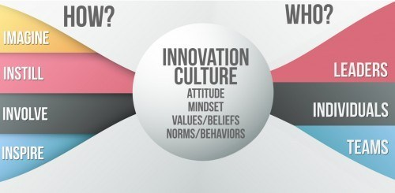
Stimulating an Innovative Culture
Definition of Innovation- A new idea applied to initiating or improving a product, process, or service.

Slide 18
Sources of Innovation:
Structural Variables-
a. dynamic – less centralization, formalization and have flexibility, adaptation and cross-fertilization lead innovation.
b. long tenure management.
c. Slack resources (hard time)
d. high communications- use of committees, task forces, cross- functional teams and interdepartmental interactions.
Cultural Variables- encouragement of experimentation, rewarding both successes and failures, celebrate mistakes.
Human Resource Variables- training and development, high job security, and encourage employees to become champion of change.

Slide 19
Potential Sources of Stress
There are 3 potential resources of stress:
Environmental Factors-
Organizational Factors-
Personal Factors-

Slide 20
Environmental Factors
Economic Uncertainty: lean economies create uncertainty for the people.
Political Factors: lack of consistency in policies and goals of the country.
Technological Change: computer, robotics, automation, and other similar types innovations.

Slide 21
Organizational Factors
Task Demands- design of job(autonomy, task variety, degree of automation), working conditions, physical work layout.
Role Demands- role ambiguity, more demand than the time permits and employee is not sure what to do.
Interpersonal Demands- lack of social support, poor interpersonal relationships can cause stress, especially among employees with high social need.

Slide 22
Personal Factors
Family Problems- marital difficulties, breaking relationships, discipline problems with children, that can not be left at the front door when arriving at work.
Economic Problems- spendthrift, loans overdue, demand more than resources generated.
Personality- negative affectivity ( taking the negative side of situation). Positive affectivity (taking positive side of situation). Basic disposition of – type A and B personality.

Slide 23
Individual Differences
Perception- people react in response to perception of reality rather than reality.
Job experiences- like used car how it was driven in what type of roads and how maintained.
Social support- relations with coworkers and superiors.
Belief in locus of control (internal and external).
Self-efficacy- how one copes with stress, style to act in crisis- some people thrive in hard situations
Hostility – Anger and strand relations with coworkers and colleagues.

Slide 24
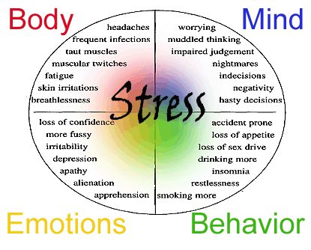
Consequences of Stress
Physiological Symptoms-
Psychological Symptoms-
Behavioral symptoms-

Slide 25
Physiological Problems
Musculoskeletal problems-tension, headaches, and back pains.
Gastrointestinal problems-diarrhea, and constipation.
Cardiovascular problems- high blood pressure, and heart rates increase and respiratory problems.
Immune system problems- decreasing the ability to fight off illness and diseases like infection.

Slide 26
Psychological Problems due to Stress
Anger
Anxiety
Depression
Nervousness
Irritability
Tension
Boredom
Procrastination
Aggressive Actions- sabotage, interpersonal aggressions, hostility, and complaints.

Slide 27
Behavioral Problems due to Stress
Changes in productivity
Absence
Turnover
Change in eating habits
Increased smoking or consumption of alcohol
Rapid speech
Fidgeting
Sleep disorders

Slide 28
Managing Stress
Individual Approaches-
Organizational Approaches-

Slide 29
Individual Approaches to cope Stress
Time management
Physical exercise
Relaxation training
Expanding the social support network

Slide 30
Organizational Approaches to cope Stress
Improved selection and job placement
Training to manage stressful situations/crisis
Use of realistic goal setting
Redesigning the jobs
Employees involvement
Improved organizational communications
Offering employees sabbaticals.(paid leave)
Establishing corporate wellness programs- programs that focus on employees physical and mental conditions.

