Slide 1
Spinal Cord Injury Management 3

Slide 2
Outline
ASIA
Impairments
Spinal shock

Slide 3
Sources
http://www.isncscialgorithm.com/
http://www.isncscialgorithm.com/Form
http://lms3.learnshare.com/home.aspx
http://www.iscos.org.uk/

Slide 4
Motor Exam
10 “key” muscles (5 upper & 5 lower ext)
C5-Elbow flexion L2-hip flexion
C6-wrist extension L3-knee extension
C7-elbow extension L4-ankle dorsiflexion
C8-finger flexion L5-toe extension
T1-finger abduction S1-ankle plantarflexion
Sacral exam: voluntary anal contraction (present/absent)

Slide 5
ASIA Impairment Scale
A = Complete - no S/M sacral function
B = Sensory incomplete -sacral sensory sparing
C = Motor incomplete -motor sparing below (strength < 3/5 in most m’s)
D = Motor incomplete - “ ”(>3/5)
E = Normal - Normal S/M exam

Slide 6
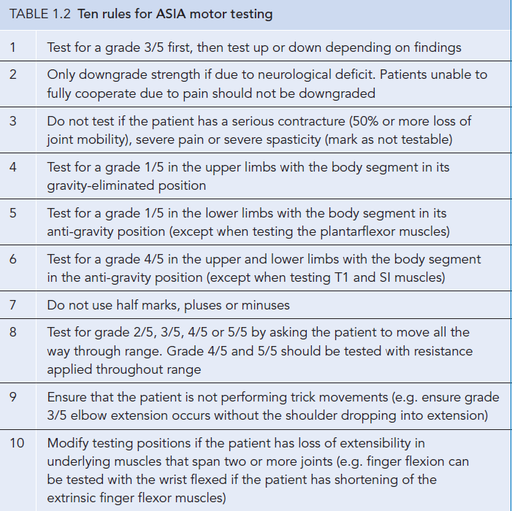

Slide 7
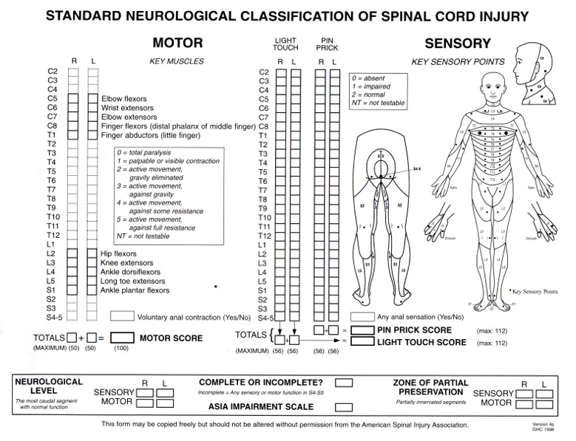

Slide 8
Motor assessment 6 point scale MMT
What is the difference of ASIA and MMT????
Supine
Iliopsoas in 2/5
Upper limb 1/5 gravity
Lower limb 1/5 except PF
Motor caudal distal key muscles at least 3/5
Thoracic motor level

Slide 9
???
If a person has C4 sensory level on right side, and left side C5 sensory level, motor level right and left side C6……what will be the neurological level????

Slide 10
S4-S5 preservation a strong predictor of recovery
Pinprick preservation predicts motor recovery (thought of proximity of tracts)

Slide 11
Clinical Manifestations
Spinal Shock
Period of areflexia
Abrupt withdrawal from higher centers
Loss of reflexes
Flaccidity
Loss of sensation
Several hours to several weeks
24hours typically

Slide 12
Ankle reflexes loss for 6 hours
Bladder reflexes loss for many month
Loss of DTR……several weeks

Slide 13
Paralytic ileus
Food cannot digested
Aspiration pneumonia
Nil by mouth

Slide 14
DVT
2weeks
Calf, groin, thigh
Low grade fever
Role of passive movement
Treatment

Slide 15
Clinical Manifestations
Impaired temperature control
Hypothalamus
No control of vasodilatation to heat
No control of vasoconstriction to cold
Diaphoresis above level of lesion

Slide 16
Clinical Manifestations
Respiratory impairments
C1-C3 lesion
Artificial ventilator or phrenic nerve stimulator
Bronchopneumonia and pulmonary embolism
High mortality in acute stage of tetraplegia
Normal breathing pattern??male & female??

Slide 17
Clinical Manifestations
Spasticity
Abnormal & velocity dependent increase resistance to stretch
Definition
Characteristics
Types
Rigidity
Tone
Modified ashworth scale (0, 1, 1+, 2, 3, 4)

Slide 18
Clinical Manifestations
Spasticity
Clonus & Babinski’sign
Gradual increase in first 6 month and plateau reached 1 yr after injury
Spasticity increased by
Positional change
Cutaneous stimuli
Environmental temperature
Tight clothing
UTI
Pressure sores
Emotional stress

Slide 19
Drugs
Baclofen
Dantrolene
Botulinum toxin
Phenol
PT
Heat , cold, TENS, electrical stimulation, hydrotherapy , weight bearing etc

Slide 20
Clinical Manifestations
Bladder & bowl control
UTI most common in acute stage
Spinal shock Bladder flaccid
Muscle tone absent
Reflexes absent
Micturation center is Conus Medullaris
S2,S3 and S4 reflex control

Slide 21
Clinical Manifestations
Bladder & bowl control
Two types of bladder
Depends on level of lesion

Slide 22
Indirect impairments
Pressure sore
Pressure area????
Grading
Etiology Vasomotor disturbance
Spasticity
Maceration
Nutrition (decreased protein)
Infection
Positional change after every 2 hours on bed
Positional change after every 15 mints on wheel chair

Slide 23
Indirect impairments
Autonomic dysreflexia (Hyper-reflexia)
Pathological reflex if lesion above T6 level(sympathetic outflow)
Both complete and incomplete lesion
Sympathetic
Afferent below lesion initiate reflex response to increase B.P
Normally impulses stimulate carotid sinus and aorta which adjust PR so maintain B.P
In SCI no regulation from higher centers so no vasodilatation
Emergency condition

Slide 24
Normal BP of SCI
20mmHg increase
Splanchnic blood vessels …sympathetic

Slide 25
Indirect impairments
Autonomic dysreflexia (Hyper-reflexia)
Stimulus Bladder distension
Pressure sore
Infection
Symptoms HTN, tachycardia
Headache, sweating
Treatment Sitting, catheter released
Loose clothing, drugs

Slide 26
Indirect impairments
Postural hypotension
Heterotopic ossification
50%
Contracture
Pain Traumatic pain
Nerve root pain
Musculoskeletal; pain

Slide 27
