Slide 1
Wheat Smut (Also known as loose smut of wheat)
Dr. Salman Ahmad
April 13, 2020

Slide 2
Description and Importance:
Smut mean sooty (black) or charcoal like powder
Responsible for heavy losses when susceptible varieties with infected seeds are grown year after year
Cause losses 3-30 %

Slide 3
Etiology:
Causal organism: Ustilago tritici
Order: Ustilaginales
Family: Ustilaginaceae

Slide 4
Symptoms:
Head of affected plants converted into black mass of spores & no grain formation
Affected young spike lets covered by silvery membrane
Only the awns of awned varieties escape transformation
Spores easily separate & blown off by wind leaving bear rachis

Slide 5
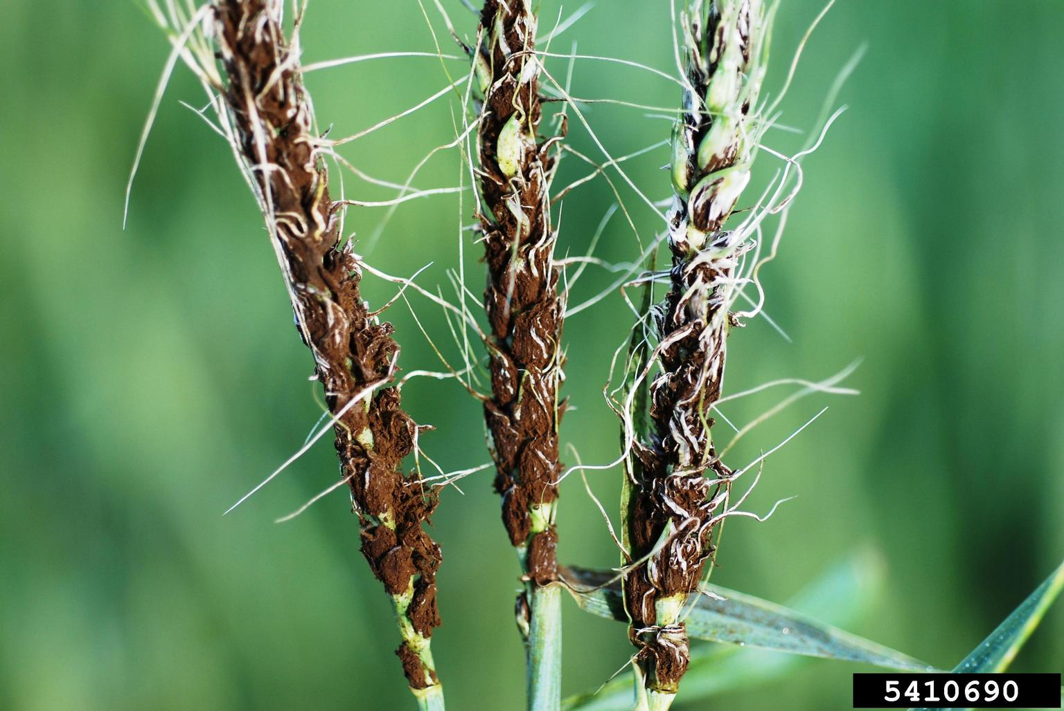
Symptoms:

Slide 6
Disease cycle:
Air dried spores can survive for 12 months at 0-10 °C
Pathogen is internally seed-borne
Infection occur when flowers are in full bloom & ovary is just developed after fertilization

Slide 7
Epidemiology:
Temp 22-25 °C
RH 60-85 %

Slide 8
Management:
Solar energy treatment: Presoaking period of 4 hrs followed by 1 hr exposure to sun in summer
Hot water treatment: 4-5 hrs in a tub at ordinary temp, at 132 F for 5 min & 132 F for 7 min
Seed treatment with Vitavax & Baviston @ 2.5-3g/kg are systemic fungicides & effective
Resistant varieties (Perwaz, Watan, Sehar, Shafaq)

