Slide 1
Bacterial Blight of Cotton

Slide 2
History and Importance:
Angular leaf spot
Black vein
Black Arm
1st reported in Alabama USA in 1891.
In sub-continent epidemics in 1948-52.

Slide 3
Etiology:
Bacterial disease
Xanthomonas axonopodis pv. malvacearum

Slide 4
Symptoms:
Bolls may become infected causing boll rot which results in rotted seed and discolored lint.
A white waxy crust containing the bacterium may form on old leaf spots or cankers.
Black cankers may girdle the stem or branches causing the portions to die above the canker.
Spots on infected leaves may spread along the major leaf veins. As disease progresses, leaf petioles and stems may become infected resulting in premature defoliation.
The angular appearance is due to restriction of the lesion by fine veins of the cotton leaf.
Bacterial blight causes small, quarter-inch-diameter lesions that are initially dark green turning to dark brown.

Slide 5
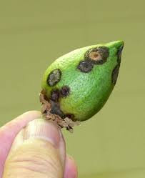
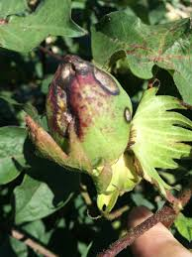
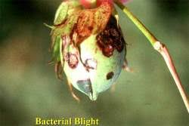
Symptoms:
Angular leaf spots
Rotting of bolls
Rotting of bolls

Slide 6
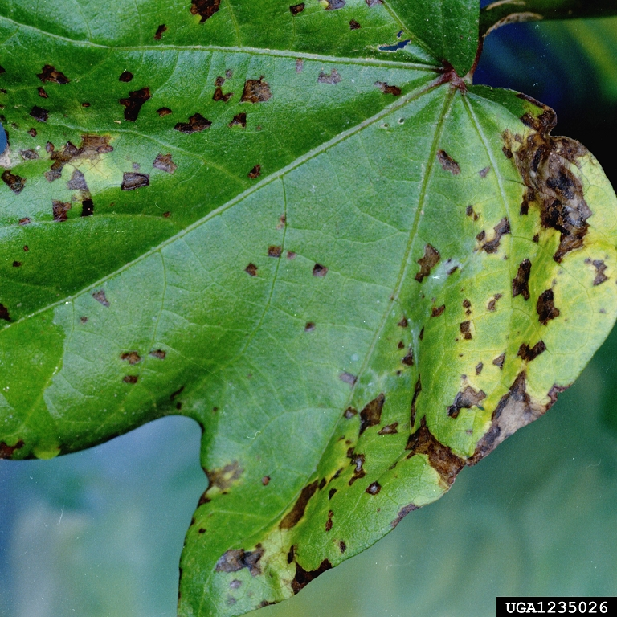
Symptoms:
White waxy crust on older leaf spots

Slide 7
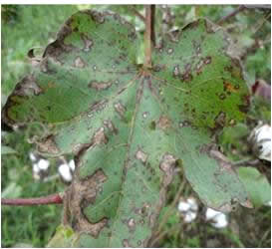
Symptoms:
Leaf spots spreading on the leaves

Slide 8
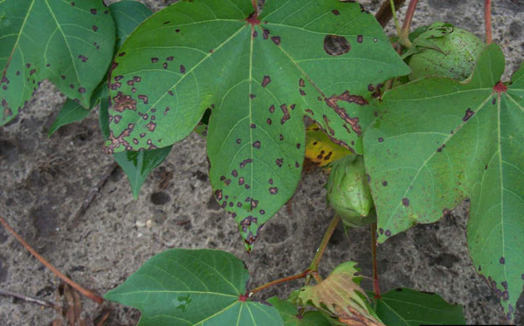
Symptoms:
Angular leaf spots

Slide 9
Disease cycle:
Bacteria can live on dry leaves for 17 years and cause infection.
Bacteria live in fuzz or inside of the seed
Infected parts (Primary source)
Secondary (Wind, Rain, Dew and Labor)

Slide 10
Management:
Seed treatment with (H₂SO₄) and streptomycin.
Hot water treatment at 56°C for 10 min.
Mixture of Agrimycin and Blitox.

