Slide 1
Repeat Pattern in Design

Slide 2
A repeat on a textile is where an identical figure or pattern begins again. The term also means the distance or number of inches between the replicated figures. Repeats can be vertical or horizontal and a random repeat places the figure across the fabric surface without using an underlying geometric pattern.

Slide 3
TYPES OF REPEATING PATTERNS
There are many types of pattern repeats. There is
Block
Brick
Half Brick
Drop
Diamond
Toss
Random
Stripe

Slide 4
Toss or Random Pattern
Creating random seamless repeating patterns is my favorite kind of pattern to make, so we will start with discussing this one first. What I love about random patterns is the interest you can create with this type of pattern.

Slide 6
Dot Pattern
A dot pattern is not necessarily a pattern of dots. It can be anything that makes up the dotted look to your pattern. A dot pattern is the same element or group of elements repeated in equal measurements from one another.
This is an example of a Dot pattern.

Slide 8
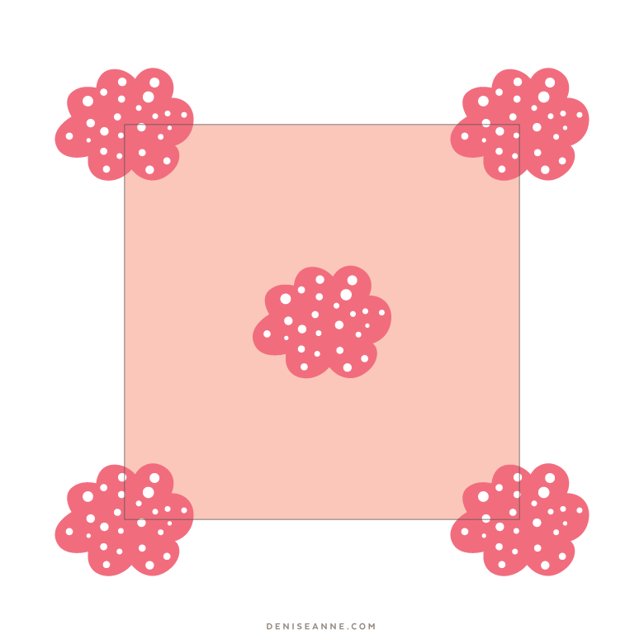
Studying What Makes Up a Dot Pattern
To make this type of pattern, the elements are repeated in all four corners, and within the center of the artboard.

Slide 9
Complex Stripe Pattern
Another pattern repeat type is the Stripe pattern. A stripe can be made out of a single fill color, or multiple design elements can be used to create the stripe itself. Your stripes can be oriented vertical or horizontal.

Slide 11
To make this type of pattern, the elements are repeated in rows that are an equal distance apart from each other.

Slide 12
Block Pattern
Block patterns are composed of a single centered object, or group of objects within the pattern artboard. This same element, when added to the swatch palette, is then repeated in line with itself.

Slide 13
Studying What Makes Up a Block Pattern

Slide 14
Diamond Pattern
A Diamond pattern is one that creates a Diamond shaped repeat. The diamonds can be connected, or they can be spread out. This pattern below is from my collection Thicket Thatch Patterns, which was inspired by nature.

