Slide 1
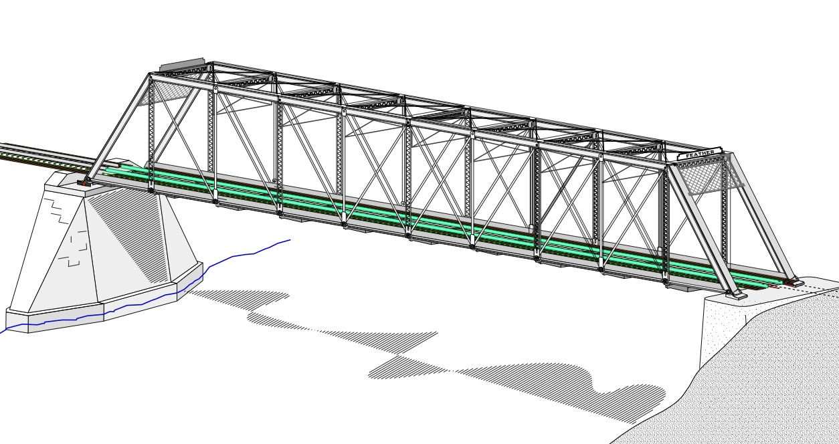
COLLEGE OF ENGINEERING AND TECHNOLOGY UNIVERSITY OF SARGODHA STEEL STRUCTURES (CT-313) (B.S TECHNOLOGY)
LECTURE-37,38 & 39
INTRODUCTION TO FLEXURAL MEMBERS
Engineer Aqeel Ahmed
Lecturer, Civil Engineering Department
CET, UOS, Sargodha

Slide 2
FLEXURAL MEMBERS
Structural members that supports transverse load and are therefore subjected primarily to flexure or bending.
Commonly referred as Beam.
If a substantial amount of axial load is also present the member is referred to as a beam-column.
Although some degree of axial load will be present in any structural member in many practical situations this effect is negligible and the member can be treated as Beam.
Beams are usually thought of as being oriented as horizontally and subjected to vertical loads, but that is not necessarily the case.
A structural member is considered to be a beam if it is loaded as to cause bending.

Slide 3
FLEXURAL MEMBERS…….
Commonly used cross-sectional shapes include the W-, S- and M- shapes. Channel shapes are sometimes used as are beams built up from plates, in the form of I or box shapes.
Whereas, doubly symmetric shapes such as the standard rolled W-, M-, and S-, shapes are the most efficient.
Coverage of beams in AISC specifications is spread over two chapters: Chapter F, “ Design of Members for Flexure” and Chapter G, “Design of Members for Shear”.
Figure 5.1 shows two types of beam cross sections: a hot-rolled doubly-symmetric built-up I-shape and welded doubly-symmetric built-up I-shape.
Welded shapes usually fall into the category classified as plate girders.

Slide 4
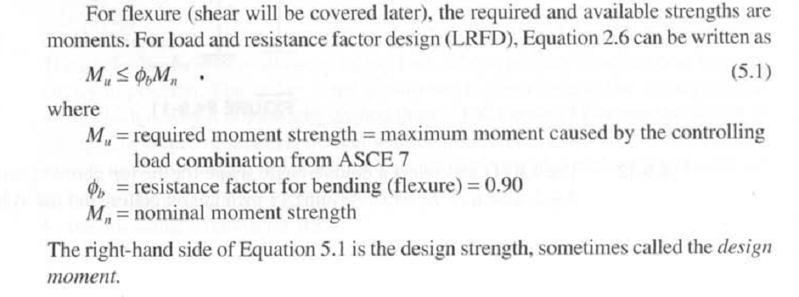

Slide 5
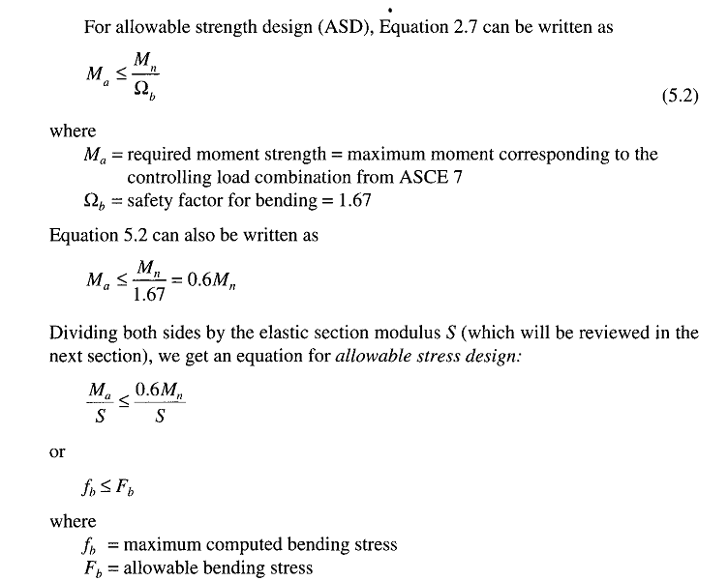

Slide 6
BENDING STRESS AND PLASTIC MOMENT
To be able to determine the nominal moment strength Mn, we must first examine the behavior of beams throughout the full range of loading from very small loads to the point of collapse.
Consider the beam shown in Figure 5.2a, which is oriented so that bending is about the major principal axis ( for an I shape, it will be the X-X axis).
For a linear elastic material and small deformations, the distribution of bending stress will be as shown in Figure 5.2b, with the stress assumed to be uniform across the width of the beam (Shear will be discussed separately).
From elementary mechanics of materials, the stress any point can be found from the flexure formula:-

Slide 7
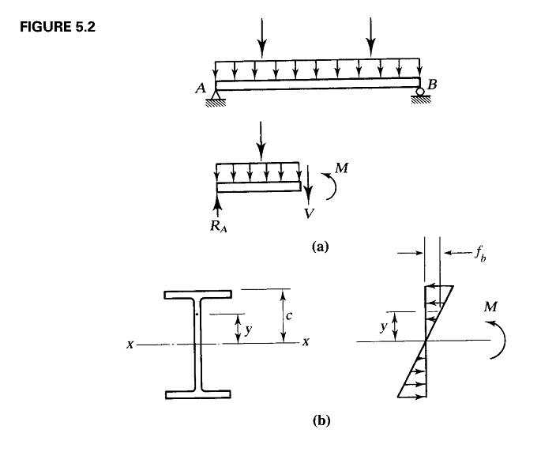

Slide 8
BENDING STRESS AND PLASTIC MOMENT………
Where M is the bending moment of the cross-section under consideration, y is the perpendicular distance from neutral plane to the point of interest and Ix is the moment of inertia of the area of the cross section with respect to neutral axis.
For a homogenous material the neutral axis coincides with the centroidal axis.
Equation 5.3 is based on the assumption of a linear distribution of strains from top to bottom, which in turn is based on the assumption that cross section that are plane before bending remain plane after bending.
In addition, the beam cross section must have a vertical axis of symmetry and the loads must be in longitudinal plane containing this axis.
The maximum stress will occur at the extreme fiber, where y is the maximum.
Thus there are two maximas : maximum compressive stress in the top fiber and maximum tensile stress in the bottom fiber.

Slide 9
BENDING STRESS AND PLASTIC MOMENT………
If the neutral axis is an axis of symmetry, these two stresses will be equal in magnitude.
For maximum stress, Equation 5.3 takes form:
Where C is the perpendicular distance from the neutral axis to the extreme fiber and Sx is the elastic section modulus of the cross-section.
For any cross-sectional shape, the section modulus will be a constant.

Slide 10
BENDING STRESS AND PLASTIC MOMENT………
For an unsymmetrical cross-section, Sx will have two values: one for the top extreme fiber and one for the bottom.
Values of Sx for standard rolled shapes are tabulated in the dimensions and properties tables in the manual.
Equations 5.3 and 5.4 are valid as long as the loads are small enough that the material remains within its linear elastic.
For Structural steel, this means that the must not exceed Fy and that bending moment must not exceed.
Where My is the bending moment that brings the beam to the point of yielding.
In Figure 5.3, a simply supported beam with a concentrated load at mid span is shown at successive stages of loading.

Slide 11
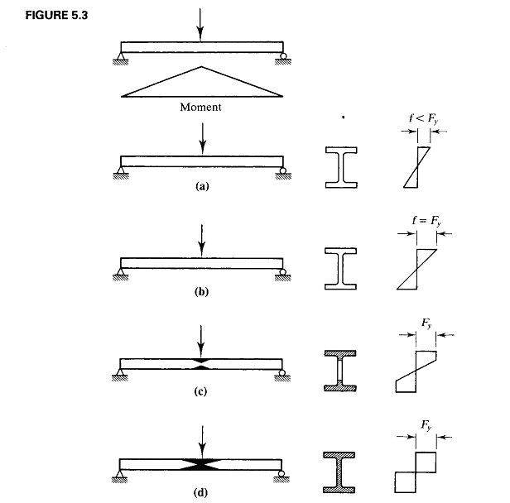

Slide 12
BENDING STRESS AND PLASTIC MOMENT………
Once yielding begins, the distribution of stress on the cross section will no longer be linear and the yielding will progress from the extreme fiber toward the neutral axis.
At the same time the yielded region will extend longitudinally from the center of the beam as the bending moment reaches My at more locations.
These yield region are indicated by the dark areas in figure 5.3 c and d.
In Figure 5.3b, yielding has just begun.
In Figure 5.3C, the yielding has progressed into the web and in Figure5.3d the entire cross-section has yielded.
The additional moment required to bring the beam from stage b to d is 10 to 20% of yield moment, My for W-shapes.
When Stage d has been reached, any further increase in the load will cause collapse, since all elements of the cross-section have reached the yield plateau of the stress-strain curve and unrestricted plastic flow will occur.

Slide 13
BENDING STRESS AND PLASTIC MOMENT………

Slide 14
BENDING STRESS AND PLASTIC MOMENT………
A Plastic hinge is said to have formed at the center of the beam and this hinge along with the actual hinges at the ends of the beam constitute an unstable mechanism.
During Plastic collapse, the mechanism motion will be as shown in Figure-5.4.
Structural Analysis based on collapse mechanism is called plastic analysis.
The plastic moment capacity, which is the moment required to form the plastic hinge can easily be calculated from a consideration of the corresponding stress distribution.
In Figure 5.5, the compressive and tensile stress resultants are shown, Where Ac, is the cross-Sectional area subjected to compression and At is the cross-sectional area in tension.
These are the areas above and below the plastic neutral axis, which is not necessarily the same as in the case of elastic neutral axis.

Slide 15
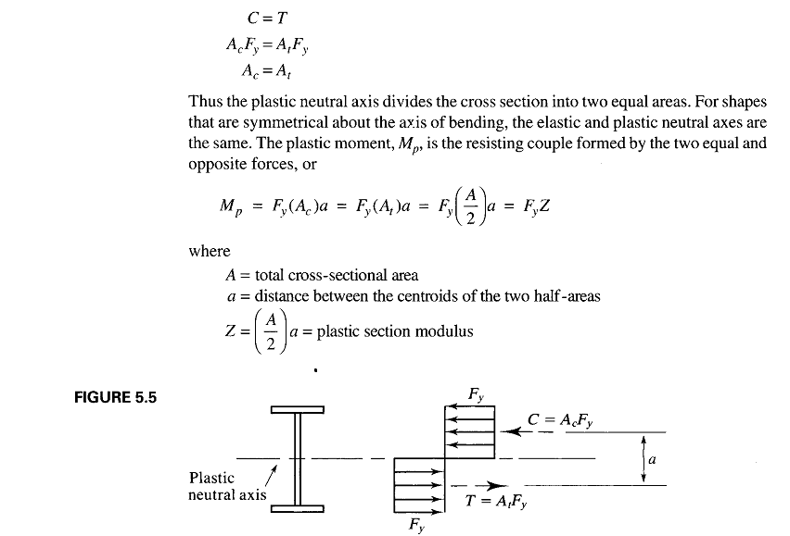
BENDING STRESS AND PLASTIC MOMENT………

Slide 16
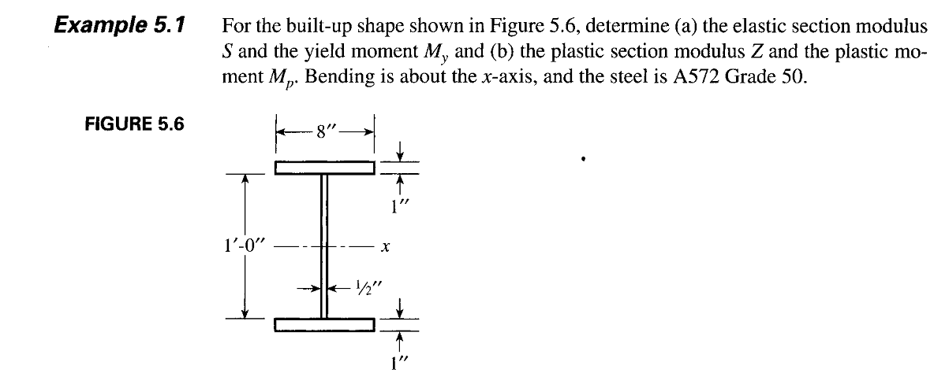

Slide 17
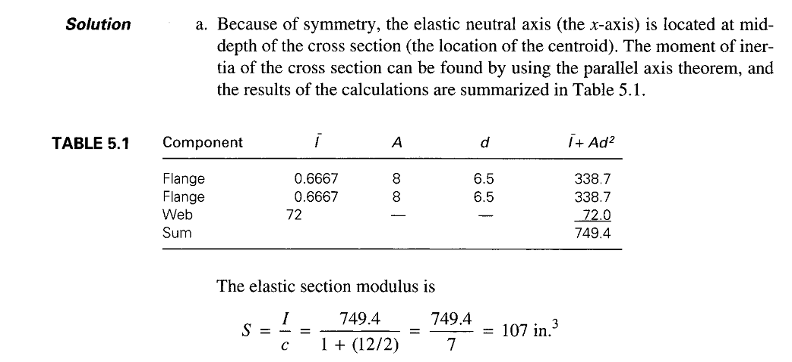

Slide 18
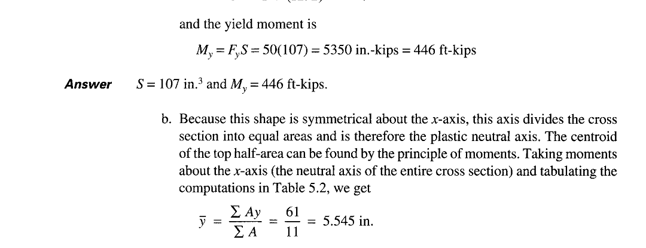

Slide 19
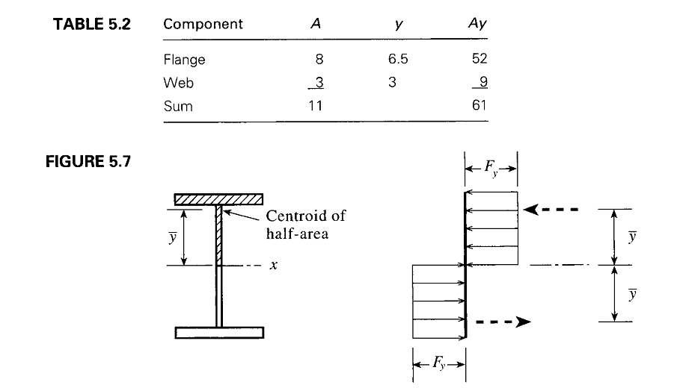

Slide 20
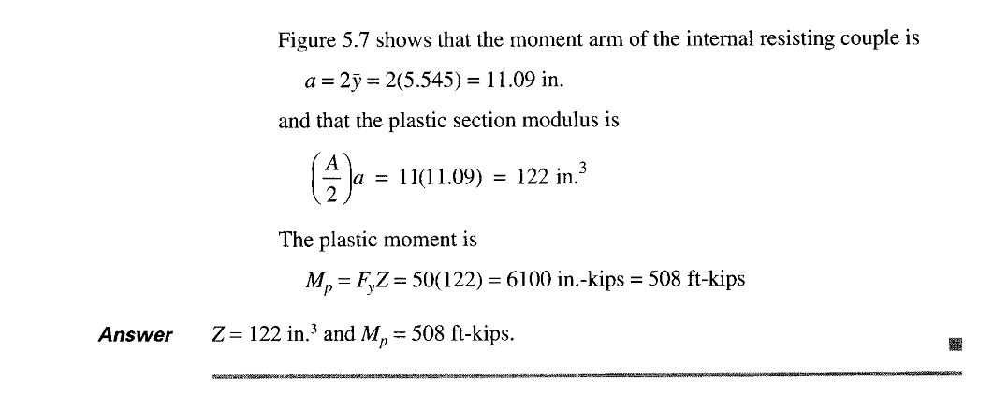

Slide 23
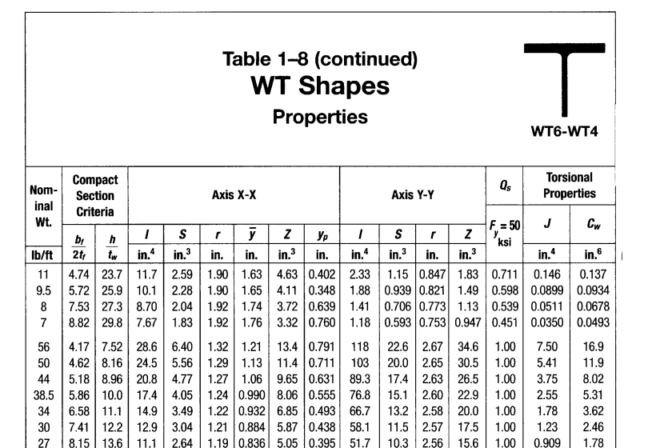

Slide 24
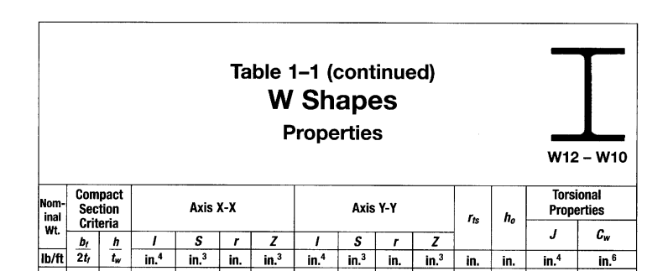

Slide 25
