Slide 1
Budgeting and cost control options
By: saba Ashraf
Noon business school, university of sargodha

Slide 2
outline
What is project budgeting?
Avoiding the classic budgeting mistake
Three levels of accuracy
Things needed to be documented
Sources of data for building budget
Building the actual budget
Refining the budget
Mastering the budget control

Slide 3
What is project budgeting?
Project budgeting is determining the total amount of money that is allocated for the project to use.
The project budget has been estimated by the project manager and/or the project management team.
The budget is an estimate of all the costs that should be required to complete the project. We use the words 'should be' because if a project is poorly estimated, then the project will require more costs.
The conceptual budget process is;
People + Resources + Time = Budget

Slide 4
Avoiding the classic budgeting mistakes
Before you start estimating the budget, desist from the following mistakes
Mistake 1: Never blurt out some random numbers that you think might be your estimate of your budget. Speaking off the top of your head can lead to scope misinterpretation.
Mistake 2: Thinking of developing a budget without creating WBS. Poorly defined number can never give the best estimate of your costs. Do not rush. Better wait for WBS to complete.
Mistake 3: Failing to account for the risks in completing the project. It does not allow you to have flexibility in budget.
Mistake 4: Not applying the proper experience and skills levels of the people available to the project work. It would take longer to complete the work.

Slide 5
Three levels of accuracy for estimating
Ballpark estimate: A ballpark figure is a rough numerical estimate or approximation of the value of something that is otherwise unknown. It is only useful if you are experienced enough to have a true gut-level feel for the entire project must cost.
Rough order of magnitude: During the project definition phase, you might recognize aspects of the project that are similar to the project you worked on before. (analogous estimate)
Detailed estimate: the two earlier estimates can occur in the project definition phase, whereas this level of budgeting occurs in the project planning phase. The project managers roll up all the estimated cost and develops a budget. This is also called bottom-up estimate. This kind of estimate takes months.

Slide 6
Things needed to be documented
The basis of the estimates (how it was developed)
All assumptions that were made.
Known constraints.
Confidence level
PEDDING:Padding the budget means making the budget proposal larger than the actual estimates for the project. It occurs when managers have lack of information. It affects the quality of estimate.

Slide 7
Sources of data for building the budget
INTRERNAL LABOR
INTERNAL EQUIPMENT
EXTERNAL LABOR AND EQUIPMENT
MATERIALS
TRAVEL

Slide 8
Direct and indirect cost
Direct costs include the following:
Labour: the cost of people working on the project
Supplies and raw material
Equipment
Travel
Legal fees
Training
Marketing and advertising

Slide 9
Direct and indirect cost
Indirect costs include:
Facilities
Site-specific requirement
Management and administrative overhead

Slide 10
Building the actual budget
The budget should help the project manager control the project. So it should be done task by task, step by step.
You must thoroughly understand the component of each activity and use the bottom up method to cost out each one. Use the best estimating capabilities.
Costs are tied up to projects goals, so you must have enough money to meet the desired goals.
Costs are tied to time frames and schedules, and doing things faster costs more money.

Slide 11
Opinion matters
Getting expert opinions (answer-back process)
People who can prove to be helpful in developing your estimate
Other project managers or experts
Your management team
Standard pricing guides

Slide 12
Refining the Budget
Doing the first cut: First cut should never become the actual budget number. It is often remembered as real budget quotation
Doing a second cut: Ask other to carefully review the budget and focus on the resources required for each time estimate. You should always look at the historical project costs for guidance
Getting it right: In this step you dot he fine tuning
Wrapping it up: you figure out if the project is workable or affordable.
Presenting it for approval: it is finally presented to steering committee for approval.
DO NOT FORGET THE ADD CONTEGENCY RESERVE

Slide 13
Mastering the budget control
You need to have full control over budget to avoid budget slippage.
It is prudent to know time value of money invested in the project as we all know what a dollar buys today will be less a year from now. There are four ways you can validate your budget.
Cash flow analysis
Payback
Net present value
Internal rate of return

Slide 14
Cash flow analysis
A cash flow statement is one of the most important financial statements for a project or business.
A cash flow analysis is a method for checking up on your firm's financial health
A cash flow statement is a listing of the flows of cash into and out of the business or project.
A cash flow statement is not only concerned with the amount of the cash flows but also the timing of the flows. Many cash flows are constructed with multiple time periods. For example, it may list monthly cash inflows and outflows over a year’s time.
Working capital is an important part of a cash flow analysis

Slide 15
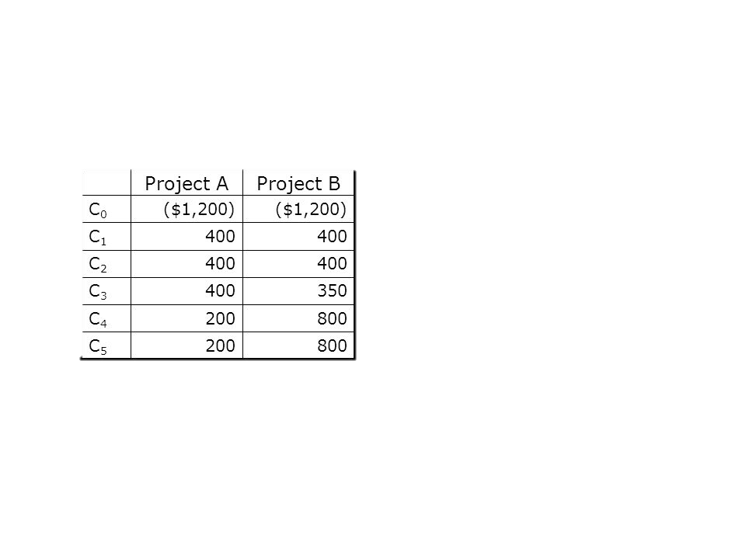
payback
The payback period refers to the amount of time it takes to recover the cost of an investment. Simply put, the payback period is the length of time an investment reaches a break-even point.
The desirability of an investment is directly related to its payback period. Shorter paybacks mean more attractive investments.
Payback period can be calculated by dividing the initial investment/cost of project by net annual inflow.

Slide 16
NET present value (NPV)
The net present value method is used to evaluate current or potential investments and allows you to calculate the expected return on investment (ROI) you'll receive.
Net Present Value (NPV) = Cash flow / (1 + discount rate) ^ number of time periods.
If the net present value is positive, your project is profitable. But, if the NPV is negative, your project is unprofitable

Slide 17
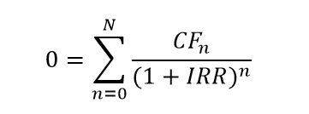
Internal rate of return
Internal rate of return (IRR) is the interest rate at which the net present value of all the cash flows (both positive and negative) from a project or investment equal zero.
Internal rate of return is used to evaluate the attractiveness of a project or investment. If the IRR of a new project exceeds a company’s required rate of return, that project is desirable. If IRR falls below the required rate of return, the project should be rejected.

