Slide 2
LECTURE # 25-26
ORGANIZATIONAL CULTURE
PSYC-6223

Slide 3
ORGANIZATION
A social unit of people that is structured and managed to meet a need or to pursue collective goal.
In simple words, different individuals come together, form a group for a collective purpose or objective.

Slide 4
CULTURE:
Something made-up of the beliefs, ideologies, principles and values of people living in the society.
It determines the direction of the “thinking and action” of the people….

Slide 5
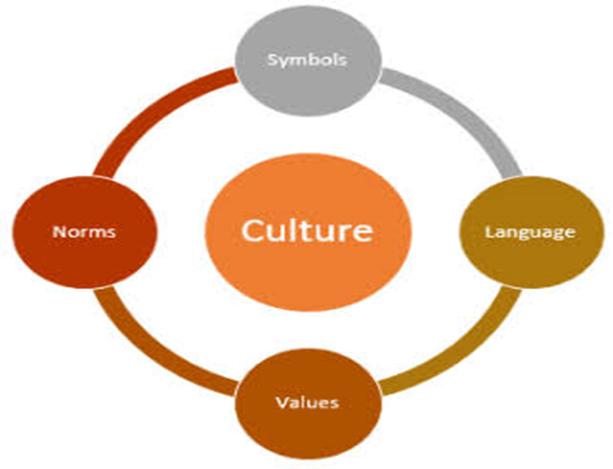
DEFINITION
Culture is the unique dominant pattern of shared beliefs, assumptions, values, and norms that shape the socialization, symbols, language and practices of a group of people.
The attitude and approaches that typify the way staff carry out their tasks.
Culture is developed and transmitted by people, consciously and unconsciously, to subsequent generations.

Slide 6
CHARACTERISTICS OF ORGANIZATIONAL CULTURE
Observed
Behavioral
regularities
Philosophy on treatment of employees/ customers
Rules
Of employee behavior
Organizational culture
Norms
Dominant values
Organizational climate

Slide 7
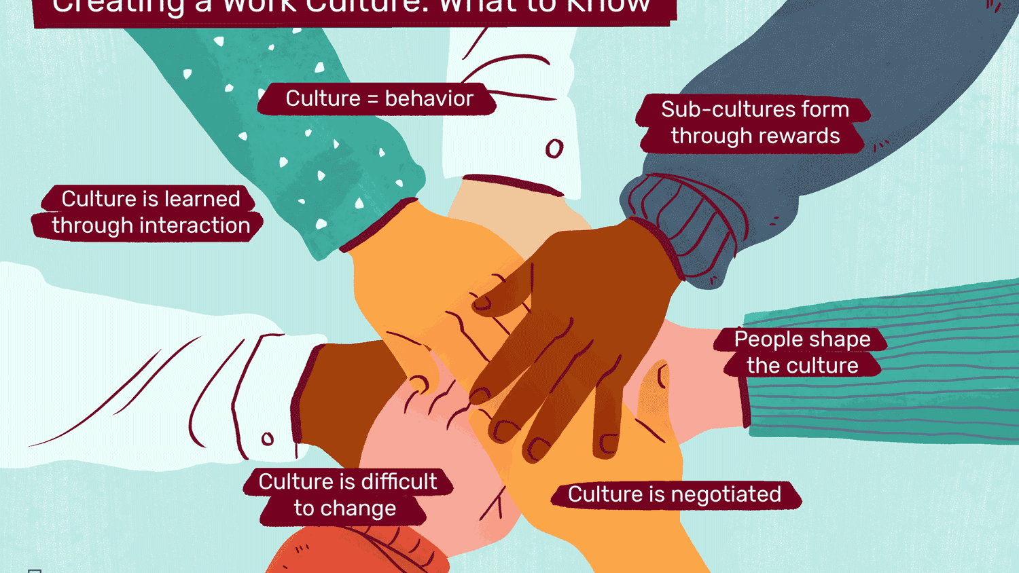
SHARED ASSUMPTIONS:
Shared assumptions are the thoughts and feelings that members of a culture take for granted and believe to be true.

Slide 8
VALUES AND NORMS:
Values are the basic beliefs people hold that specify general preference and Behaviours, and define what is right and wrong.
cultural values are reflected in a society’s morals, customs and established practices
Norms are rules that govern Behaviours of groups of people.

Slide 9
SYMBOLS:
A symbols is any visible object, act, or event that conveys meaning to others. examples:
Artefacts
Dress
Office layout
Slogans
ceremonies

Slide 10
LANGUAGE
Language is a shared system of vocal sounds, written signs, and/or gestured used to convey meaning among members of a culture.

Slide 11
PRACTICES:
Practices are observable cultural customs such as taboos (culturally forbidden Behaviours) and ceremonies.

Slide 12
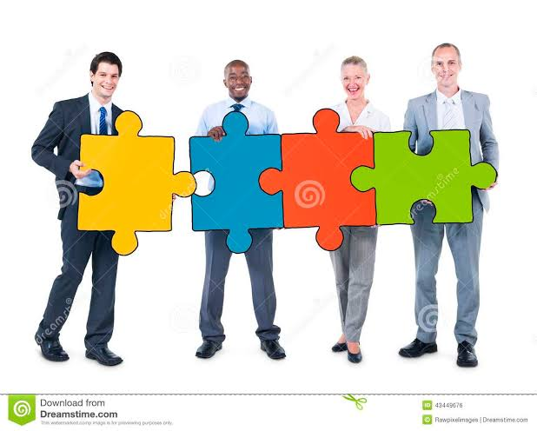
SOCIALIZATION
Socialization is the process by which people lean values, norms, Behaviours and social skills. It is the means by which new members are brought into a culture.

Slide 13
WHAT MUST BE FOR CULTURE TO EXIST?
It must be shared by the vast majority of members of a group or society.
It must be passed on from generation to generation; and
It must shape behavior and perceptions.

Slide 14
CULTURAL ICEBERG

Slide 15
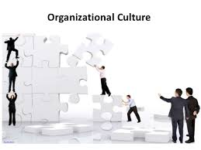
ORGANIZATIONAL CULTURE
It determines through the organization’s rituals, values, means, norms and language.
As a result the culture of an organization is a sense if identity_ ‘who we are’, ‘what we stand for’, and ‘what we do’.
In short, org. culture is the way in which ‘things are done in the organization.’

Slide 16
ROLE OF AN ORGANIZATIONAL CULTURE:
Culture provides a sense of identity.
Culture helps to create a commitment to the vision and the mission of the organization,
Culture clarifies and reinforces standards of behavior.

Slide 17
IMPORTANCE OF AN ORGANIZATIONAL CULTURE:
It is the culture that decides the way employees interact at their workplace.
It also promotes healthy relationships at workplace (among the employees).
It represents certain predefined guidelines which guide the employees and give them a sense of direction at the workplace.

Slide 18
No two organizations can have the same culture. It is the culture of an organization which make it distinct from others.
It bring all the employees on a common platform and also unites the employees coming from various background (i.e.- religion, cast, area, etc.)

Slide 19
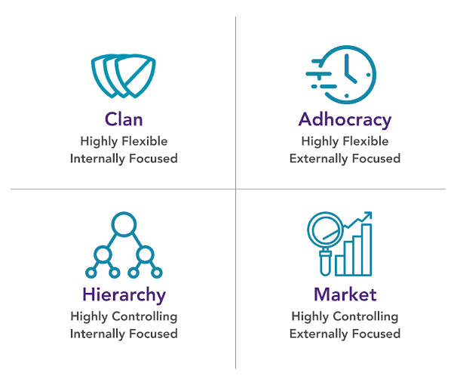
TYPES OF CULTURE
The basic types of organizational culture are:
Hierarchy culture
Market culture
Clan culture
Adhocracy culture

Slide 20
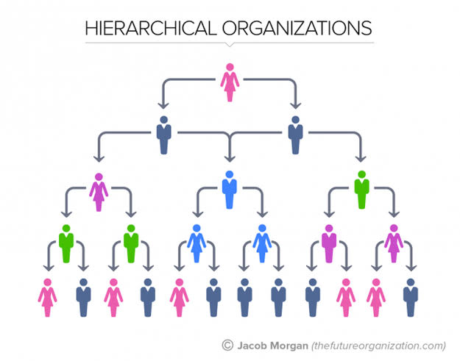
HIERARCHY CULTURE:
it is a systematic culture in which every things has its own level and importance. In it every things is done in a systematic process.

Slide 21
MARKET CULTURE:
In such a organizational culture the organizational total depend upon the outside or the external environment. In this culture the main focused in on stability and order with an external orientation in mind.
In a market culture, the values and norms reflect the significance of achieving measureable and demanding goals mainly concerning those that are financial and market based.
Companies with a market culture tend to focus on:
Sales growth
Profitability
Market share

Slide 22
CLAN CULTURE:
A culture which is flexible and discrete. Here the members as employees share the vision, mission and values of the organization and an atmosphere is created for fun and adventure with the spirits of work for the employees.
A clan culture achieve unity through socialization.

Slide 23
ADHOCRACY CULTURE:
Organization that have an adhocracy culture emphasize an orientation towards the external environment with an internal flexibility and discretion.

Slide 24
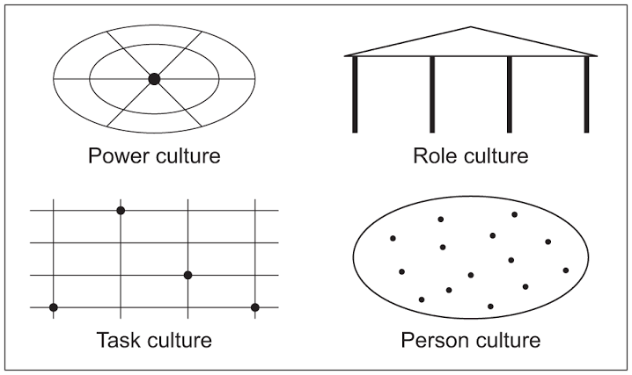
HANDY’S 4 TYPES OF ORGANIZATIONAL CULTURE:
Following are the four organizational culture:
A power culture
A role culture
A task culture
A person culture

Slide 25
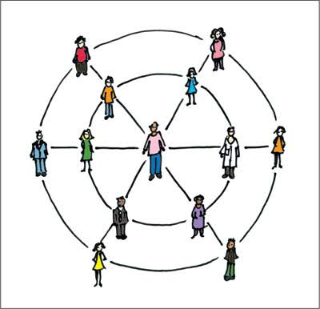
A POWER CULTURE:
A power culture is one based on the dominance of one or a small number of individuals within an organization. They make the key decisions for the organization.

Slide 26
A ROLE CULTURE:
A role culture exist in large hierarchical organizations in which individuals have clear roles (jobs) to perform which are closely specified.

Slide 27
A TASK CULTURE:
A task culture it exist when teams are formed to complete particular tasks. A different teams have distinct culture…..
which make it more creative.

Slide 28
A PERSON CULTURE:
A person culture is the most individualistic form of culture and exist when individuals are fully allowed to express themselves and make decisions for themselves. It only exist in a very loose form of organization.

Slide 29
CLASSIFICATION OF ORGANIZATIONAL CULTURE:
Strong vs. weak culture
Soft vs. hard culture
Formal vs. informal culture

Slide 30
STRONG VS. WEAK CULTURE:
Strong culture is said to exist where staff respond to stimulus because of their alignment to organizational values.
i.e. Firm operate like a very well oiled machines….
Whereas, in weak culture there is a little alignment with organizational values and control must be exercised though extensive procedures and bureaucracy.

Slide 31
SOFT VS. HARD CULTURE:
In a soft culture the employees pursue their own personal goals and give less importance to the organizational goals.
Whereas, in a hard culture the employees consider more on organizational goals than of their own goals.

Slide 32
FORMAL VS. INFORMAL CULTURE:
In formal organizational culture there is more emphasis on roles, responsibilities, rules and regulations.
Whereas, in informal culture there is no such thing like rules and regulations, etc. employees are free to do there works as they like…

Slide 33
RELATIONSHIP BETWEEN CULTURE AND ORGANIZATIONAL PERFORMANCE:
Organizational culture has a potential to enhance organizational performance, individual satisfaction, the sense of certainty about how problems are to be handled.
Culture serve as a control mechanism to channel behavior towards Behaviours and to prevent undesired Behaviours.

Slide 34
BUILDING A STRONG ORGANIZATIONAL CULTURE:
A common behavioral style must be shared by managers and employees.
Have the same basic approaches to solving problems, meeting goals and dealing with stakeholders.
Have share common norms that guide rule governing rewards and punishment.
a strong organizational culture assist in the creation of a stable organization, the consequences of which lead to the achievement of the company’s strategic goals.

Slide 35
STEPS TO BUILDING A STRONG ORGANIZATIONAL CULTURE:

Slide 36
OUTCOMES OF SOCIALIZATION PROCESS:

Slide 37
ANY QUESTION

