Slide 1
Vitamin B6
Vitamin B6 refers to a group of three compounds.
pyridoxol (pyridoxine), pyridoxal, and pyridoxamine
Their activities are equivalent in animals but not in various microorganisms.
Vitamin B6 acts as a component of many enzymes that are involved in the metabolism of.

Slide 2
proteins,
fats, and
Carbohydrates
Common feed ingredients for typical poultry and swine diets contain adequate amounts of vitamin
Although such conditions are rare, vitamin B6 can be deficient for poultry and swine in a few situations B6.

Slide 3
HISTORY
The early history of vitamin B6 has been summarized by McCollum (1957), Snell (1986), and Loosli (1991).
Clinical signs of what was later to be known as vitamin B6 deficiency were described in 1926 by Goldberger and Lillie.
The vitamin was first isolated from rice bran and yeast.

Slide 4
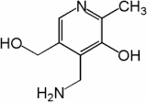
CHEMICAL STRUCTURE
Vitamin B6 is a relatively simple compound with three substituted pyridine derivatives that differ only in functional group in the 4-position:
alcohol (pyridoxine or pyridoxol), aldehyde pyridoxal, and amine pyridoxamine

Slide 5
Pyridoxine is the predominant form in plants, whereas pyridoxal and pyridoxamine are the forms generally found in animal products.
Various forms of vitamin B6 can be destroyed by heat and alkali, and exposure to light.
vitamin B6 are colorless crystals soluble in water and alcohol.

Slide 6
METABOLISM
Utilization of dietary vitamin B6 by animals necessitates digestion and absorption of the five forms known to occur in foods.
pyridoxine,
pyridoxal,
Pyridoxamine
PLP, and
pyridoxamine phosphate

Slide 7
Vitamin B6 is absorbed mainly in the jejunum, but also in the ileum.
After absorption, B6 compounds rapidly appear in liver, where they are mostly converted into PLP.
Pyridoxamine phosphate and PLP are also interco nvertible through aminotransferases.

Slide 8
Storage
Only small quantities of vitamin B6 are stored in the body.
The vitamin is widely distributed in various tissues, mainly as PLP or pyridoxamine phosphate.

Slide 9
Excretion
Pyridoxic acid is the major route for elimination of vitamin B6, which is excreted in urine.
Excretion mainly from kidney but small quantities through feces and sweet.

Slide 10
FUNCTIONS
PLP transfer to amino group allow the synthesis of nonessential amino acid.
Without PLP every amino acid would be essential.
PLP helps convert homocystine to cystine .
PLP required for release of glucose from glycogen…..helps maintain blood glucose concentration.

Slide 11
Function synthesis of compound
In RBCs, PLP catalyzes a steep in the hem synthesis.
Ring in some protein that holds iron
Ex. Hemoglobin
PLP require for neurotransmitter synthesis.
Serotonin, dopamine, gamma- aminobutaric acid.
Play a role in Niacin synthesis.

Slide 12
Additional function
Helps support immune function and regulation 0f gene expiration.
May help prevent colon cancer.
Increase intake and blood level hade lower risk of colorectal cancer.

Slide 13
REQUIREMENTS
Requirement for vitamin B6 has been found generally to depend on:
species, age, physiological function, dietary components, the intestinal flora.
Men – women- 2mg
Children – 1.7 mg
Infant - o.1-o.4
Dairy cattle Calf - 6.5 ppm milk replacer

Slide 14
Boys and girls - 9-13y 1.0mg/D
Pregnancy - 14- 18y 1.9mg/D
Lactation - 14-18y 2 mg/D
Chicken
Leghorn, 0–18 weeks 3.0 mg/kg
Laying (100-g intake) 2.5 mg/kg
Broilers, 0–8 weeks

Slide 15
DEFICIENCY
vitamin B6 deficiency are:
retarded growth,
epileptic-like convulsions
Anemia
Weakness
Sleeplessness
Dermatitis
Nerve damage

Slide 16
Swine
In growing pigs, clinical signs of vitamin B6 deficiency include
poor appetite,
slow growth
microcytic hypo chromic
an liver,
diarrhea,
rough hair coats,
scaly skin Aemia

Slide 17
Poultry
Chicks fed a vitamin B6-deficient diet have little:
appetite
and grow slowly,
with plumage failing to fully develop
general weakness after a few days of deprivation

Slide 18
Humans
A high proportion of the human population receives inadequate dietary.
vitamin B6, particularly young
and pregnant or lactating women.
Typical vitamin B6 deficiency symptoms in humans include:
hypochromic,
microcytic anemia,
loss of weight,
abdominal distress, vomiting

Slide 19
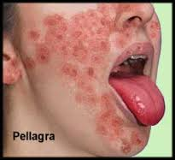
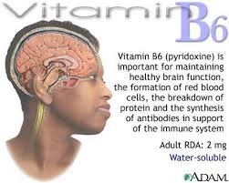
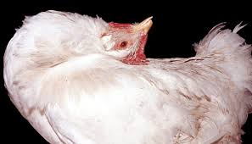
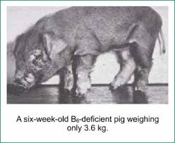

Slide 20
Sources
Stored in musscle tissue of animal.
meat, fish , and poultry
Whole grain are good source and some loss during of grains.
Fruits and vegitablies are not god source.
Exception: carrot products, potatos, spinach, bananas.

Slide 21
TOXICITY
In common with other members of the vitamin B complex, vitamin B6 has a very low toxicity.
large of vit. B6 cause sever nerve damage.
Too much vit. B6 in the body can risult in night restlessness a vivid dream recall.
More then 200mg/day cause peripheral neutopathy.

Slide 22
Dosses higher then 500mg/day may7 be toxic leading to:
Serious CNS problems.
Pains in the arms and legs.
A numbness or tingling in the hands and feet.
Clumciness
Loss of balance
And difficulty in walking

Slide 23
References
Adams, C.R. (1973).
Adams, C.R. (1978).

