Slide 2
Milk sampling and diseases.

Slide 3
Group Members
Ayesha Sadiqqa
Uzma Fatima
M.Awais
M.Wajahat

Slide 4
Sampling Milk
Assessing the quality of liquid milk is done through performing quality assurance tests, which begins by sampling liquid milk.
you need to verify that you are starting off with the best quality available.

Slide 5
Milk Sampling
Since you are dealing with large quantities of milk, it is necessary to take a representative sample from which you will be able to ascertain the quality of the entire batch. This is why you will need to do sampling of liquid milk.

Slide 6
Sampling liquid milk from a single container
Mix the milk mechanically and then draw the required quantity of sample
collecting a composite sample from several container
A composite sample is the quantity of milk obtained by mixing proportional parts of different milks. A sample is then picked from the composite sample to represent the whole lot.
Sampling liquid milk from storage tanks and road tankers
Storage tanks usually have agitators used to mix the milk. Ensure the milk is mixed gently for about 15 minutes in the tank and in case there are no mechanical agitators, mix the milk mechanically using a stirrer and then pick the sample using a dipper.

Slide 7
Milk Sampling
Pick the samples proportionate to the size of the tank. The minimum amount of the sample should not be less than 500 mls.
Most modern tanks and tankers have automatic samplers from which you obtain the sample after the contents have been uniformly mixed.

Slide 9
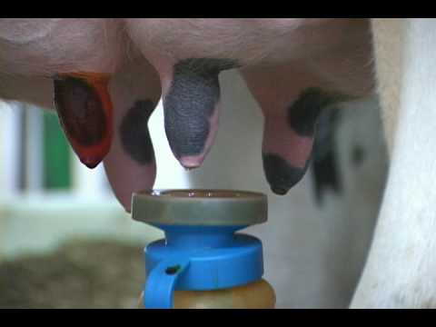

Slide 15
Mastitus

