Slide 1
Lecture # 7 Plane table surveying

Slide 2
Plane Table Surveying
Plane table is a graphical methodof surveying in which the field work and the plotting is done simultaneously.
It is adopted in small mapping.
It is also ideally suited to filling detail on a map already prepare and available on the drawing sheets.
It can also be used to prepare a fresh map with the linear measurements being taken with a chain or tape.

Slide 3
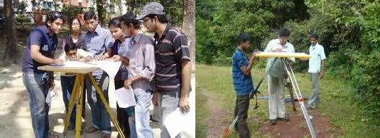
Plane Table And Accessories

Slide 4
Plane Table And Tripod
A simple plane table is a drawing board provided with a ball and socket arrangement for leveling the table
,with an arrangement to fix the table to a tripod.

Slide 5
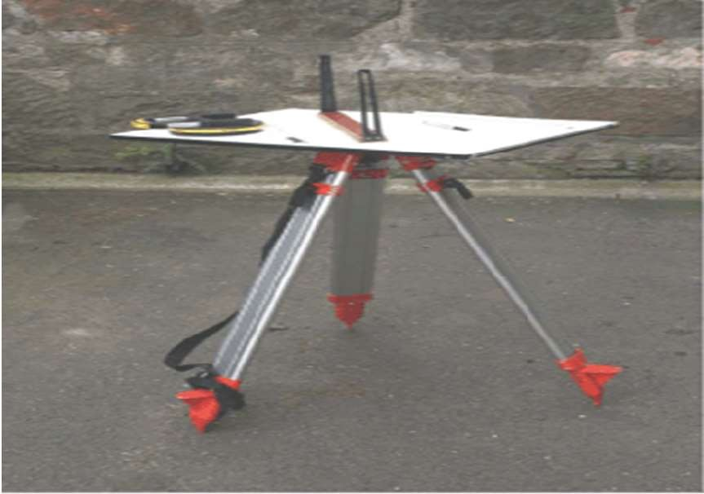

Slide 6
Alidade
A plane alidade consists of a metallic rule with a fine beveled edge called the fiducial edge.
This edge is used for drawing line.
Two frame are attached vertically at its end.
The sight vane-a small metal frame with a silt.
The object vane-a frame with a fine hair placed vertically
,for bisecting – the part directed towards the object.
The center of the sight vane and hair of the object vane provides the line of site.

Slide 7
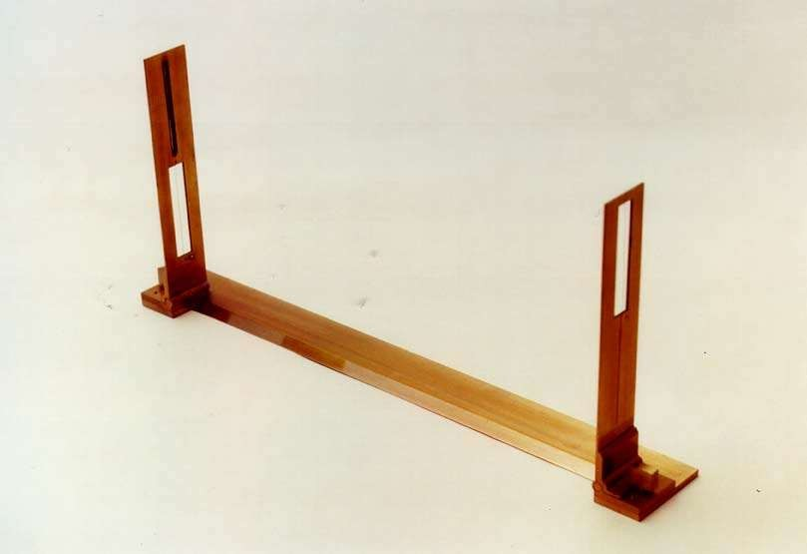
Sight Vane
Object Vane
Fiducially Edge

Slide 8
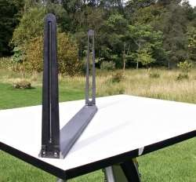

Slide 9
Telescopic Alidade
The alidade which is fitted with a telescope is known as a telescopic alidade.
It is used to take inclined sights.
It increases the range and accuracy of the sights.
It consists of a small telescope with a level tube.
A graduated scale is mounted on the horizontal axis.
One side of the metal ruler is used as the working edge along which lines are drawn.
The angles of elevation or depression can be read on the vertical circle.

Slide 10
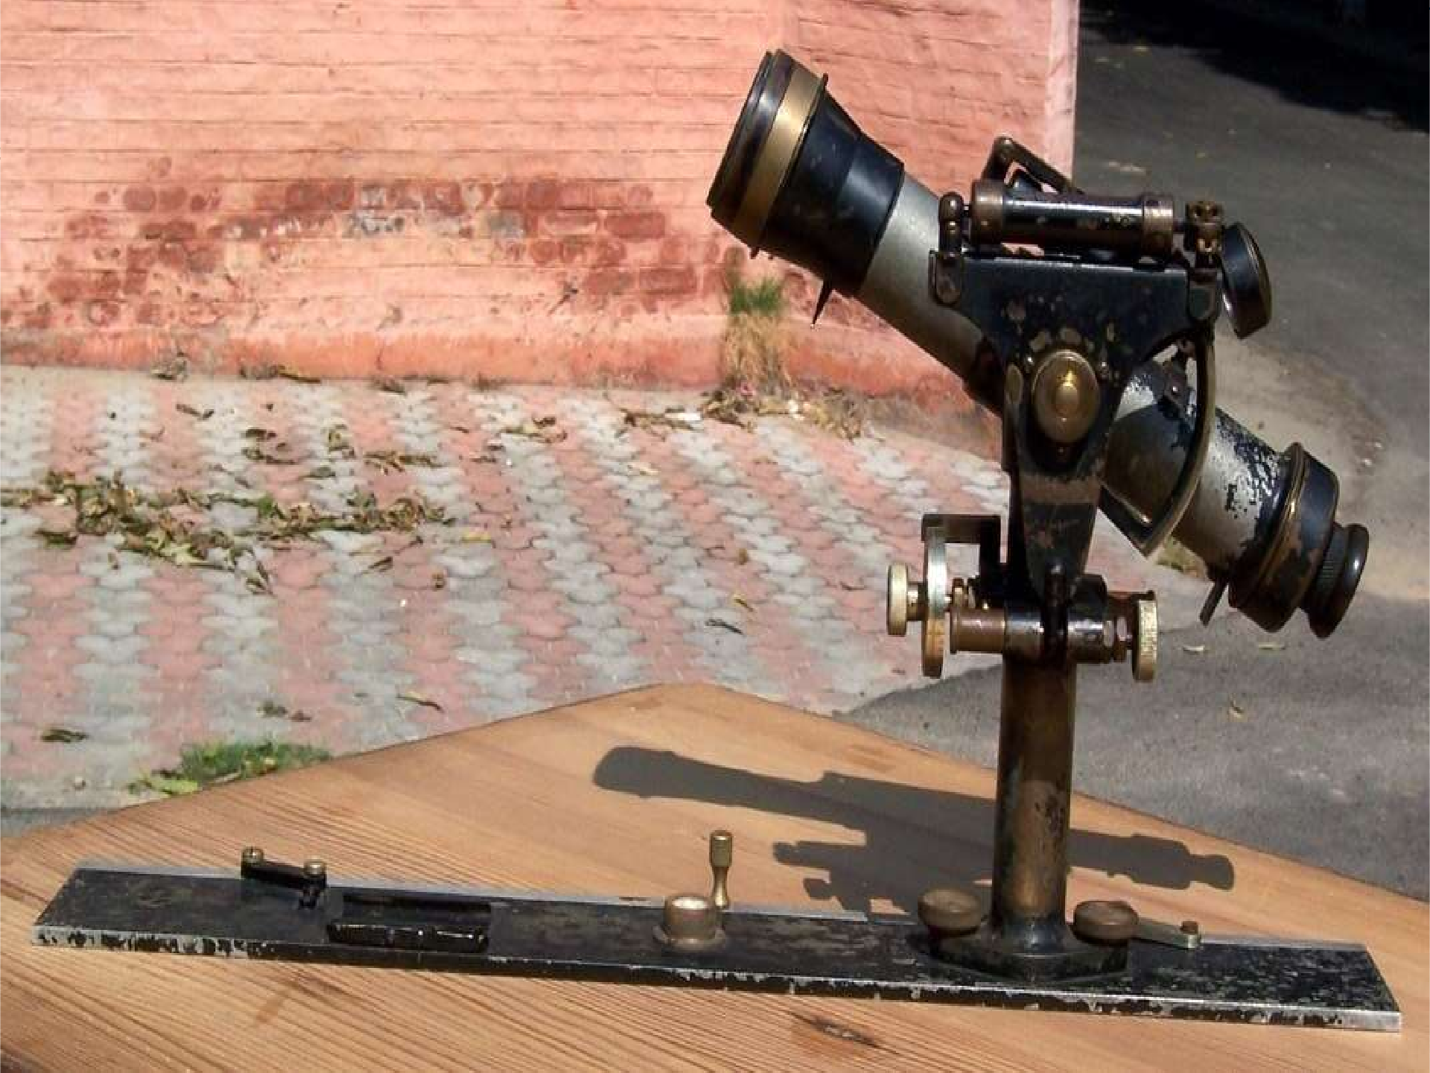

Slide 11
Spirit Level
Spirit level can be used to level the plane table.
It can be tubular level which can be placed in two perpendicular positions and leveled.

Slide 12
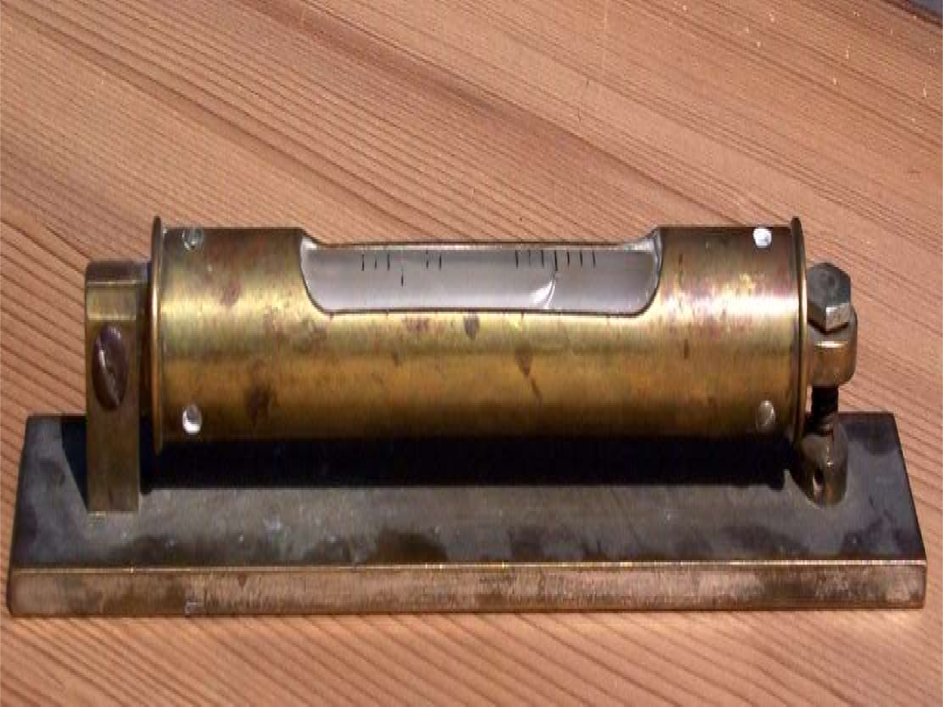

Slide 13
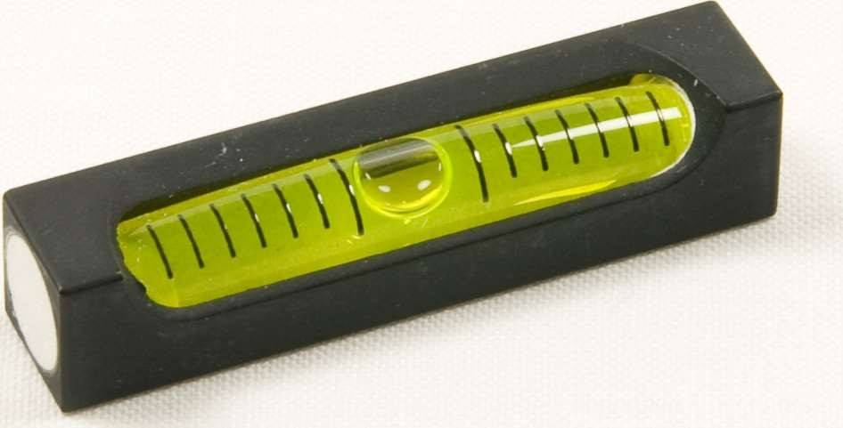

Slide 14
Trough Compass
A box compass consists of a magnetic needle pivoted at its centre freely
It is used for orienting the plane table to magnetic north.
• The edges of the box compass are straight and the bottom is perfectly flat.

Slide 16
Plumbing fork
The plumb bob is fitted on to a folded frame (fork).
The straight edge can be placed on the table and the bottom leg on the frame is under the table.
The top leg has a fine point which can be kept on a plotted point.

Slide 17
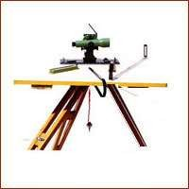
Plumbing Fork

Slide 18
Setting up of the Plane Table
Setting up the Plane Table in the Field.
• The table should be set up at a convenient height. (say about 1m). The legs of the tripod should be spread well apart, and firmly fixed into the ground in such a way that the table is approximately level.
Leveling the table
• In this operation, the table top is made truly horizontal. For rough and small scale work, leveling can be done by eye estimation, whereas for accurate and large scale work, leveling achieved with an ordinary spirit level. The leveling is specially important in hilly terrain where some of the control points are situated at higher level and some other at lower level. The disleveling of the plane table, throws the location of the point considerably out of its true location.

Slide 19
Setting up of the Plane Table
Centering the table:
• The table should be so placed over the station on the ground that the point plotted on the sheet corresponding to the station occupied should be exactly over the station on the ground. This operation is known as the centering of the table. This may be done using a plumbing fork or U frame.
Orienting the plane table:
• The operation of keeping the table at each of the successive stations parallel to the position which it occupied at the first station is known as orientation. It is necessary when the instrument has to be set up at more than one station.

Slide 20
Plane Tabling Methods
The plane table can be used in four ways-
radiation
intersection
Traversing
Plane table is generally used with the traverse drawn on a sheet for filling details or
Can also be used for doing a fresh survey.
These methods cover both these aspects of surveying with the plane table.

Slide 21
Radiation Method
It requires the plane table to occupy a single station .
Orientation table is not required.
To conduct the survey of an area ,the table is kept at a convenient station P commanding a full view of the area to be surveyed.

Slide 22
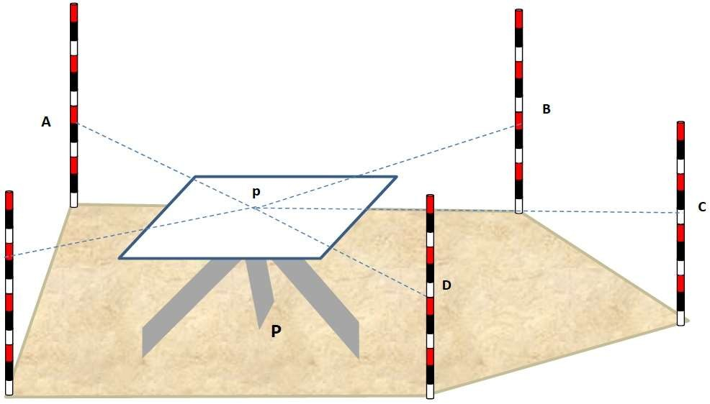

Slide 23
Intersection Method
This method requires setting the table up at minimum of two stations.
Orientation is essential and be can done by back sighting.
Two station A and B are selected so that they command a full view of the area to be surveyed.

Slide 24
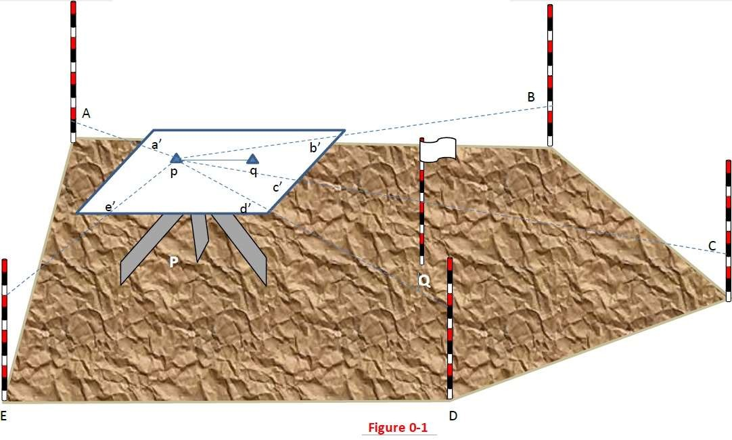

Slide 25
Traversing Method
This method is used to connect the two or more stations , however it is similar to the compass traversing but are done simultaneously.
Traversing is a method of surveying where by a series of lines are surveyed.
Traverse may be open or closed one.

Slide 26
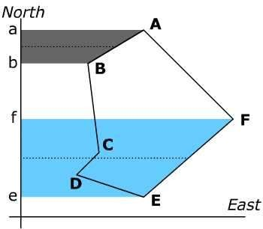
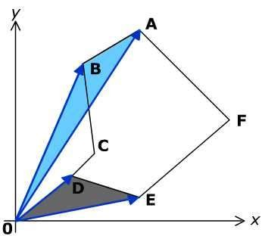

Slide 27
Advantage Of Plane Table Surveying
It is suitable for location of details as well as contouring for large scale maps directly in the field.
As surveying and plotting are done simultaneously in the field, chances of getting omission of any detail get less.
The plotting details can immediately get compared with the actual objects present in the field. Thus errors as well as accuracy of the plot can be ascertained as the work progresses in the field.
Contours and specific features can be represented and checked conveniently as the whole area is in view at the time of plotting.
Only relevant details are located because the map is drawn as the
survey progresses. Irrelevant details get omitted in the field itself.
The plane table survey is generally more rapid and less costly than most other types of survey.
As the instruments used are simple, not much skill for operation of instruments is required. This method of survey requires no field book.

Slide 28
Disadvantage Of Plane Table Surveying
The plane table survey is not possible in unfavourable climates such as rain, fog etc.
This method of survey is not very accurate and thus unsuitable for large scale or precise work.
As no field book is maintained, plotting at different scale
require full exercise.
The method requires large amount of time to be spent in the field.
Quality of the final map depends largely on the drafting
capability of the surveyor.
This method is effective in relatively open country where stations can be sighted easily .

Slide 29
Thanks

