Slide 1
Soil Mechanics
(BS-Civil Technology) UOS
SAEED HASSAN

Slide 2
Soil
Soil is a material, by means of which and upon which engineers build their structures. The term soil includes entire thickness of the earth’s crust, which is accessible and feasible for practical utilization as foundation support or construction material.
Notes:
The term Soil Structure refers to the orientation and distribution of particles in a soil mass (also called "fabric" and "architecture") and the forces between adjacent soil particles. {Ref. 1. Pg # 71, Chap # 7. Soil Mecanics by T. William Lambe. (Elsevier Academic Press)

Slide 3
Soil Mechanics
Soil Mechanics is defined as the branch of engineering science which enables to know the behavior of soil under the action of ;
Loads,
Gravitational forces,
Water and,
Temperature.
Simply speaking it is the knowledge of engineering science , which deals with properties, behavior and performance of soil as a construction material or foundation support.

Slide 4
Why we study Soil Mechanics?
Various reasons to study the properties of Soil:
Foundation to support Structures and Embankments
Construction Material
Slopes and Landslides
Earth Retaining Structures

Slide 5
Weathering of Rocks
Physical Weathering
Chemical Weathering

Slide 6
Weathering of Rocks
Weathering is the process of breaking down of rocks by physical and chemical process into smaller particles.
There are two main types of weathering processes:
Physical (or mechanical) Weathering
Chemical Weathering
Notes:
Burrow: a hole in the ground dug by an animal such as a rabbit, especially to live in

Slide 7
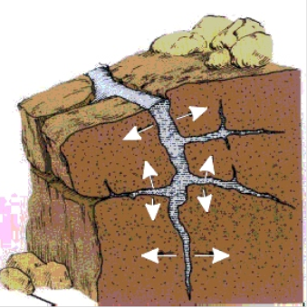
Physical Weathering
Physical (or mechanical) Weathering is the disintegration of rocks into smaller particles through physical processes, including:
The erosive action of water, ice and wind.
Opening of cracks as a result of unloading due to erosion of overlying soil and rock.
Expansion and contraction from season to season.
Landslides and rockfalls.
Abrasion from the downhill movement of nearby rock and soil.
Notes:
Interlock: ایک دوسرے میں پیوست ہوجانا

Slide 8
Chemical Weathering
Chemical Weathering is the disintegration of rock through chemical reactions between the minerals in the rocks, water, and oxygen in the atmosphere.
Notes:
Hydration, Carbonation, Oxidation, and Reduction
Rock can be defined as a compact, semi-hard to hard mass of natural material composed of one or more minerals.
A 'mineral‘ is a natural inorganic substance of a definite structure and chemical composition.

Slide 9
Soil and its Types
What is Soil?
Formation of Soil
Types of Soil
Geological Consideration
Engineering Consideration

Slide 10
What is Soil? (Definition)
The term soil according to engineering point of view is defined as the material, by means of which and upon which engineers build their structures. The term soil includes entire thickness of the earth’s crust, which is accessible and feasible for practical utilization as foundation support or construction material. It is composed of loosely bound mineral particles of various sizes and shapes formed due to weathering of rocks.
Notes:
The term Soil Structure refers to the orientation and distribution of particles in a soil mass (also called "fabric" and "architecture") and the forces between adjacent soil particles. {Ref. 1. Pg # 71, Chap # 7. Soil Mecanics by T. William Lambe. (Elsevier Academic Press)

Slide 11
Types of Soil
Soil types, based on geological and engineering view points, are separately discussed below:
Geological consideration:
Following are the types of soil based on the geological processes through which the soil deposits have been developed.
Glacial Soil: This type of soil is developed, transported and deposited by the actions of glaciers. These deposits consists of rocks fragments, boulders, gravels, sand, silt and clay in various proportions (i.e., a heterogeneous mixture of all sizes of particles).

Slide 12
Types of Soil
Residual Soil: This type of soil is found on nearly flat rock surfaces were the weathering action has produced a soil with a little or no tendency to move. Residual soil also occurs when the rate of weathering is higher than the rate of removal.
Alluvial Soil: The soil transported and deposited by water is called alluvial soil. As flowing water (stream or river) looses velocity, it tends to deposit some of particles that it was carrying in suspension or by rolling or sliding along the river bed.

Slide 13
Types of Soil
Aeolian Soil: The soil transported by the geological agent ‘wind’ and subsequently deposited is known as Aeolian Soil. Aeolian soil are of two types namely Dune sand and Loess.
a) Dune or Dune Sand: In arid parts of the world, wind is continually forming sand deposits in the form of dunes characterized by low hill and ridge formation. They generally occur in deserts and comprise of sand particles, which are fairly rounded and uniform in size. The particles of the dune sand are coarser than the particles of loess. Dune material is generally, a good source of sand for construction purposes.

Slide 14
Sand dunes fill this view of the desert in Qatar.

Slide 15
Types of Soil
b) Loess: Accumulations of wind blown dust (mainly silt or silty clay) laid down in a loose condition is known as loess. Silt soil in arid regions have no moisture to bond the particles together and are very susceptible to the effects of wind and therefore can be carried great distances by wind storms. An important engineering property of loess is its low density and high permeability. Saturated loess is very weak and always causes foundation problems e.g., liquefaction.
Colluvial Soil: The accumulation formed by the rock fragments and soil material resulting from the mechanical weathering of rocks is known as colluvial soil. This type of soil is formed more or less in situ or as a result of transport by gravity over a short distance.

Slide 16
Types of Soil
Engineering consideration :
The types of soil based on engineering consideration depend on the particle size. Since the engineering properties of soil markedly change with the change of particle size, different names are assigned to particular ranges of particle sizes.
Clay: ( < .002mm): It is composed of very fine particles, less than .002 mm in size. They are flaky in shape. Their surfaces carry electrical charge, which helps in understanding the engineering properties of clay soils. In moist condition, clay becomes sticky and can be rolled into threads.
Notes:
Capillarity: The tendency of a liquid in a capillary tube or absorbent material to rise or fall as a result of surface tension.
Frictional Resistance depends upon particle shape and size.

Slide 17
Types of Soil
Silt: (.002mm < Size < .06mm)
It is composed of very fine particles ranging in size between .002 and .06mm. It has high capillarity, no plasticity and very low dry strength. It possesses properties of both clay and sand, i.e. it shows slight cohesion and also friction. The colour of silty soil is mostly brown.
Sand: (.06mm < Size < 2mm)
It consists of particles ranging in size from .06 and 2mm. It has a grey colour. These particles may be rounded to angular in shape. It shows no plasticity, high strength in a confined state and has considerable frictional resistance. It has high permeability and low capillarity. Sand is the most wanted construction material. Abundant quantities of sand are available in deserts and riverbeds.
Notes:
Capillarity: The tendency of a liquid in a capillary tube or absorbent material to rise or fall as a result of surface tension.
Frictional Resistance depends upon particle shape and size.

Slide 18
Types of Soil
Gravels: (2mm < Size < 60mm)
They consists of particles varying in size from 2mm to 60mm. They form a good foundation material. They show high frictional resistance. The frictional resistance depends upon the particle size and shape. The gravels produced by crushing of rocks are angular in shape, while those taken from river beds are sub-rounded to rounded. They show very high permeability. When sand and silt are mixed with gravels their bearing capacity is further increased but permeability may be decreased.
Cobbles and Boulders:
Particles larger than gravels are commonly known as cobbles and boulders. Cobbles generally range in size from 60mm t0 200mm. The material larger than 200mm is designated as boulders.
Notes:
Capillarity: The tendency of a liquid in a capillary tube or absorbent material to rise or fall as a result of surface tension.
Frictional Resistance depends upon particle shape and size.

Slide 19
Types of Soil
Organic Matter:
The main source of organic matter is the plants or animal remains that are added to the soil when these organism die. Plants decompose at a slower rate than the animal remains. Commonly about 12” of the soil from top surface has a major concentration of organic matter. It undergoes large volume changes under loads and contains high natural moisture content. The strength of soil is very much reduced when the concentration of organic matter is more than 2% and the soil is considered unsuitable for foundation support.
The soil types based on the grain size limits according to ASTM and AASHTO are given in the following table.
Notes:
Capillarity: The tendency of a liquid in a capillary tube or absorbent material to rise or fall as a result of surface tension.
Frictional Resistance depends upon particle shape and size.

Slide 20
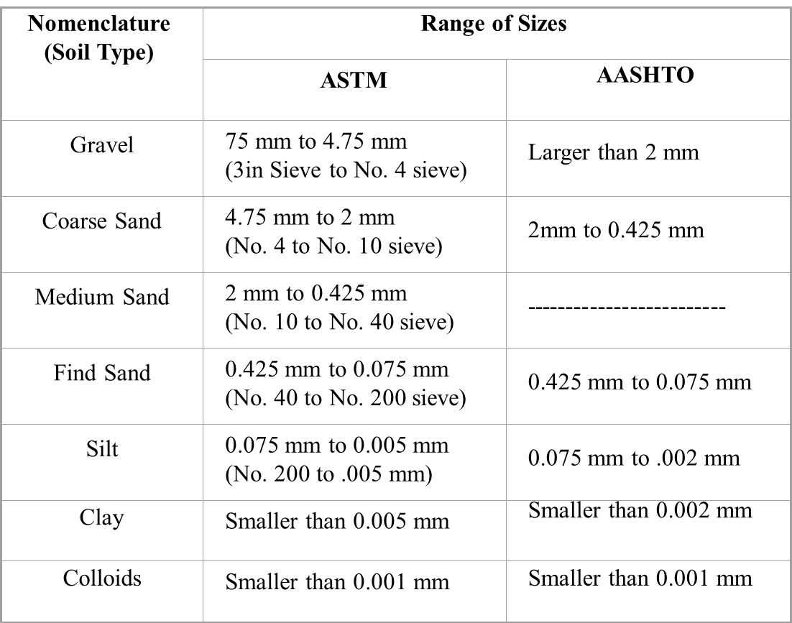
Types of Soil
Table: Nomenclature of material (soil type) & range of sizes

Slide 21
Soil Structure & its Texture
Soil Structure
Texture of Soil

Slide 22
Soil Structures
Soil structure refers to the arrangement or state of aggregation of particles in a soil mass.
The engineering behaviour of soil is influenced by soil structure to varying degrees.

Slide 23
Soil Structures
Types of Soil Structures
Single grained structure.
Honeycomb structure.
Flocculated structure and dispersed structure

Slide 24
Soil Structures
(i) Single grained structure
Found in the case of coarse-grained soil deposits. When such soils settle out of suspension in water, the particles settle independently of each other.
Major force causing their deposition is gravitational and the surface forces are too small to produce any effect.

Slide 25
Soil Structures
(ii) Honeycomb structure
Associated with silt deposits.
When silt particles settle out of suspension, in addition to gravitational forces, the surface forces also play a significant role. When particles approach the lower region of suspension they will be attracted by particles already deposited as well as the neighbouring particles leading to formation of arches.
The combination of a number of arches leads to the honey comb structure.

Slide 26
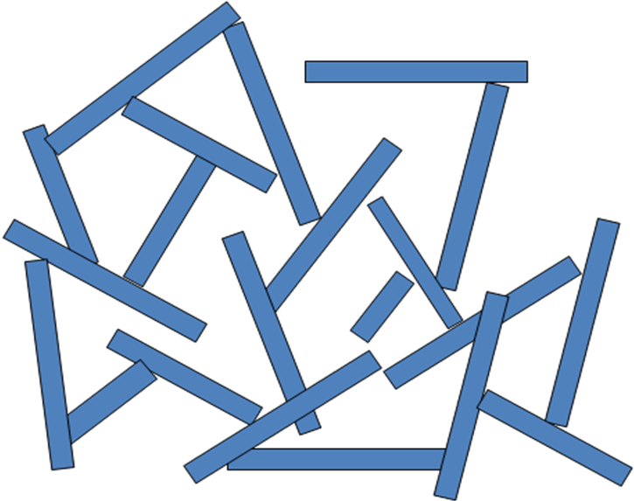
Soil Structures
(iii) (a) Flocculated structure
There will be edge-to-edge and edge-to-face contact between particles.

Slide 27
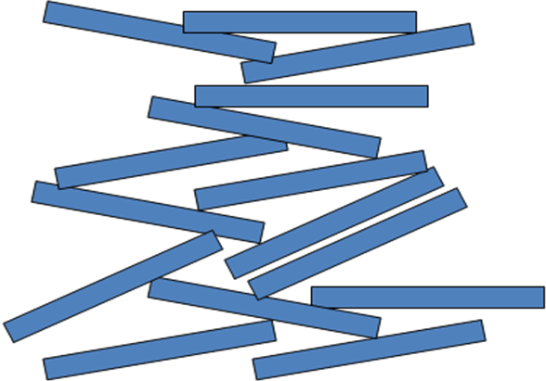
Soil Structures
(iii) (b) Dispersed structure
The particles will have face to face contact as shown below:

Slide 28
SOIL TEXTURE
The look and the feel of a soil is referred to as soil texture which is determined by the relative proportion of mineral particles of different sizes present in the soil.
Soil are composed of sand ,slit and clay particles.
Stones and gravels are excluded from the textural classes.

Slide 29
THANK YOU

