Slide 1
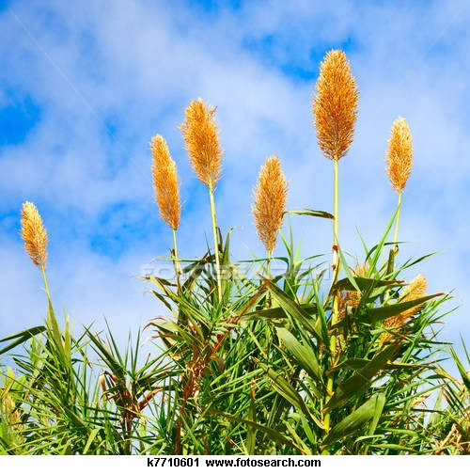
Sugar cane production technology

Slide 2
Sugar cane
(Saccharum officinarum)

Slide 3
Botanical Description
Botanical name: (Saccharum officinarum)
Family: Gramineae/ poaceae
English name: Sugar cane
Common name: Kamad, gana
Propagation: Vegetatively / seed
Origin and History:
originated in new Guinea.
About 600 B.C. reached in India.
In 1932 it was cultivated in sindh after construction of sukkur barage.

Slide 4
Economic importance:
GDP: 0.9%
value addition 4.5 %.
Total production: 50 million tonnes (ministry of Food & Agricuture)
Area: 1.12 million ha
Per capita sugar consumption : 25-30 kg/year.

Slide 5
Products & byproducts:
73_76% water and 24_27% solids
11_16 % fiber 10_16 % soluble solids
soluble solids consists of 75_92 % sugar ,3_7% salts and organic acids and organic non sugars
Sugar,Gur, Shakar,
Begasse, molasses, filter cake,
Ethanol(in brazil)
Wax, fructose sorbitol and mannitol
Urethanes( rigid foams)
Pallete fuel.
Polyesters of fatty acid(blood cholesterol depressor),
Dextrin, xanthenes (food, pharmaceutical)
Leucrose (diabetic patient)
Substitute sweeteners for sugar.
Molasses production 2 million metric tons.
(0.4 m molasses & 1.6 m ethanol exported )
Bagasse (paper, hard board, live stock feed)
Molasses(alcohol, livestock feed & fertilizer)
Filtercake (organic fertilizer)
sugar

Slide 6
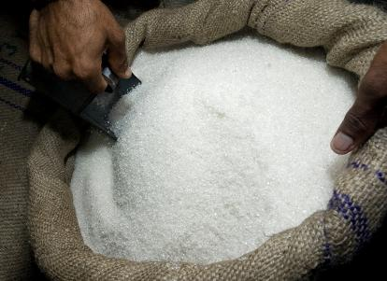
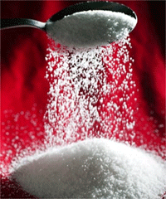
Refined sugar

Slide 7
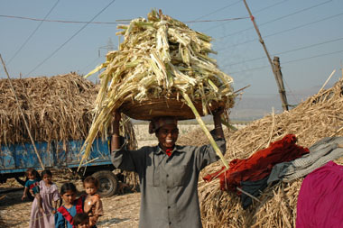
Begasse

Slide 8
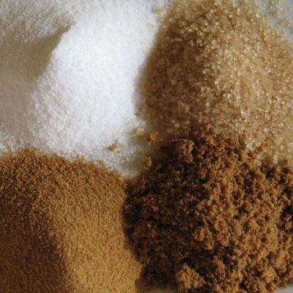
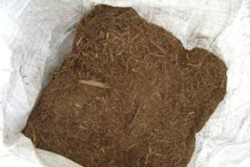
Unrefined sugar(shakr))
Refined begasse

Slide 9
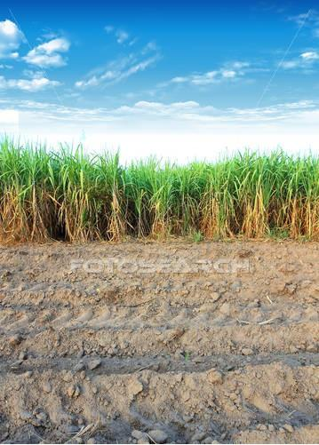
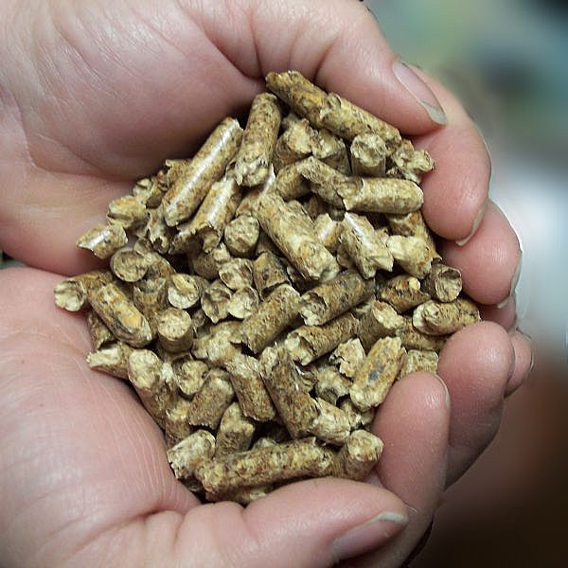
.
Sugar cane palette fuel
ntry

Slide 10
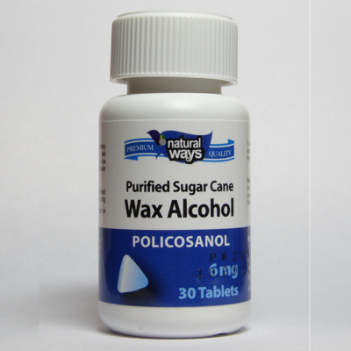

Slide 11
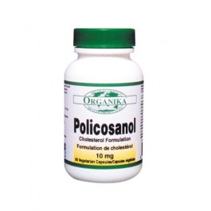
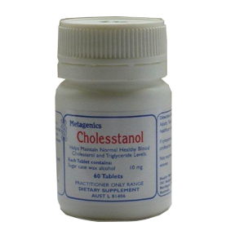

Slide 12
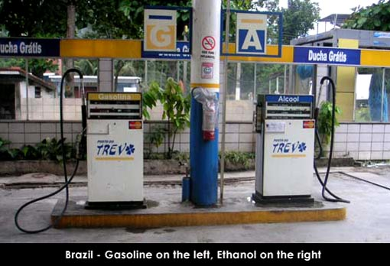

Slide 13
Sugar industry in pakistan:
86 sugar mills
capacity = 7.0 m.t. sugar annually,
crushing capacity = 80 million tones.
annual sugar consumption= 4 million tonnes
valued at US$1.8 billion.
revenue to the Government Rs. 22.0 billion
growers Rs. 110-135 billion
vendors contractors, transporters and suppliers by about Rs. 20.0 billion.
employment 1.20 million people
.

Slide 14
Botanical description
Tall perennial plant growing erect even up to 5-6 meter
4 principle parts
The root system
The stalk
Leaves
inflorescence
Root system
Selt root
primordial roots
thin, branched and function for a limited
period.
provide moisture and nutrients for the
growing primary shoot
Later on these 'selt roots' cease to function
and die.
Shoot roots
Roots produced from lower rings of the lower nodes , Later goes downwards,
those formed near the soil surface grow in upper layer of the soil for anchorage .
These are permanent roots, are fleshy and white in color.

Slide 15
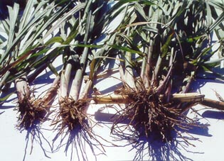

Slide 16
Stem is harvested part with nodes and internodes
Below soil surface and base area stem are compact while higher up increase length
Internodes remain small during cold weather and moisture stress periods
Stem is circular and oval in cross section
Stalk
Above ground portion which bears leaves and flower
Cylindrical with distinct nodes and internodes
At each node there is bud (eye)
Leaf scarf
below bud raised portion of leaf (point of attachment of leaf to stalk)
Root stalk
Under ground portion of cane
Tiller
Shoot developed from lateral bud of under ground portion of cane

Slide 17
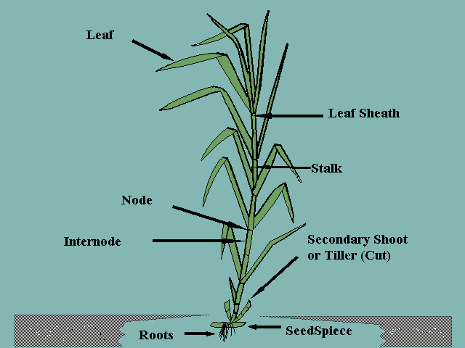

Slide 18
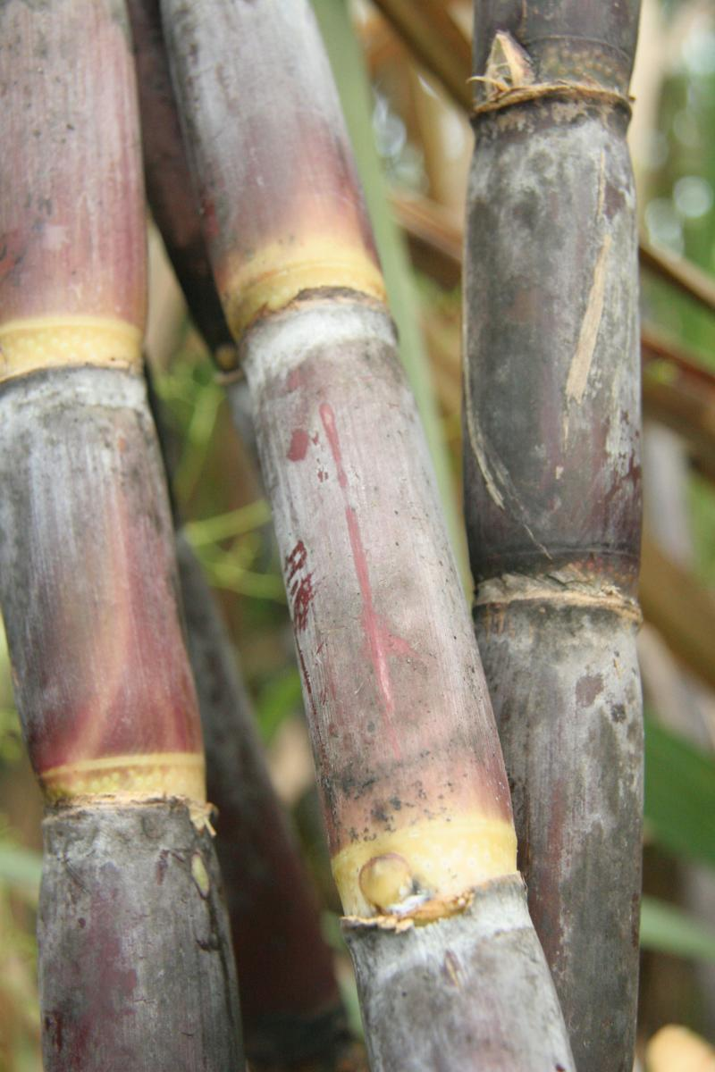

Slide 19
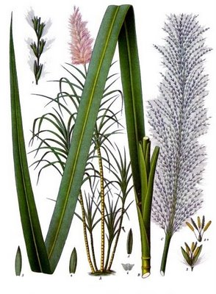
Leaves
Grow alternatively
Leaf(blade + ligules + sheath)
Sheath: light green color
surface is hairy
Blade: flat long 1-1.5 meter length, 5-7 cm wide
prominent midrib groove on upper surface
color yellow to dark green

Slide 20
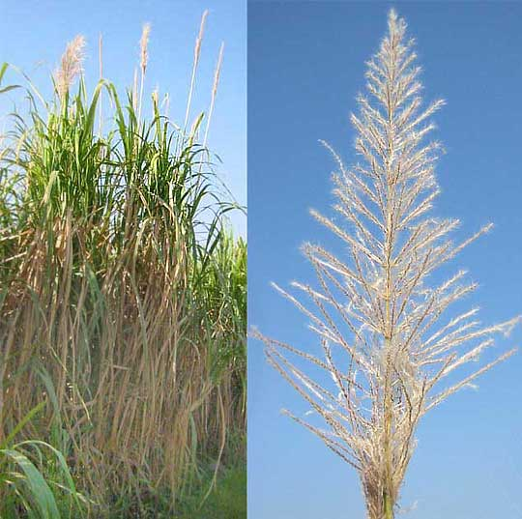
Inflorescence (arrow)
Open panicle
30 cm long
Arrangement of spikelet's is racemose

Slide 21
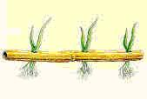
Phenology or growth phases of sugarcane
Germination stage
Planting cuttings (sets) should have at least of three buds.
The sprouting phase (the beginning is marked by 10% and the complete stage
by 75% sprouts) is thought to commence when two leaves appear on the
stem.
It completes in 25-30 days

Slide 22
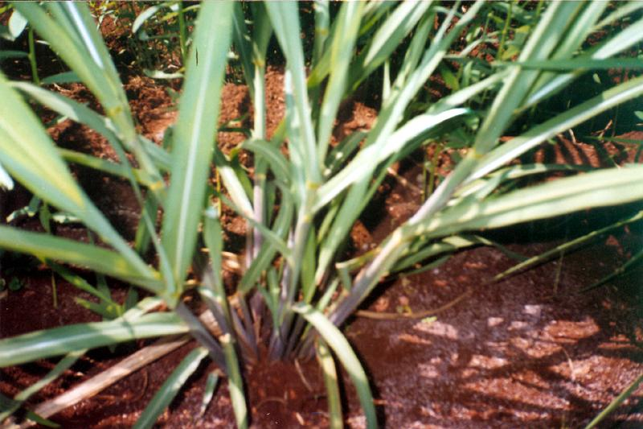
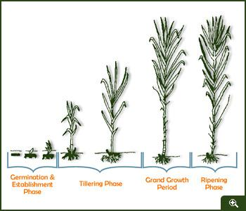
Tillering phase
Tillering of sugarcane in the tropics begins soon (in about 15-20 days) after the first sprouts appear.
The secondary sprouts are formed from underground buds.
In early ripening varieties of sugarcane, tillering lasts for 4-6 months
In the late-ripening varieties of sugarcane, tillering lasts long as 6-8 months.
Every new sprout appears in 2 to 4 days.
Under field cultivation each plant develops :
(a) In the strong-bushy varieties 20 to 40 sprouts
(b) In medium-bushy 15 to 25 sprouts
(c) And in weak-bushy 8 to 12 sprouts

Slide 23
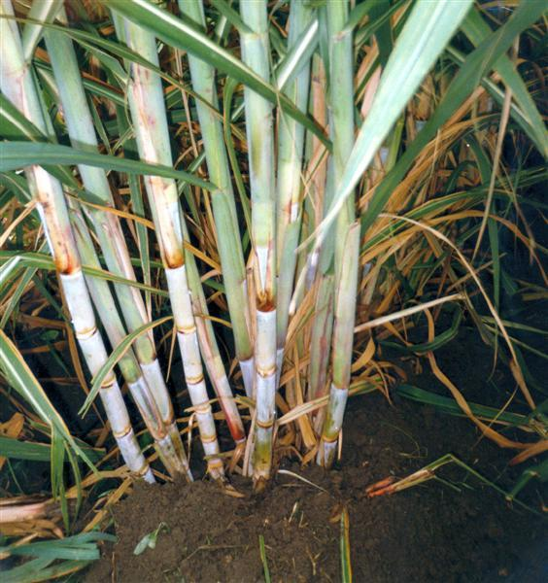
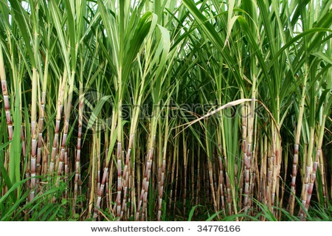
Grand Growth Phase
This stage lasts for 5 to 8 months. Sugarcane plants normally vegetate at this stage, if properly supplied with heat and moisture.
Grand growth phase starts from 120 days after planting and lasts up to 270 days in a 12-month crop. During the early period of this phase tiller stabilization takes place. Out of the total tillers produced only 40-50% survives 150 days to form millable cane.
Most important phase of the crop wherein the actual cane formation and elongation and thus yield build up takes place.
Leaf production is frequent and rapid during this phase with LAI reaching around 6-7.
Under favourable conditions stalks grow rapidly almost 4-5 internodes per month.

Slide 24
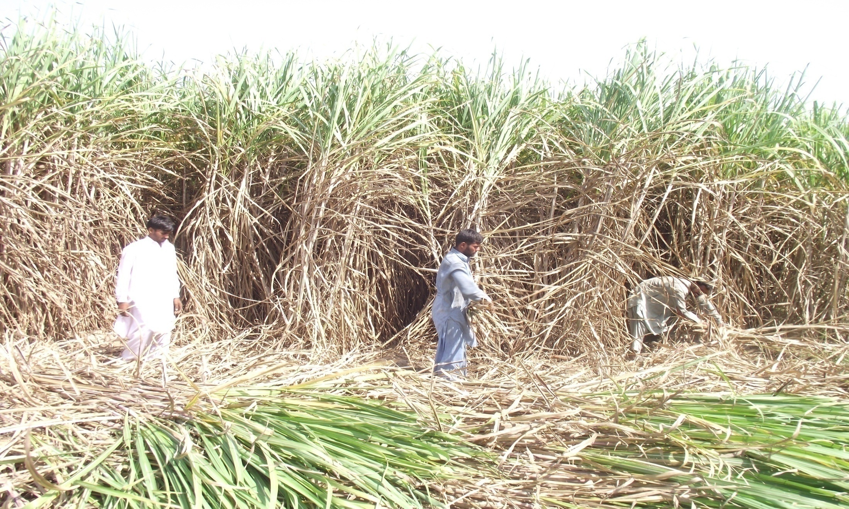
Maturation and Ripening
This phase lasts for about three months.
Its maturation is determined by a definite sucrose level in the stems
in subtropics sugarcane stem accumulate average 8-12% sugar.

Slide 25
Basic principle of crop management
Cultural practices
Seed and variety
Fertilizer and manuring
Irrigation management
Plant protection measures
Considerations before sowing
Land selection: fertile & well drained
Suitable is deep clay loam
Environmental conditions:
sun loving plant, high temperature moderate humidity,
no-prolonged period of frost, lot of sun shine hour,
rainfall 1250-2500,

Slide 26
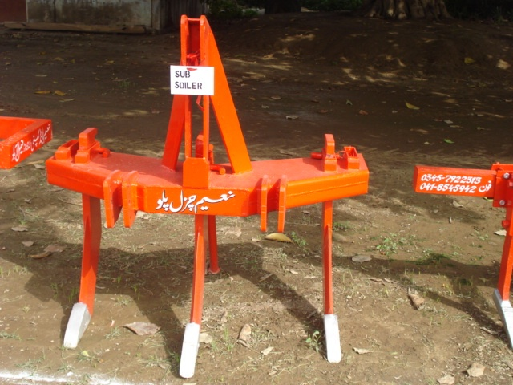
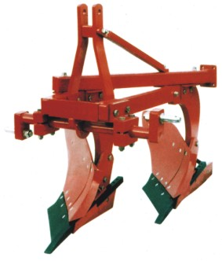
cultural practices
Land preparation
A deep-rooted crop so land preparation is
very important for proper root development.
Proper soil tilth to support germination.
Deep ploughing with mould board plough, disc plow or
chisel. Use cultivator with planker
Objective
To prepare root bed
To prepare seed bed
Interculture

Slide 27
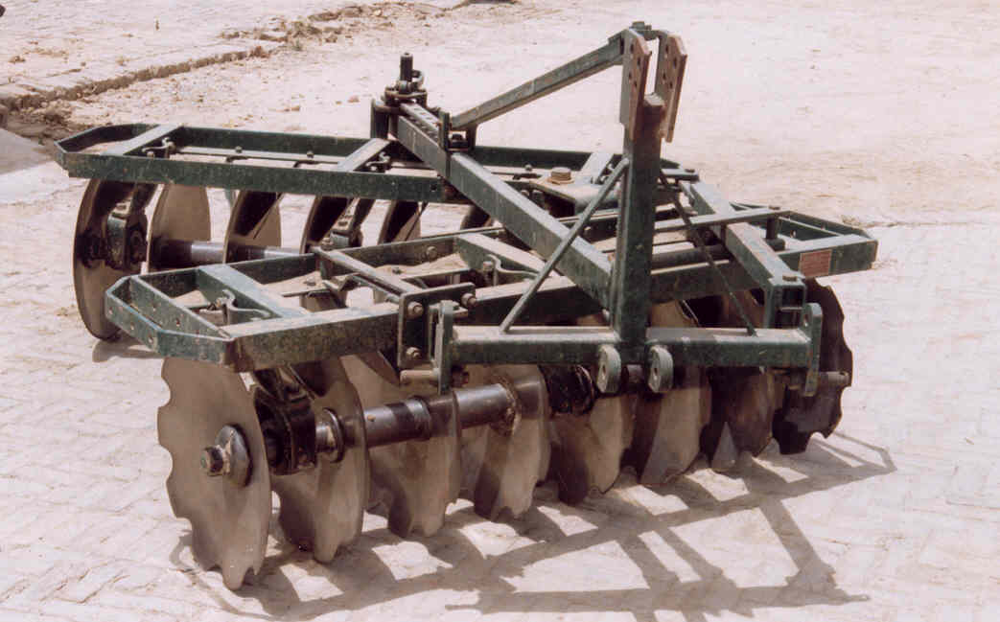

Slide 28
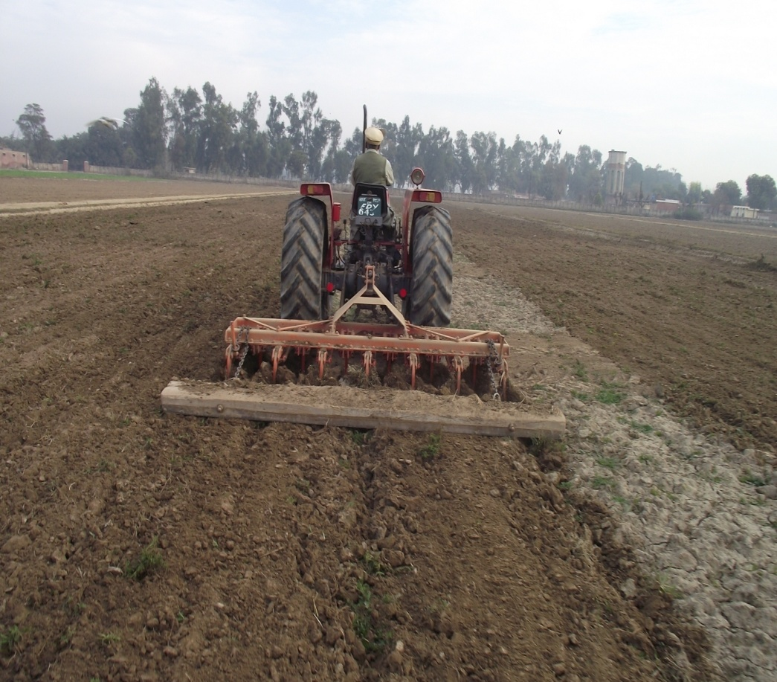

Slide 29
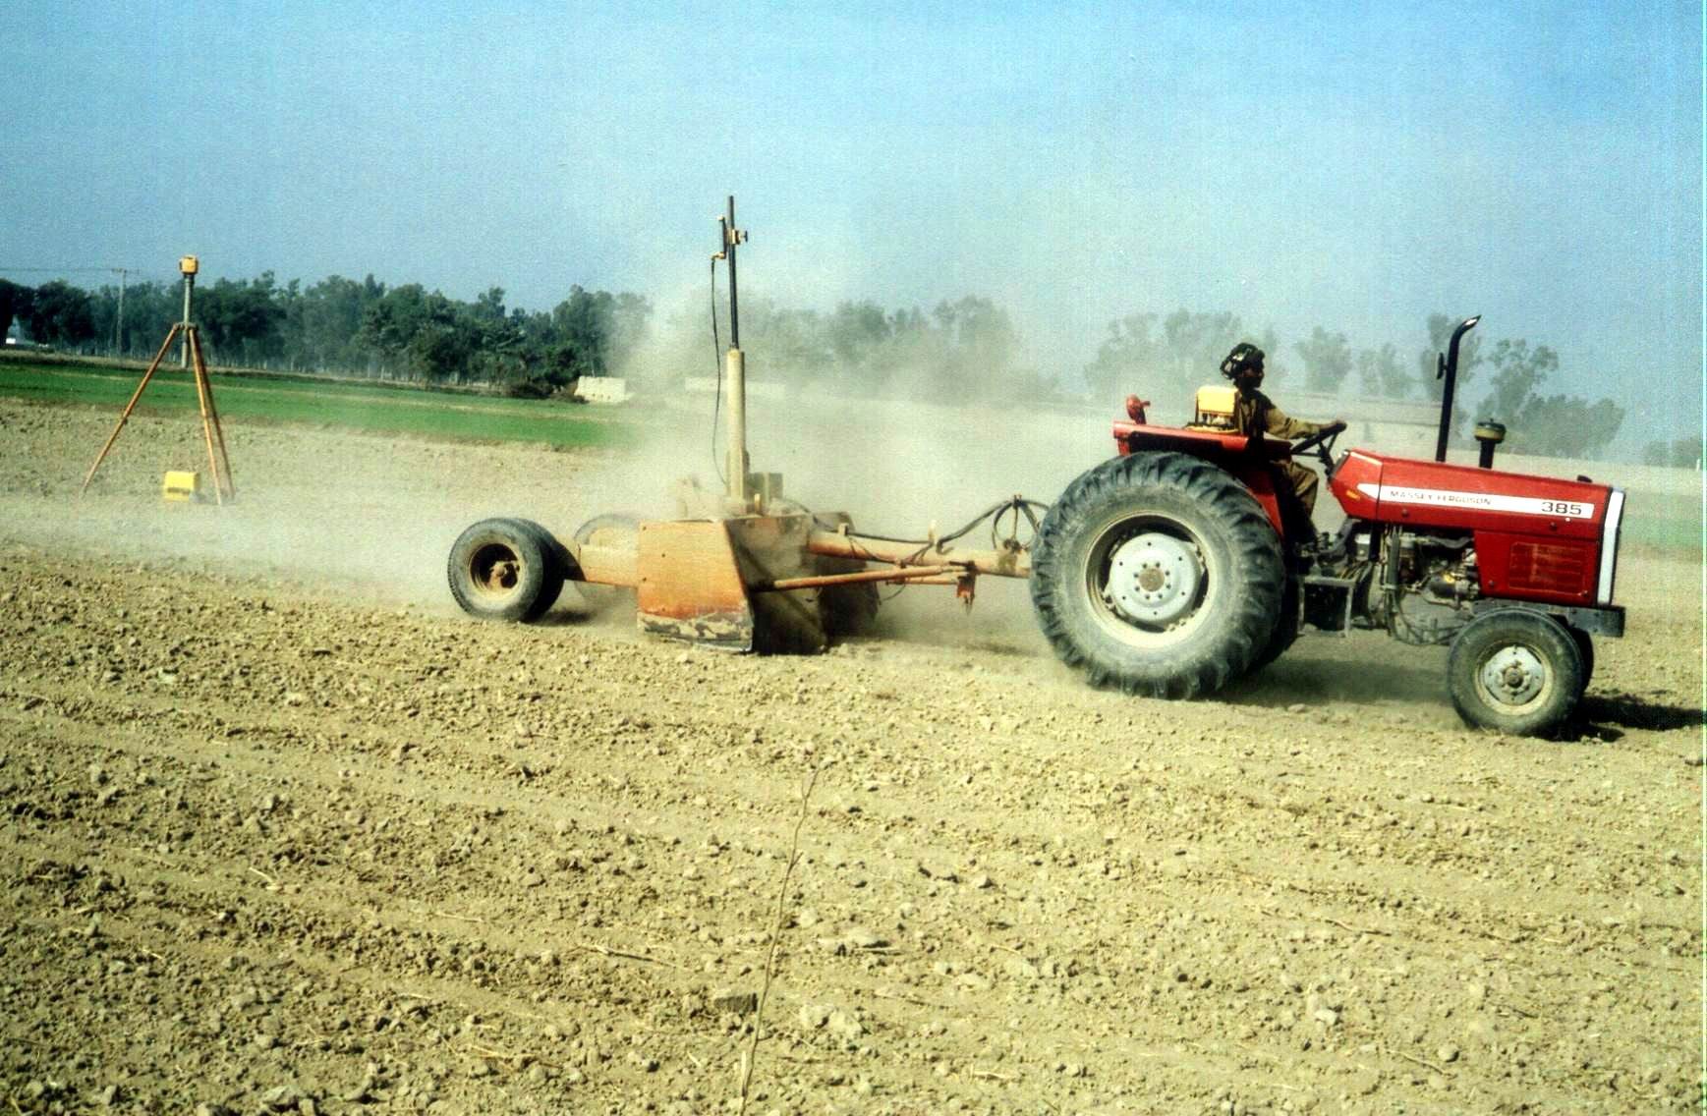

Slide 30
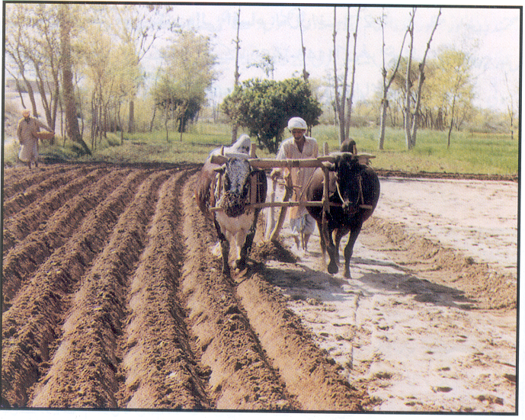
Sowing and sowing method
1.Conventional method
2.Strip planting
60 cm apart single row system
90 cm apart double row system
120 cm apart triple row system
3.Trench sowing
4.Pit plantation

Slide 31
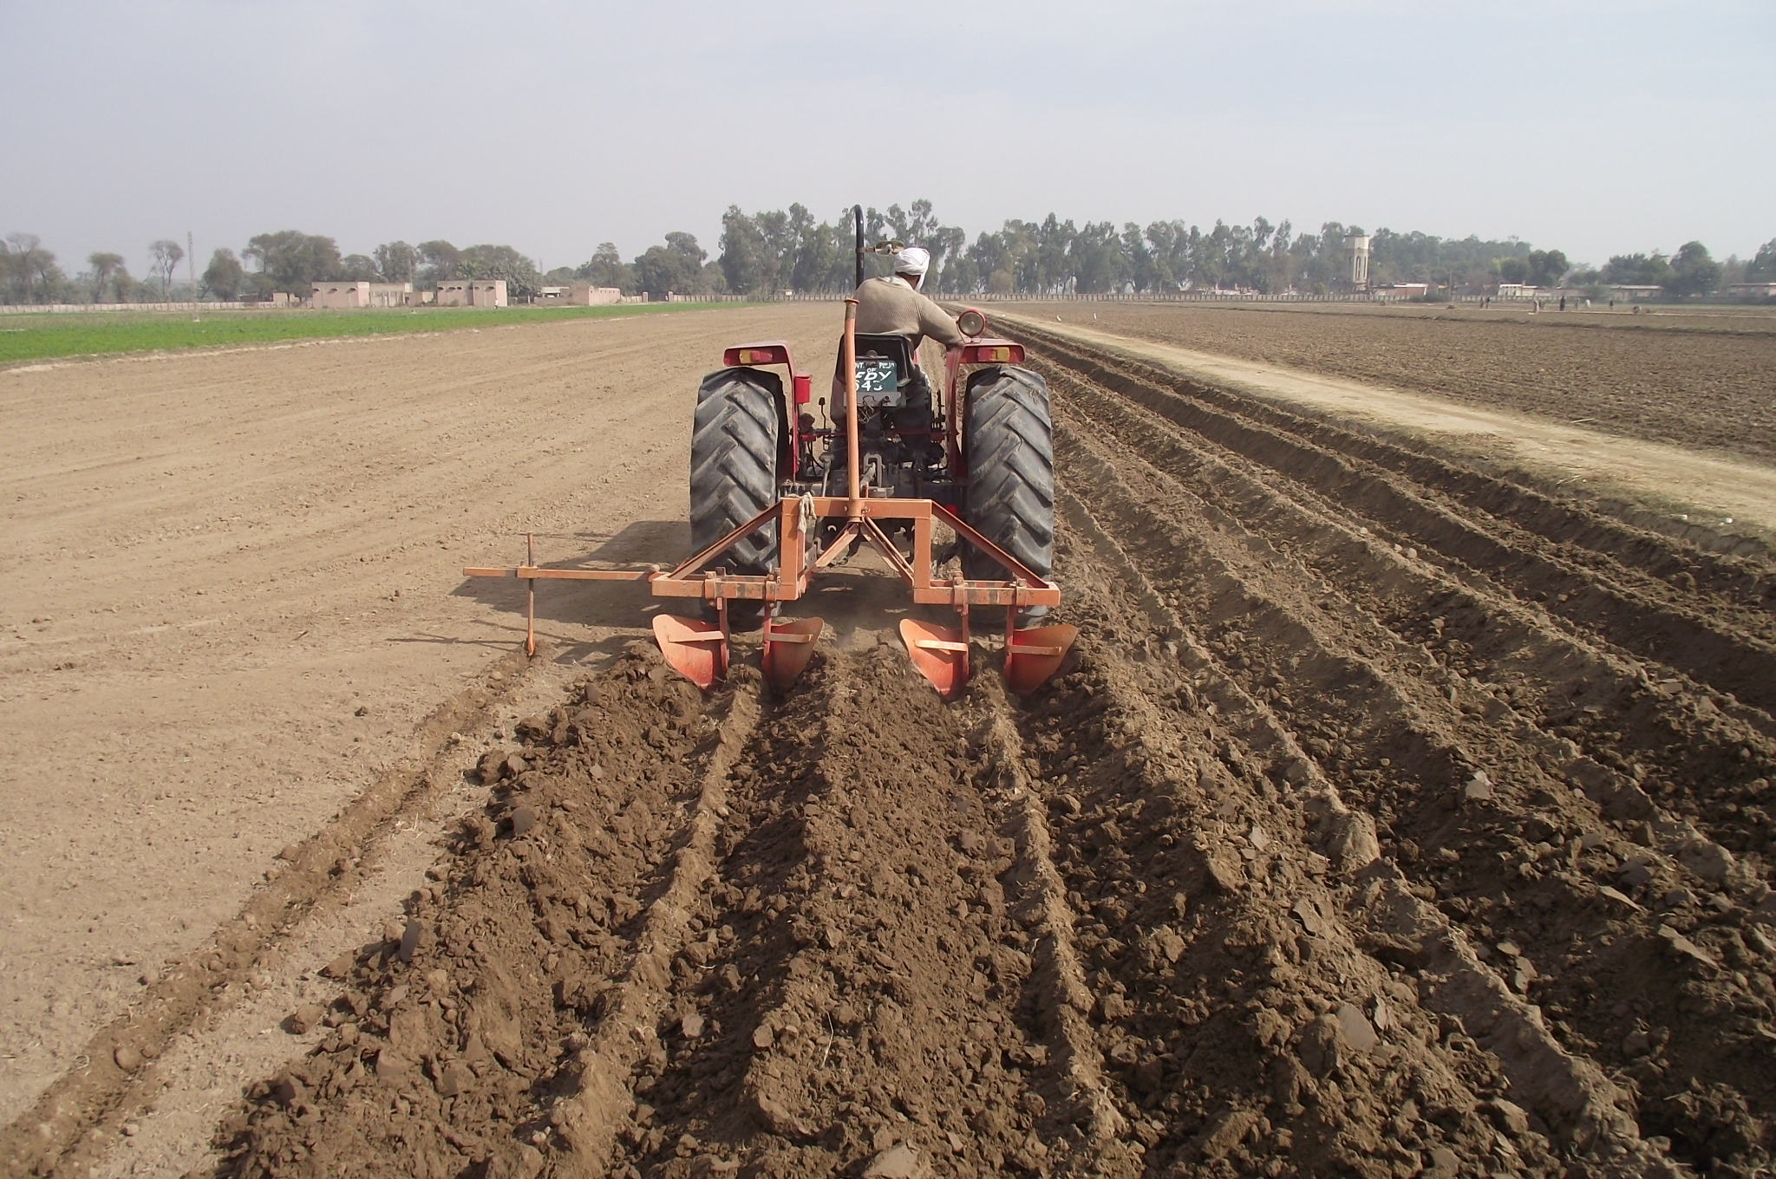

Slide 32
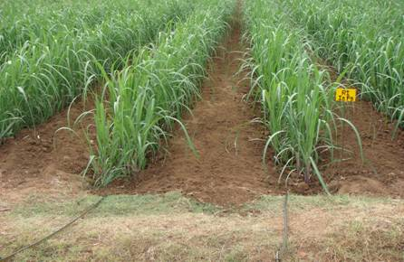
Strip planting
1. 90 cm apart, double row system

Slide 33
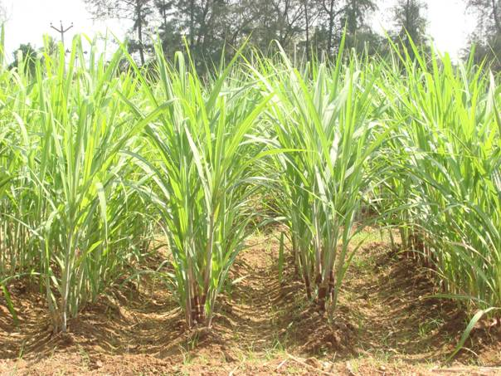
60 cm apart single row system

Slide 34
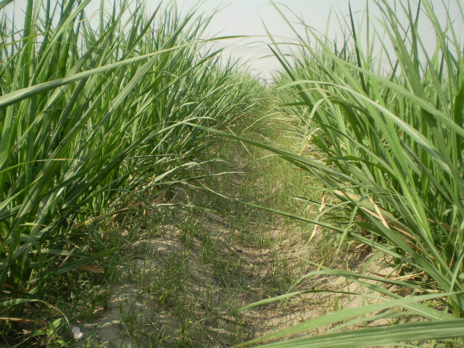
Trench sowing

Slide 35
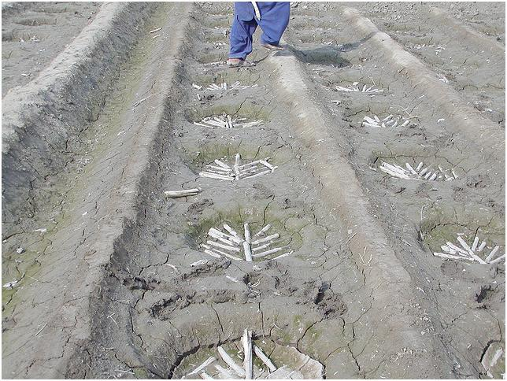
Pit plantation
100*100 pit size with 50 cm distance

Slide 36
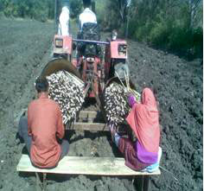
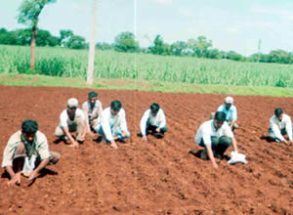
Placement of sets

Slide 37
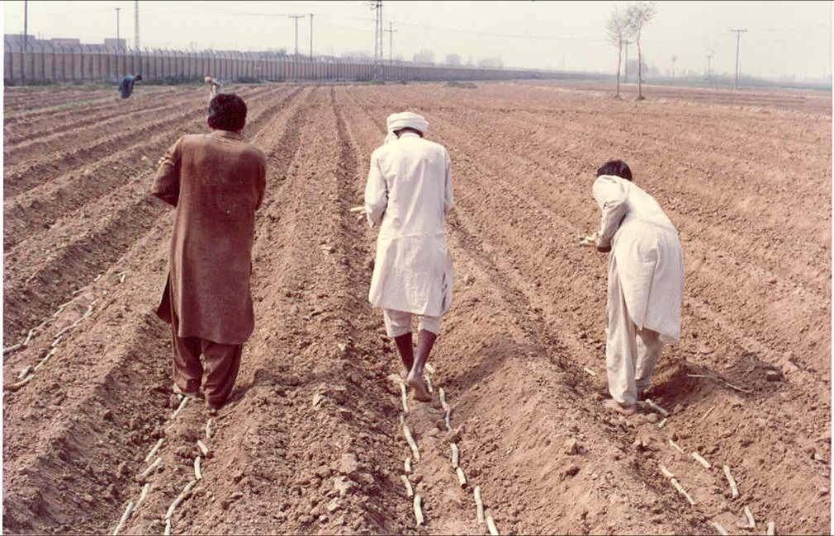

Slide 38
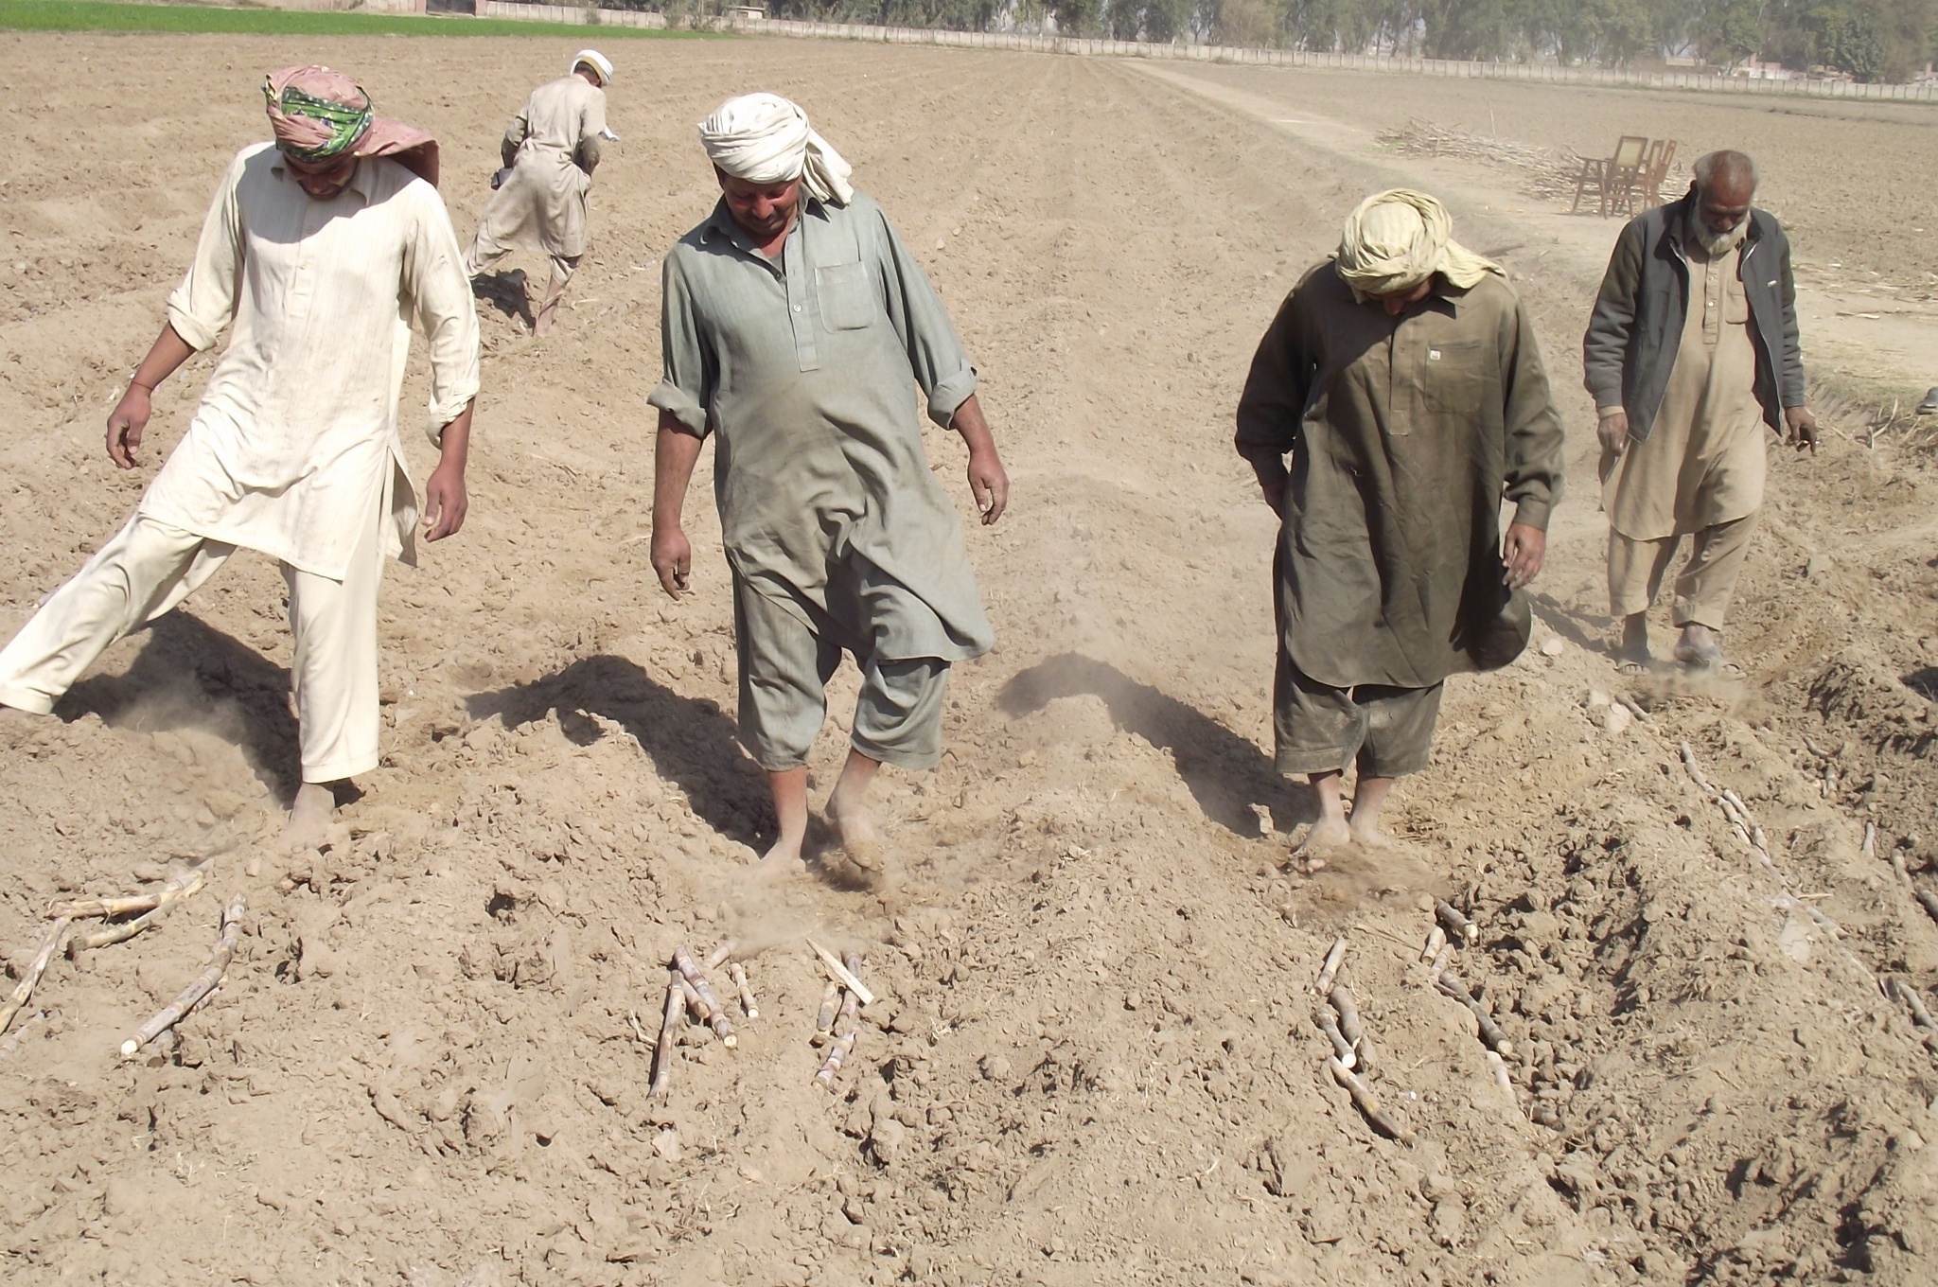
Burying of sets

Slide 39
Sowing time:
spring season: feb-15 march
September sown: sep
Recommendation:
don’t sow before September it will cause lodging
don’t sow after march it reduces germination due to high temp. of soil

Slide 40
Seed & recommended varieties
no | varieties | Prod. Mn/acre | % sugar | Resistant against diseases | Ratooning ability | lodging | Tillering capacity | Height meter
1 | CPF-246 | 1400 | 12.5 | very good | very good | Vey low | high | 4.16
2 | SPF-237 | 1300 | 11 | medium | Very good | Very low | high | 4.41
3 | HSF-242 | 1500 | 12.5 | moderate | Very good | Very low | high | 4.01
4 | CPF-243 | 1300 | 12.55 | moderate | good | High | high | 3.98
5 | CP-77-400 | 1300 | 11.90 | good | good | High | high | 4.14
6 | CP-72-2086 | 1085 | 12.35 | good | good | High | high | 4.26
7 | CP-43-33 | 975 | 11.06 | moderate | Very good | Low | Very high | 3.17
8 | CPF-237 | 1400 | 12.50 | good | Very good | low | Very high | 4.45
9 | SPf-213 | 1300 | 10.50 | good | Very good | low | very high | 4.01
10 | Coj-84 | 1200 | 9.80 | moderate | Very good | low | Very high | 3.96
11 | HSF-240 | 1355 | 11.70 | good | Very good | low | Very high | 4.13
12 | SPF-243 | 1450 | 11.60 | moderate | Very good | low | Very high | 3.71

Slide 41
Seed rate & selection
Free from insect pest attack
Take from 1st year crop, don’t from ratoon crop
3 eyes per set
Sow immediately after cutting
Take set from upper part of cane
Seed rate
100-120 mond/ acre

Slide 42
A Nutrient Management Strategy
UNIVERSAL BASIC SCIENTIFIC PRINCIPLES BEHIND THE
4R (4RIGHTS) STRATEGY OF NUTRIENT MANAGEMENT
RIGHT SOURCE
RIGHT RATE
Supply in plant available forms
Suit soil properties
Recognize synergisms among elements
Blend compatibility
Appropriately assess soil nutrient supply
Assess all available indigenous nutrient sources
Assess plant demand
Predict fertilizer use efficiency
RIGHT TIME
RIGHT PLACE
Assess timing of crop uptake
Assess dynamics of soil nutrient supply
Recognize timing of weather factors
Evaluate logistics of operations
Recognize root-soil dynamics
Manage spatial variability
Ferti. need of tillage system
Limit potential in field transport

Slide 43
Fertilizer
NPK kg per acre
Soil type | N | P | K
Weak | 120 | 69 | 50
Fair | 92 | 46 | 50
Fertile | 69 | 23 | 25

Slide 44
FERTILIZER; TIME OF APPLICATION
For autumn sown crop
All P+K+1/3rd N at sowing
½ of remaining N at end of Feb.
½ of remaining N in Mid April
For spring sown crop
All P+K+1/3rd N at sowing
½ of remaining N in April
½ of remaining N at end of May

Slide 45
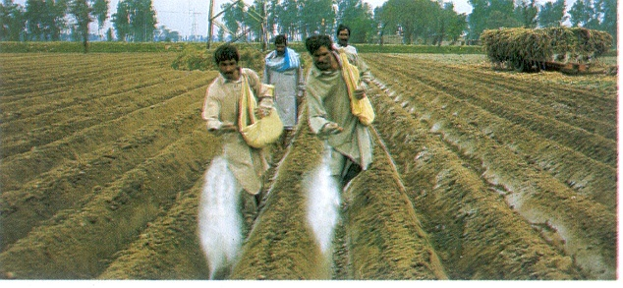

Slide 46
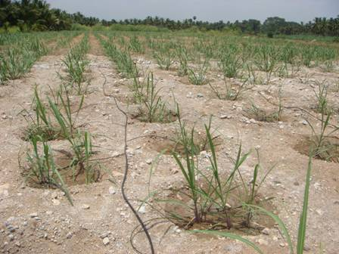

Slide 47
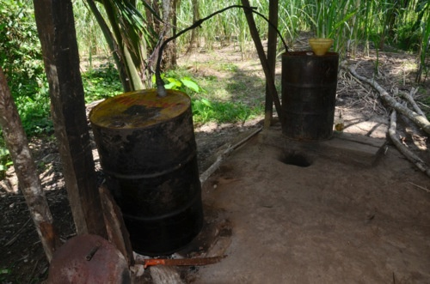

Slide 48
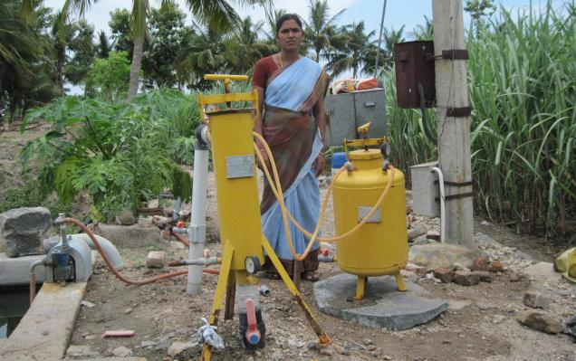

Slide 49
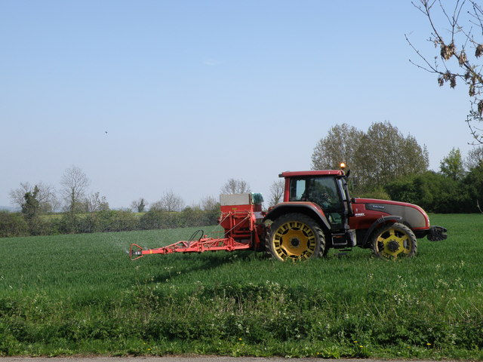

Slide 50
IRRIGATION
Irrigation Interval
March-April 18-20 days
May-June 10-12 days
July-August 13-15 days
September-October 15-22 days
November-December 40-50 days
Total Irrigations: 16
For September sown:20

Slide 51
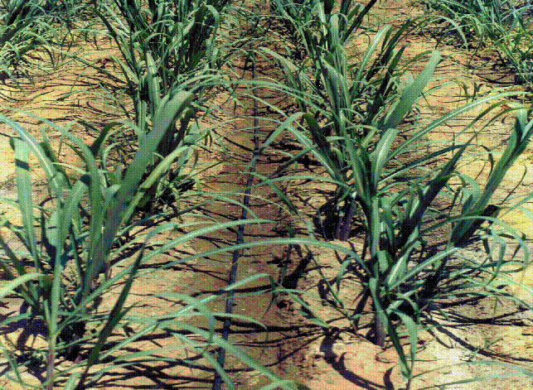
Drip irrigation

Slide 52
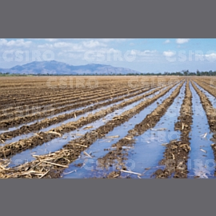
Flooded irrigation

Slide 53
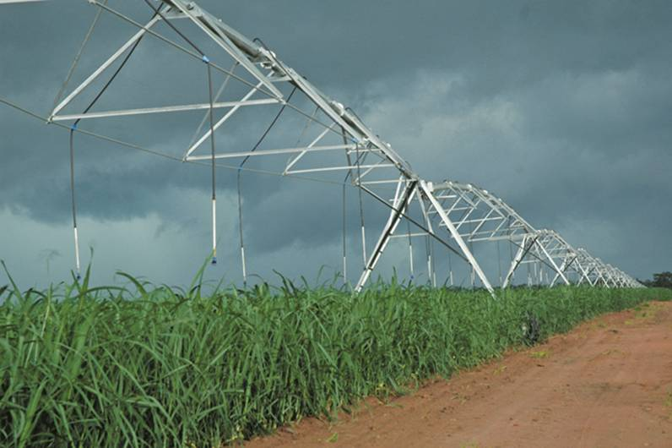
Sprinkler irrigation

Slide 54
WEED CONTROL
Losses: 10-35%
Crop weed competition 90-120 days
Weed control method
1.Cultural method
Hoeing (1st blind hoeing before emergence, 2nd at crop emergence,3rd after 1 month from 2nd).
Intercultivation
2. Chemical weed control

Slide 55
Chemical weed control
Herbicides Rate (mL, g/acre) Time
Atrazie 1000 post-emergence
Pendimethlin 1500 Pre-emergence
Gezapaxcombi 1000 post-emergence
Important instructions:
Use integrated weed management
approach
Ensure that target weeds are
controlled at the rates used
Ensure the correct use of nozzle,
pressure and volume
Always consider weather
conditions near spray when there
is risk of drift

Slide 56
INSECT PEST MANAGEMENT
Important insect pests and chemical control
Top borer (Carbofuron)
Stem borer (Carbofuron)
Gurdaspur borer (Carbofuron)
Pyrilla (Carbofuron)
Whitefly (Imidacloprid)
Termites (bifenthrin & chlorpyriphos)

Slide 57
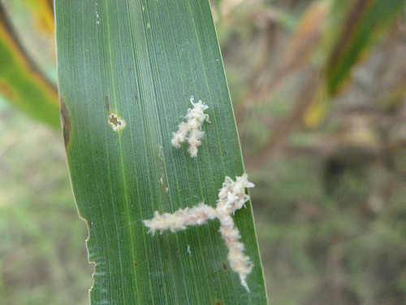
Sugarcane pyrilla

Slide 58
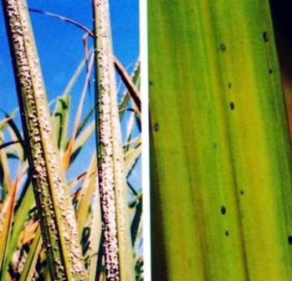
Cane white fly

Slide 59
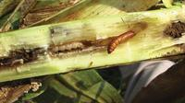
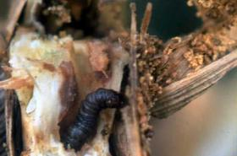
Top borer
Stem borer

Slide 60
Army worm

Slide 61
Field crickets

Slide 62
Sugar cane white wooly aphid

Slide 63
Management for borers
Cultural practices
1.Cutting should be 1-2 inch below soil
2. Earthing up in may june
Chemical control
basodin 10 g (8-10 kg/acre)
furadon 30% (12-15 kg/acre)
Biological control of insect pest
Save beneficial insects
e.g. tricograma, eprikenia melanoluka

Slide 64
DISEASE MANAGEMENT
Losses: 10-70%
Red rot
Whip smut
Rust
Mosaic
Red stripe
Helminthosporium leaf spot
Pokkah boeng
Brown stripe
Management strategy
Use disease free seed
crop, rotation
Soak sets in fungicide for 5 mints
Fungicide ( topsin M, Dithene, agaloll, Benlate)

Slide 65
Brown spots

Slide 66
Red strips

Slide 67
Red rot

Slide 68
Brown strips

Slide 69
Whip smut

Slide 70
Harvesting of sugar cane
Time: oct-nov
Yield: 458 mound per acre
Sugar recovery/sucrose %:9.2
Gur recovery%=13.5-14.5

Slide 71
Cane harvester

Slide 72
Manual harvesting

Slide 73
Manual harvesting

Slide 74
Maintaining ratoon crop
Don’t take more than 2 ratoon
Ratoon should be maintained from last January to march harvested crop
For ratoon cut cane 1-2 inch below soil/
Gap filling should be done
Use stubble shaver after harvesting of cane
Stubble shaver

Slide 75
Factors Affecting Sugar Recovery/ Sucrose%
Lot of sunshine is essensial for high sugarcane and sugar% yield
 | High Sunshine Area | Low Sunshine Area
Cane(Tonns) | 69 | 24
Sugar % | 11.1 | 8.7
Sugar (Tonns) | 7.8 | 2.1

Slide 76
Comparison between sugar production and consumption
Total prouction = 3.77 MMT
Total compustion= 4.28 MMT
Import of sugar =1.03-70,000 MMT
90 cm apart, double row system

Slide 77
Important point for better production
level the soil with laser land leveler
Sub soil or mould board must be used in land preparation
Use resistant varieties
Trench plantation should be preferred
Use 100-120 mond seed/acre
Must cover the sets
Fertilizer should be applied on the basis of soil survey report
Integrated weed mgt should be proefered
Earthing up should be done after 90-120 DAS
Integrated insect disease management
Ratoon should not be maintained from effected field

Slide 78
Thanks

