Slide 1
ENTO-306
Agricultural pests and their management
Identification of important agricultural pests
Their mode of damages
Control measures
By: Dr. Muhammad Zeeshan Majeed

Slide 2
Insect Pests of Wheat and Gram

Slide 3
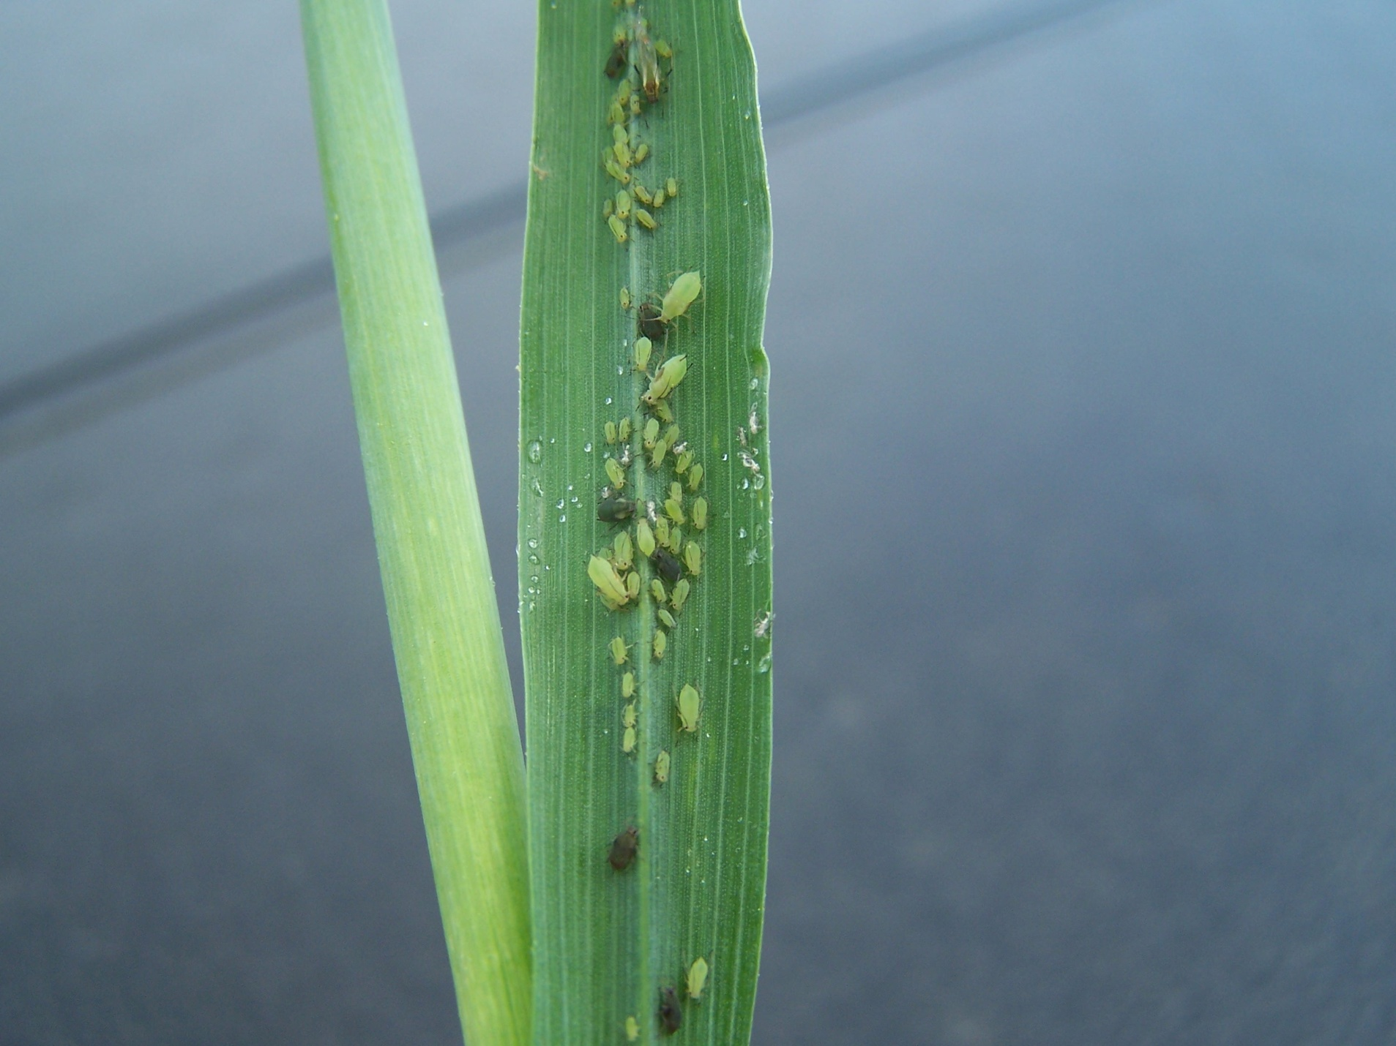
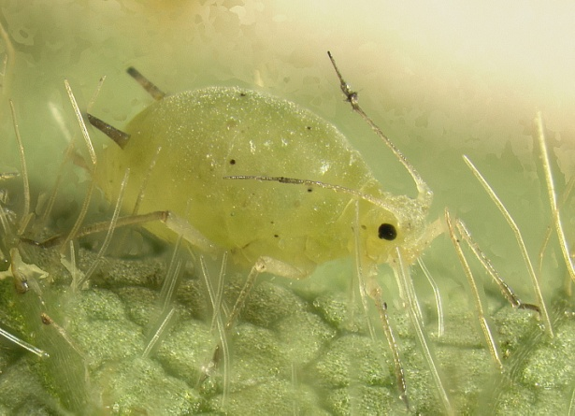
ENTO-306 Agricultural pests and their management 4(3-1)
Insect pests of Wheat Wheat aphid (Schizaphis granarium: Aphididae: Homoptera)
Sitobion avenae / Aphis avenae / Macrosiphum granarium

Slide 4
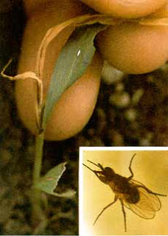
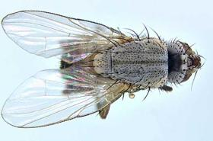
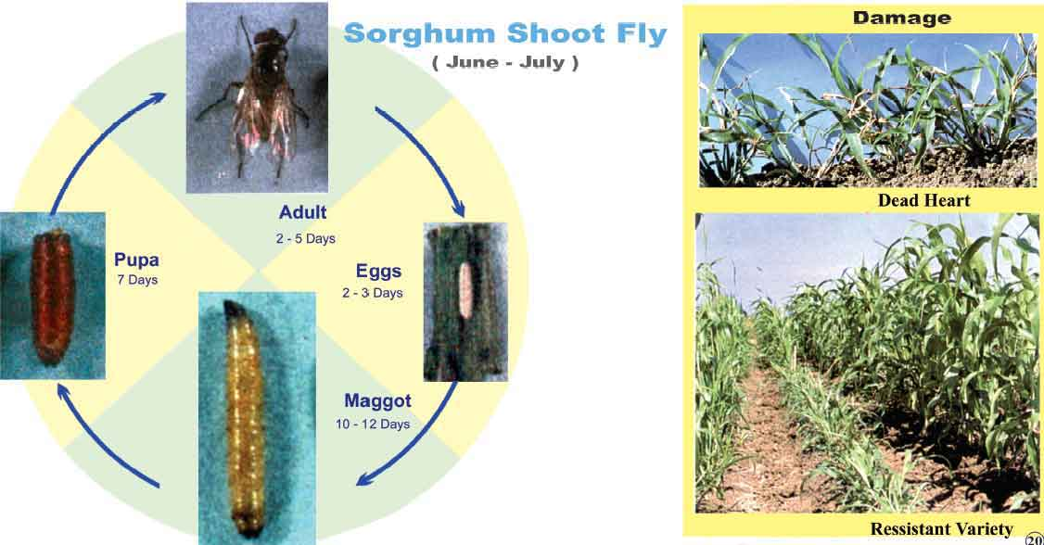
ENTO-306 Agricultural pests and their management 4(3-1)
Insect pests of Wheat Wheat shoot fly (Atherigona soccata: Muscidae: Diptera)
s
farmer.gov.in

Slide 5
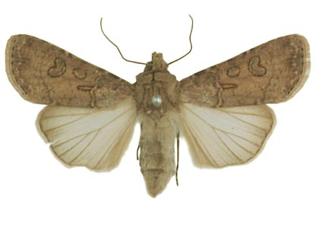
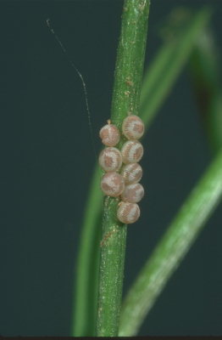
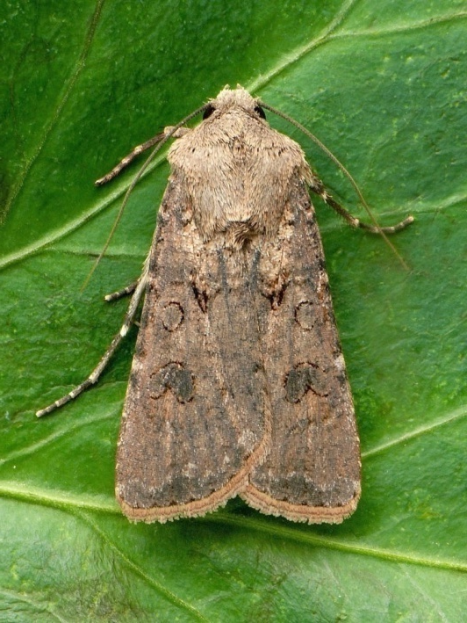
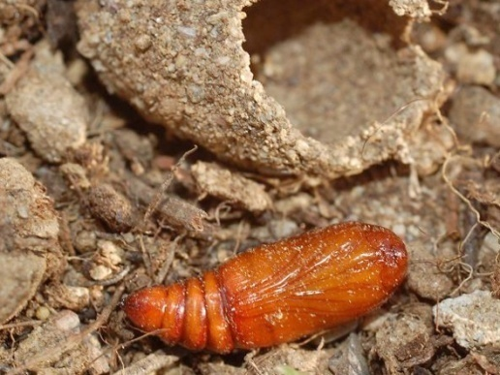
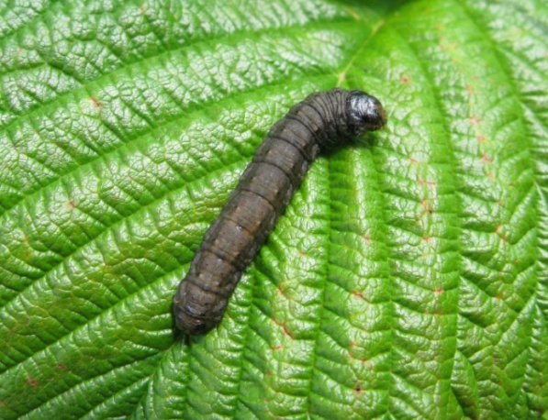
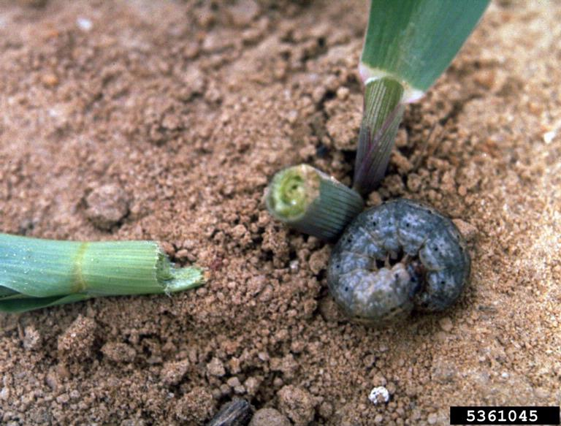
ENTO-306 Vegetable Insect Pests
Gram cutworm( Agrotis segetum :Noctuidae, Lepidoptera)
Host plants: Major pest of gram crop.
Also found infesting potato, cucurbits, wheat, mustard, maize and pulses (polyphagous insect)
Identification
Adult: Grayish brown (20 mm body length / wingspan 50 mm)
Eggs: Creamy white, dome-shaped eggs (laid in clusters of about 15-30 eggs)
200-300 eggs per female
Larva: 1st instar larva_1.5mm/full grown size_42 mm dark
grey in color (6 larval instars)
Pupa: Reddish brown
Life history:
Life cycle: 2-3 months
Egg: hatching: 3-7 days
Adult: 1.5 – 2 weeks
Larva: 1 – 1.5 months
Pupa: 2 – 3 weeks
No. of generations per annum: 1 – 2
Damage:
Active period: November to May
(maxi. Damage/infestation in December-February)
Inactive period: May – Nov. (migration to hilly areas)
Voracious feeding and cutting of roots and shoots
of tender plants during night
Cut-away seedlings in field indicate its attack.
30-80% damage to Rabi crops
Control:
Deep soil ploughing/hoeing
Egg collection and destruction
Light traps / Organic baits / traps
Chemical control (Chlorpyriphos, deltamethrin etc.)

Slide 6
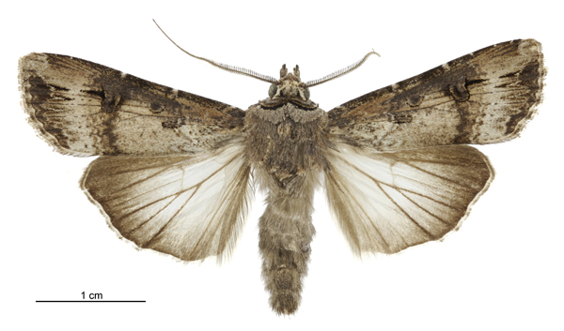
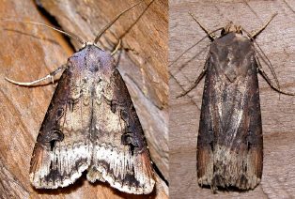
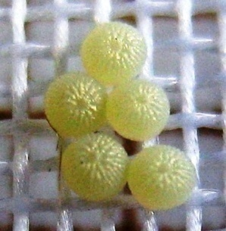
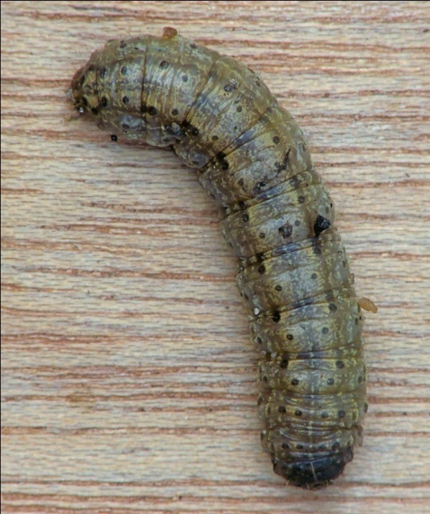
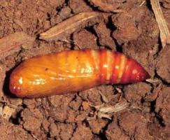
ENTO-306 Vegetable Insect Pests
Greasy / Black cutworm of gram ( Agrotis ipsilon: Notuidae, Lepidoptera)
Notes:
DAMAGE
This pest has solitary habits. They commonly feed on seedlings at ground level, cutting off the stem and sometimes dragging the plants into their burrows. Most of the plant is not consumed but merely eaten enough to cause it to collapse. Since the larvae occur burrowed near the roots of the host, it sometimes feeds on roots and the below ground stem. Because of the nature of their feeding on young plants, this pest can do great damage in newly planted fields.
PUPAE
Mature larvae burrow several inches into the soil where they form a pupation cell. Pupae are dark brown and are about 3/4 inch in length. Pupal development is completed in 10-30 days.
The creamy white eggs are globular with a ribbed surface
The larvae are thin, cylindrical and dark brown to greasy gray
BEHAVIOR
Larvae remain below the surface of the ground, under clods of soil, or other refugia (shelters) during the day and feed at night. The first two larval stages feed on the foliage of the plant. The third and later stages often become cannibalistic and thus adopt solitary habits (Hill, 1983).

