Slide 1
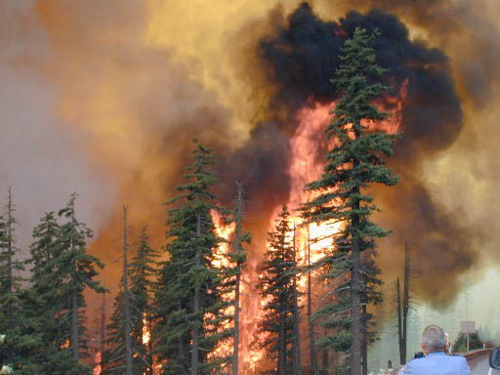
Role of Forest Fires in our Environment

Slide 2
What is Fire?
Fire is a disturbance. Disturbance is “any relatively discrete event in time that disrupts any ecosystem, community, or population structure and changes resources, substrate availability, or the physical environment”

Slide 3
How does a disturbance affect Succession?
How does a forest stay a forest?

Slide 4
Historic perspective of fire in forest ecosystems
In prehistoric times, fire occurred periodically due to lightning, dry conditions, etc.
Native people altered the N. American landscape with fire
Took advantage of “natural” fire
Also capable of very precise controlled burns
Resulted in altered vegetation patterns

Slide 5
Historic perspective of fire in forest ecosystems
Early Euro-Americans use fire to clear land
1600’s – current: Use fire to create new habitat

Slide 6
Fire regime characteristics
Frequency
Size
Fire type (crown, surface, light surface)
Fire intensity (how hot, how long)
High intensity results in uniform burn
Low intensity effected by small-scale variability in fuel & moisture, leaving a patchy landscape
All dependent variables

Slide 7
What is the correlation of frequency & intensity of Fire?
Inverse correlation between frequency and intensity

Slide 8
All other things similar…
Frequent, low intensity fires → open stands of longleaf or slash pine (Pinus elliottii) with grassy understory
Less frequent, more severe fires → closed canopy of sand pine with dense understory
Absence of fire → dominated by evergreen oaks and hickories

Slide 9
Why do we use fire?
Extensive natural fire prevention (Back fires)
Habitat improvement for species of interest
Restore natural or historic landscape

Slide 10
Factors affecting rate of fire
Weather (Temp, Precipitation, Wind, Humidity)
Fuel load
Habitat type
Natural and human-created fire barriers

Slide 11
Mortality due to fire
Plant susceptibility to damage/death increases with decreasing size
Herbs, seedlings, and small saplings may be killed by low intensity fire that has no effect on trees
Low – intermediate fires may produce selective mortality
High intensity fires may kill many plants

Slide 12
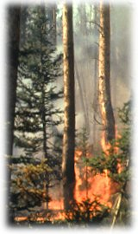
Fire and ecosystems
Prairie grassland
Forest ecosystem

Slide 13
Fire and grassland ecosystems
Fire reduces shade, promote seed germination, releases nutrients into the soil
Fire prevents establishment of trees and shrubs that would eventually out-compete and shade out the grasses
Fire adaptation – many grassland plants have no permanent above ground parts

Slide 14
Fire in the Southeast US Forests
Wet and dry seasons
Fire adapted plants
Sand pine (Pinus clausa) – serotinous (closed/dormant) cones
Wiregrass – meristem is 1-1.5” underground
Long leaf pine (Pinus palustra) – large underground root system, rapid growth, thick bark

Slide 15
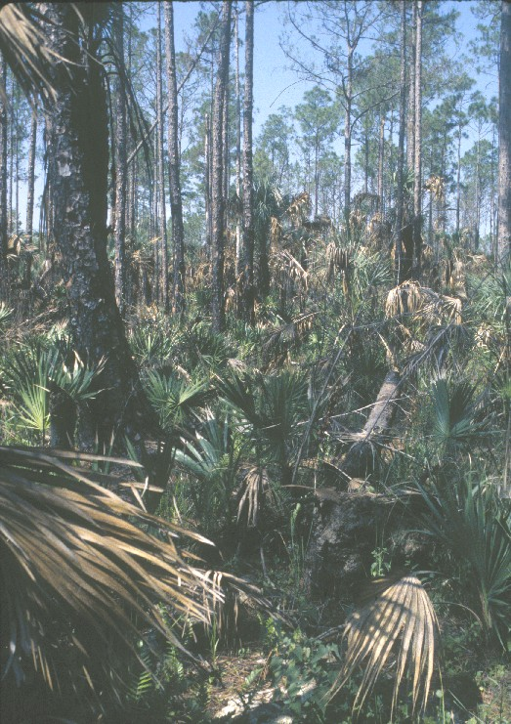
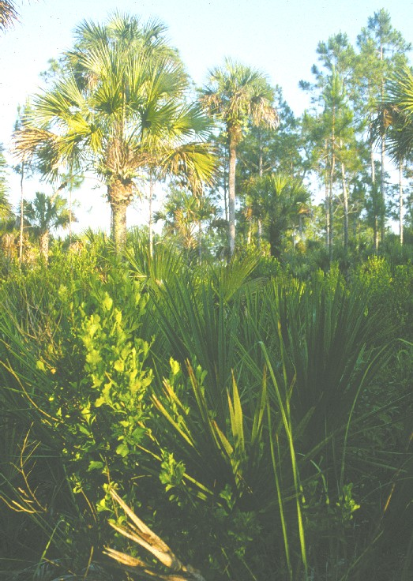
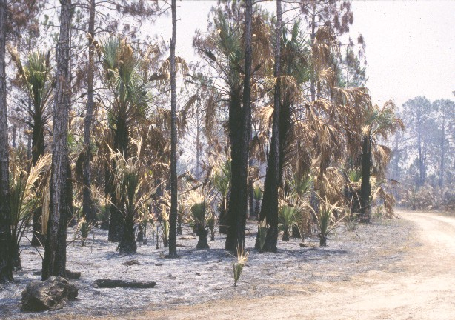

Slide 16
Ecological Role of Fire in Forest Ecosystems
Reduce fuel load
Open understory
Increase light reaching forest floor
Favors fire-tolerant species
Release nutrients back into the soil or sterilize soil

Slide 17
Ecological Role of Fire in Forest Ecosystems
Reduces probability of catastrophic fire
Nutrient input into soils
Control of insect pests
Control of tree pathogens
Plant adaptations to fire
Maintains species diversity

Slide 18
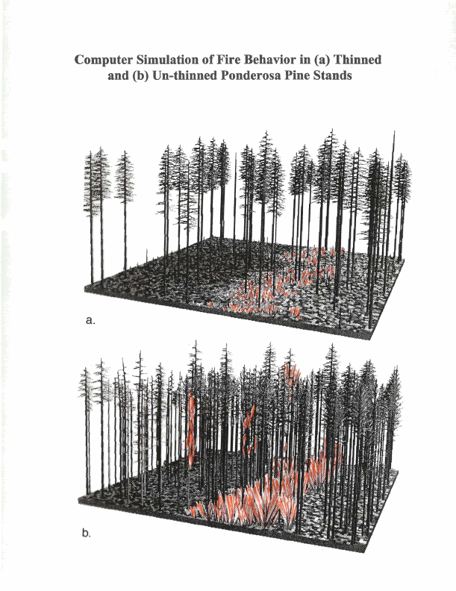
Fire reduces the probability of catastrophic fire
Historical fire regime (the historical frequency and intensity of natural fires)
Altered with fire suppression
Increased tree density and ladder fuels
Notes:
In many forest types, the fire regime (the historical frequency and intensity of natural fires) reduces fuels such that fires burn frequently and at low to moderate intensity. With fire suppression, tree density increases along with the abundance of ladder fuels, resulting in an increased probability of crown fires due to the “staircase effect.”

Slide 19
These are crown fires in which the majority of dominant trees are killed by the fire.
US Forest Service
Notes:
These crown fires are more likely to result in a stand replacement fire in which the majority of dominant trees are killed by the fire.

Slide 20
Nutrient input into soils after fire
NCSR
Notes:
Fire impacts physical, chemical, and biological components of soil in both beneficial and detrimental ways that can affect long-term site productivity (a common sustainable management goal). Soil chemistry is particularly complex after a fire.
Soil nutrients such as N, P, K and Ca are usually tied up in organic matter (forested soils tend to be low N systems).
All are released in a pulse at the burn site and leached into the soil, which increases availability to plants and soil microorganisms (bacteria, fungi and protists).
Warmer temperatures created by greater heat absorption by blackened soil increases rates of absorption.
For nearby aquatic ecosystems, erosion from uplands may increase sediment input into streams. Nutrients that runoff into these systems increase algae growth which support higher trophic levels in food webs.

Slide 21
Nutrient input into soils
Soil nutrients are usually tied up in organic matter
Released in a pulse after fire
Increased availability to plants and soil microorganisms
Blackened soil increases rates of absorption of solar energy
High fire temperatures can volatilize some nutrients (e.g., nitrogen at >200 °C)
Notes:
High fire temperatures can volatilize some nutrients, which are then lost to the system. Significant amounts of nitrogen, for example, can be lost at temperatures above 200 °C . Potassium, in contrast, is lost only at temperatures above 550 °C and calcium is rarely lost since temperatures above 750 °C are required (wildfire temperatures rarely exceed 700 °C ).

Slide 22
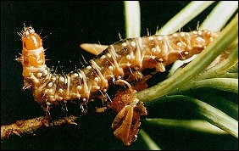
Control of insect pests
USDA Forest Service
USDA Forest Service
Notes:
Spruce budworm (inset) and a Douglas-fir forest affected by this defoliating insect are shown here. Some insect pests of trees (especially conifers) are apparently controlled by fire. This control may be indirect or direct.

Slide 23
Control of insect pests
Some insect populations are apparently controlled by fire
High temperatures and smoke directly kill adults, larvae and eggs
Reduced tree density decreases susceptibility to insect attack
Insect pests can also influence fire regimes
Notes:
Direct:
High temperatures and smoke directly kill adults, larvae and eggs. There is some evidence, for example, that the lack of fire (due to fire suppression efforts) may be linked to spruce budworm outbreaks.
Indirect:
When trees are overly dense, individual trees compete for limited sunlight, moisture, and nutrients and become susceptible to insect outbreaks due to a weakened state (e.g., bark beetles in the Rogue Valley in Southern Oregon attack Douglas-fir, Ponderosa pine and sugar pine).
Fires that under historical conditions would have thinned these stands, have been suppressed creating high tree density.
Forest management practices have also contributed by planting high value species (e.g., Douglas-fir) in areas that are more suitable for pines (due to exposure or elevation).
It is important to note that while fire influences insect and pathogen levels, the reverse is also true. Outbreaks of Douglas-fir tussock moth and spruce budworm create greater amounts of dead trees which set the stage for more intense wildfire.

Slide 24
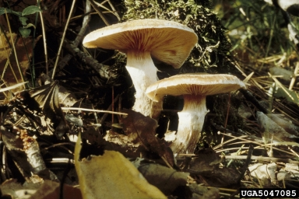
Control of tree pathogens
USDA Forest Service, Joseph O’Brien, Bugwood.org
Notes:
Control of fungal pathogens is a mixed bag and, at this point, we have a minimal understanding of the relationships between fire and fungi.
Beneficial fungi such as mycorrhizae have been shown to be eliminated or significantly reduced following severe forest fires. Since the vast majority of forest plants benefit from mycorrhizal relationships, the recovery of forests following a wildfire may be hampered. Recent research suggests that innoculation of severly burned soils with mycorrhizal spores may enhance rehabilitation efforts (see www.mycorrhizae.com).
Mycorrhizae are the symbiotic association between specific soil fungi and plant roots. Benefits of this relationship include increased capture and uptake of nutrients, protection against pathogens and reduced water stress.

Slide 25
Control of tree pathogens
Spore germination inhibited by smoke in some fungi (e.g., annosus root rot)
Spread of Phellinus weirii (laminated root rot) inhibited by fire
Spores of Port Orford cedar root rot are killed by fire and fire spaces trees making transmission from one tree to another less likely
Dwarf mistletoe infestations are reduced by fire
Some pathogens are promoted by fire (e.g., Rhizina undulata)
Notes:
Spore germination in at least one species (the fungus that causes annosus root rot) has been shown to be inhibited by smoke.
The spread of Phellinus weirii (laminated root rot) appears to be inhibited on the east side of the Cascades by fire as a result of removal of stumps and roots that get burned up in fires. On the west side of the Cascades, however, the pathogen does not appear to be affected.
Port Orford cedar root rot spores are killed by fire, and fire spaces trees further apart making transmission from one tree to another less likely.
Some pathogens are promoted by fire. The fungus Rhizina undulata, for example, affects Douglas-fir seedlings on sites that burn at high temperatures.
Dwarf mistletoe (a parasitic plant on Douglas-fir that creates large “brooms” that can promote fire) is knocked back by fire.

Slide 26
Plant defenses & adaptations against fire
Bark
Height
Roots
Thick, leathery leaves with cuticle
Cones

Slide 27
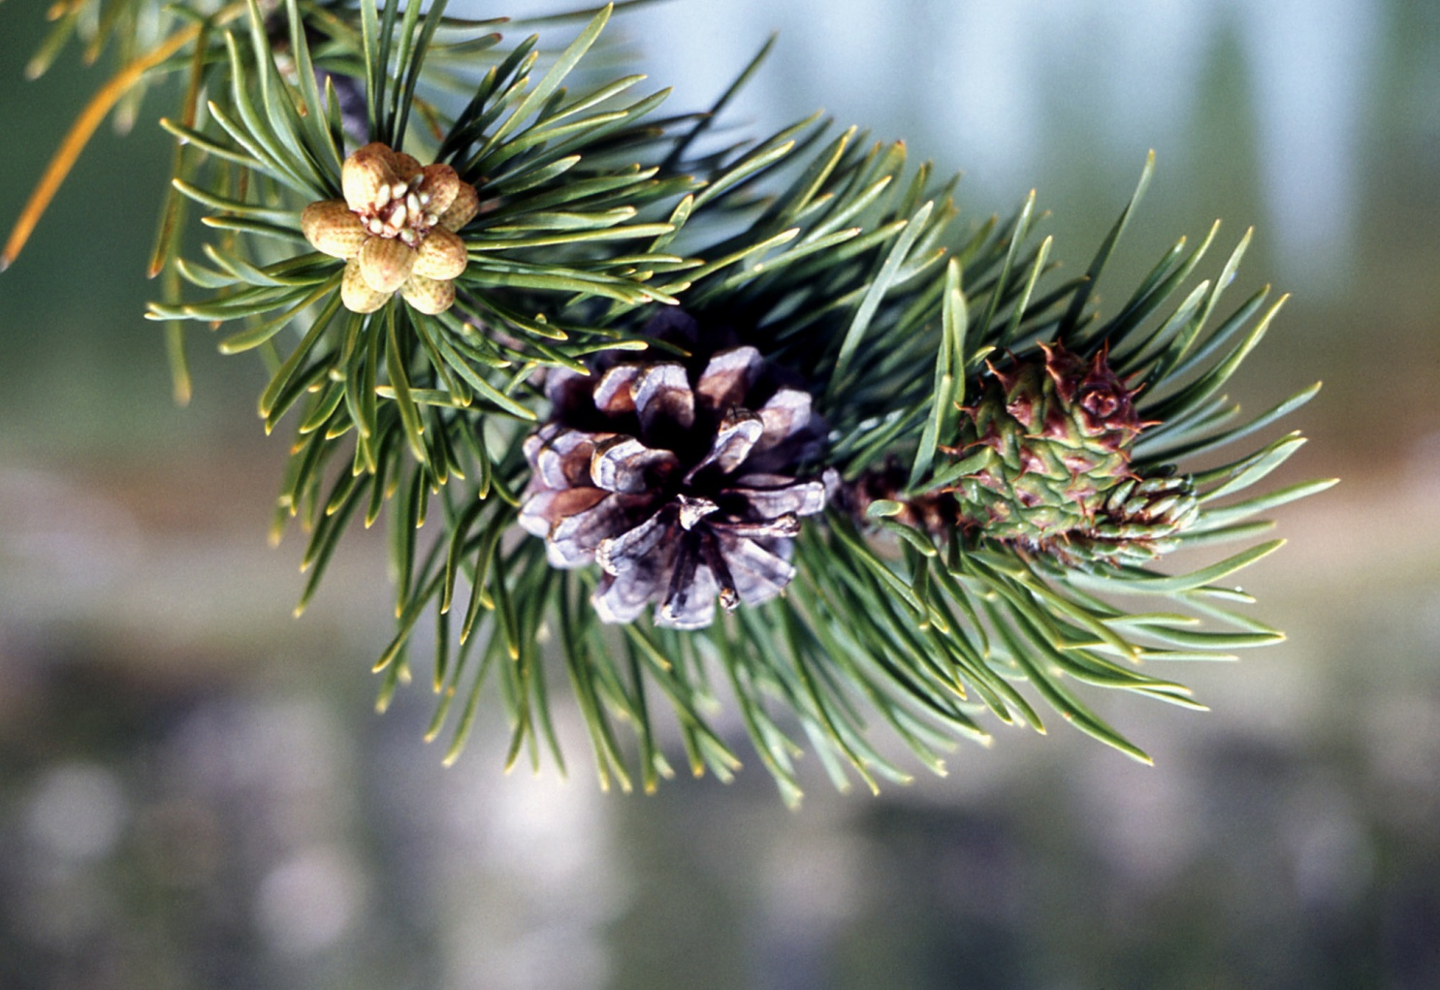
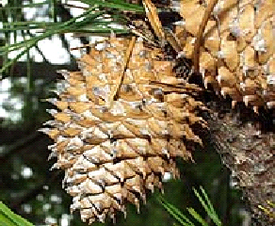
Plant adaptations to fire
National Park Service
Virginia Tech University: College of Natural Resources
Notes:
Forests are fire-dependent because many species are fire-adapted:
Ponderosa pine – thick, fire-resistant bark, lateral branches start high up on trunk, produces abundant pitch, which allows them to seal off fire wounds
Lodgeple pine – produces both open and serotinous cones which release seeds in response to fire
Knobcone pine – produces only serotinous cones
Western larch, Douglas-fir, redwood and sequoia – thick bark, which protects cambium layer from lethal temperatures during a fire
Quaking aspen and redwood – regenerate rapidly from roots after fire
Pitch pine - (in eastern U.S.) can resprout directly from the trunk, enabling trees to re-grow after fire has killed the crown

Slide 28
Plant Adaptations to Fire
Serotinous cones
Thick bark
Rapid growth from roots
Rapid colonization

Slide 29
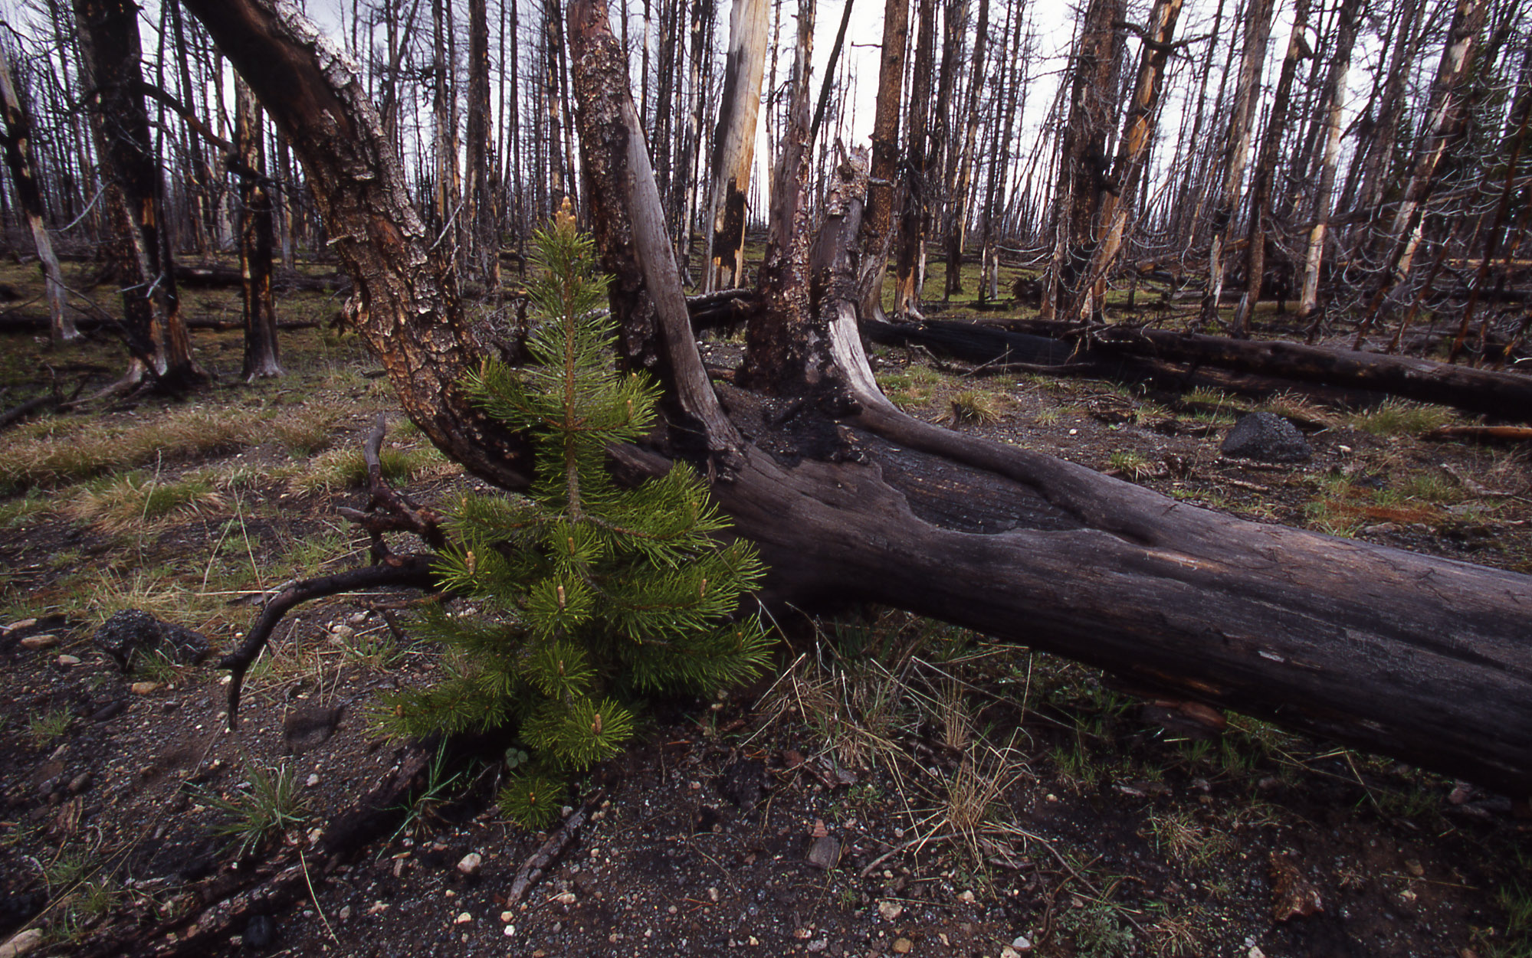
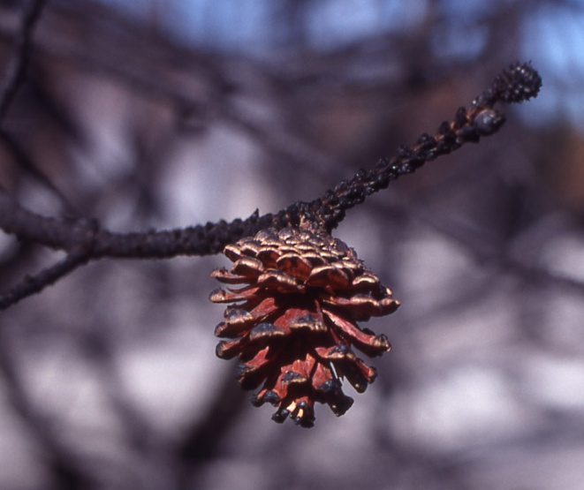
National Park Service: Jim Peaco
Notes:
Lodgepole pine with serotinous cones after fire.

Slide 30
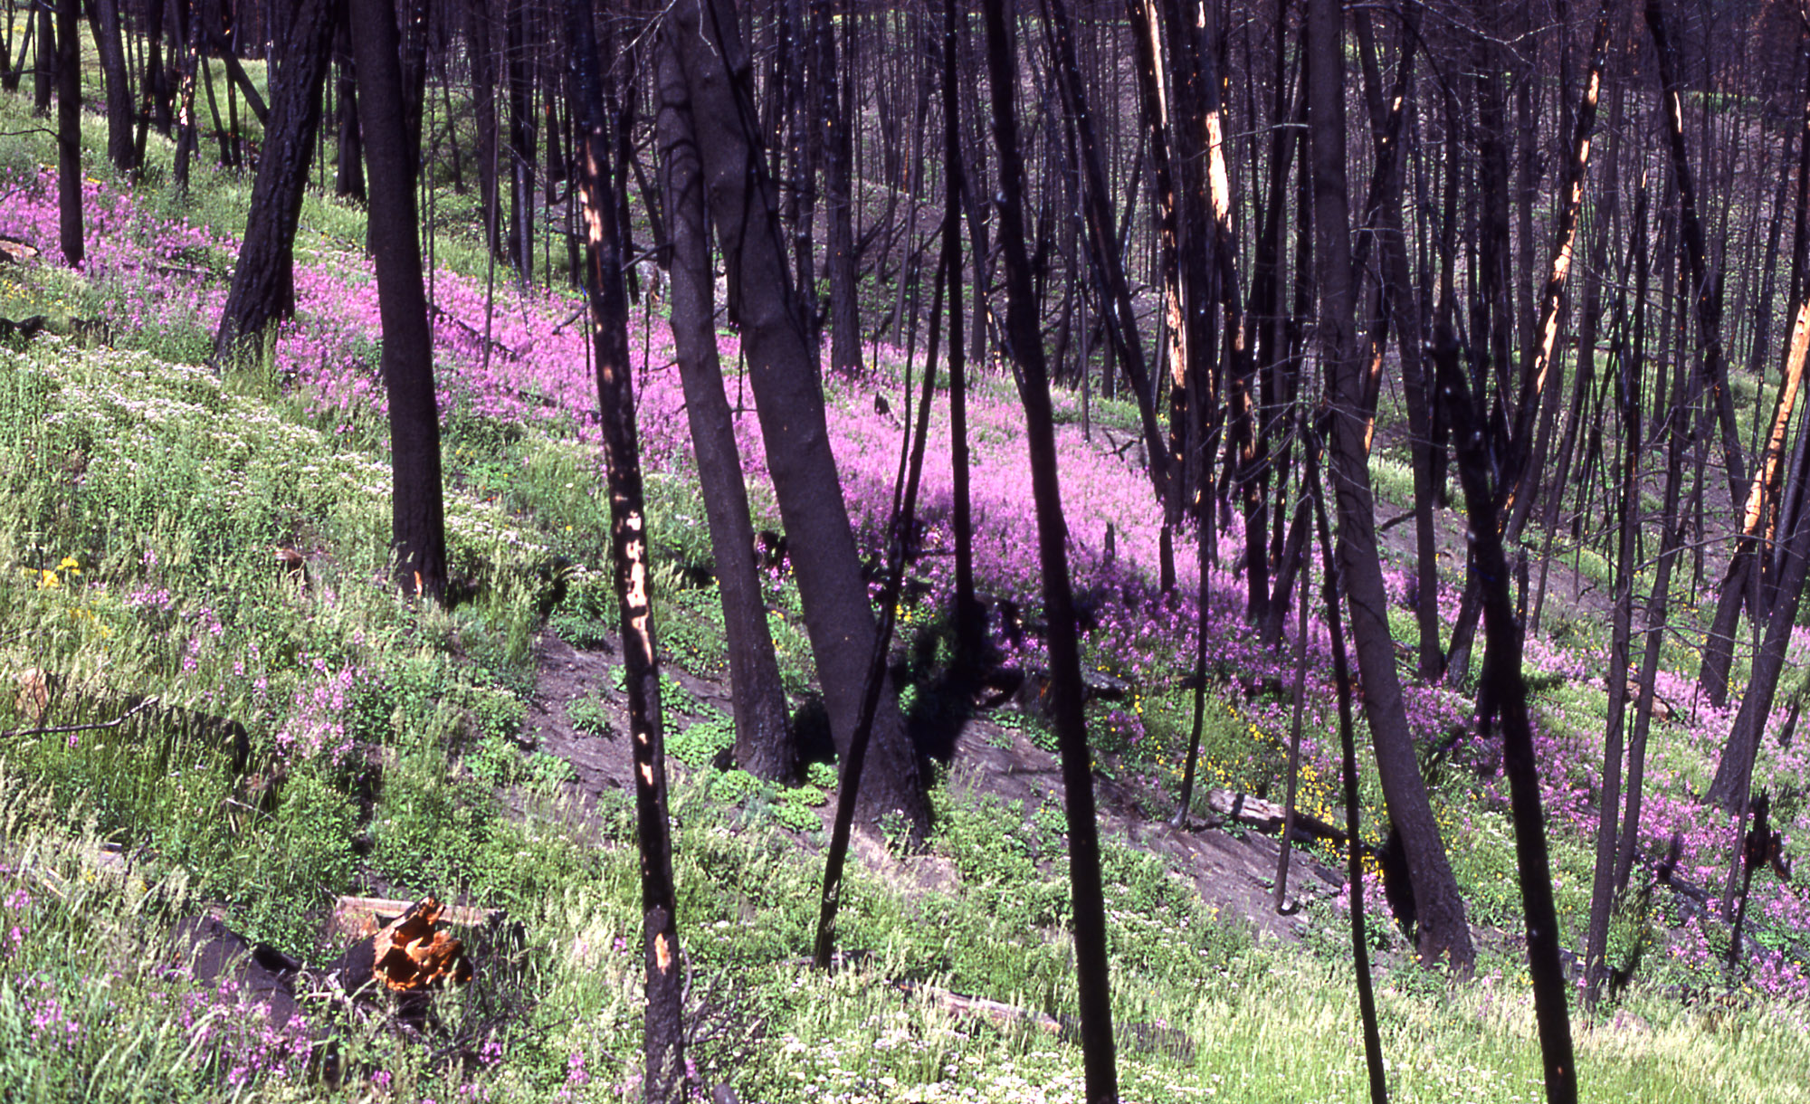
National Park Service: Jim Peaco
Notes:
Some species are adapted to rapidly colonizing areas after fire (e.g., Epilobium fireweed).

Slide 31
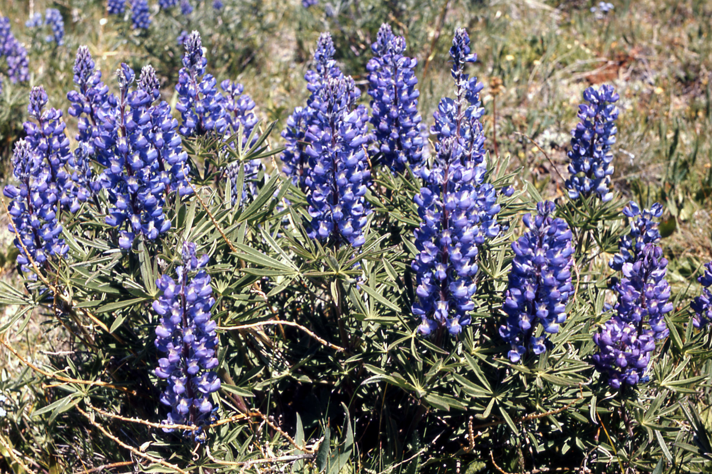
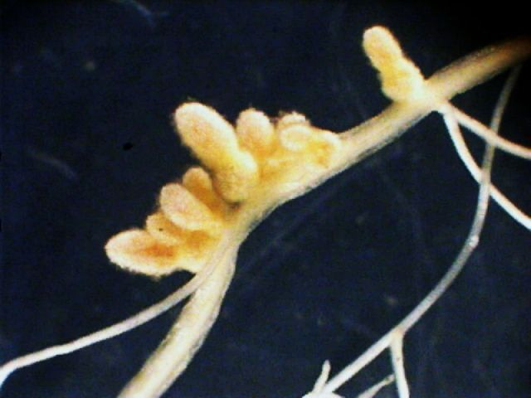
Inset: University of Wisconsin: Jean-Michel Ane, Ph.D.
National Park Service; Bryan Harry
Notes:
Some of these rapid colonizers are nitrogen-fixing legumes (like this lupine). These species play an important role in maintaining soil fertility as the ecosystem recovers. Inset shows root nodule containing nitrogen-fixing bacteria associated with a legume.

Slide 32
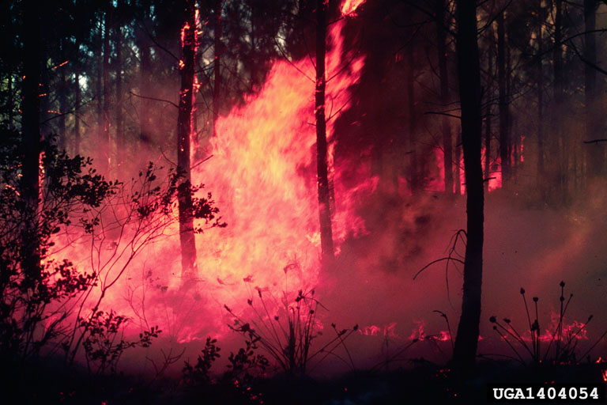
Thus – what is seen as devastating in the short-term, actually has benefits to some species in the long-term and some species are actually inhibited by lack of fire.
Forestry Images: Dale Wade, Rx Fire Doctor, Bugwood.org
Notes:
Thus – what is seen as devastating in the short-term, actually has benefits to some species in the long-term and some species are actually inhibited by lack of fire.

Slide 33
Maintain species diversity
Some forest types are fire-adapted
Impacts on wildlife
Insect specialists
Habitat diversity
Notes:
The role of fire in maintaining species diversity by increasing habitat diversity is a recent development in our understanding of these ecosystems

Slide 34
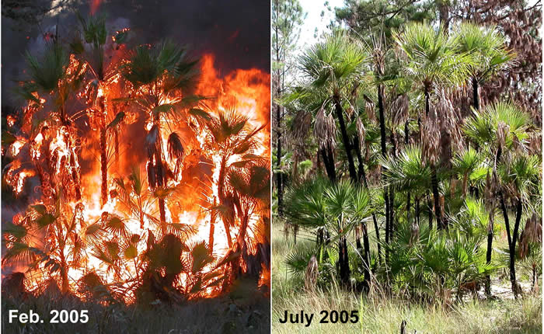
Fire-adapted
Plants
The role of fire in maintaining species diversity by increasing habitat diversity is a recent development in our understanding of these ecosystems
The Nature Conservancy: Ronald L. Myers, PhD
Notes:
A number of forest types are “fire-adapted”. SE pine forests (loblolly, slash, yellow, longleaf pines), Lodgepole pine, Ponderosa pine, chaparral, and sequoia are examples. These forest types decline in the absence of fire due to competition from other species and insect outbreaks.
Some species are remarkably resilient to fire. The photo pair here shows Palmetto during and five months after fire on Nature Conservancy property in the Caribbean.

Slide 35
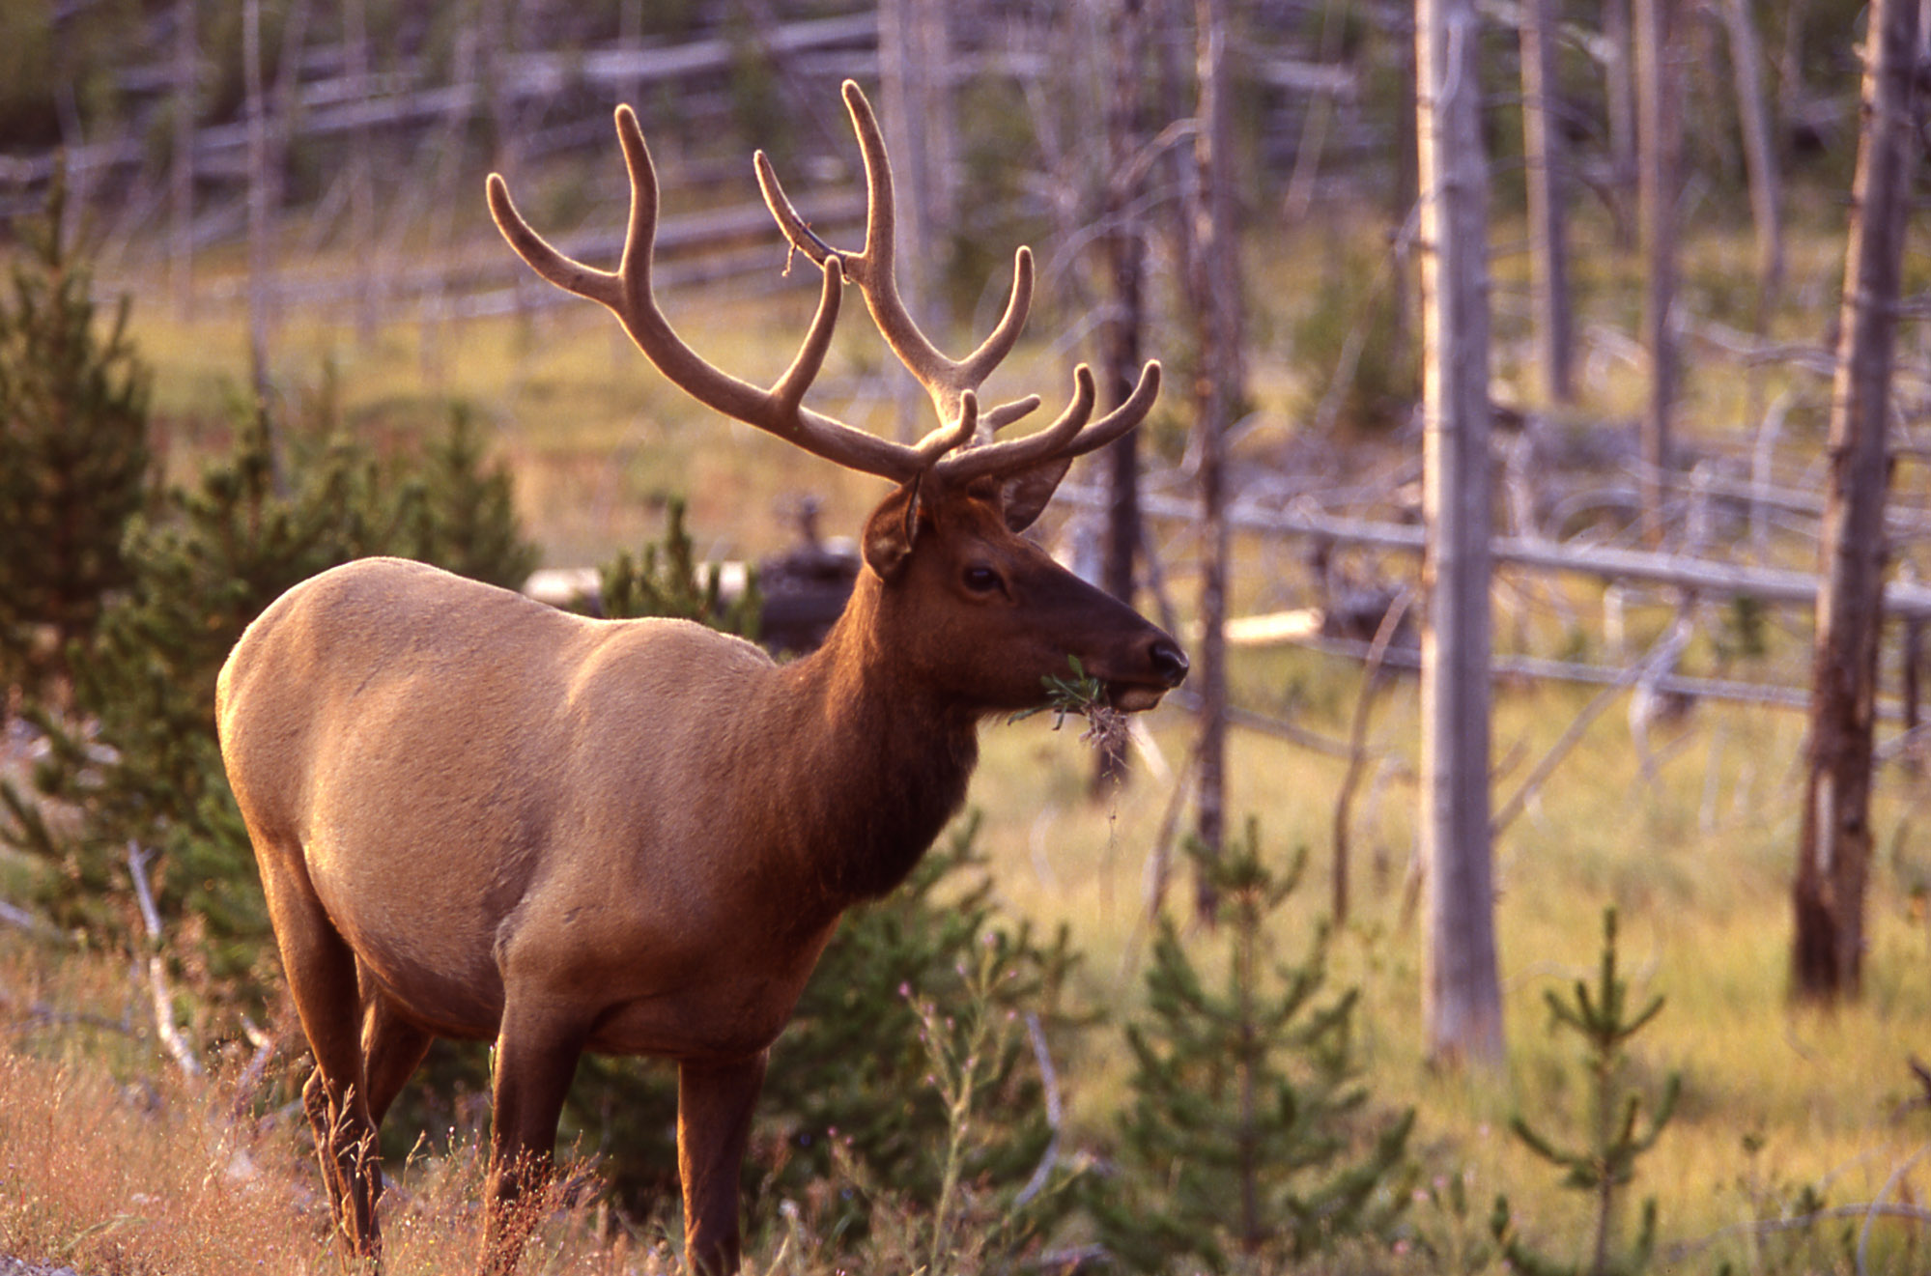
Impacts of Fire on Wildlife
Yellowstone Fires - 1988
350 of 30,000 elk (1%)
9 of 2500 bison (0.4%)
National Park Service: Jim Peaco
Notes:
Short-term impacts on wildlife – large mammals are best studied.
Even with the intense fires in Yellowstone in 1988 (1 million acres burned) only 350/30,000 elk (1% of population) and 9/2500 (<0.4%) bison perished in the fire (most by smoke inhalation).
Predators (e.g., cougars, hawks) and scavengers are either unaffected by fire or are favored in the short-term due to increased food availability.

Slide 36
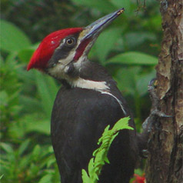
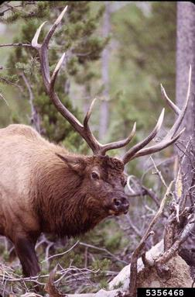
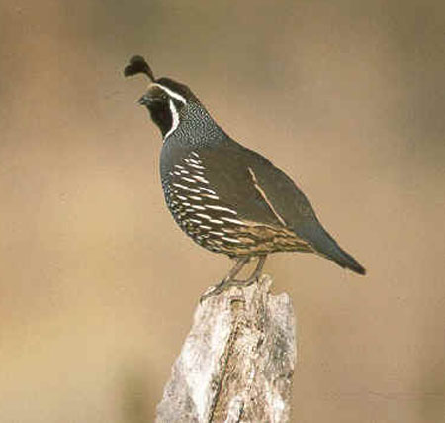
NCSR
Washington Biodiversity project
US Fish and Wildlife
Forestry Images: Terry L Spivey
Notes:
What are the long-term impacts on wildlife?
As with any environmental change, there are “winners” (e.g., moose, deer, elk, woodpeckers, black bear, quail) and “losers” (e.g., marten, wolverine, fisher, caribou).

Slide 37
Impacts on Wildlife
Short-term impacts on wildlife – large mammals are best studied. Even with the intense fires in Yellowstone in 1988 (1 million acres burned) only 350/30,000 elk (1% of population) and 9/2500 (<0.4%) bison perished in the fire (most by smoke inhalation).
Predators (e.g., cougars, hawks) and scavengers are either unaffected by fire or are favored in the short-term due to increased food availability.

Slide 38
Impacts on Wildlife
What are the long-term impacts on wildlife?
As with any environmental change, there are “winners” (e.g., moose, deer, elk, woodpeckers, black bear, quail) and “losers” (e.g., marten, wolverine, fisher, caribou).

Slide 39
NCSR
Notes:
Standing dead trees (snags) are an example of this biological legacy.

Slide 40
The major effects of fire are on habitat.
creation
destruction
NCSR
Notes:
The major effects of fire are on habitat.
Cavity nesting birds (e.g., tree swallows, woodpeckers) benefit from habitat creation (snags and logs) and food availability (wood-boring insects). In Yellowstone, species that had been in decline due to the suppression of fire thrived in the aftermath of the 1988 fires (e.g., 3-toed woodpecker feeds primarily on wood boring insects and uses snags as nest sites).
Forage increases for large herbivores such as elk and deer and omnivores such as bears.
Ground-foraging birds such as quail, grouse, turkeys and pheasants have been shown to increase after fires presumably due to a reduction in forest cover or an increase in edge habitat.
Habitat components are created as a result of fire – some of these components are in short supply in young managed stands. Most of these components are “biological legacies” (habitat components that are left behind after a disturbance such as fire). These legacies are remnants from the previous ecosystem and contribute to the recovery of that system. Several current forestry practices are designed to increase the level of biological legacies in harvested stands.

Slide 41
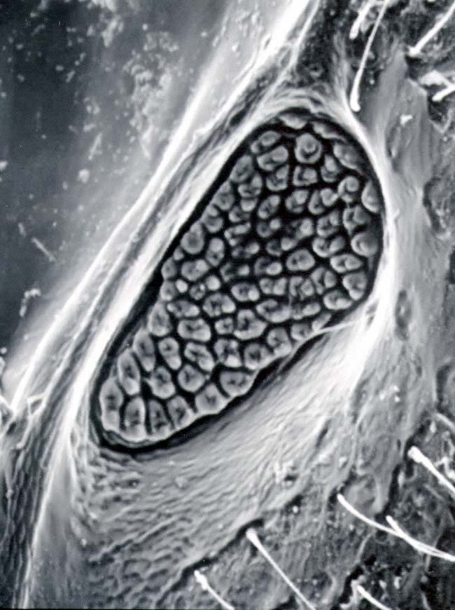
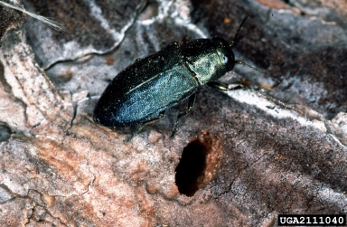
Insect Specialists
Melanophila beetle (flat-head borers)
breed in fire-damaged pines
eggs deposited below bark
larvae feed on cambium of
newly killed trees
adults are attracted by
heat and smoke
Flybrain online
Forestry Images: Petr Kapitola, State Phytosanitary Administration, Bugwood.org
Notes:
Melanophila beetle (flat-head borers) – usually breed in fire-damaged pines, eggs are deposited below the bark and larvae feed on cambium of newly killed trees. Adults are attracted by heat and smoke (adults have infrared detectors in sensory pits). Agee (1993) reports that at University of California football games in the 1940’s, there were regular reports of fans being annoyed and sometimes even bitten by these beetles attracted to the 20,000 or so lit cigarettes in the stands!

Slide 42
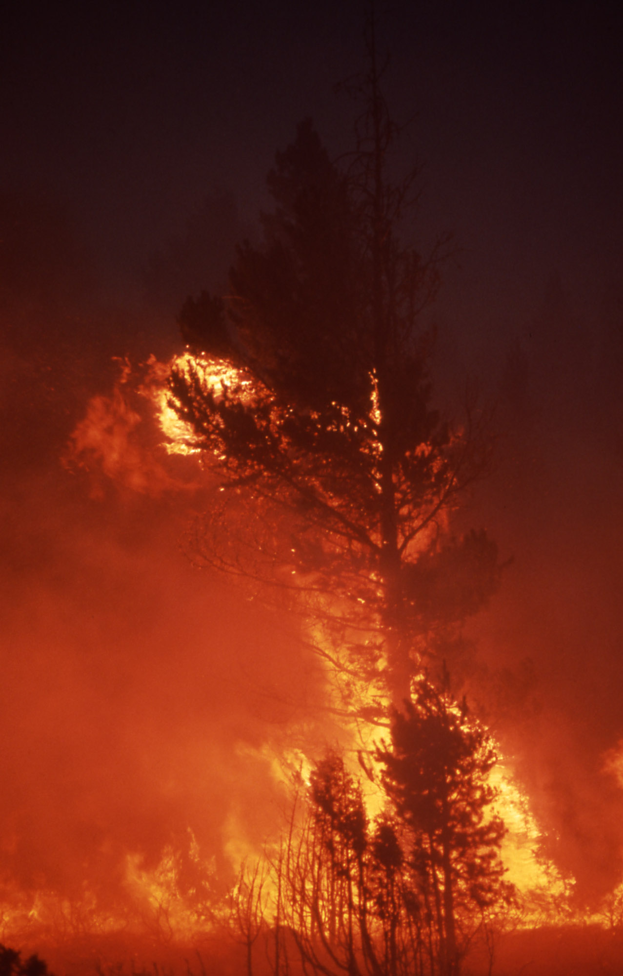
Therefore, what may be seen as catastrophic to our eyes, may be a “welcoming mat” to other species.
National Park Service
Notes:
Therefore, what may be seen as catastrophic to our eyes, may be a “welcoming mat” to other species.

Slide 43
Other possible effects…
Fisheries: increase water temp & sedimentation, decrease water quality, change water chemistry
Destroy/create critical habitat
Invasive plants
Disease/insect infestations

Slide 44
Thank You!

