Slide 1
Software Testing & Quality Engineering
Chapter 5
Teams
Linda Westfall Quality Press
Notes:
Team: Unity of purpose – coordination – Patience – Interaction – responsibility – Communication
Team goals: Team is responsible, With in team ind. Responsibility.
Make team: Team members – Technical skills, Individual, Confidence (Initiatives)
Team structure: People with technical skills (is this a surety team will perform)
Final year projects : Requirement capturing , documentation , design, coding ( Coding, Documentation, Presentation)

Slide 2
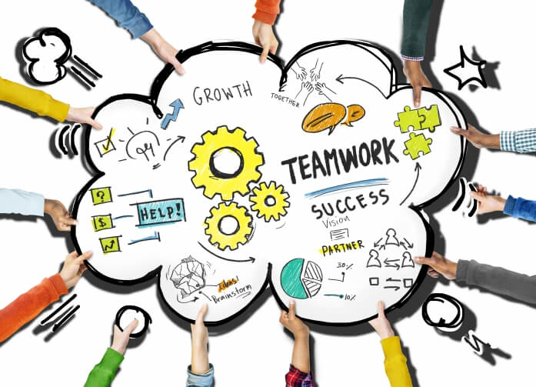
Objectives
Team Skills
Team Management
Team Tools

Slide 3
Team essentials
When under severe schedule pressure software engineers will generally concentrate on those tasks they know how to do, even if others are more important.
Thus, when engineers do not know how to develop firm requirements, produce a well structured and documented design, or establish an effective working team environment, they will generally concentrate on coding and testing.
When given a clearly structured set of tasks and a defined process for handling them, engineers will generally follow the process. This assumes that they know how to follow a defined process.
A fully functioning “gelled” team wont happen by accident.
The team does need to identify and resolve team issues.
The team needs to measure its performance.
The team needs to decide what improvements to make and how to make them.

Slide 4
Leadership Styles
decision-making
autocrat
democrat
directive
implementation
Permissive /
Laissez-Faire
Notes:
Directive autocrat: makes decisions alone: close supervision of implementation
Permissive autocrat: makes decisions alone: subordinates have latitude in implementation
Directive democrat: makes decisions participatively: close supervision of implementation
Permissive democrat: makes decisions participatively: subordinates have latitude in implementation

Slide 5
Developing, building and organizing teams
Since around 1980, quality concepts and team concepts have moved in tandem through the economy.
Teamwork is now vital in government, space exploration, healthcare, education, and most profit-oriented businesses.
The autocratic leader of one or two generations ago would be utterly perplexed (stunned) by how much control has now shifted to the team level.
Notes:
Tandem mean “working or occurring in conjunction with each other”.

Slide 6
Qualities of a Team members
Just as effective teams have certain key characteristics, so do also effective team members. An effective team member is committed to the team’s goals and understands his/her role and the role of the other team members in the achievement of those goals. They are effective communicators who keep an open mind while supporting their position and actively seeking the input of others. Characteristics of an effective team member include:
• Openness to feedback • Acceptance of responsibility for members’ behaviors • Provides feedback to other team members • Takes initiative • Concerned about winning • Willingness to let others win occasionally • Willingness to confront and stand up on important issues • Attacks problems, not people • Being a good listener • Willingness to change • Willingness to lead when necessary • Eagerness to learn new things
These characteristics can be used to identify potential team members as well as guide and reinforce behaviors of existing team members (see Sample Mission Statement in notes). Team members should strive to embody these qualities, but management must set the example by first exhibiting these qualities itself.
Notes:
We dedicate ourselves to the following principles of quality management:
“To establish an environment of mutual trust and understanding which provides for the education, safety, training, and empowerment of all “Company” people.”
Team charter:

Slide 7
Characteristics of effective team
Shared vision
Clear role and expectations
Cooperation
Support
Communication
Trust
Problem solving

Slide 8
Need for teams
The drive for excellence includes better deployment of people at all levels.
Workers at all levels now expect to have some say in designing and implementing change, and only through change can quality improve.
Managing an organization through teams has become recognized as a core component of business.
There are many types and purposes of teams, each requiring different structures, skills, resources, and support. Leaders of an organization must therefore be clear about what they are trying to accomplish and ensure that the appropriate team processes are utilized for their situation.
Notes:
Quality means achieving excellence.
Skills set

Slide 9
Balanced teams
Meredith Belbin studied the performance of top executives carrying out group work at the Hendon Management Centre
Tried putting the ‘best’ people together in ‘Apollo’ teams – almost invariably did badly
Identified the need for a balance of skills and management roles in a successful team

Slide 10
Becoming a team
Five basic stages of development:
Forming
Storming
Norming
Performing
Adjourning
Classification associated with Tuckman and Jensen
Notes:
The members of the group get to know one another and try to set up some ground rules about behaviour.
Storming – conflicts arise as various members of the group try to exert leadership and the group’s methods of working are established
Norming – conflicts are largely settled and a feeling of group identity emerges
Performing – the emphasis is now on the tasks at hand
Adjourning – the group disbands
One way of attempting to accelerate this process is through team-building exercises.
This is covered in Section 11.9 of the text book.

Slide 11
Types of Teams
Process improvement team: These are temporary teams whose missions are to develop a new process or improve an existing process. These teams are often cross-functional, consisting of representatives from multiple departments involved in the process under study. The management sponsor typically selects the team leader and will negotiate with other area managers to identify other team members appropriate for the project mission.
Work group: These teams consist of the personnel who work in a particular department or process area. Their mission is the ongoing monitoring and improvement of process performance and they typically meet on a regular basis (for example, weekly) to review indicators and identify any actions required. The work group leader usually is the individual with supervisory responsibility for the process area. The team also may initiate a process improvement team, especially when the improvement requires interfacing with other departments who are suppliers or customers of the work group. Organizations committed to applying work group–based improvement from top to bottom can use an interlocking team structure that includes all members of the organization.
Self-directed work team (SDWT): A self-directed work team is a group of individuals who have much broader and deeper day-to-day responsibility for management and improvement of their process area. SDWT members are highly trained in subjects such as quality, safety, maintenance, and scheduling, and in some cases also carry out human resource functions. These teams are highly empowered to make their own decisions, although of course there are still limits, such as spending authority.
Notes:
Whether and to what extent an organization utilizes teams usually is dependent on factors such as the rate of change in their industry, the culture of the organization the predominant management style, employee educational levels, and where the company’s product or service is in the maturity cycle.

Slide 12
Support Mechanism for Teams
Equipment
Training: The organization must determine the specific skills required and the current skill levels of employees, and provide opportunities to close the gap.
Management Sponsor: A Leadership role that includes staying in contact with the team leader to ensure sufficient progress and resolving any conflicting issues with other parts of the organization.
Systems Change: Setting up a new team in an organization that is not adequately designed for this way of working is a prescription for failure. An organization is a system, meaning that if one part is changed, other parts will be affected.
Notes:
Training. Unless an organization is extremely lucky, most employees who become involved in teams will not have all of the necessary skills. Such skills may include how to plan and effectively manage meetings, how to analyze processes and data, and how to make group decisions based on consensus.
Management Sponsor: The sponsor also is ultimately responsible for effective implementation of the team’s recommendations.
System Change: If the primary management style is autocratic and people are rewarded for competition versus cooperation, teams are unlikely to be an effective mechanism. Before beginning the team process, leadership must consider what other changes will be necessary to align the various parts of the organization. How team success will be recognized and rewarded is an especially vital component.
Objectives unrealistic:- Conflicts

