Slide 1
ROLE OF CHISELING AND DEEP PLOUGHING IN SOIL AND WATER CONSERVATION

Slide 2
Chisel plough
It is equipped with narrow, double-ended shovels, or chisel points, mounted on long shanks.
These points rip through the soil and stir it but do not invert and pulverize as well as the mould board and disk plough.
It is an inexpensive implement.
It is often used to loosen hard dry soils.
Usually, it is recommended after 3-4 years.

Slide 3
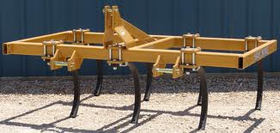
Chisel plough

Slide 4
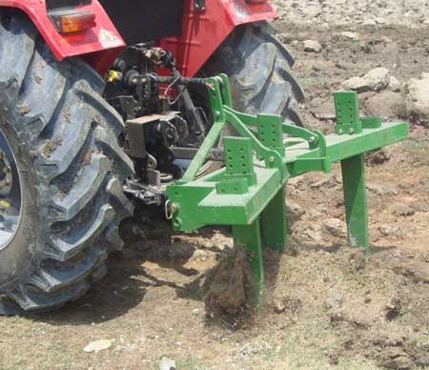
Chiseling/Chisel ploughing
It is preparing of croplands by using a special implement (chisel plough) that avoids complete inversion of the soil.
It can plough the soil up to 60-70
cm deep.
A powerful tractor is required for
this operation.

Slide 5
Role of chiseling in soil and water conservation
Helps in incorporating fertilizers.
Reduce wind erosion.
Provide mini storage basins for water.
To breakage of hardpan.
Improve the drainage, root growth and mineral efficiency of soil.

Slide 6
Role of chiseling in soil and water conservation
It shatters the soil well below. Thus increasing the water holding capacity.
It preserves moisture during high rainfall which is very important for the crop to withstand rainfall or drought periods.
It provides a simple and economical way to obtain boosting crop yields and profits.
It looses the soil for better growth of crop plants.

Slide 7
Role of chiseling in soil and water conservation
Deep rooted weeds are uprooted, so causing increase in organic matter.
Leave crop residues on soil surface to prevent water evaporation.

Slide 8
Deep ploughing/Deep plough
The type of ploughing in which we cultivate or plough the soil up to 50 cm deep.
Mostly done by mold board plough or disc plough.
Soil surface is inverted in deep ploughing.

Slide 9
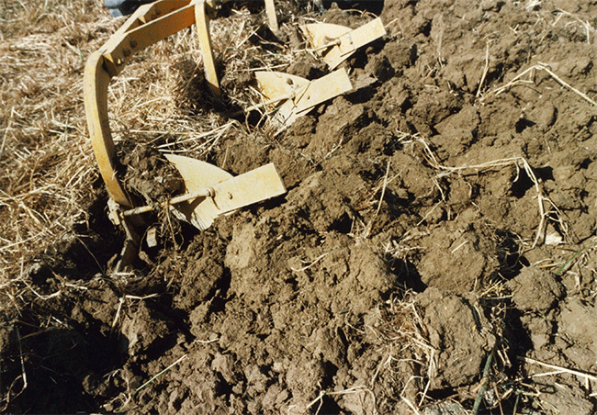

Slide 10
Role of deep ploughing in soil and water conservation
Improves the physical condition of soil.
Better soil structure can save the land from soil erosion but the excessive cultivation will destroy the soil structure.
Breaks the hard pan of soil .
Makes easy the availability of nutrient because it mix the top layer of soil with inner layers.
In some experiments deep ploughing has shown a higher cereal yield.

Slide 11
Role of deep ploughing in soil and water conservation
It is mostly used in barani areas for moisture conservation.
Also reduces the water erosion as water infiltrate into soil.
Better control on perennial weeds.
Reduce run off of fertilizer.
Increased aeration.
Eradication of insect hibernated in soil.
Destroy the insects at larval stage.

Slide 12
Disadvantages of deep Ploughing
Not suitable for dry land areas.
Exposure of micro organism to surface.
Formation of large clods.
Time consuming.
A powerful machinery is required for
this operation.

Slide 13
Disadvantages of deep Ploughing
Exposure of soil microbes to sunlight.
A trained man is required for this operation.

Slide 14
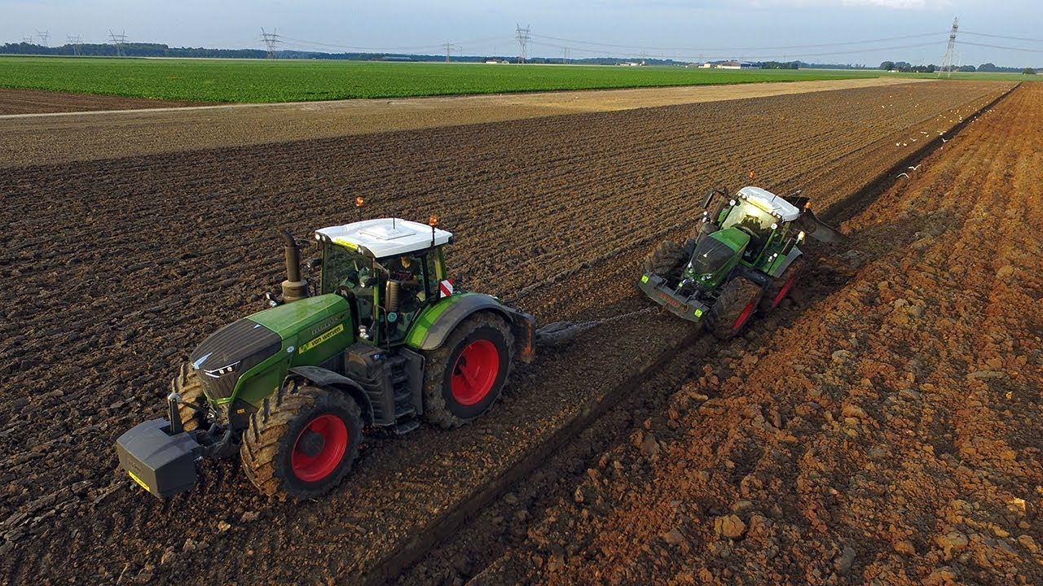

Slide 15
THANK YOU!

