Slide 1
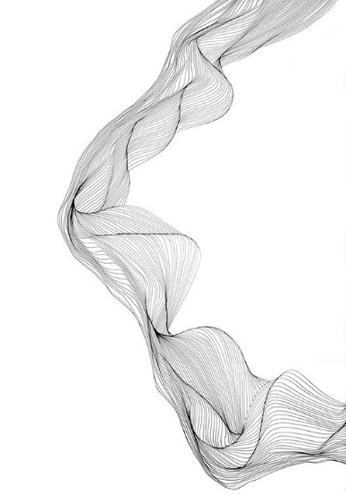
Heteoscedasticity
1.What is the nature of heteroscedasticity?
2. What are its consequences?
3. How does detect it?
4. What are the remedial measures?
Department：Agri-Economics Subject: Econometrics

Slide 2
Nature of Heteroscedasticity

Slide 3
Nature of heteroscedasticity :
Hetero means “Different or Unequal”
Scedastic means “Spread or Scatter”
Heteroscedasticity is a systematic pattern in the errors where the variances of errors are not constant.
The model now becomes;
Yᵢ= β1 + β2Xᵢ + uᵢ
Y represents savings and X represents income.
uᵢ represent error term.

Slide 4
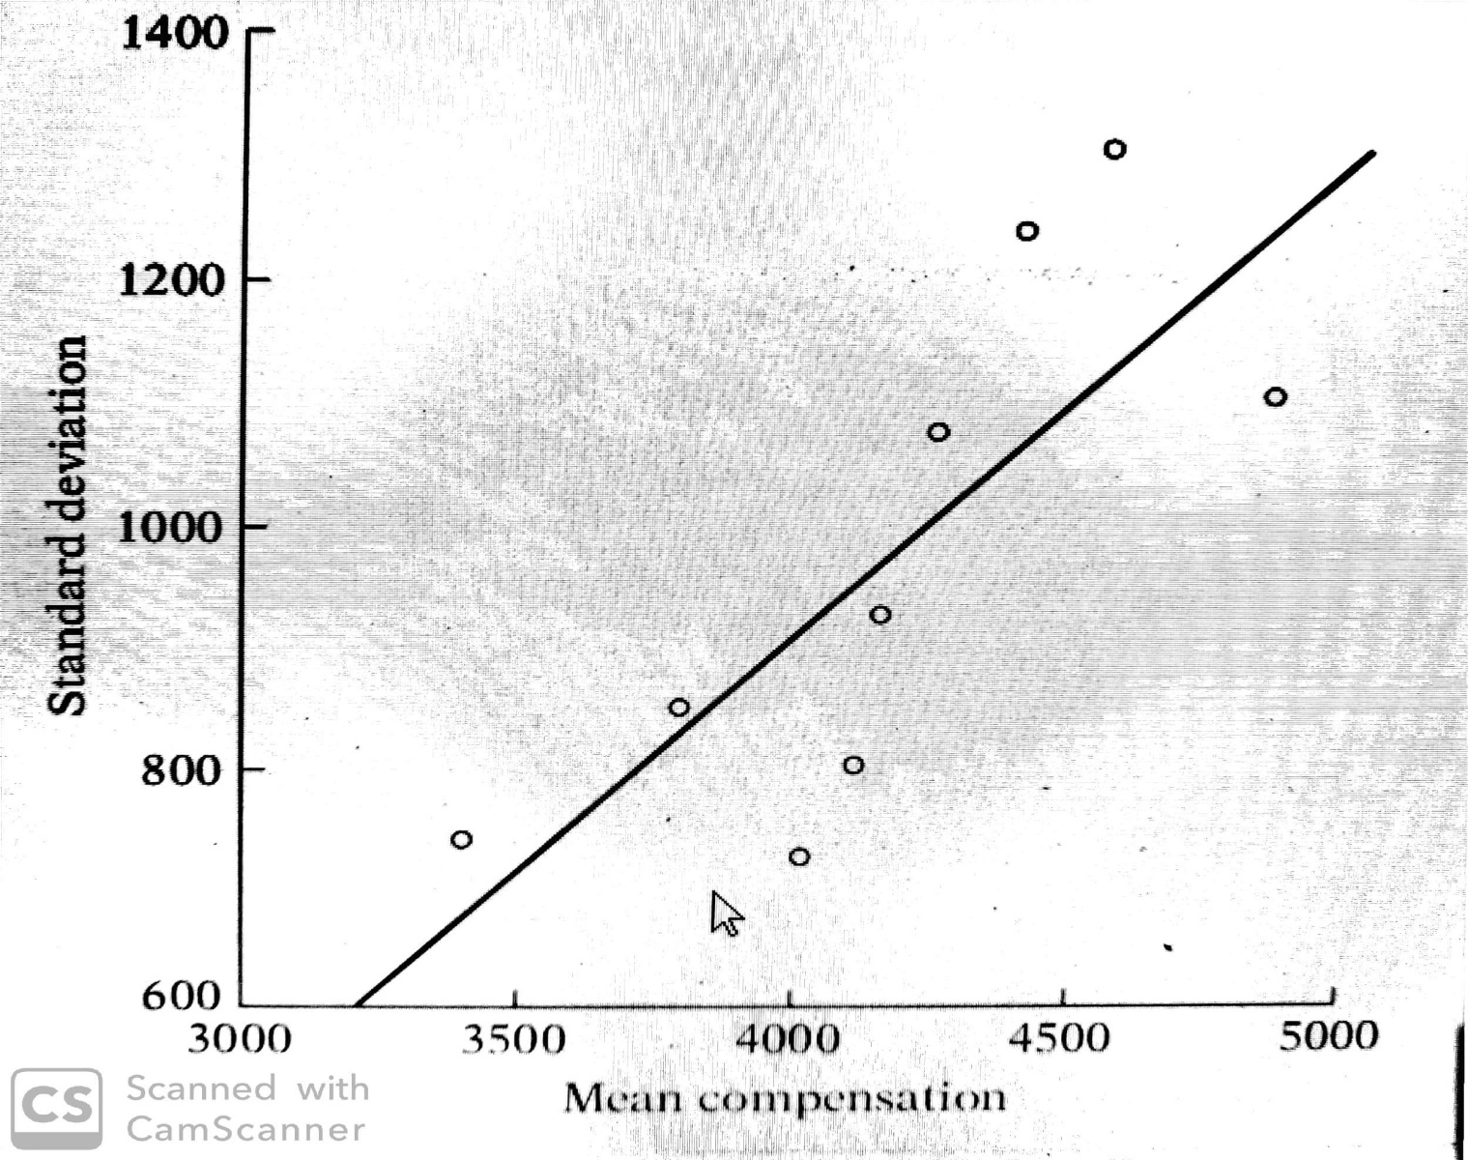
Example
Suppose 100 students enroll in typing class. Some of which having typing experience and some of which don't. After 1st class there would be great deal of dispersion in number of typing mistakes, although after the last class there would be less mistakes rather than 1st class. The error variance is Non-constant.

Slide 5
Homoscedastic disturbances
This is the assumption of homoscedisasticity, or equal spread, that is equal variance.
Symbolically;
E(uᵢ²)= σ²
i = 1, 2, ... ,n
The variance of savings remains the same at all levels of income.

Slide 6
Heteroscedastic disturbances
According to fig, the variance of Yᵢ are not same. Hence there is heteroscedasticity.
Symbolically;
E(uᵢ²)= σᵢ²
It increases with income. It seems that in Figure the higher income families on the average save more than the lower-income families,but there is also more variability in their savings.

Slide 7
Reasons: (why the variances of uᵢ may be variable)
The presence of outliers in the data.
Incorrect functional form of regression model.
Incorrect transformation of data.
Mixing observation with different measures of scale(Such as mixing high income houshold with low income houshold).

Slide 8
Consequences
of Heteroscedasticity

Slide 9
Consequences:
OLS estimators still linear and unbiased.
OLS estimators not efficient.
usual formulas give incorrect standard errors for least squares.
Confidance intervals and hypothesis test based on usual standard error are wrong.

Slide 10
Consequences of using OLS in the presence of heteroscedasticity:
OLS estimation still gives unbiased coefficient estimates, but they are no longer BLUE.
This implies that if we still use OLS in presence of heteroscedasticity, our standard error could be inappropriate and hence any inferences we make could be misleading.

Slide 11
Conti...
whether the standard error calculated using the usual formula are too big or too small will depend upon the form of heteroscedasticity.
In the presence of heteroscedasticity, the variance of OLS estimators are not provided by usual OLS formulas. But if we persist in using usual OLS formulas, the t & f test based on them can be highly misleading in invalid/wrong conclusion.

Slide 12
Detection
of Heteroscedasticity

Slide 13
01
IN-FORMAL METHOD
Nature of the problem
Graphical method
02
FORMAL METHOD
Park Test
Breusch-pagan Test
Spearman’s Rank Correlation Test
Goldfeld-Quandt Test

Slide 14
Nature of the problem:
Nature of the problem may suggest heteroscedasticity is likely to be encountered.
For instance, in the consumption expenditure and income study.
Residual variance around the regression of consumption on income incresed with income.
Hence, in similar studies one can expect unequal variances among the error terms.

Slide 15
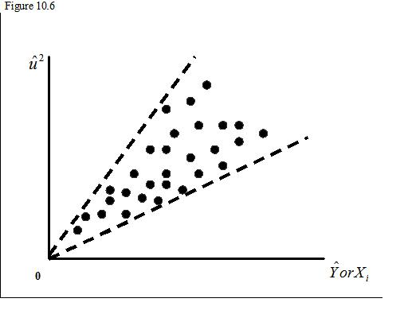
Graphical method:
Informal way which is done through graphs and therefore we call it the graphical method.

Slide 16
Graphical method:
If there is prior information about the nature of heteroscedasticity, then do the regression analysis based on the assumption.
We then obtained the residuals and analysis the square of the residuals. The square residuals Uᵢ² are plotted against.Yᵢ
The estimated mean value of Y is systimatically related to the squared residuals.

Slide 17
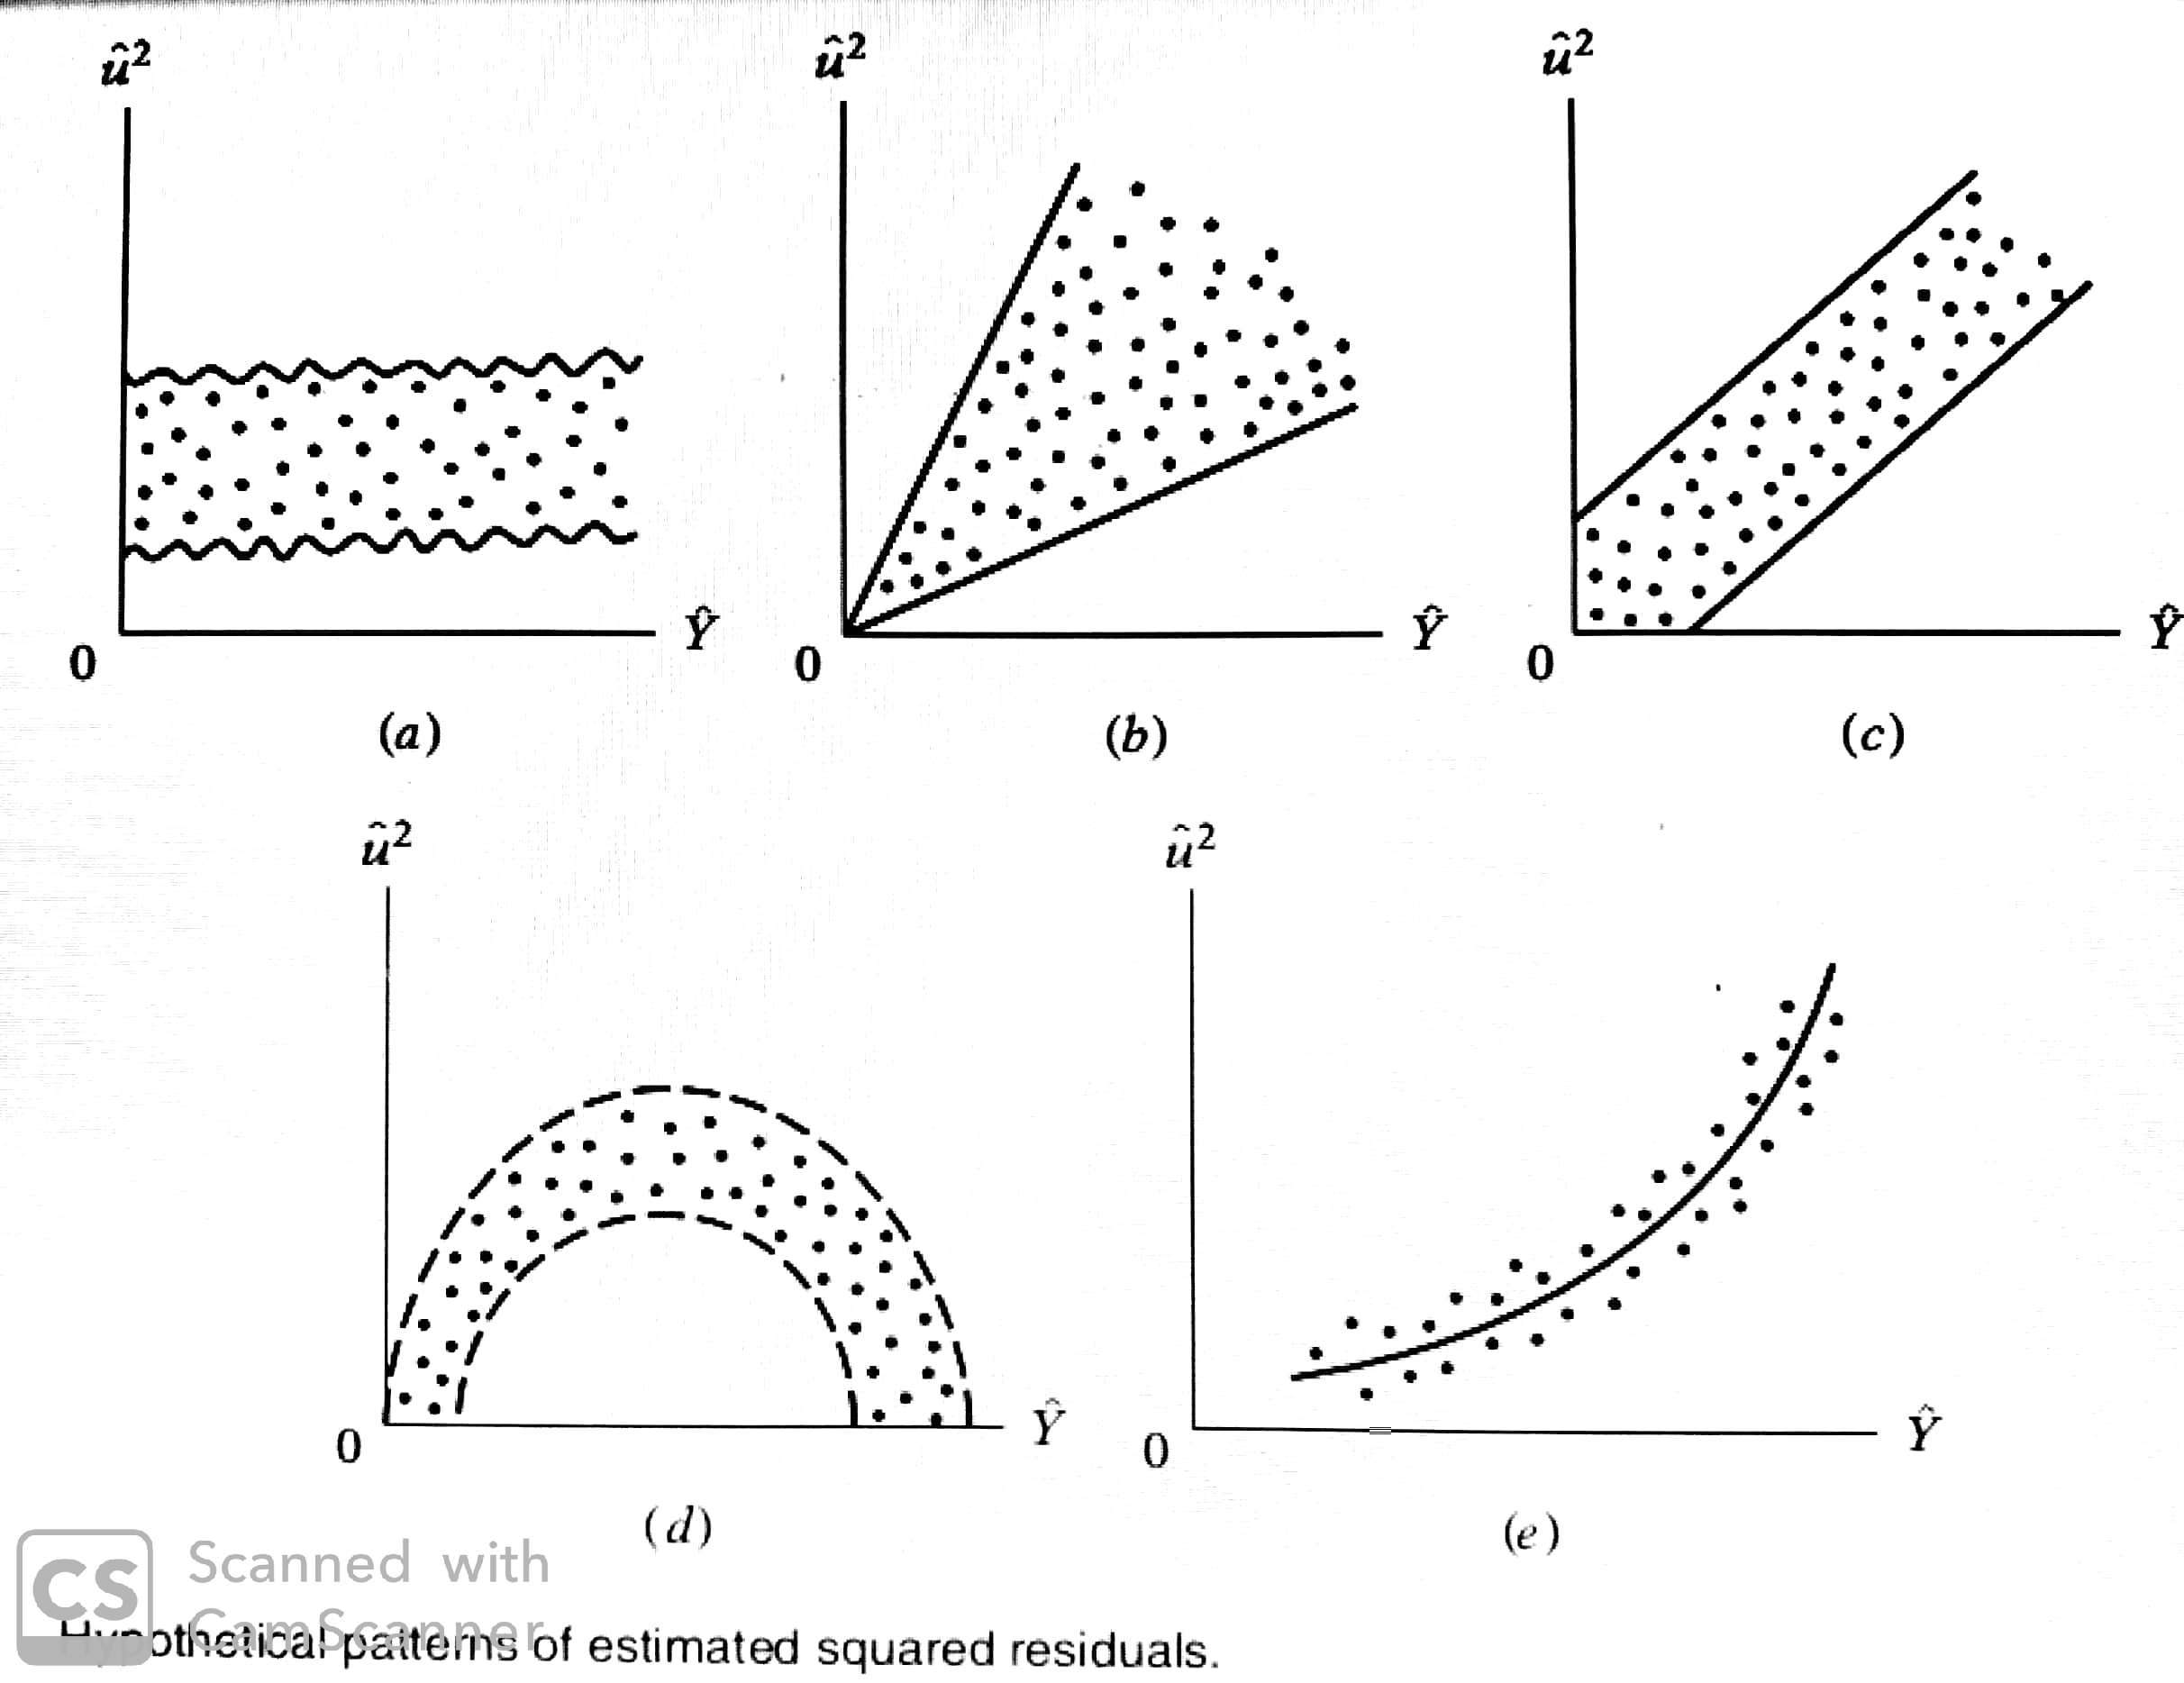
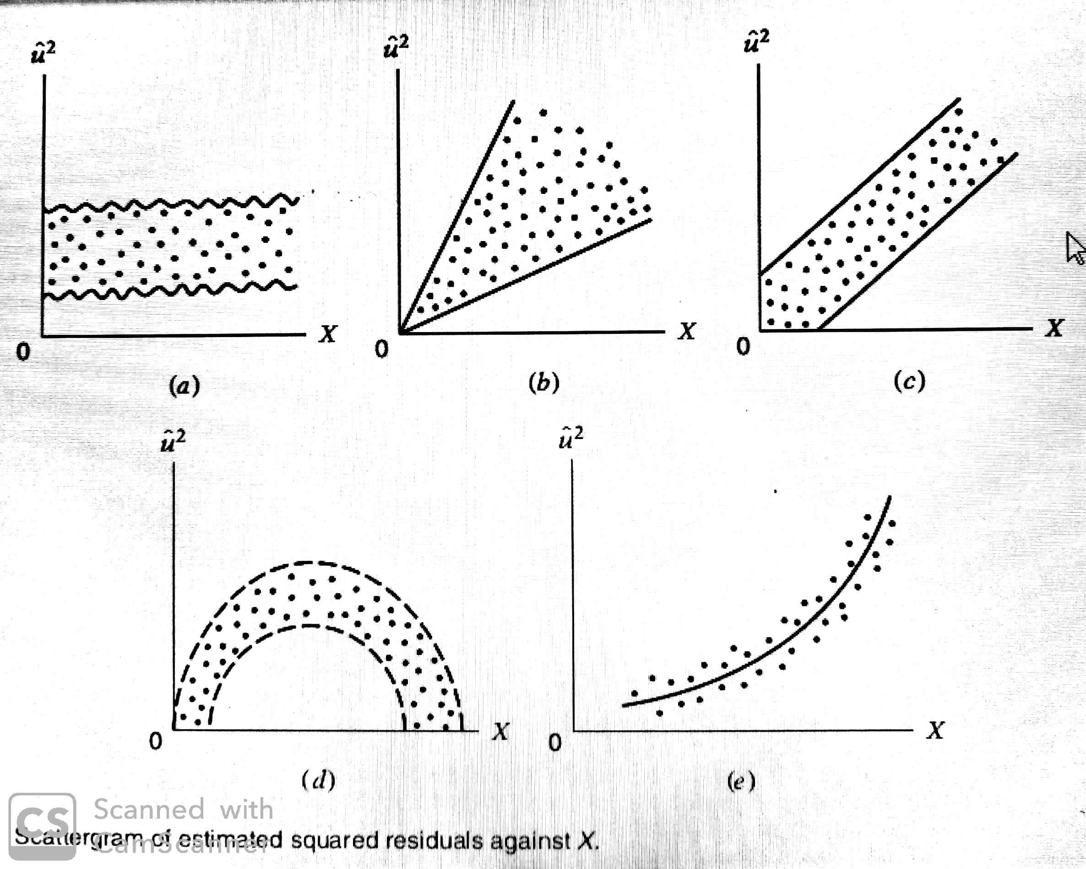

Slide 18
Example:
There is no systematic pattern between two variables.
No heteroscedasticity is present

Slide 19
Example:
There is systematic pattern between two variables.
The residuals show cone line pattern.
Heteroscedasticity is present

Slide 20
Formal Method

Slide 21
Park Test
P
B
Breusch-pagan Test
S
G
Spearman's Test
Gold-feld quandt Test

Slide 22
1. Park Test
Run OLS on regression: Yᵢ=β₁+β₂Xᵢ+Uᵢ
Take square and take log: ln(Uᵢ²)
Run OLS on regression: ln(Uᵢ²) = β₁*+β₂*lnXᵢ+Uᵢ
Use t-test to test H˳: β2*=0 (Homoscedasticity)
If t*>tᶜ______ Reject H˳ ___________ Heteroscedasticity exist
If t*<tᶜ _____ Not reject H˳ _________ Homoscedasticity

Slide 23
2. Breusch-pagan Test
Estimate the OLS regression, and obtain the squared OLS residual from this regression.
Regress the squared residuals on the k regressors included in the model.
You can choose other regressors also that might have some bearing on the error variance.

Slide 24
Conti...
The null hypothesis here is that the error variance is homoscedastic – that is, all the slope coefficients are simultaneously equal to zero.
Use the F statistic from this regression with (k-1) and (n-k) in the numerator and denominator df, respectively, to test this hypothesis.
If the computed F statistic is statistically significant, we can reject the hypothesis of homoscedasticity. If it is not, we may not reject the null hypothesis.

Slide 25
3. Spearman’s Rank Correlation Test
We defined the Spearman’s rank correlation coefficient as;
rs = 1 − 6[Σdi²/n(n²-1)
where;
dᵢ = difference in the ranks assigned to two different characteristics
n = number of individuals.
The above spearman's rank correlation coefficient can be used to detect heterosceadsticity.

Slide 26
Procedure:
Fit the regression line on Y & X and obtain the residuals.
Rank the residual by ignoring their sign.
Rank either the value of X or Y.
Find difference between two rankings.
Applying the following test statistic to the test hypothesis that the population rank correlation coefficient Pᵢ=0 & n>8
If the computed t value exceeds the critical t value, we may accept the hypothesis of heteroscedasticity; otherwise we may reject it.

Slide 27
4. Goldfeld-Quandt Test
Applicable when one assume that the heteroscedastic variance increases with the increase in explanatory variable i.e;
σᵢ²↑ , Xᵢ↑
Step 1: Arrange the observation in increasing order xᵢ.
Step 2: Omit 'c' central observations where 'c' is fixed in advance, & then divide the remaining observation into 2 groups.
Step 3: Fit the OLS regression model to both groups and obtain sum of square of regression i.e; RSS1 & RSS2

Slide 28
Conti...
Step 4: Compute the ratio
λ = RSS2/df/RSS1/df
If the Computed value of λ is greater than the tabulated value of F then we can reject the hypothesis of homoscedasticity.

Slide 29
Remedy of heteroscedasticity

Slide 30
REMEDIAL MEASURES:
Heteroscedasticity does not destroy the unbiasedness and consistency.
But OLS estimators are no longer efficient, not even asymptotically (i.e., large sample size).
There are two approaches to remediation:
when σᵢ² is known
when σᵢ² is not known.

Slide 31
1. σᵢ² is known:
The most straightforward method of correcting heteroscedasticity is by means of weighted least squares.
WLS is an example if gemeralized least square (GLS) estimator-more efficient than OLS on the unweighted data.
WLS method provides BLUE estimators.

Slide 32
Weighted Least Squares:
The basic model with heteroscedasticity is
Yᵢ=b_{o}+b₁Xᵢ+Uᵢ
Dividing each observation by the assosiated standard deviation of the error transform the model,
Yᵢ/ σᵢ =bo/ σᵢ+b₁Xᵢ/ σᵢ+Uᵢ/ σᵢ
The error term in the transformed model is no longer heteroscedastic,
var(Uᵢ/ σᵢ)=var(Uᵢ/ σᵢ²= σᵢ²/ σᵢ²=1
The transformed model is called weighted least squares.

Slide 33
Method:
Method of estimating σi include;
Assume σᵢ² is a function of an explanatory variable.
Divide each observation by the value of Xᵢ.
Must be careful when interpret the resulting coefficient.
Grouped data;
From CLT, know that the variance of means of more populated states will be smaller than variance for less populated states.
So, WLS with square root of state population as weight

Slide 34
2. σi² is not Known
the true σᵢ² are rarely known.
Is there a way of obtaining consistent (in the statistical sense) estimates of the variances and covariances of OLS estimators even if there is heteroscedasticity?
The answer is yes
Use White's Heteroscedasticity-Consistent Variances and Standard
Errors.
Valid in large samples.

