Slide 1
Makeup or Lay Out
News Reporting and Sub Editing

Slide 2
Make Up/Lay out
The process of arrangement of typography, the size of headline, number of stories to be published, the size and number of pictures to be pasted on the copy according to the policy of media organization is called make up or lay out. It is done to beautify the page, enhance the stall value, adjust the maximum printable material and satisfy the reader esthetic.

Slide 3
Purpose of Make Up
The attract the readers
Enhance the stall value
Beautification of the page
Adjust the news material
Helping the writing headline
Reflection of Newspaper policy
To develop the esthetic sense of reader

Slide 4
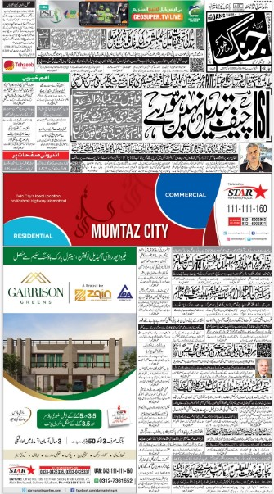
Types of Make Up Balance Makeup
In this type of make up the page designer tries to balance against heads, pictures against pictures, stories against stories and work against work. The reader gains the impression of restrained when someone looks at the page.

Slide 5
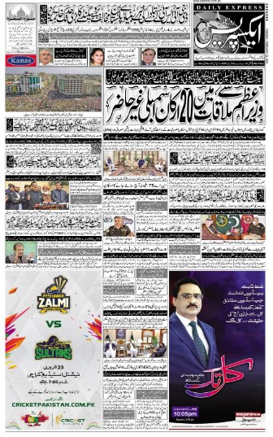
Broken or Mixed Make Up
In this type of make up the page maker tries to avoid balance or any suggestion of it. Make up editor is allowed complete freedom to obtain the effects he desire and many interesting and made up pages result from this lack of definite portion.

Slide 6
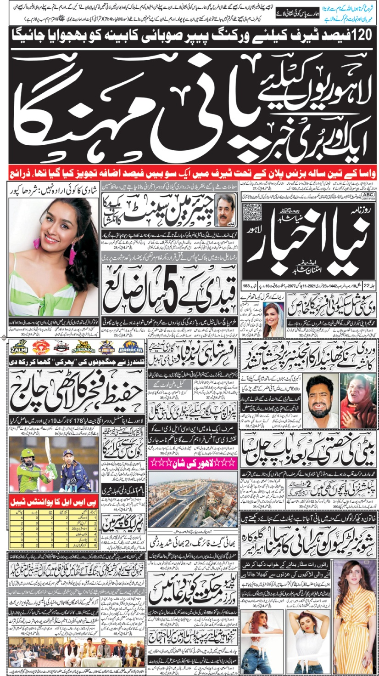
Circus Make Up
It is carried to the extreme headline, glaring black type and with dozen different part of the fairly glimmering for attention of the reader. There is no focus of interest. It is often adopted by evening newspapers.

