Slide 1
Tree Legumes

Slide 2
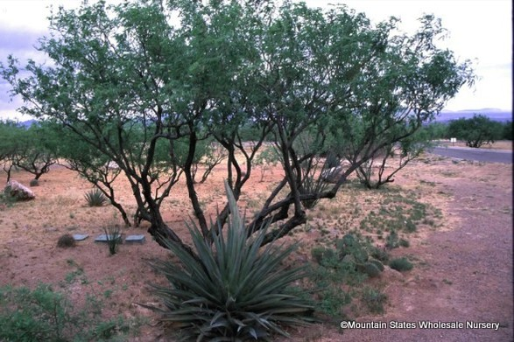
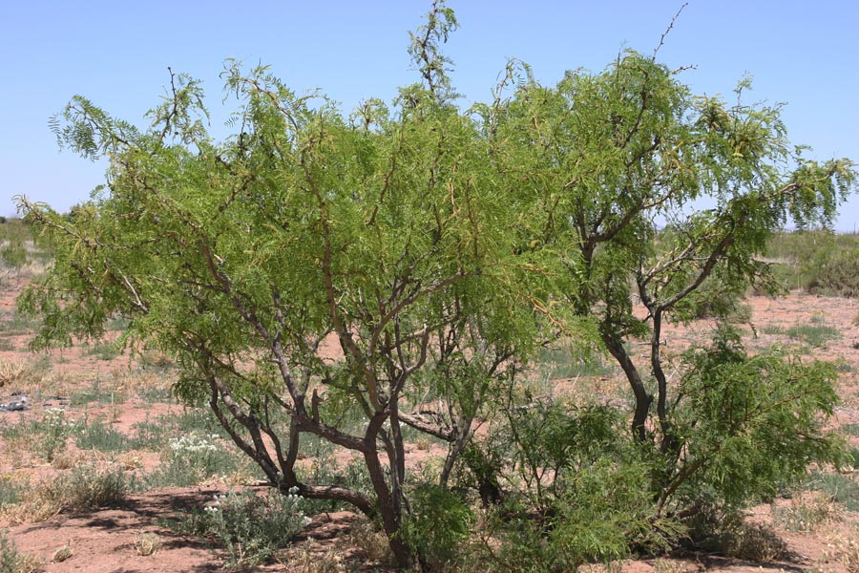
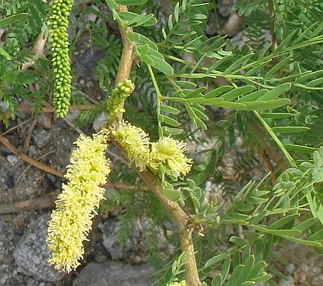
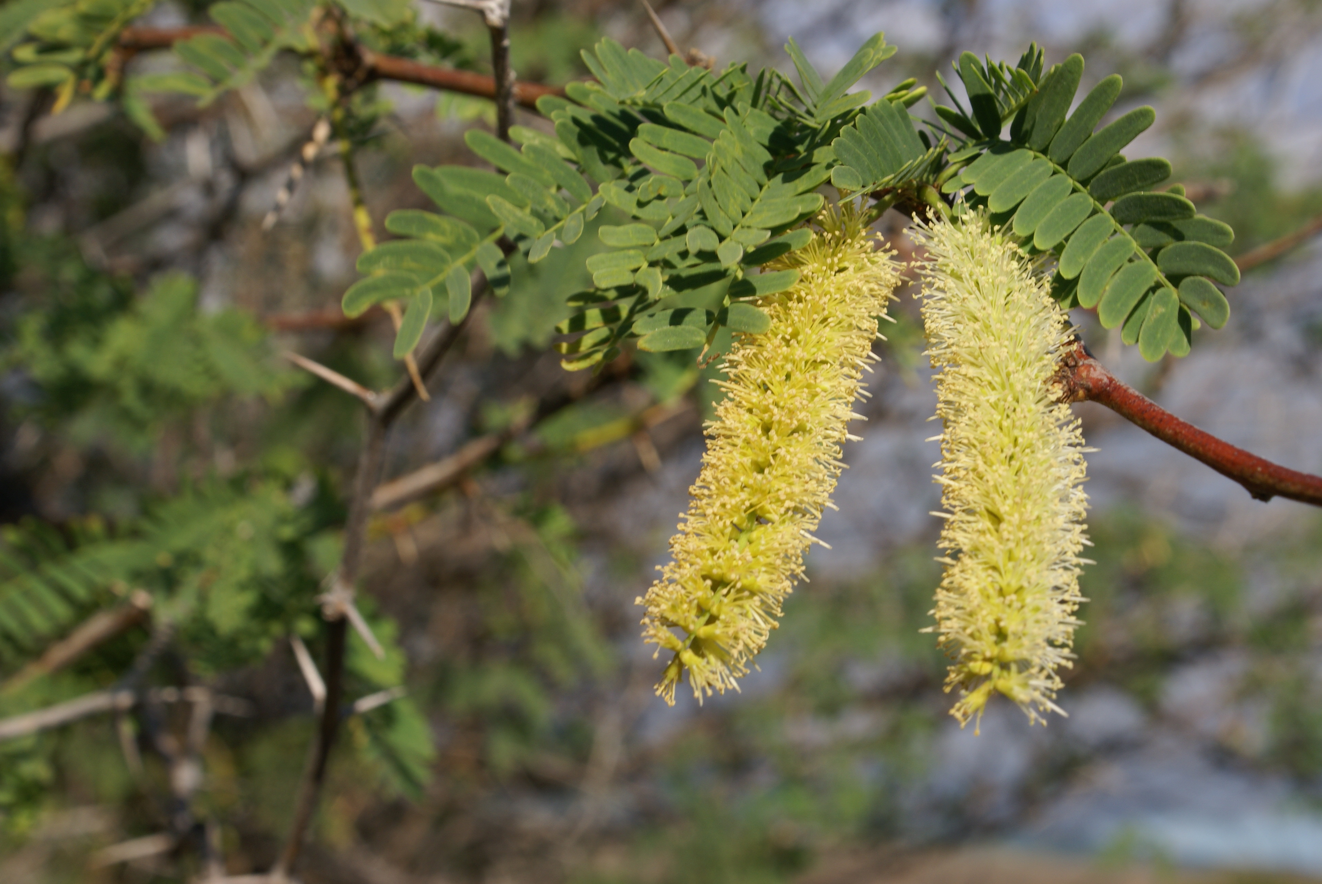
Tree Legumes
Mesquite, also known as Algaroba and Keawe, Prosopis juliflora, is native to the West Indies, Central America and Mexico.
The introduction of a single tree into Hawaii was followed by a spread to the drier climatic zones of all the islands.
Another species, Prosopis glandulosa, is better adapted to colder climates.
Prosopis juliflora
Prosopis glandulosa

Slide 3
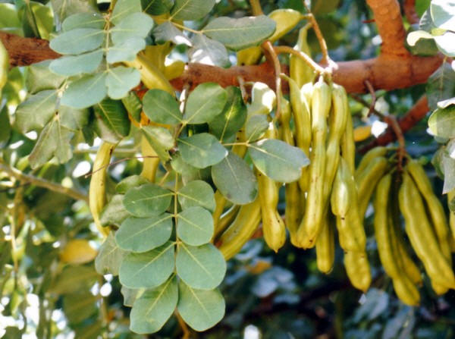
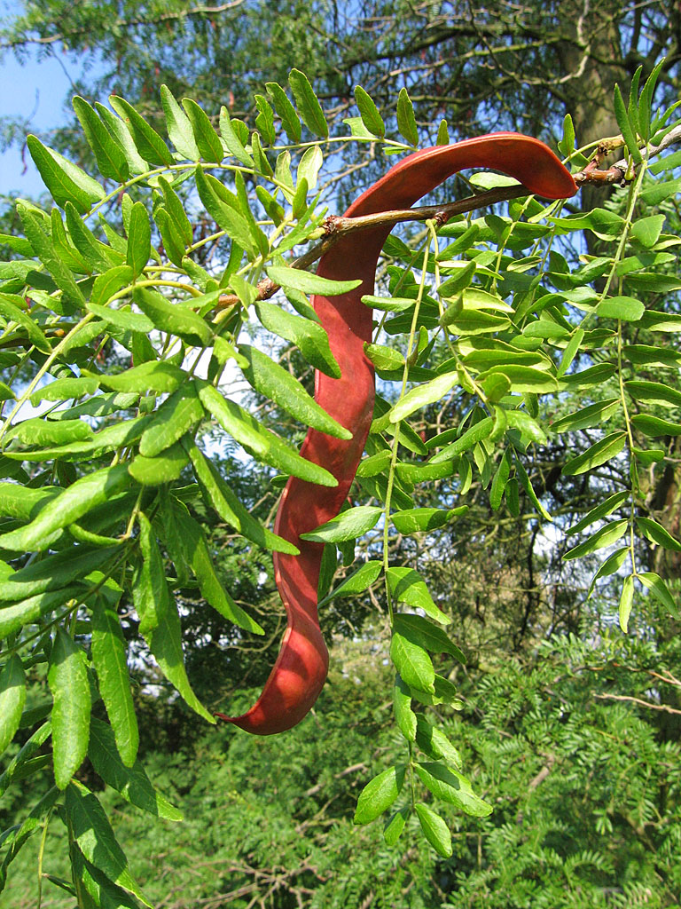
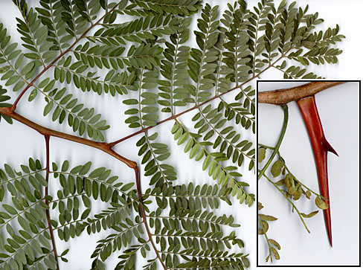
The carob tree, Ceratonia siliqua, is native to Syria but has been cultivated since ancient times in other Mediterranean countries.
The ground seeds yield a highly nutritious meal that can be added to bread.
The pods contain a valuable gum known as Tragasol.
Honey locust, Gleditsia triacanthos, is indigenous to the humid eastern North America in areas of hot summers and cold winters.
The pods contain 29 percent sugar and are readily eaten by livestock.
Honey locust is also a valuable ornamental and timber tree.

Slide 4
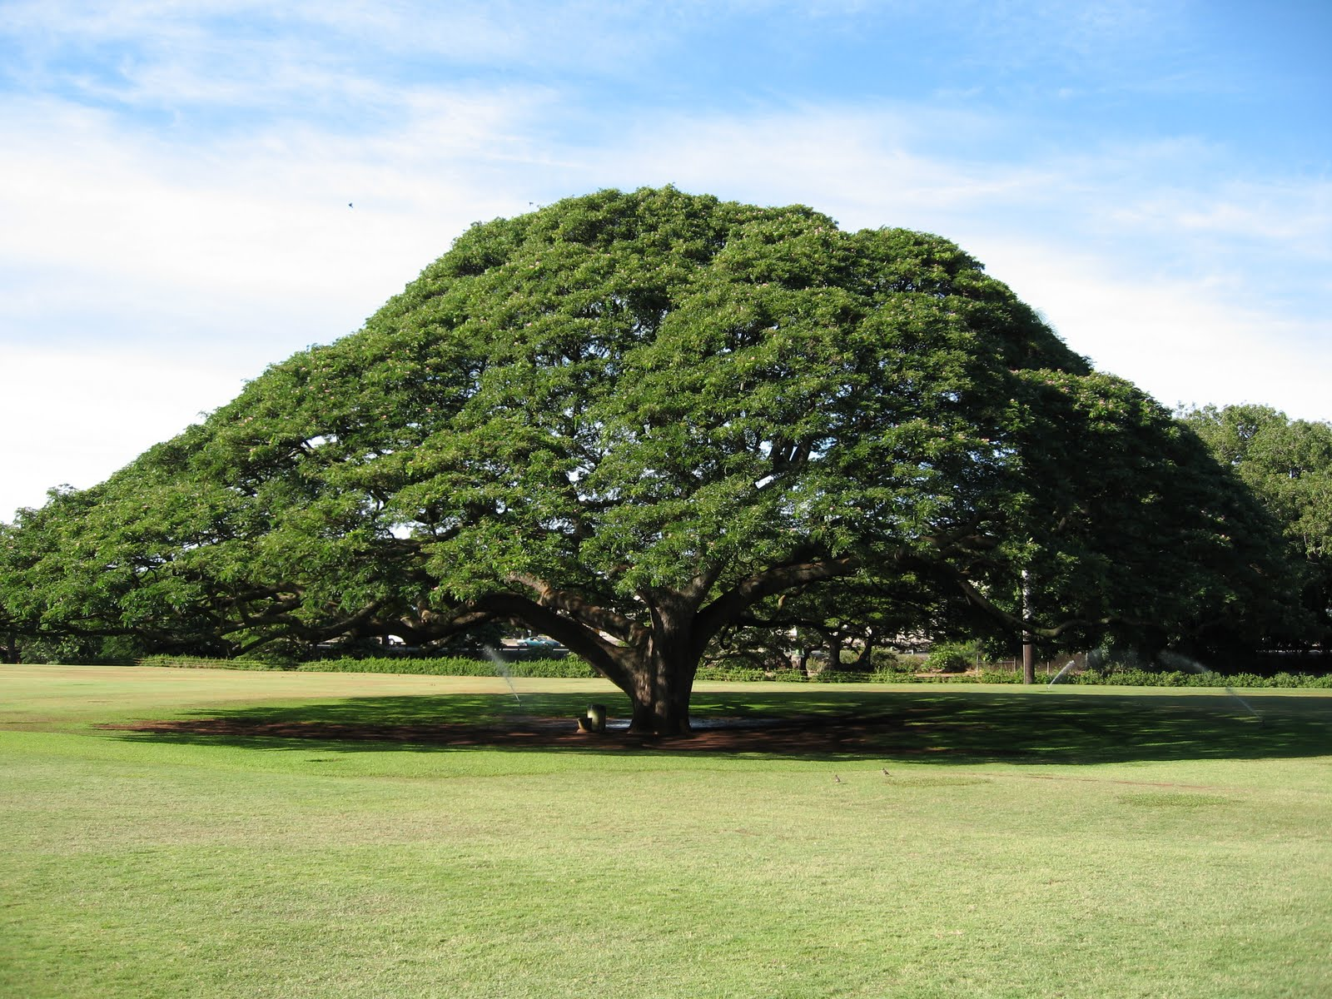
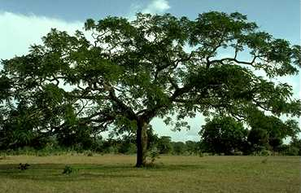
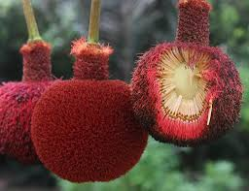
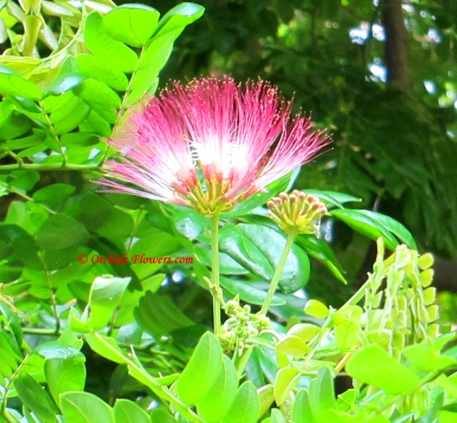
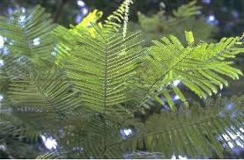
The Rain Tree, Samanea saman, a huge tropical American tree, bears curved black pods that are filled with sweet pulp and which is an excellent livestock feed.
The Nittas, Parkia biglobosa and P. filicoidea, of West Africa have large pods with 31 percent sugar content.
The seeds yield a very nutritious flour with 36 percent protein, 23 percent fat, 15 percent starch and over 12 percent sugar.

Slide 5
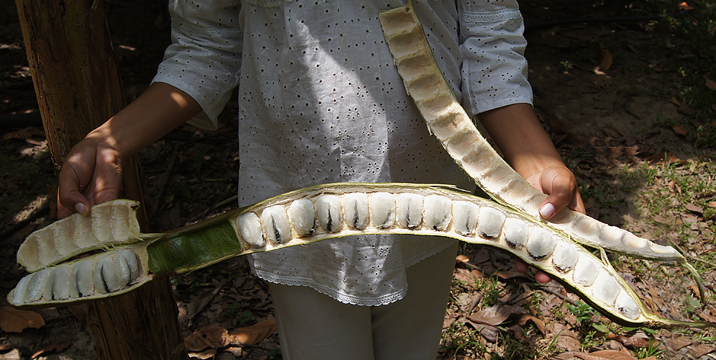
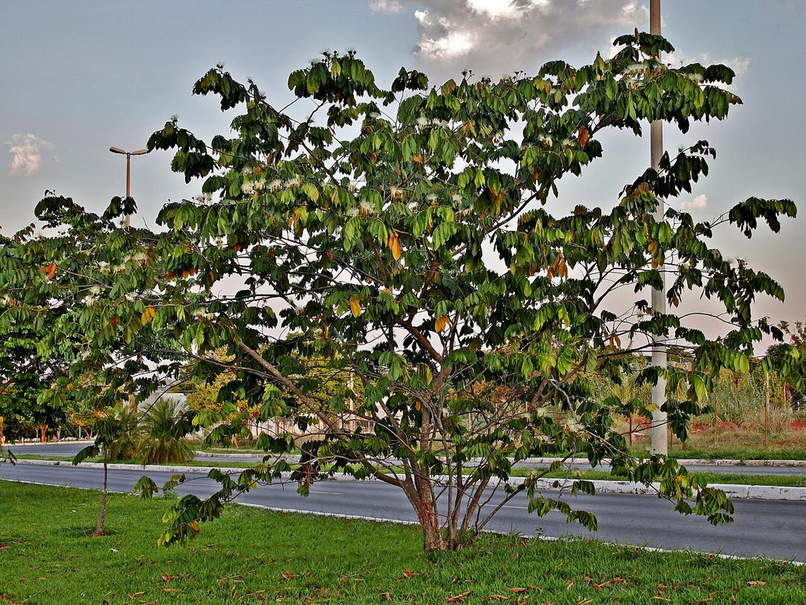
In other parts of tropical America Inga edulis and other species of the genus are cultivated for their pods, which have a sweet and agreeable pulp, and as shade trees in coffee plantations.

Slide 6
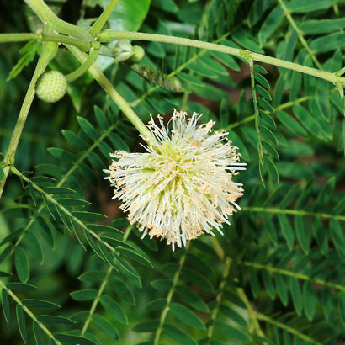
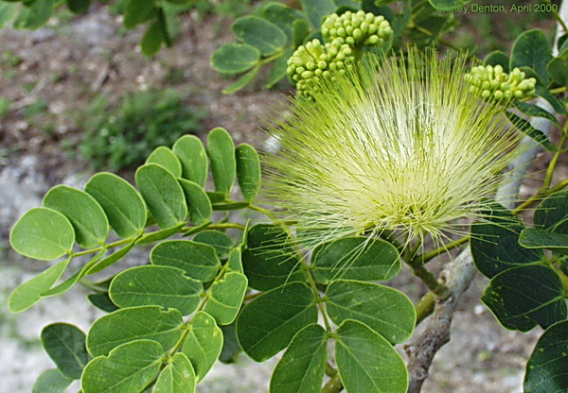
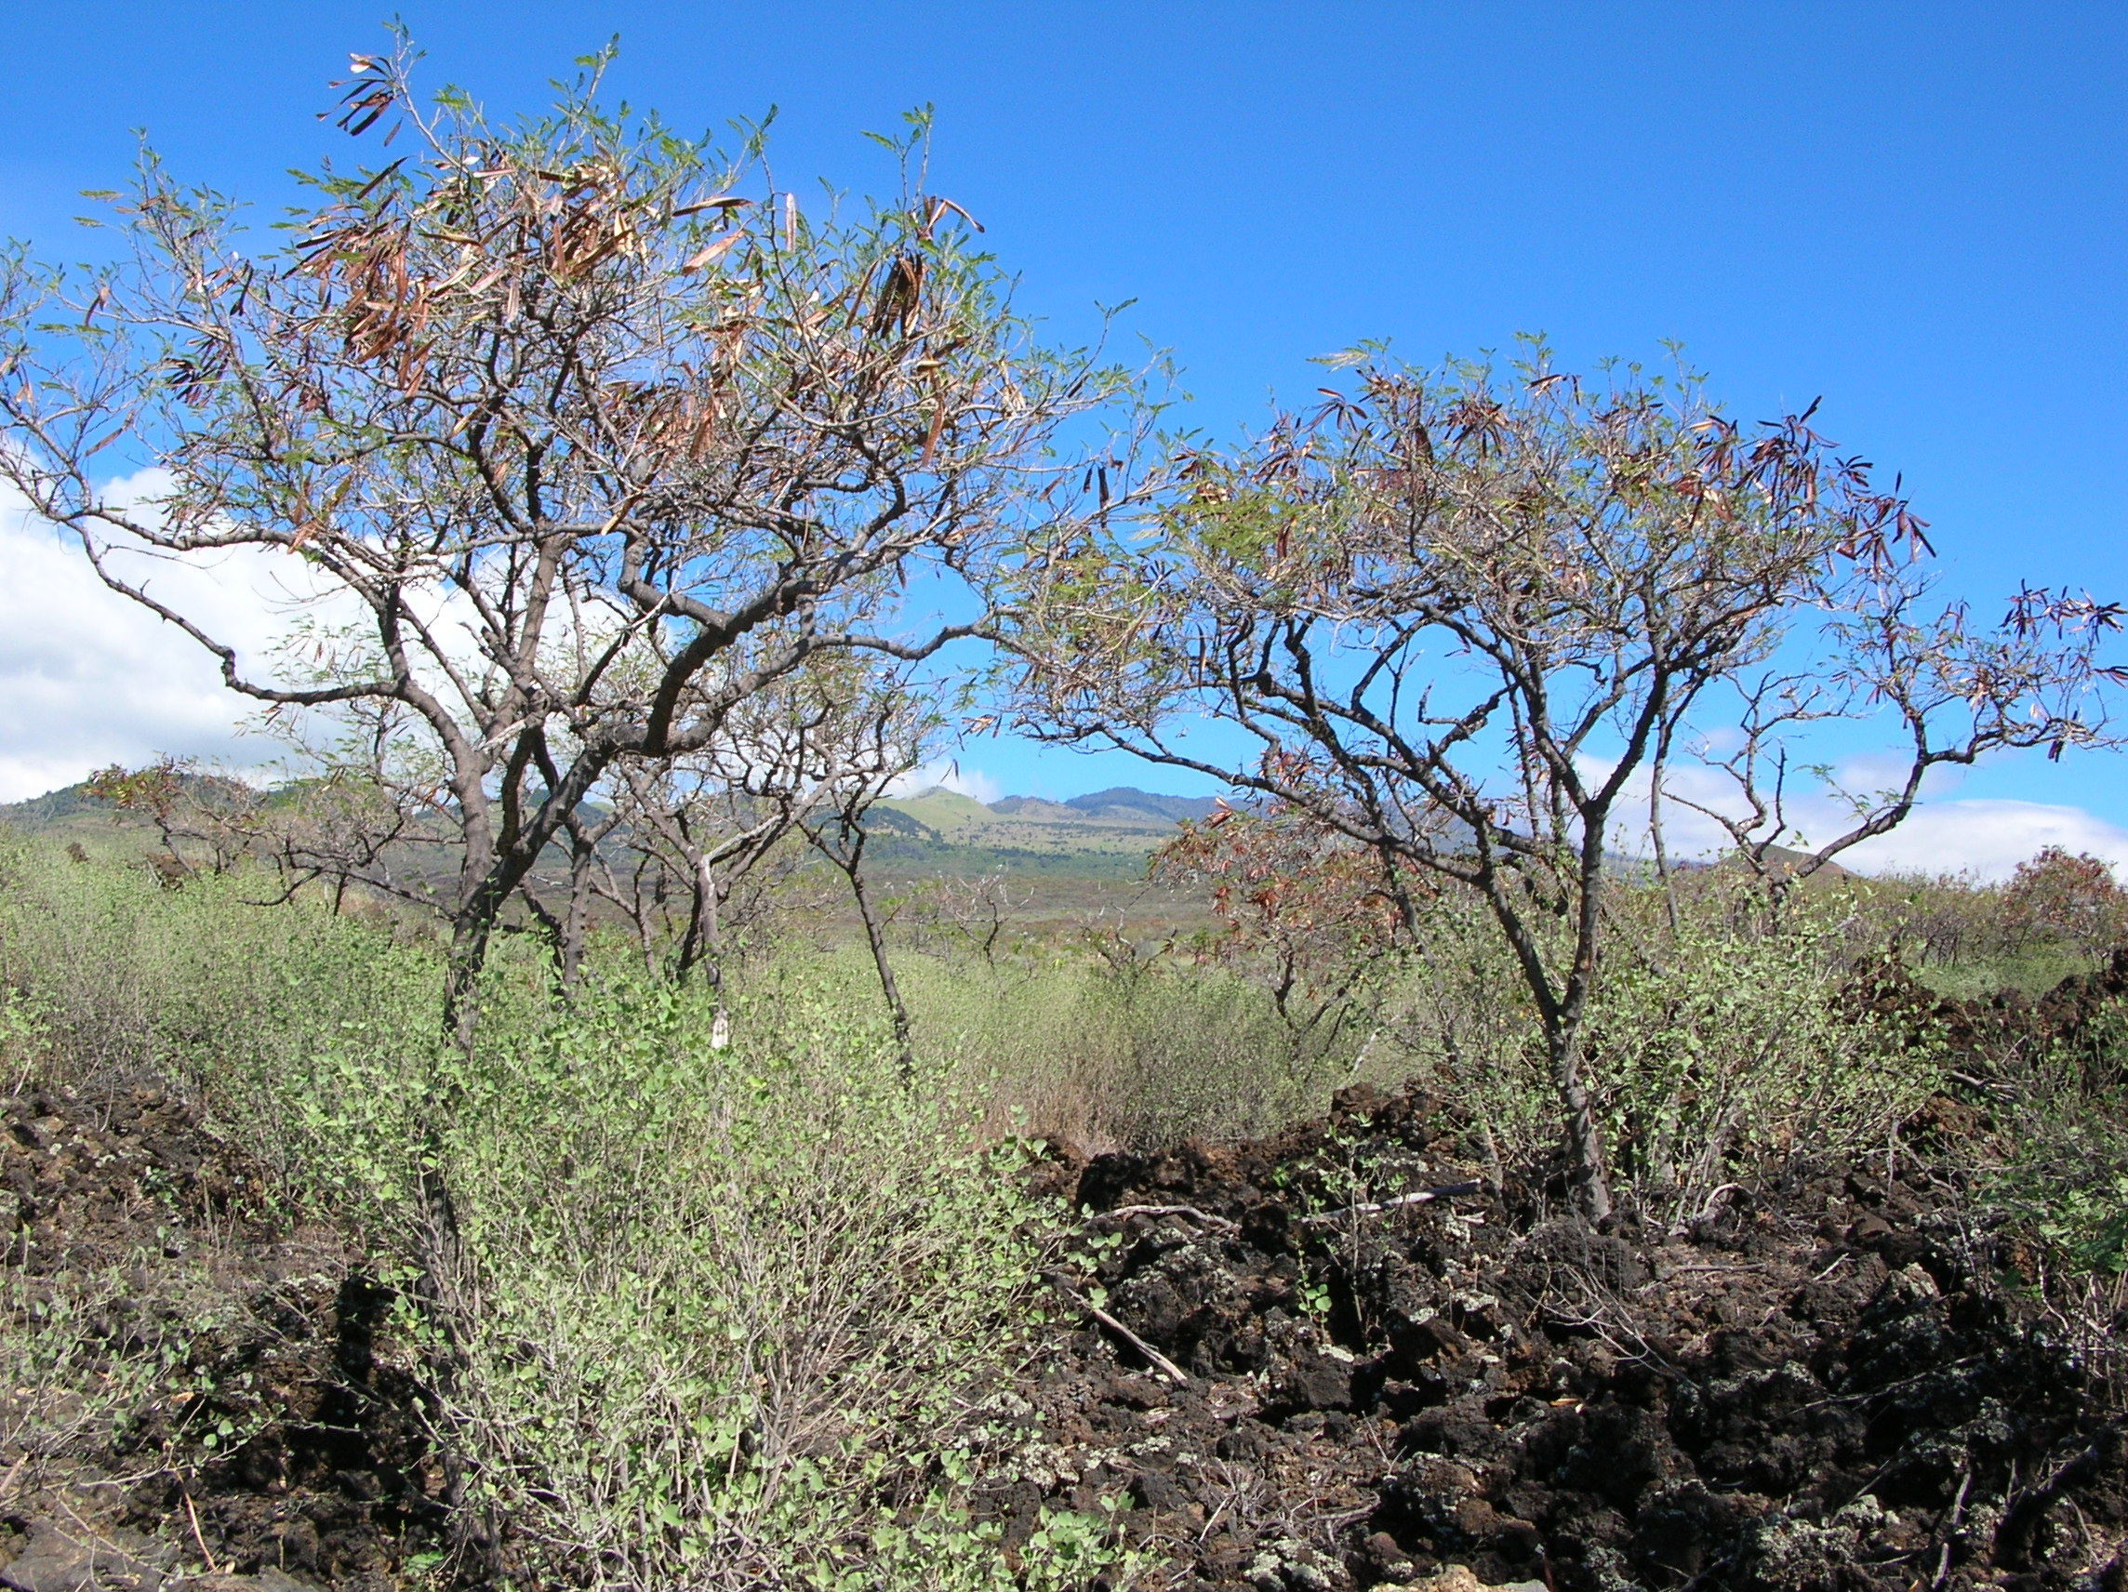
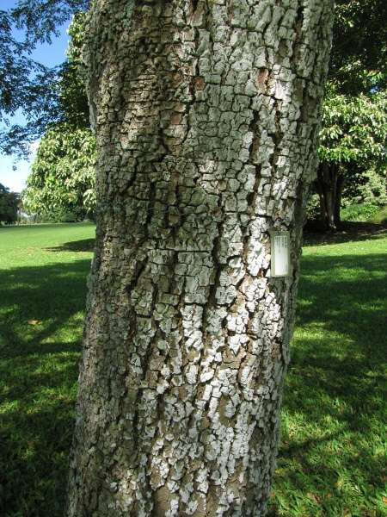
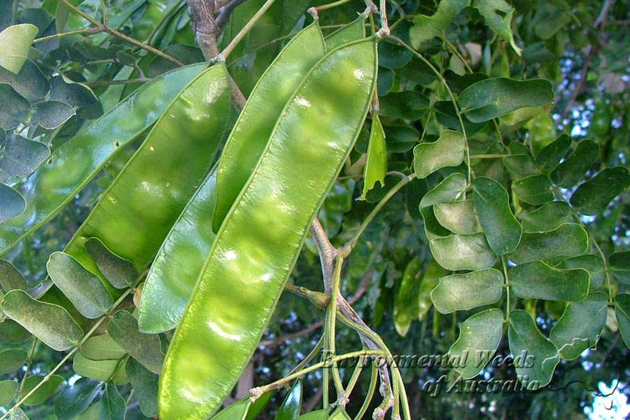
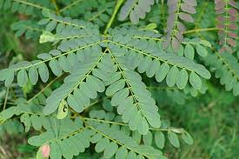
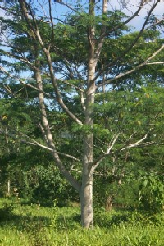
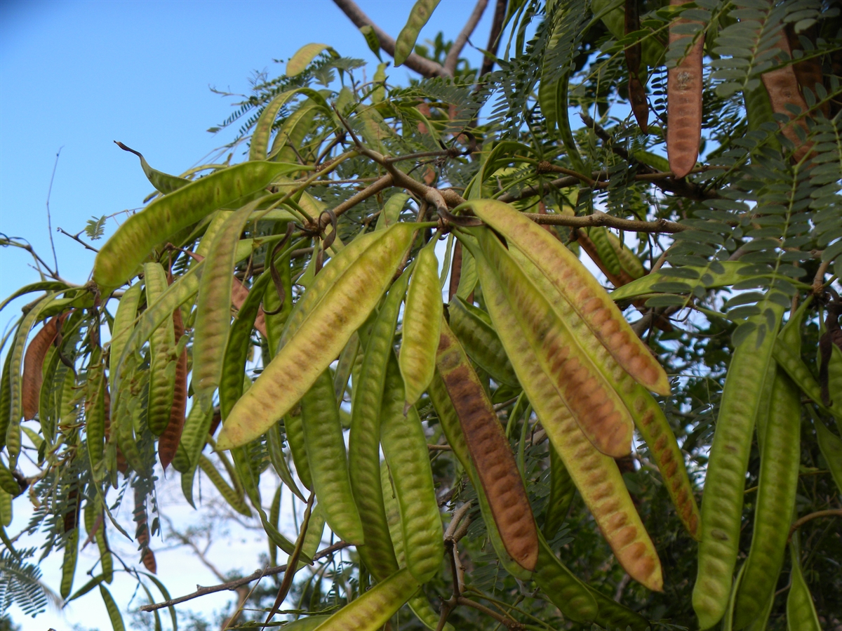
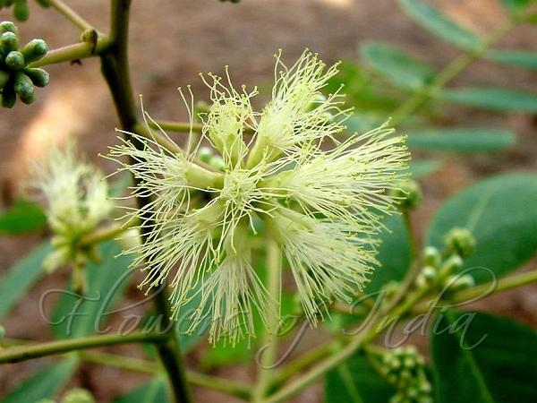
Tree species cultivated in Pakistan
Albizia procera
Albizia lebbeck
Leuceana leucocephala

