Slide 1
Dosage Compensation
Dosage compensation is the mechanism that keeps females (XX) from expressing twice as much of X-chromosome genes as males (XY), who have only one X chromosome.
Both sexes are rendered roughly equal by inactivation of one X chromosome in females.

Slide 2
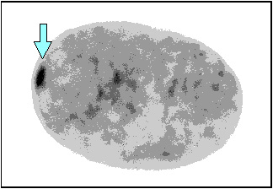
Barr Bodies
A Barr body is, simply, the extra, inactivated X chromosome.

Slide 3
Barr Bodies
No Barr bodies are observed in Turner (XO) females.
One Barr body is observed in Klinefelter (XXY) males and normal (XX) females.
All but one X chromosome is inactivated and are visible as Barr bodies in extra-X (XXX, XXXX, XXXY, etc.) individuals.

Slide 4
Dosage compensation is incomplete
Individuals with Klinefelter, Turner and extra-X syndromes are not perfectly normal, though.
There are two probable explanations:
First, the extra X chromosomes may not be inactivated right away and therefore may influence development prior to inactivation.

Slide 5
Dosage compensation is incomplete
Second, Barr bodies may not be completely inactivated such that the extra X chromosomes may produce over-expression of some X-linked genes at different times.

Slide 6
X-Inactivation
It is thought that early in embryonic development, X-inactivation occurs randomly (maternal or paternal chromosome is not targeted) in somatic cells of females.
Once inactivation has occurred, though, the same X chromosome will be inactivated in progeny cells after mitotic cell division (i.e., if the maternal X chromosome was inactivated in the progenitor, the maternal X chromosome will be inactivated in the daughter cells).

Slide 7
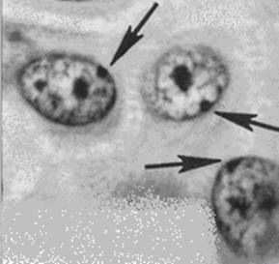
X Inactivation in Female Mammals
In mammalian females, one of the two X chromosomes in each cell is randomly inactivated during embryonic development
The inactive X condenses into a Barr body.
The Barr body lies along the inside of the nuclear envelope. Most of the genes in the Barr body are not expressed.
Copyright © 2008 Pearson Education Inc., publishing as Pearson Benjamin Cummings

Slide 8
Barr Bodies: the inactive X in each cell of a female
If a female is heterozygous for a particular gene located on the X chromosome, she will be a mosaic for that character

Slide 9
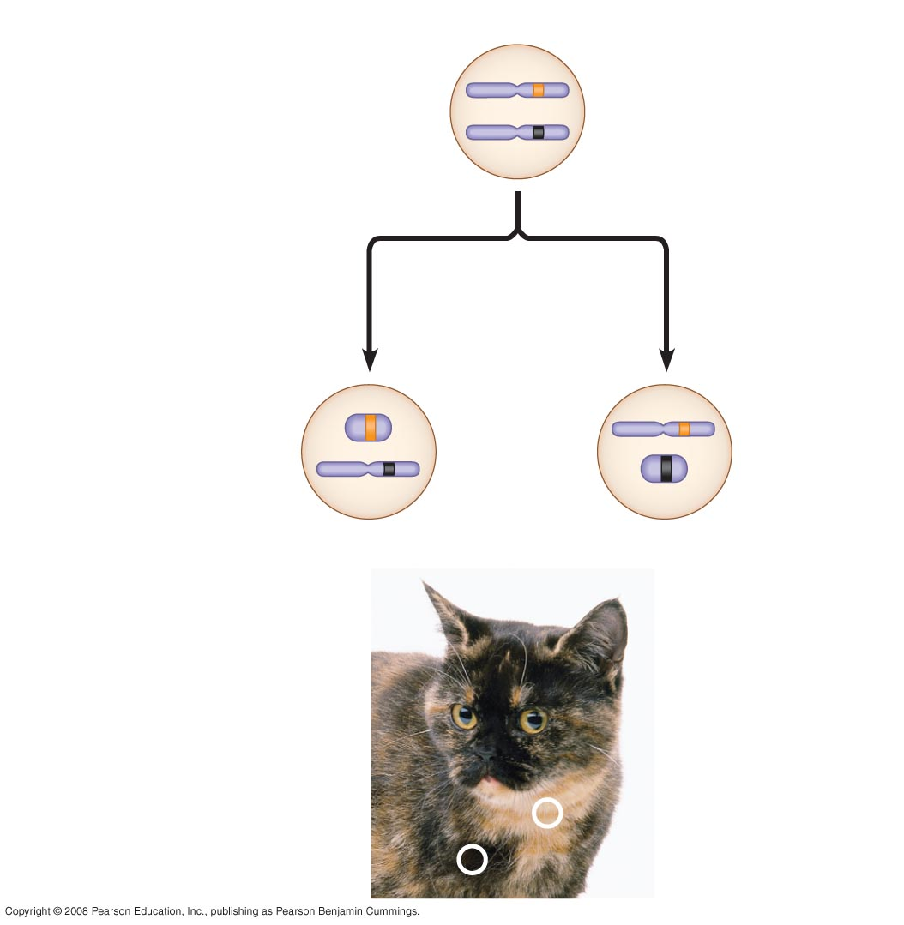
X chromosomes
Allele for
orange fur
Early embryo:
Allele for
black fur
Cell division and
X chromosome
inactivation
Two cell
populations
in adult cat:
Active X
Inactive X
Active X
The tortoiseshell gene is on the X chromosome in cats.
The tortoiseshell color requires the presence of two alleles: one orange and one black. These are located on the X chromosome.
Black fur
Orange fur
If a female (XX) is heterozygous, the orange and black patches are present in populations of cells with that activated gene.
Notes:
Figure 15.8 X inactivation and the tortoiseshell cat

Slide 10
Calico cats: X-inactivation in action
In cats, base coat color is encoded on the X chromosomes.
Male cats have only one X chromosome, so can only express one base color.
Females have two X chromosomes, so can express two base colors. For example, say the sire of a kitty contributed the black gene and the dam contributed the red gene.

Slide 11
Calico cats: X-inactivation in action
Hair follicles derived from embryonic cells in which the maternal chromosome was inactivated will grow black hairs (express the paternal gene).
Hair follicles derived from embryonic cells in which the paternal chromosome was inactivated will grow red hairs (express the maternal gene).
Tortoiseshell cats do not have white patches, which is controlled by a separate gene.

Slide 12
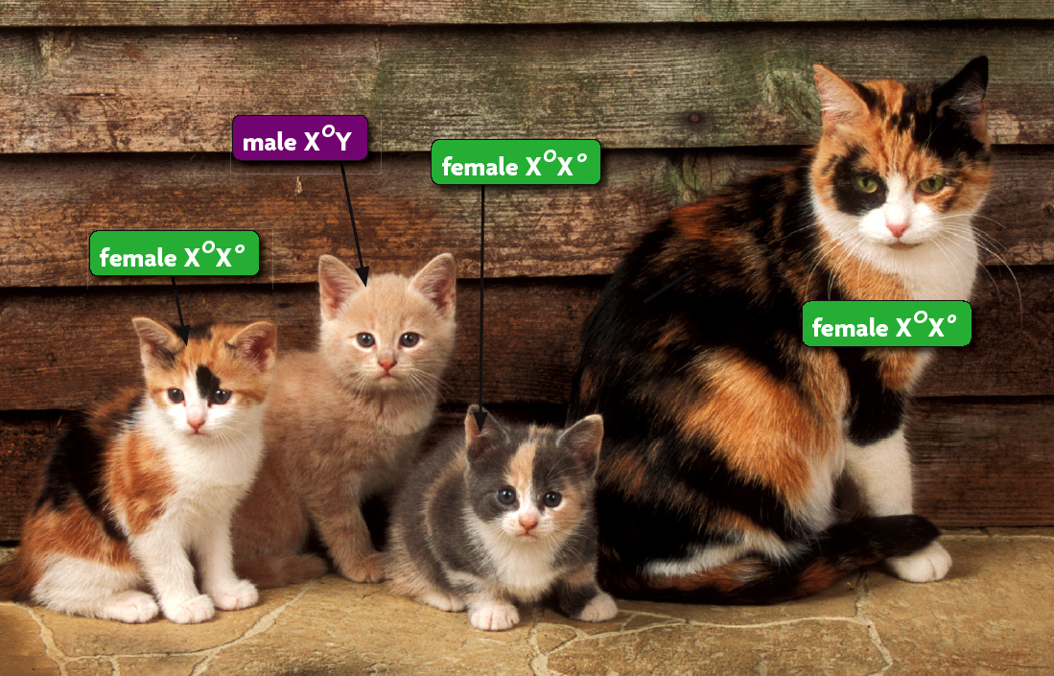

Slide 13
The Mechanism of Inactivation
Remember DNA methylation? That plays an important role in X-inactivation.
Now, I introduce you to another, more important player.

Slide 14
The Mechanism of Inactivation
There is a large gene on the end of the p-arm of the X chromosome thought to be a primary driver of inactivation.
It is called the X-inactive specific transcript (Xist), and expression of this transcript from an X chromosome results in inactivation of that chromosome.

Slide 15
Xist is a strange gene
The Xist gene is big, over a million bases long.
The RNA is not translated, and is thought to be a structural component of the inactivation process by physically associating with the inactive chromosome.

