Slide 1
Chapter 10: The t Test For Two Independent Samples

Slide 2
Independent-Measures Designs
The independent-measures hypothesis test allows researchers to evaluate the mean difference between two populations using the data from two separate samples.
The identifying characteristic of the independent-measures or between-subjects design is the existence of two separate or independent samples.
Thus, an independent-measures design can be used to test for mean differences between two distinct populations (such as men versus women) or between two different treatment conditions (such as drug versus no-drug).

Slide 3
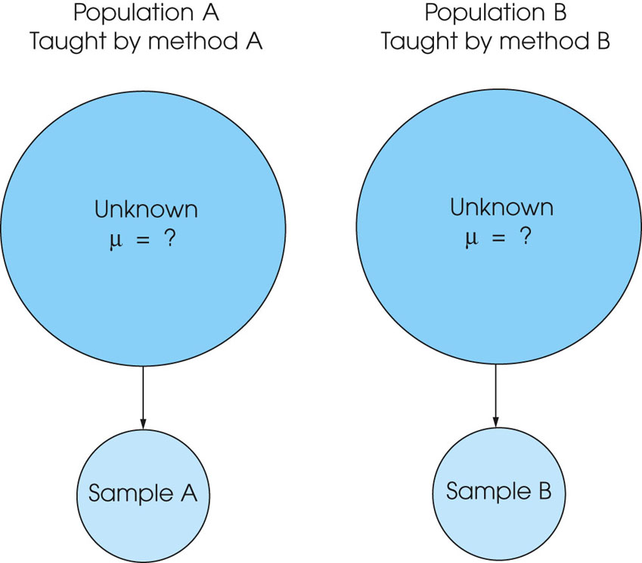
Notes:
Figure 10.2
Do the achievement scores for children taught by method A differ from the scores for children taught by method B? In statistical terms, are the two population means the same or different? Because neither of the two population means is known, it will be necessary to take two samples, one from each population. The first sample will provide information about the mean for the first population, and the second sample will provide information about the second population.

Slide 4
Independent-Measures Designs (cont.)
The independent-measures design is used in situations where a researcher has no prior knowledge about either of the two populations (or treatments) being compared.
In particular, the population means and standard deviations are all unknown.
Because the population variances are not known, these values must be estimated from the sample data.

Slide 5
Hypothesis Testing with the Independent-Measures t Statistic
As with all hypothesis tests, the general purpose of the independent-measures t test is to determine whether the sample mean difference obtained in a research study indicates a real mean difference between the two populations (or treatments) or whether the obtained difference is simply the result of sampling error.
Remember, if two samples are taken from the same population and are given exactly the same treatment, there still will be some difference between the sample means..

Slide 6
Hypothesis Testing with the Independent-Measures t Statistic (cont.)
This difference is called sampling error
The hypothesis test provides a standardized, formal procedure for determining whether the mean difference obtained in a research study is significantly greater than can be explained by sampling error

Slide 7
Hypothesis Testing with the Independent-Measures t Statistic (cont.)
To prepare the data for analysis, the first step is to compute the sample mean and SS (or s, or s²) for each of the two samples.
The hypothesis test follows the same four-step procedure outlined in Chapters 8 and 9.

Slide 8
Hypothesis Testing with the Independent-Measures t Statistic (cont.)
1. State the hypotheses and select an α level. For the independent-measures test, H₀ states that there is no difference between the two population means.
2. Locate the critical region. The critical values for the t statistic are obtained using degrees of freedom that are determined by adding together the df value for the first sample and the df value for the second sample.

Slide 9
Hypothesis Testing with the Independent-Measures t Statistic (cont.)
3. Compute the test statistic. The t statistic for the independent-measures design has the same structure as the single sample t introduced in Chapter 9. However, in the independent-measures situation, all components of the t formula are doubled: there are two sample means, two population means, and two sources of error contributing to the standard error in the denominator.
4. Make a decision. If the t statistic ratio indicates that the obtained difference between sample means (numerator) is substantially greater than the difference expected by chance (denominator), we reject H₀ and conclude that there is a real mean difference between the two populations or treatments.

Slide 11
The Homogeneity of Variance Assumption
Although most hypothesis tests are built on a set of underlying assumptions, the tests usually work reasonably well even if the assumptions are violated.
The one notable exception is the assumption of homogeneity of variance for the independent-measures t test.
The assumption requires that the two populations from which the samples are obtained have equal variances.
This assumption is necessary in order to justify pooling the two sample variances and using the pooled variance in the calculation of the t statistic.

Slide 12
The Homogeneity of Variance Assumption (cont.)
If the assumption is violated, then the t statistic contains two questionable values: (1) the value for the population mean difference which comes from the null hypothesis, and (2) the value for the pooled variance.
The problem is that you cannot determine which of these two values is responsible for a t statistic that falls in the critical region.
In particular, you cannot be certain that rejecting the null hypothesis is correct when you obtain an extreme value for t.

Slide 13
The Homogeneity of Variance Assumption (cont.)
If the two sample variances appear to be substantially different, you should use Hartley’s F-max test to determine whether or not the homogeneity assumption is satisfied.
If homogeneity of variance is violated, Box 10.3 presents an alternative procedure for computing the t statistic that does not involve pooling the two sample variances.

Slide 14
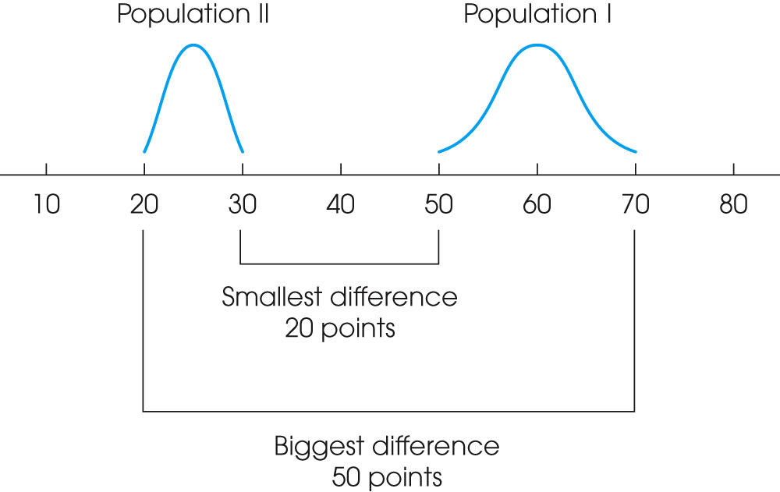
Notes:
Figure 10.3
Two population distributions. The scores in population I vary from 50 to 70 (a 20-point spread), and the scores in population II range from 20 to 30 (a 10-point spread). If you select one score from each of these two populations, the closest two values are X₁ = 50 and X₂ = 30. The two values that are farthest apart are X₁ = 70 and X₂ = 20.

Slide 15
Measuring Effect Size for the Independent-Measures t
Effect size for the independent-measures t is measured in the same way that we measured effect size for the single-sample t in Chapter 9.
Specifically, you can compute an estimate of Cohen=s d or you can compute r² to obtain a measure of the percentage of variance accounted for by the treatment effect.

Slide 16
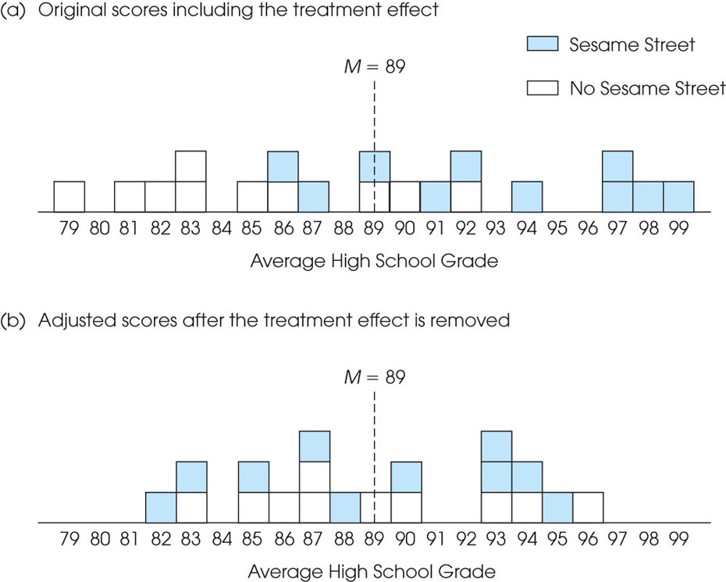
Notes:
Figure 10.5
The two groups of scores from Example 10.1 combined into a single distribution. The original scores, including the treatment effect, are shown in part (a). Part (b) shows the adjusted scores, after the treatment effect has been removed.

Slide 17
