Slide 1
Lecture # 15 Area and Volume Calculations

Slide 18
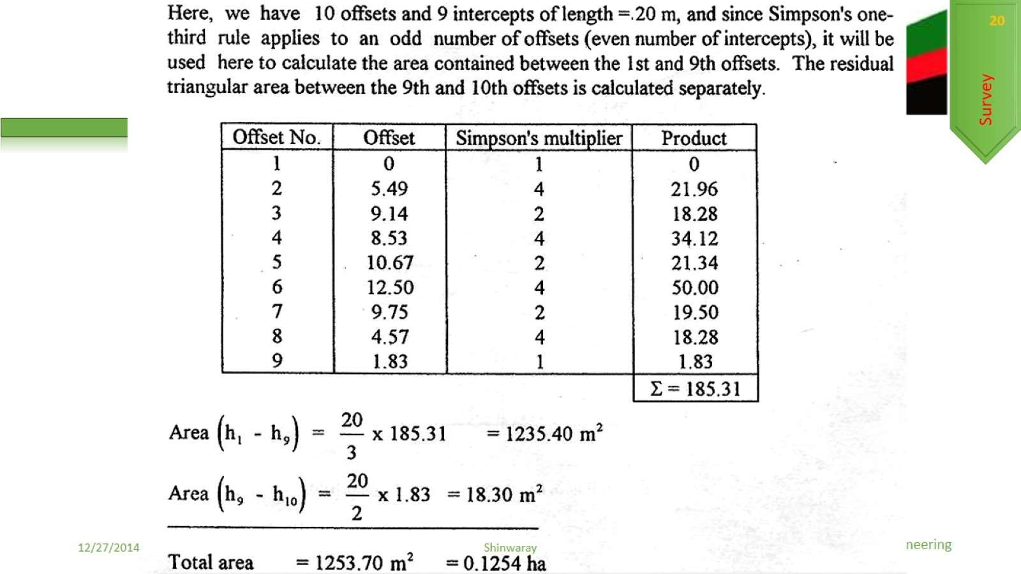

Slide 20
